Slide 1
CPEN 315
Computer Organisation
& Architecture
Final Project 2026
16-bit CPU Design · 32-bit MIPS Processor
University of Ghana — School of Engineering Sciences
Examiner: Prof. Robert A. Sowah

Slide 2
Project Overview
PART A — Logisim Evolution
PART B — VHDL / GHDL
16-bit CPU Design
32-bit MIPS Processor
ALU with 14 arithmetic + 6 relational operations
Register File: Reg A, B, IR, MAR, MBR, Output
Shared internal bus with tri-state buffers
Program Counter: wraps at address 4
Manual simulation of 4 instruction types
6 VHDL components with full testbenches
Instruction Memory (ROM, 16 entries)
CPU Control Unit — combinational logic
ALU Control + Register File (8 × 32-bit)
ALU + Data Memory (256 × 32 RAM)
Waveforms captured in GTKWave (.ghw)
University of Ghana | CPEN 315 — Computer Organisation & Architecture | 2026

Slide 3
Part A — 16-bit CPU in Logisim Evolution
1
ALU supports 14 arithmetic + 6 relational operations via op-code MUX
Instruction Formats (16-bit)
R-type
2
Instruction formats: R-type, I-type, J-type (all 16-bit wide)
op
(4)
rs
(3)
rt
(3)
rd
(3)
fn
(3)
3
Shared internal bus — tri-state buffers control data flow between units
I-type
4
Registers: Reg A, Reg B, IR (Instruction), MAR (8-bit), MBR, Output Reg
op
(4)
rs
(3)
rt
(3)
Imm
(6)
5
Program Counter wraps at address 4 (0000 → 0001 → 0010 → 0011 → 0000)
J-type
op
(4)
Target Address
(12)
University of Ghana | CPEN 315 — Computer Organisation & Architecture | 2026

Slide 4
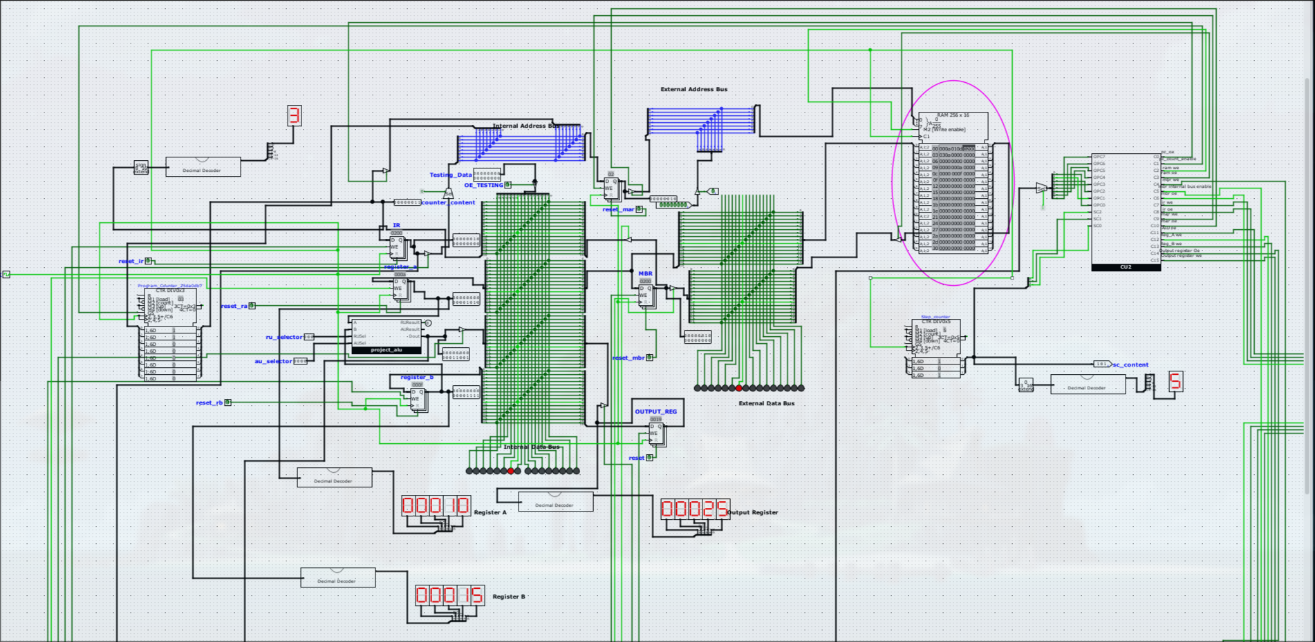
Logisim 16-bit Full Implementation

Slide 5
ALU Design — project_ao & project_ro
Op Code | Operation | Notes
0 | ADD | Adder block
1 | AND | Bitwise
2 | OR | Bitwise
3 | XOR | Bitwise
4 | DIV | Quotient output
5 | MOD | Remainder output
6 | MULT | Lower 16 bits
7 | SUB | Subtract (input tied HIGH)
8–9 | SHL A / B | Logical left shift by 2
10–11 | SHR A / B | Logical right shift by 2
12 | NEG A | 2's complement
13 | NEG B | 2's complement
Relational Unit (project_ro)
Uses Logisim's built-in Comparator block.
Outputs one of 6 conditions selected by a 3-bit RUSel MUX:
EQ · NEQ · GT · GTE · LT · LTE
ALU Architecture
14 arithmetic ops via op-code multiplexer
Output driven by final MUX selecting between arithmetic result and relational result
University of Ghana | CPEN 315 — Computer Organisation & Architecture | 2026

Slide 6
Control Unit — Combinational Analysis
Combinational Analysis
RAM Contents — Simulation Programme
Logisim's built-in tool auto-generates minimised Boolean logic from truth tables
Address | Hex | Meaning
0x0000 | 0x000A | LoadA from address 10
0x0001 | 0x010D | LoadB from address 13
0x0002 | 0x0200 | Arithmetic — ADD
0x0003 | 0x030A | Store to address 10
0x000A | 0x000A | Operand A = 10
0x000D | 0x000F | Operand B = 15
Inputs
OPC7–OPC0 (8-bit opcode) + SC2–SC0 (3-bit step counter)
Outputs
C0–C15 — 16 control signals driving datapath components
Instructions handled
LoadA, LoadB, Arithmetic, Store — 4 instruction types
University of Ghana | CPEN 315 — Computer Organisation & Architecture | 2026

Slide 7
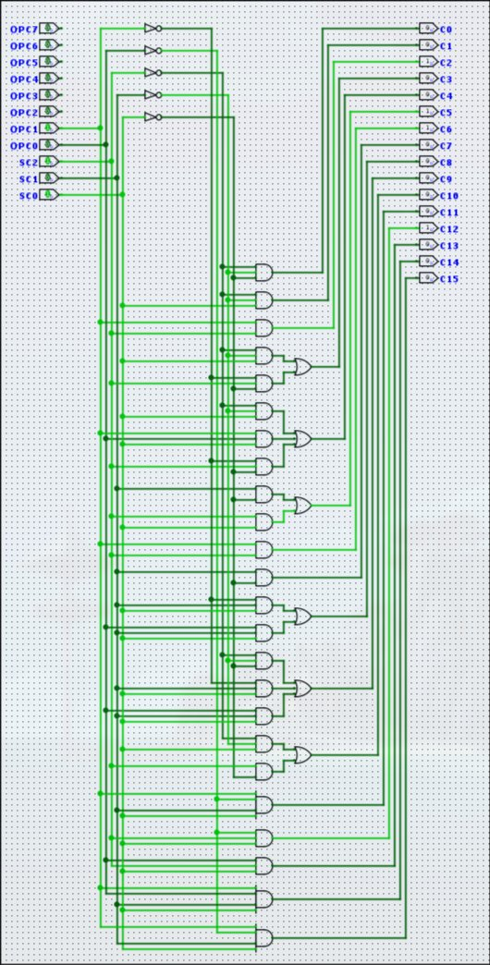
Control Unit Implementation

Slide 8






Part B — 32-bit MIPS Processor in VHDL
Instruction Memory
CPU Control Unit
ALU Control Unit
ROM, 16 entries
Fully combinational
PC → instruction(32)
opcode(3) → 9 control signals
Combinational logic
Reset drives all to 0
ALUOp(2) + Funct(4)
→ alu_control(3)
Decodes R-type funct field
Register File
ALU
Data Memory
8 registers × 32-bit
R0 always reads 0
Sync write, async read
5 ops: ADD/SUB/AND/OR/SLT
zero flag output
a(32), b(32) → result(32)
256 × 32 RAM
Sync write, async read
addr(32), write_data(32)
Toolchain: GHDL (--std=08) → .ghw waveform file → GTKWave viewer
University of Ghana | CPEN 315 — Computer Organisation & Architecture | 2026

Slide 9
Instruction Set Architecture
Instruction Formats
Instruction | Type | Operation
add | R | R[rd] = R[rs] + R[rt]
sub | R | R[rd] = R[rs] − R[rt]
and / or | R | Bitwise operations
slt | R | Set if less than
lw / sw | I | Load / Store word
beq | I | Branch if equal
addi / slti | I | Immediate arithmetic
j / jal | J | Jump / Jump-and-link
R-format
op
(3)
rs
(3)
rt
(3)
rd
(3)
funct
(4)
I-format
op
(3)
rs
(3)
rt
(3)
Addr/Imm
(7)
J-format
op
(3)
Target Address
(13)
University of Ghana | CPEN 315 — Computer Organisation & Architecture | 2026

Slide 10
CPU Control Unit — Signal Mapping
Instruction | RegDst | ALUSrc | MemtoReg | RegWrite | MemRead | MemWrite | Branch | ALUOp | Jump
R-type | 1 | 0 | 0 | 1 | 0 | 0 | 0 | 10 | 0
lw | 0 | 1 | 1 | 1 | 1 | 0 | 0 | 11 | 0
sw | 0 | 1 | 0 | 0 | 0 | 1 | 0 | 11 | 0
addi | 0 | 1 | 0 | 1 | 0 | 0 | 0 | 11 | 0
beq | 0 | 0 | 0 | 0 | 0 | 0 | 1 | 01 | 0
j | 0 | 0 | 0 | 0 | 0 | 0 | 0 | 00 | 1
slti | 0 | 1 | 0 | 1 | 0 | 0 | 0 | 10 | 0
Green = signal asserted (1). ALUOp: 00=pass-through 01=subtract 10=R-type 11=add (for lw/sw/addi)
University of Ghana | CPEN 315 — Computer Organisation & Architecture | 2026

Slide 11
VHDL Component Specifications
Component | Key Ports | Behaviour
Data Memory | clk, addr(32), write_data(32), read_data(32) | Synchronous write, asynchronous read — 256 × 32 RAM
ALU | a(32), b(32), alu_control(3), result(32), zero | 5 operations: ADD / SUB / AND / OR / SLT
ALU Control | ALUOp(2), Funct(4) → alu_control(3) | Decodes funct field for R-type instructions
Register File | clk, rst, 8 registers × 32-bit, R0 always 0 | Synchronous write, asynchronous read
Instruction Memory | pc(32) → instruction(32) | ROM — 16 entries, fully combinational
Control Unit | opcode(3) → 9 control signals | Combinational; reset drives all outputs to 0
University of Ghana | CPEN 315 — Computer Organisation & Architecture | 2026

Slide 12





GHDL-Specific Implementation Notes
Multiplication Width
32×32 = 64-bit result. Always capture in an intermediate variable before slicing to avoid bound-check failures at elaboration time.
No Inline Slicing
(a * b)(15 downto 0) is invalid VHDL-2008 in GHDL. Assign the product to a variable first, then slice it separately.
No Duplicate Signal Drivers
Assigning to the same signal twice in concurrent code causes an elaboration error. Use a single conditional assignment instead.
Simulation Termination
Use std.env.stop at the end of stimulus. Without it, a lone clock process runs forever and hangs GHDL indefinitely.
Procedure Parameters
Never use the signal keyword in procedure parameters when the procedure is called from inside a process — use variable or in/out mode instead.
University of Ghana | CPEN 315 — Computer Organisation & Architecture | 2026

Slide 13
Testbench Results — Expected Values
Component | Test Case | Expected Output | Pass
Data Memory | Write 1024 → address 2 | Read back 0x00000400 | ✓
Data Memory | Write 429496 → address 4 | Read back 0x00068DF8 | ✓
ALU | ADD 2500 + 25000 | 0x00006B6C (27500) | ✓
ALU | SUB 540250 − 37800 | 0x00076AA2 (502450) | ✓
ALU | AND 53957 & 30000 | 0x00005180 | ✓
ALU | SLT 58847537 < 72464383 | 0x00000001 (true) | ✓
Register File | Write R1 = 1934858 | Read R1 = 0x001D874A | ✓
Register File | Write R0 (zero register) | Always reads 0x00000000 | ✓
University of Ghana | CPEN 315 — Computer Organisation & Architecture | 2026

Slide 14
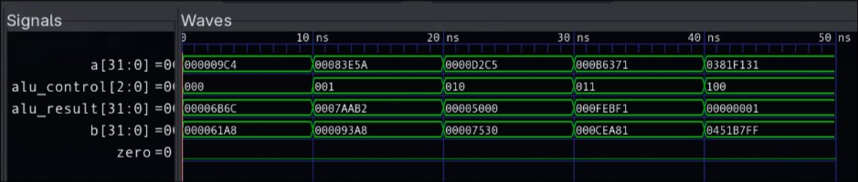
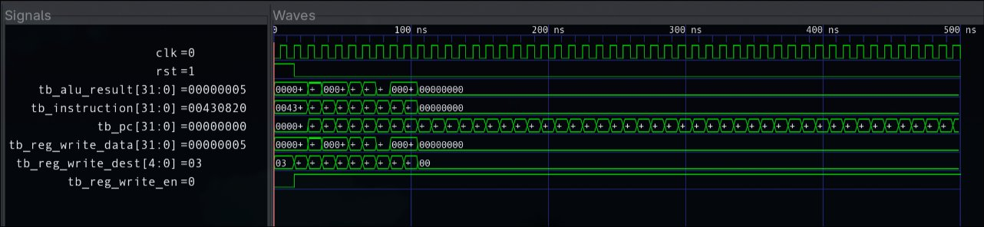
Datapath Testbench — GTKWave

Slide 15
Development & Simulation Workflow
1
Write VHDL
2
Analyse
3
Elaborate
4
Simulate
5
GTKWave
Author entity + architecture for each component. Follow VHDL-2008 std.
ghdl -a --std=08 *.vhdl
ghdl -e --std=08 tb_name
ghdl -r ... --wave=wave.ghw
Open .ghw file. Add signals, zoom, verify transitions.
Syntax + semantic check. Errors reported per file.
Link design hierarchy and resolve port maps.
Run testbench and emit waveform file.
⏱ Stop time formula: 100 ns + (N_tests × 10 ns) + margin
Ensures all stimulus completes before GHDL auto-terminates the simulation.
University of Ghana | CPEN 315 — Computer Organisation & Architecture | 2026

Slide 16
Conclusion
16-bit CPU — Complete
Successfully designed a full 16-bit CPU in Logisim with ALU, datapath, and combinational control unit.
32-bit MIPS — All 6 Components
Extended all 6 components to 32-bit in VHDL-2008; all simulate cleanly in GHDL with zero errors.
Testbench Validation
All testbenches validate correct behaviour for every specified test case across Data Memory, ALU, and Register File.
Key Insight
GHDL's strict IEEE-2008 compliance requires careful bit-width management and explicit intermediate variables.
University of Ghana — CPEN 315 — 2026

