Slide 1



CSE424 Individual Paper Presentation
Presented by
Asief Iqbal Dieyaz
23341081
CSE424
section 1

Slide 2
Overview
1
Summary
1.1
Motivation
1.2
Contribution
1.3
Methodology
1.4
Result
1.5
Conclusion
2
Limitations
3
Synthesis

Slide 3
Summary
Paper Title:
Detection of Mental State from EEG Signal Data:
An Investigation with Machine Learning Classifiers
Ahnaf Akif Rahman, Muntequa Imtiaz Siraji, Lamim Ibtisam Khalid, Fahim Faisal, Mirza Muntasir Nishat,
Mohammad Rakibul Islam and Nchouwat Ndumgouo Ibrahim moubarak
Published: 2022 14th International Conference on Knowledge and Smart Technology (KST)
The study investigates the detection of mental states through the analysis of EEG patterns using ten different machine learning algorithms. Thus enabling to develop a better understanding of human psychology and forecast their actions.

Slide 4
Motivation
To provide insights into human psychology and behavior.
An effective tool to monitor inappropriate activity (e.g., drowsy drivers)
A helpful method for those who are suffering from mental disability or Autism.
The paper aims to help those mentally stressed due to COVID-19 and aftermath

Slide 5
Contribution
Effectiveness of machine learning algorithms
Applicability in healthcare for mentally disabled people
Faster real time mental state detection
Bioinformatics

Slide 6
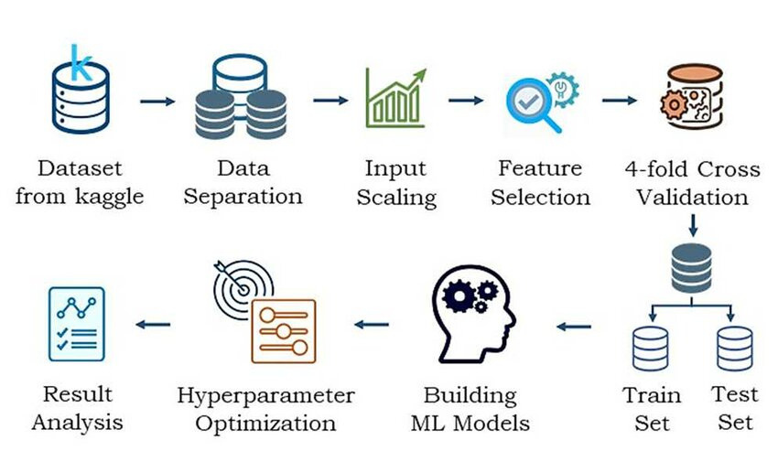
Methodology
EEG dataset from Kaggle, consisting of EEG recordings three distinct mental states: tranquil, concentrating, and impartial.
Utilized ten different machine learning algorithms (LoR, GNaB, KNN,DeT,RaF, AdaB, SVM,GrB, MuLP,XGB)
Uses RandomSearchCV method for hyperparameter tuning.

Slide 7
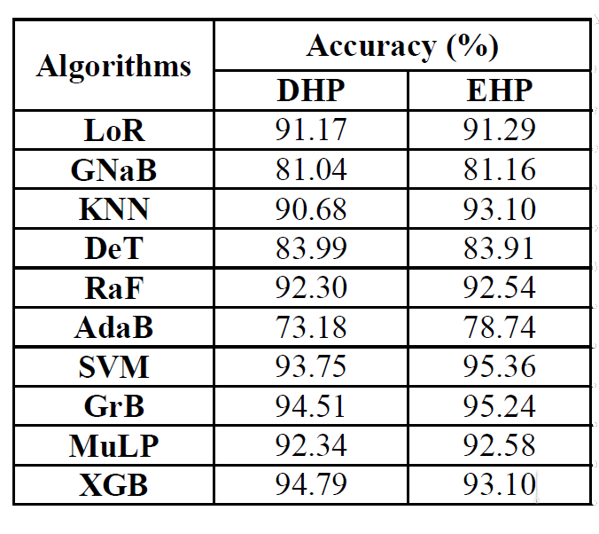
Result
The study presents comprehensive performance metrics, showcasing SVM's superior accuracy of 95.36% and its effectiveness compared to other classifiers.

Slide 8
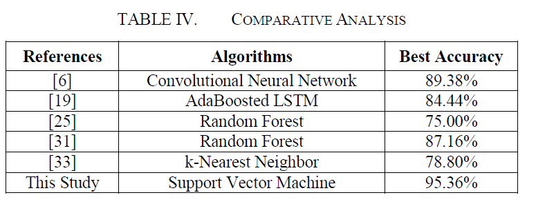
Conclusion
The study states to have more accuracy than other related studies mentioned with SVM having 95.36%. Thus, it can be used to detect the hidden patterns and psychological disorders. With the rapid advancement in
bioinformatics and other medical-based sectors, the
outcomes can benefit the early adopters to determine an
optimized way.

Slide 9
Limitations
1st Limitaion
Relatively small size of the dataset, which may impact the generalizability of the results
2nd limitation
Potential overfitting in the dataset, as some algorithms displayed lower performance even after hyperparameter tuning

Slide 10
Synthesis
Significant implications for understanding human psychology.
The potential for the development of automated systems for real-time mental state detection.
Facilitating early intervention and personalized healthcare.
ML models can enforce an enormous impact not just in economics but also in aiding healthcare professionals by providing necessary insights.

Slide 11
Thank
You

