Slide 1
Refinement of Timing Constraints for Concurrent Tasks in Event-B
Chenyang Zhu 27 June 2017
Notes:
Please use the dd month yyyy format for the date for example 11 January 2008. The main title can be one or two lines long.

Slide 2
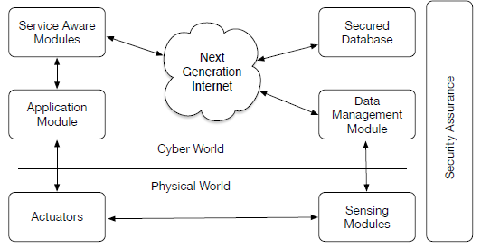
Cyber Physical System
Computing devices interact with physical world
Time critical systems
Real-time performance

Slide 3
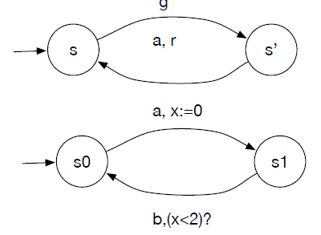
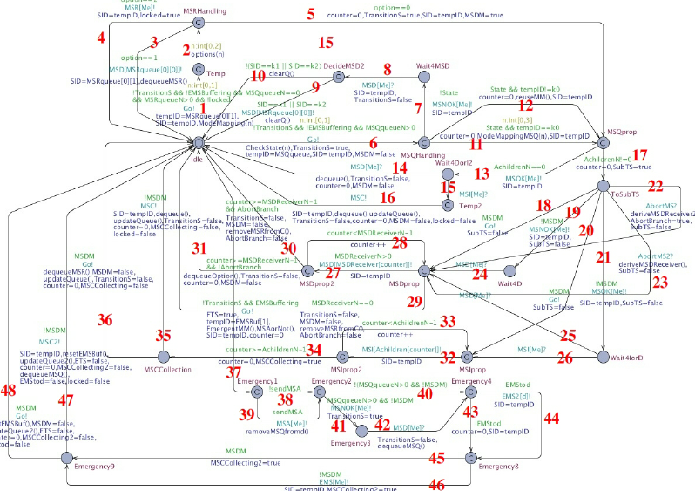
Timed Automata
State transition system
Tool support: UPPAAL, KRONOS, PRISM
Counter-Example Guided Abstract Refinement

Slide 4
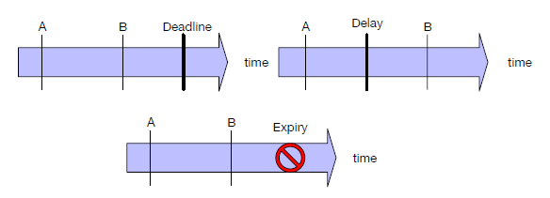
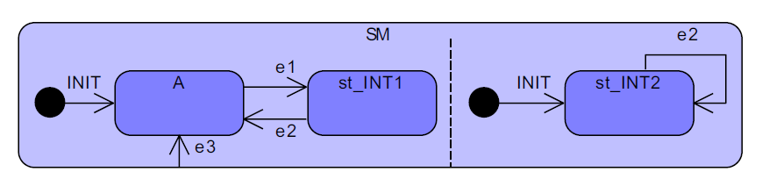
Time Modelling in Event-B
Trigger-Response Pattern
Deadline
Delay
Expiry
Time Interval Approach
Interval(T1[,…,Ti];R1[,…,Rj];[I1,…Ik];TP1(t1)[,TP2(t2)])
Interval(e1;e2;e3;Delay(e1,e2,delay),Deadline(e1,e2,deadline))

Slide 5
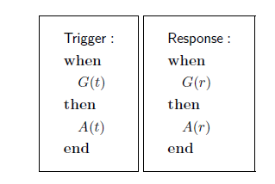
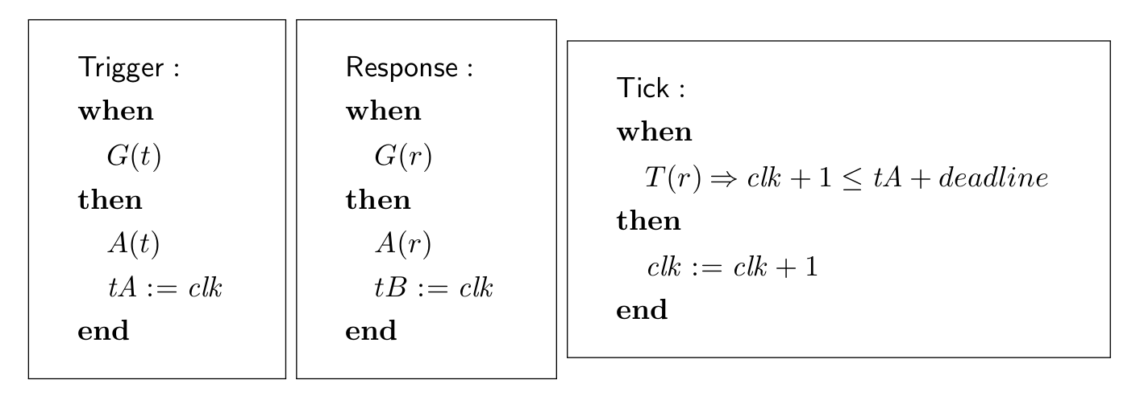


Deadline Semantics
Deadline(Trigger, Response, deadline)
Inv1:tB$≥$tA => tB-tA$≤$deadline
Inv2: T(r) =>clk$≤$tA+deadline

Slide 6
Patterns to Refine Deadline
Refine a deadline to sequential sub-deadlines
Refine a deadline to alternative sub-deadlines
Asymmetric alternatives

Slide 7
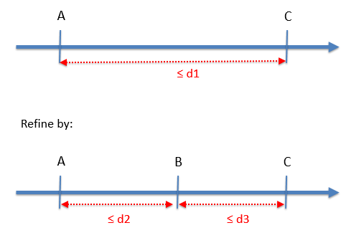
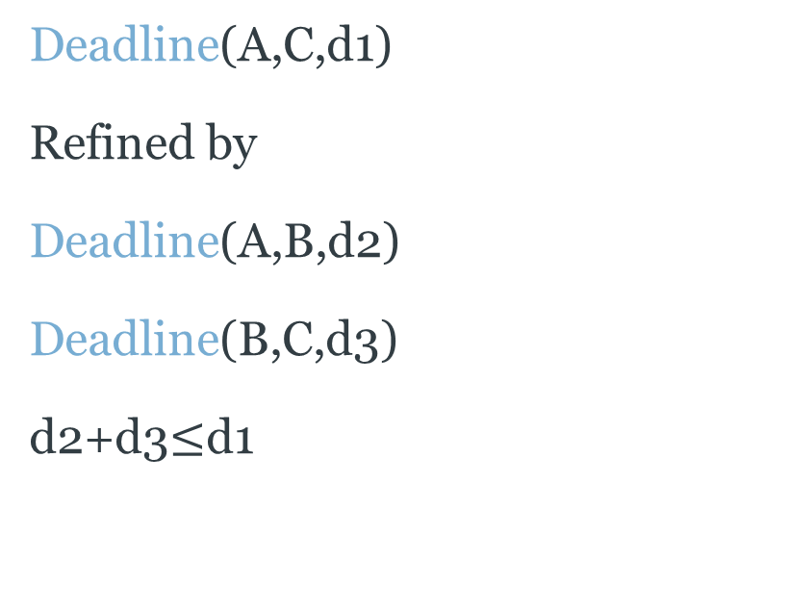
Refine a deadline to sequential sub-deadlines
Deadline(A,C,d1)
Refined by
Deadline(A,B,d2)
Deadline(B,C,d3)
d2+d3$≤$d1

Slide 8
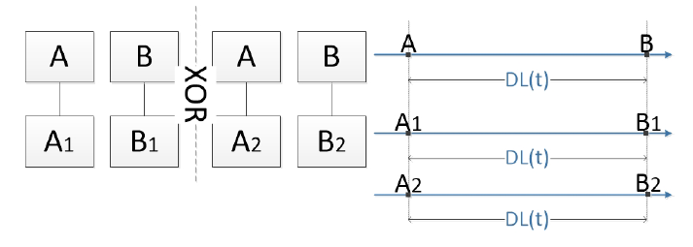
Refine a deadline to alternative sub-deadlines
Deadline(A,B,DL(t))
Refined by
Deadline(A1,B1,DL(t))
OR
Deadline(A2,B2,DL(t))
Invariants to specify the relation between abstract trigger event and response event

Slide 9
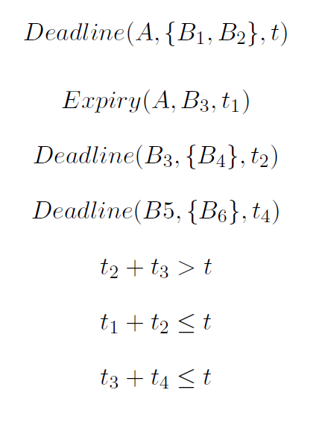
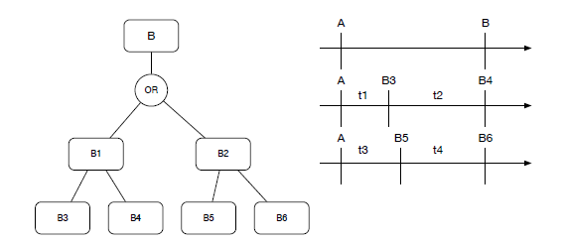
Asymmetric Alternatives

Slide 10
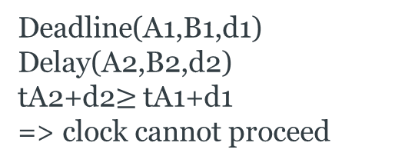
Deficiency of Existing Pattern
Does not capture communication and/or competition between concurrent processes
Cannot specify timing properties in presence of concurrency
Does not distinguish between task-based time properties and system time properties
Deadline(A1,B1,d1)
Deadline(A1,B1,d1)
Delay(A2,B2,d2)
tA2+d2$≥$ tA1+d1
=> clock cannot proceed
A1
A2
B1
B2
Delay(A2,B2,d2)

Slide 11
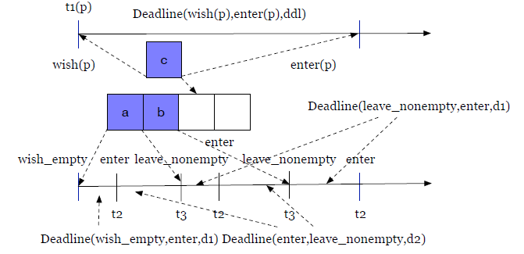
a
Critical Section
b
c

Slide 12
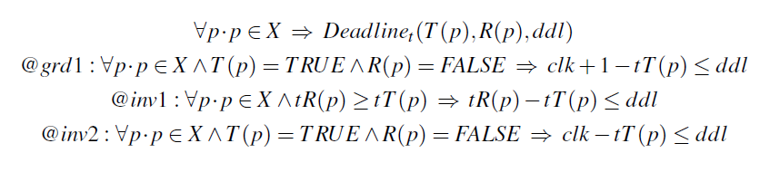
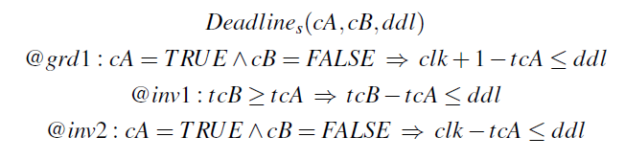
Task-based vs System Time Constraint
Task-based Time Constraint
System Time Constraint

Slide 13

Refine task-based deadline with system deadline
Task-Based Deadline: Deadline(wish(p),enter(p),ddl)
System Deadline: Deadline({wish_empty,leave_nonempty},enter,d1), Deadline(enter,leave_nonempty,d2)

Slide 14
Future Work
Update existing refinement patterns of time constraints
Develop a priority queue data type with theory plugin to model some typical scheduling policies
Work on patterns to model periodic tasks.
Perform time analysis on CPSs that execute concurrent tasks periodically with scheduling policies.
Notes:
If using a school logo, make sure that if you have a long page title, it does not encroach on the logo. Allow about 2cm around the logo. Run the page title onto two lines if necessary.

Slide 15
Reference
Jean-Raymond Abrial (2010): Modeling in Event-B: System and Software Engineering. Cambridge University Press
Butler, M. (2013). Mastering System Analysis and Design through Abstraction and Refinement
Michael Butler & Jerome Falampin (2002): An approach to modelling and refining timing properties in B.
Gintautas Sulskus, Michael Poppleton & Abdolbaghi Rezazadeh (2015): An Interval-Based Approach to Modelling Time in Event-B. Fundamentals of Software Engineering 9392, pp. 292–307.
Mohammad Reza Sarshogh (2013): Extending Event-B with discrete timing properties. Ph.D. thesis
Notes:
If using a school logo, make sure that if you have a long page title, it does not encroach on the logo. Allow about 2cm around the logo. Run the page title onto two lines if necessary.

