Slide 1
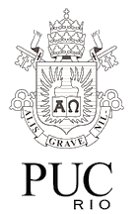
Project
A Real-time ENVIRONMENTAL SOUND RECOGNITION SYSTEM using Machine Learning Techniques.
Asiel Aldana Ortiz

Slide 2

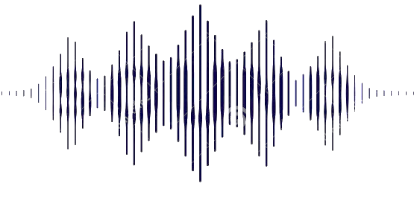
Motivation:
SOUND RECOGNITION for environmental sounds classification

Slide 3

Objective:
Obtain a model based on a CONVOLUTIONAL NEURAL NETWORK for environmental sound classification.
Develop a DISTRIBUTED(or EMBEDDED) COMPUTING ARCHITECTURE for real-time classification of environmental sounds.

Slide 4
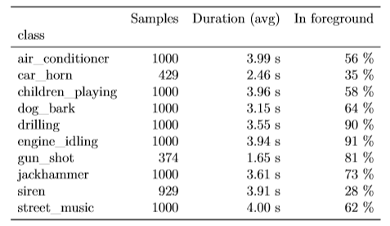
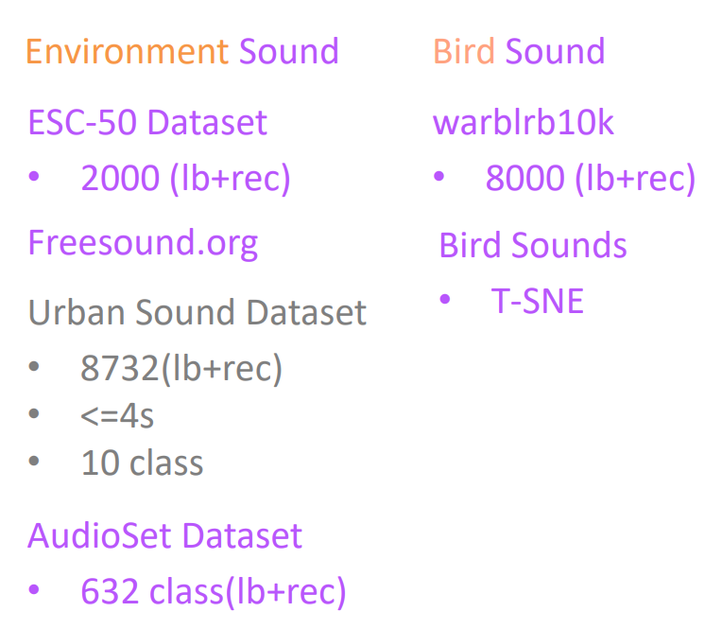
URBAN SOUND DATASET
8732(Annotations+Records)
<= 4s
10 Class
www.freesound.org

Slide 5
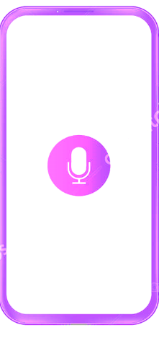



System Architecture:
(Inference)
Sound recording.
(3) Add decision and
Recording in db
(2) Decision
iOSX
Deployment Python Code -> Pyramid web service

Slide 6
Working plan:
MACHINE LEARNING TECHNIQUES.
Classification.
Training process.
NEURAL NETWORKS
Multi-Layer Perceptron.
Convolutional Neural Network(CNN).
Convolutional Recurrent Neural Network.
Efficient CNNs for Image Classification.
AUDIO CLASSIFICATION
Digital sound.
Audio Signal Preprocessing Techniques.
Spectrogram.
Mel-spectrogram.
Data augmentation.
Normalization.
Analysis Windows.
Weak labeling.
Efficient CNNs for Sounds Classification.
ENVIRONMENTAL SOUND RECOGNITION(ESR)
Datasets.
Feature Extraction.
Stationary “ESR” Techniques:
Zero-crossing Rate (ZCR).
Short-time Energy (STE)
MFCCs
Non-stationary “ESR” Techniques:
Wavelet-based methods.
Power-spectrum-based methods.
Sparse-representation-based
methods.
DATABASE
Warblrb10k.
Bird Sounds
Urban Sound Dataset.
COMPUTATIONAL ARCHITECTURE
Multilayer Computing Architecture.
Audio Streaming.

Slide 7
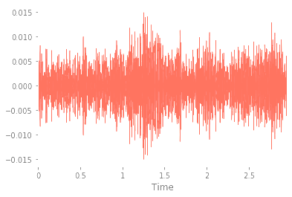
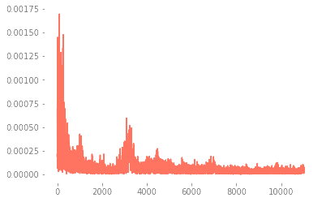
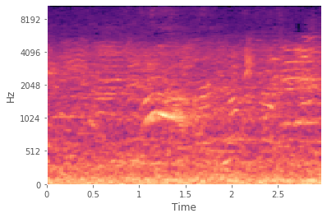
SIGNAL REPRESENTATION
(Feature extraction)
♪ Amplitude/Time
♪ Frequency/Time
♪ Amplitude/Frequency

Slide 8
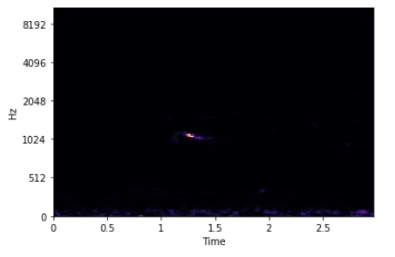
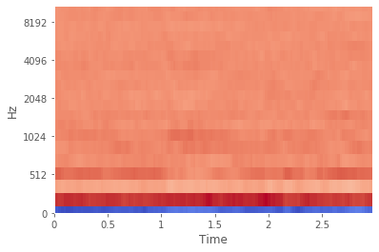
SIGNAL REPRESENTATION
(Feature extraction)
100263-2-0-121.wav
100263-2-0-121.wav(20 Coefficients per frame)
Mel Frequency Cepstrum(MFC):
Mel Frequency Cepstral Coefficients(MFCCs)
Is a representation of the Short-Term Power Spectrum of a sound.
Are coefficients that collectively make up an MFC.

Slide 9
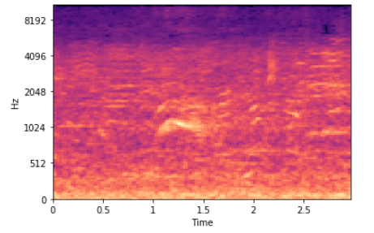
Power to Decibel
MFC(Power)
MFC(Decibel)

Slide 10
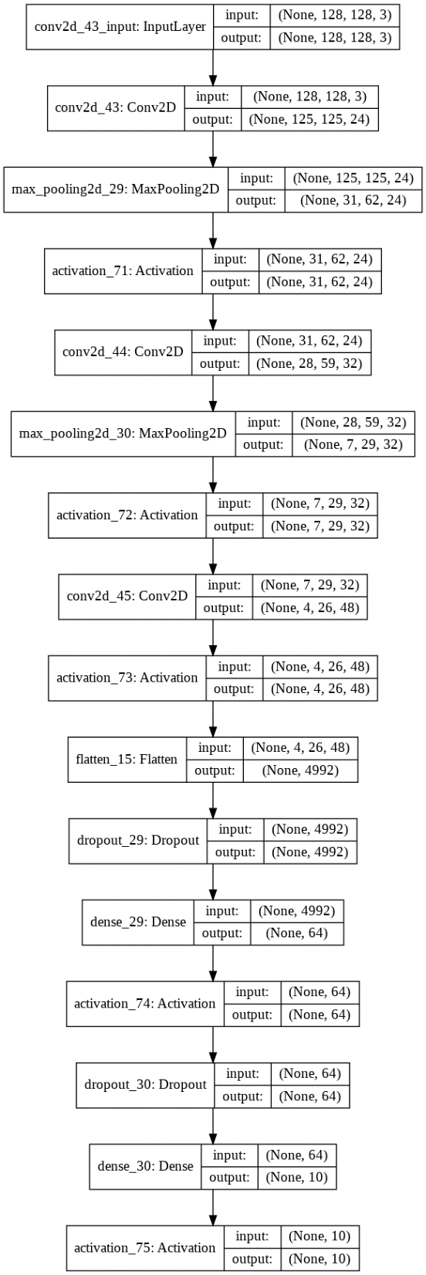
MODEL

Slide 11
Duration_Sound = 2.95 s
sr = 22050 Hz
t(s)= hop_lennght/sr ~23ms
N = 2.95/t
mf = n_mels
shape(N,mf) = 128x128

Slide 12
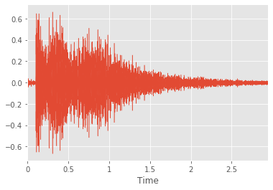
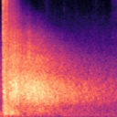
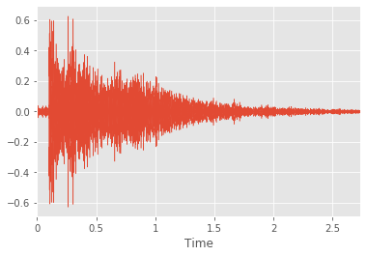
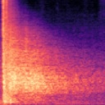
Data Augmentation
rate = 1.08
Original
122690-6-0-0.jpg
Obtained
122690-6-0-0TS108_c6.jpg
Time Stretch Class 6 (122690-6-0-0TS108_c6.wav)
0.82, 0.94 -> 90 increased samples(30/34)

Slide 13
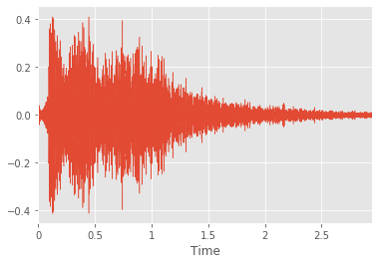
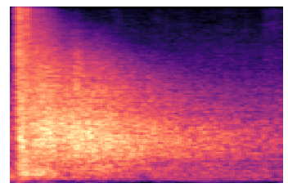
Data Augmentation
n_steps = 2
Original
122690-6-0-0.jpg
Obtained
122690-6-0-0mfccPS2_c6.wav
Pitch Shift Class 6 (122690-6-0-0mfccPS2_c6.wav)
−2, −1, 1 ->120 increased samples(30/34)

Slide 15
TESTS
Learning rate | Epochs | Batch_size | N_Test
0.01-0.001 | 20-100 | 100-128 | 479
Learning rate | Epochs | Batch_size | N_Test
0.001 | 55 | 100 | 479
loss="categorical_crossentropy"
optimizers.Adamax
optimizers.Adam
optimizers.RMSprop

Slide 16
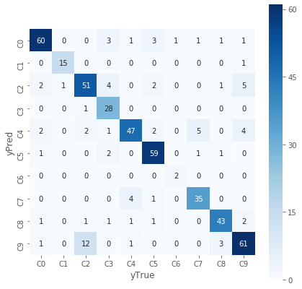
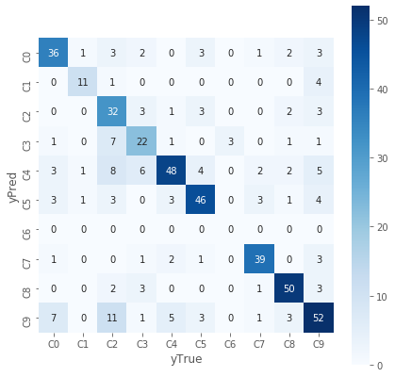
RESULTS MFC/MFCCs
Learning rate | Epochs | Batch_size | N_Test
0.001 | 55 | 100 | 479
Confusion matrix MFC
Confusion matrix MFCCs
0.80<Acc<= 0.84
0.65<Acc<= 0.70

Slide 17
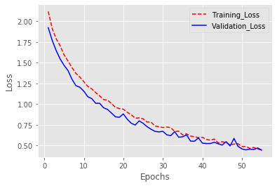
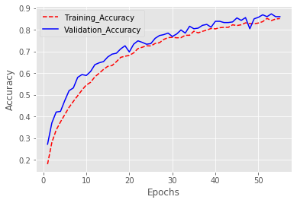
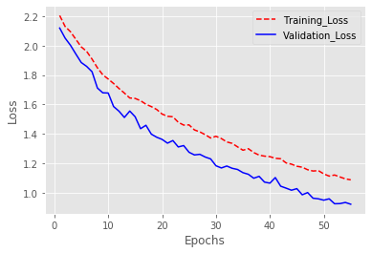
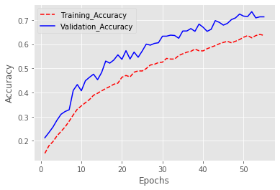
Training/Validation
Loss: 0.4618090449643782
Acc: 0.8371607499480994
Loss MFC
Accuracy MFC
Loss: 0.9861080977513547
Acc: 0.7014613767506435
Loss MFCCs
Accuracy MFCCs

Slide 18
RESULTS MFC/MFCCs
 | Acc0 | Acc1
MFC | 0.813 | 0.882
MFCCs | 0.679 | 0.721
Acc0: Mean accuracy (not increased)
Acc1: Mean accuracy (increased)
0.84507042, 0.9375 , 0.77272727, 0.96551724, 0.74603175,
0.921875 , 1. , 0.875 , 0.86 , 0.78205128
0.89552239, 0.9375 , 0.76119403, 0.71794872, 0.87037037,
0.86764706, 0.66666667, 0.83333333, 0.87755102, 0.82432432
0.70588235, 0.6875 , 0.72727273, 0.61111111, 0.60759494, 0.71875 , 0. , 0.82978723, 0.84745763, 0.62650602
0.70588235, 0.78571429, 0.47761194, 0.57894737, 0.8 ,
0.76666667, 0. , 0.82978723, 0.81967213, 0.66666667
0.86956522, 0.9375 , 0.76691729, 0.82352941, 0.8034188 ,
0.89393939, 0.8 , 0.85365854, 0.86868687, 0.80263158
0.70588235, 0.73333333, 0.57657658, 0.59459459, 0.69064748,
0.74193548, 0. , 0.82978723, 0.83333333, 0.64596273

Slide 19
Asiel Aldana Ortiz
<asiel.aldana89@gmail.com/>
<www.onclix.tech/>

