Slide 1







Andrew Siemer
http://about.me/andrewsiemer
Notes:
Andrew Siemer, obstacle races, ranching, shooting

Slide 2
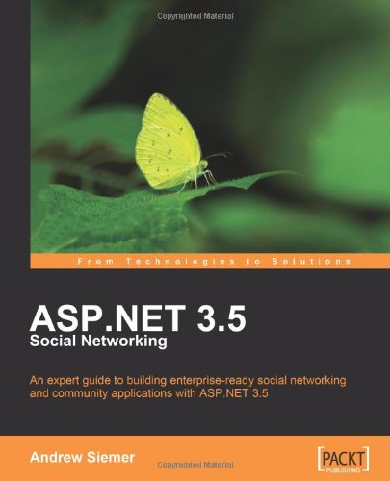
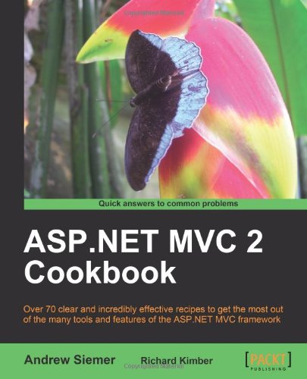
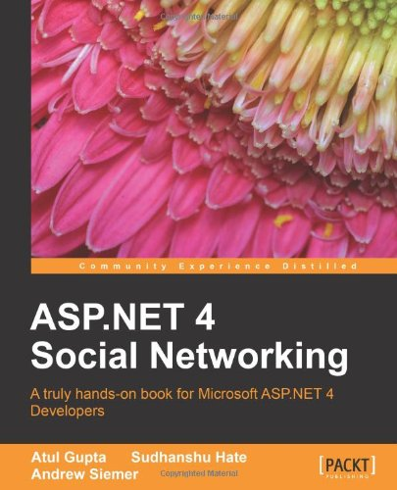

Notes:
Some books I have written or am writing

Slide 3





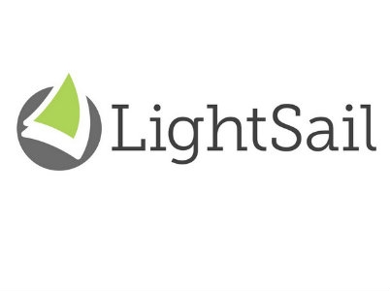





← We are hiring!!!
Notes:
Some places I have worked and some projects I have worked on

Slide 4


DocumentDB
Azure Search

Slide 5
Azure Search
“Standard” can be scaled based on workload
“Shared” is free and solely for testing (no perf guarantees)
REST API access only – no SDK (yet)
Security is limited to API key
What | Free | Standard
Size | 50mb | 25gb per unit
Queries per second | N/A | 15 per unit
Number of documents | 10,000 across 3 indexes | 15M per unit, 50 index limit
Scale out limits | N/A | Up to 36 units
Price | Free | $.168/hour, $125/month

Slide 6
DocumentDB
Has SDK
Uses auth key for security
Throughput equals more partitions
Up to 5 capacity units for preview
Based on a capacity unit
10GB per capacity unit (50GB for preview)
2000 request units per second
$.73/day ($22.50 per month)
Average operations per second per capacity unit
2000 read of a single document
500 inserts, replaces, or deletes
1000 predicate queries returning a single document

Slide 7
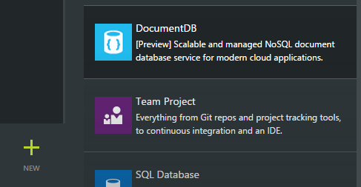
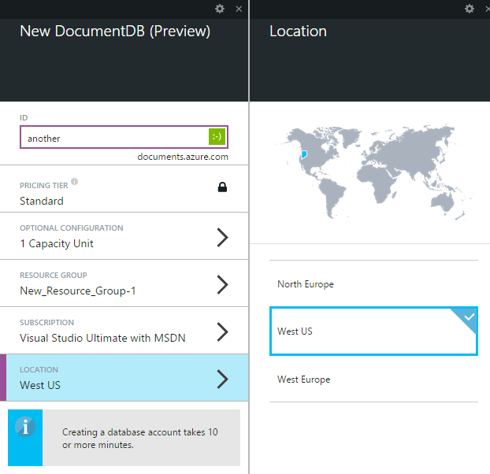
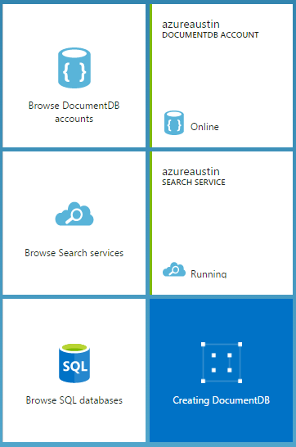
Creating a document DB

Slide 8
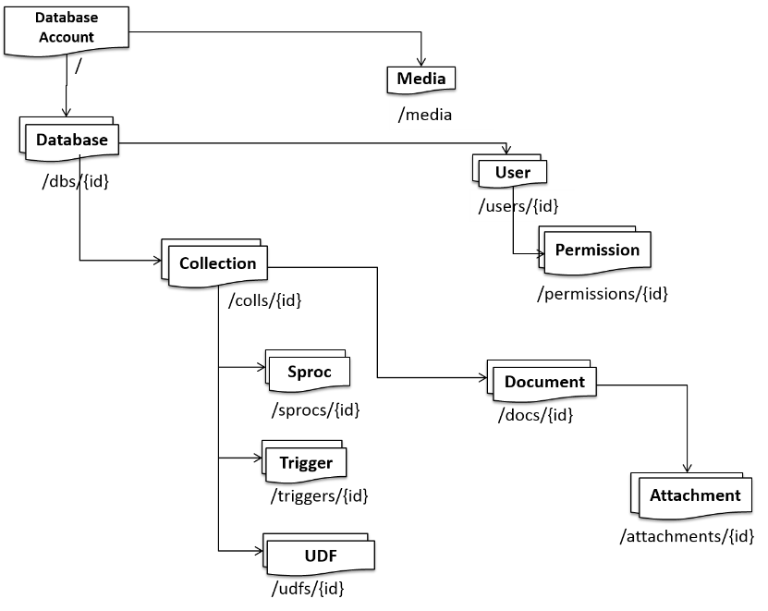
Understanding the DocumentDB structure
Notes:
http://azure.microsoft.com/en-us/documentation/articles/documentdb-interactions-with-resources/

Slide 9
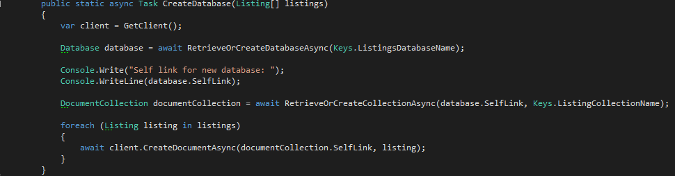
Populating the document store

Slide 10
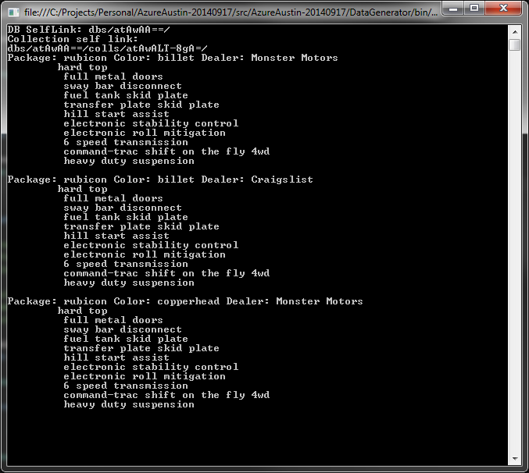
Querying
string sql = String.Format("SELECT * FROM {0} l WHERE l.Package = 'rubicon'", Keys.ListingCollectionName);
http://azure.microsoft.com/en-us/documentation/articles/documentdb-sql-query/

Slide 11
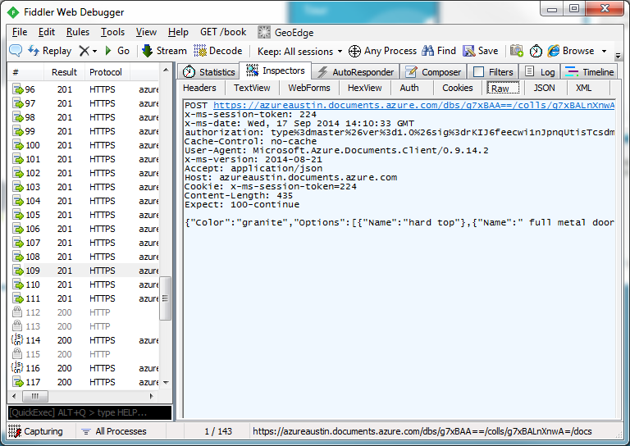
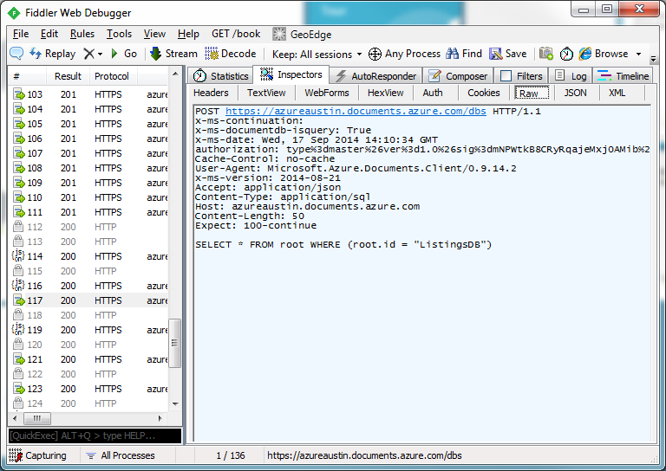
REST API
Create data request
Query data request

Slide 12
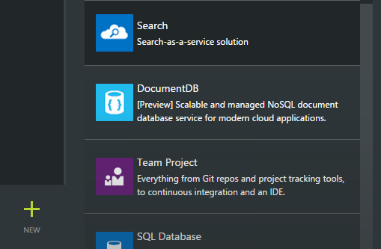
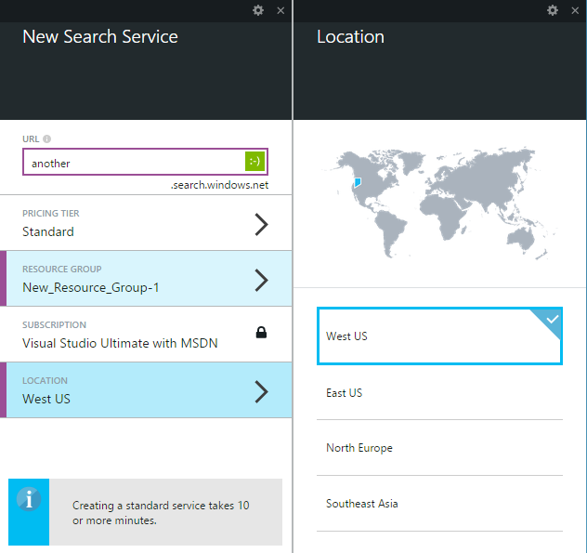
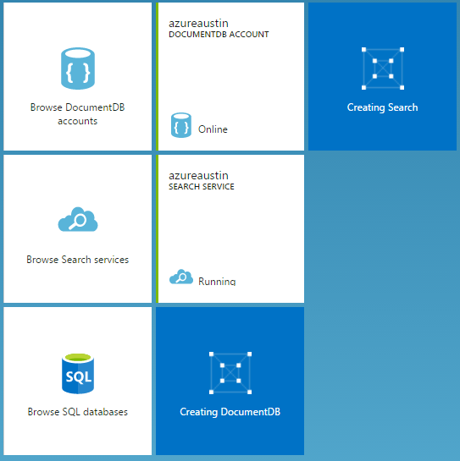
Creating a search instance

