Slide 1
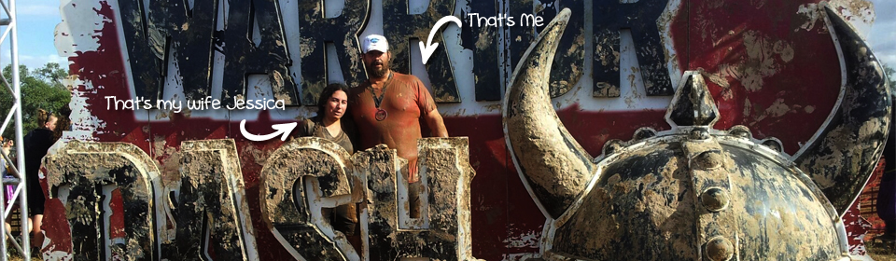



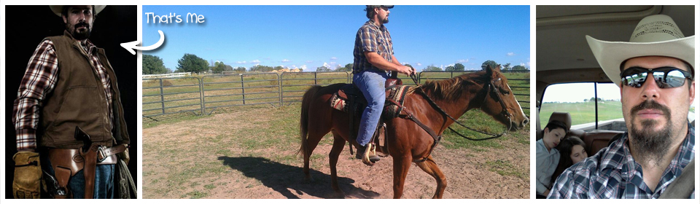

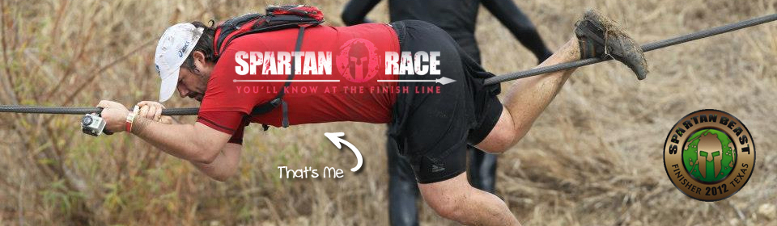
Andrew Siemer
http://about.me/andrewsiemer
Notes:
Andrew Siemer, obstacle races, ranching, shooting

Slide 2
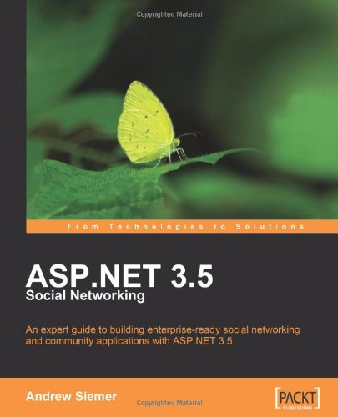
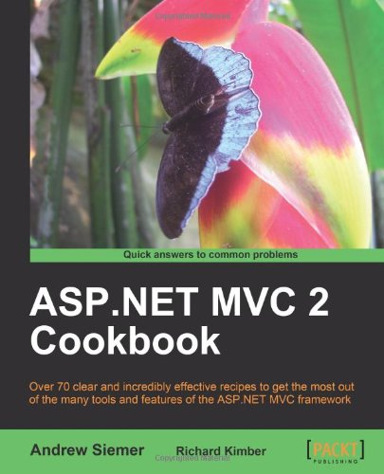
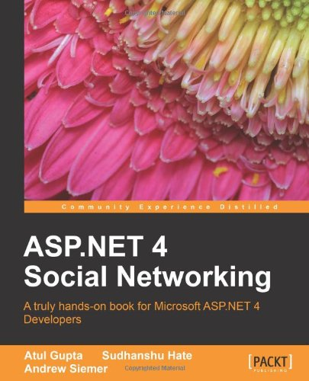

Notes:
Some books I have written or am writing

Slide 3











← We are hiring!!!
Notes:
Some places I have worked and some projects I have worked on

Slide 4


DocumentDB
Azure Search

Slide 5
DocumentDB
Has SDK
Uses auth key for security
Throughput equals more partitions
Up to 5 capacity units for preview
Based on a capacity unit
10GB per capacity unit (50GB for preview)
2000 request units per second
$.73/day ($22.50 per month)
Average operations per second per capacity unit
2000 read of a single document
500 inserts, replaces, or deletes
1000 predicate queries returning a single document

Slide 6
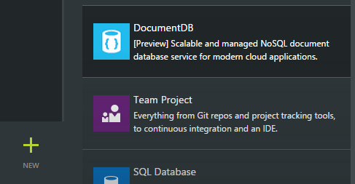
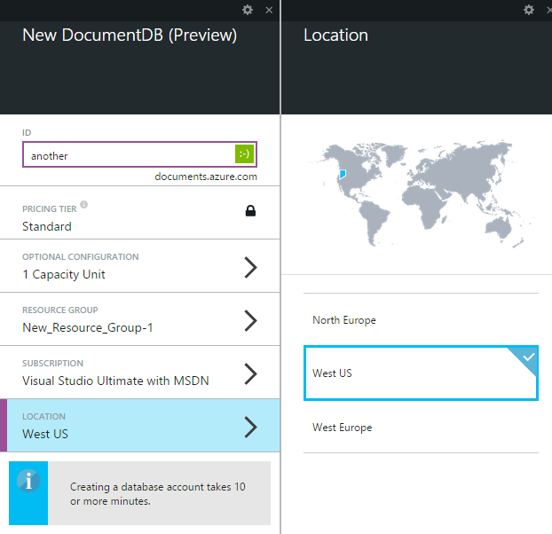
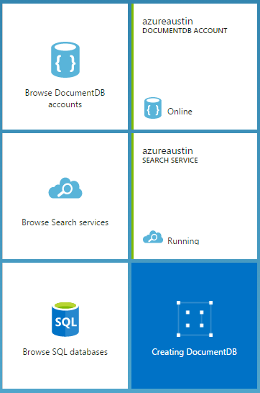
Creating a document DB

Slide 7
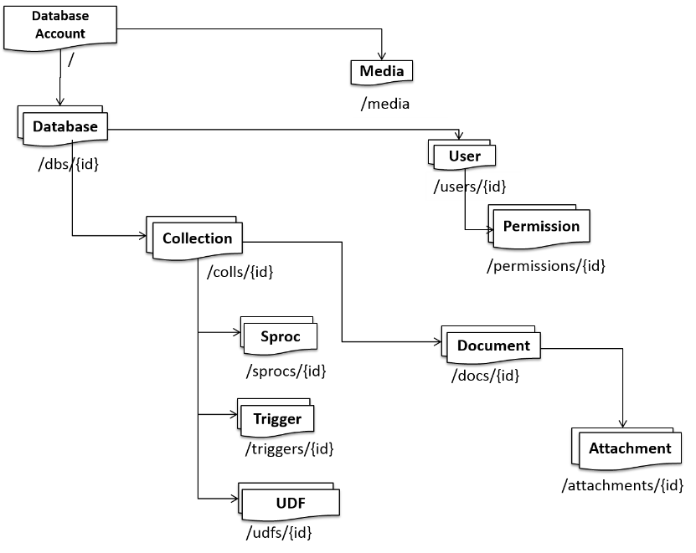
Understanding the DocumentDB structure
Notes:
http://azure.microsoft.com/en-us/documentation/articles/documentdb-interactions-with-resources/

Slide 8
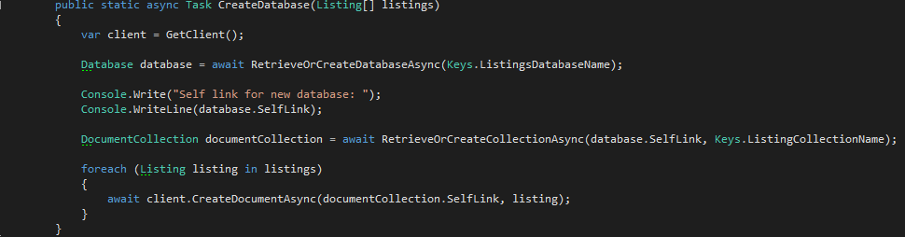
Populating the document store

Slide 9
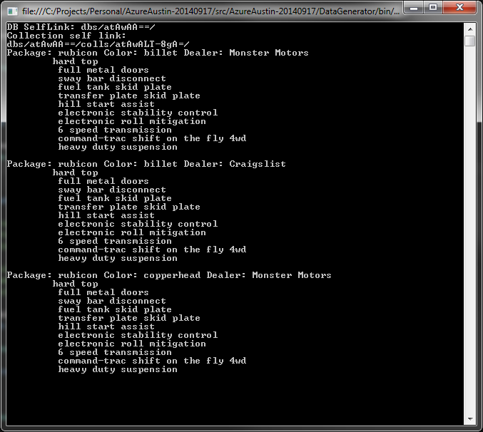
Querying
string sql = String.Format("SELECT * FROM {0} l WHERE l.Package = 'rubicon'", Keys.ListingCollectionName);
http://azure.microsoft.com/en-us/documentation/articles/documentdb-sql-query/

Slide 10
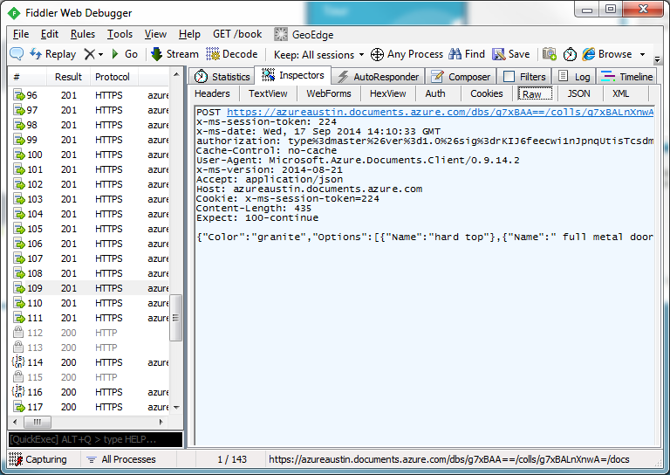
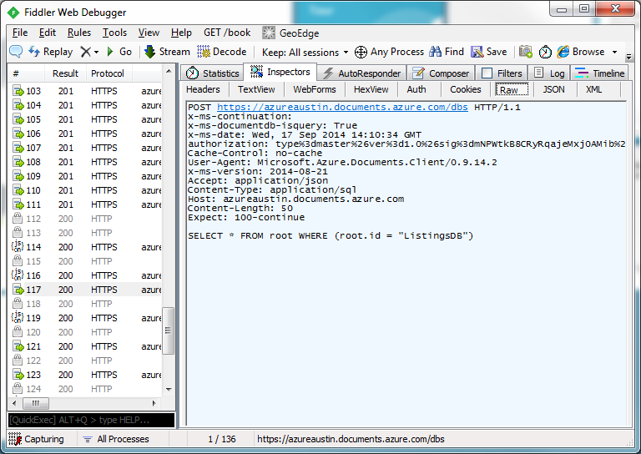
REST API
Create data request
Query data request

Slide 11
Azure Search
“Standard” can be scaled based on workload
“Shared” is free and solely for testing (no perf guarantees)
REST API access only – no SDK (yet)
Security is limited to API key
What | Free | Standard
Size | 50mb | 25gb per unit
Queries per second | N/A | 15 per unit
Number of documents | 10,000 across 3 indexes | 15M per unit, 50 index limit
Scale out limits | N/A | Up to 36 units
Price | Free | $.168/hour, $125/month

Slide 12
Understanding “units”
More replicas equals more performance
More partitions equals more documents and size
1 replica + 1 partition = 1 search unit
6 replicas + 1 partition = (1 replica & 1 partition) + 5 replicas = 6 search units
2 replicas + 2 partitions = (1 replica & 1 partition) + (1 replica & 1 partition) = 2 search units

Slide 13
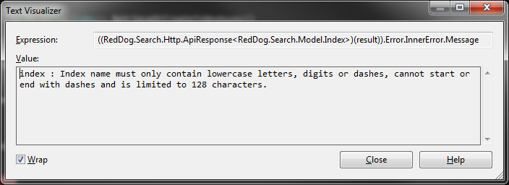
Index naming
I found this out the hard way
…index names must be all lower case, digits, or dashes – 128 character max

Slide 14
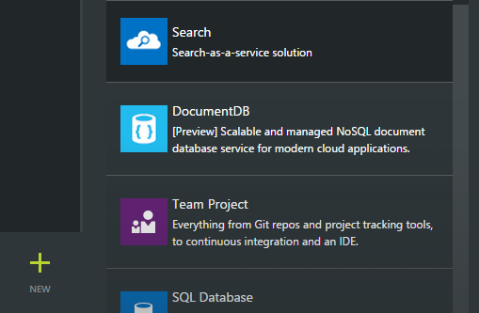
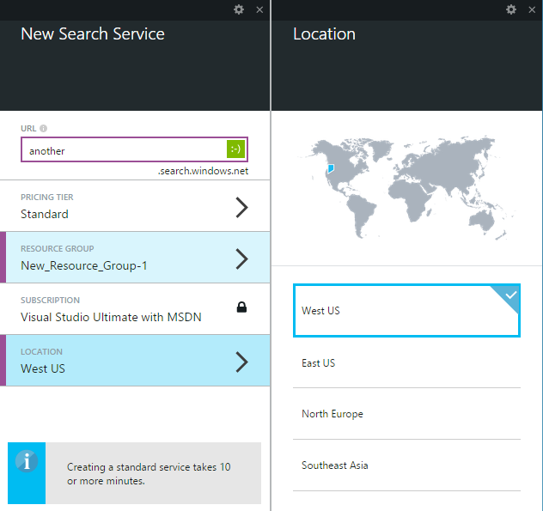
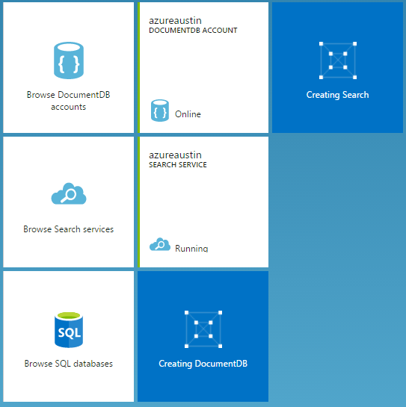
Creating a search instance

