Slide 1
Test driving Azure Search and DocumentDB
Andrew Siemer
Clear Measure
asiemer@hotmail.com / @asiemer

Slide 2





Thank you to our sponsors…
Austin .Net User Group
Codecamp 2014
GOLD
Happy Hour sponsor
Bronze

Slide 3







Andrew Siemer
http://about.me/andrewsiemer
Notes:
Andrew Siemer, obstacle races, ranching, shooting, has 6 kids

Slide 4

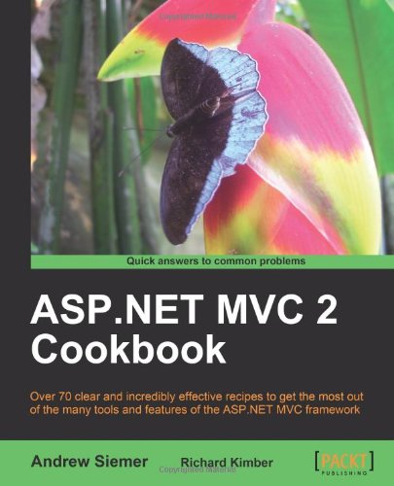


Notes:
Some books I have written or am writing

Slide 5











← We are hiring!!!
Notes:
Some places I have worked and some projects I have worked on

Slide 6
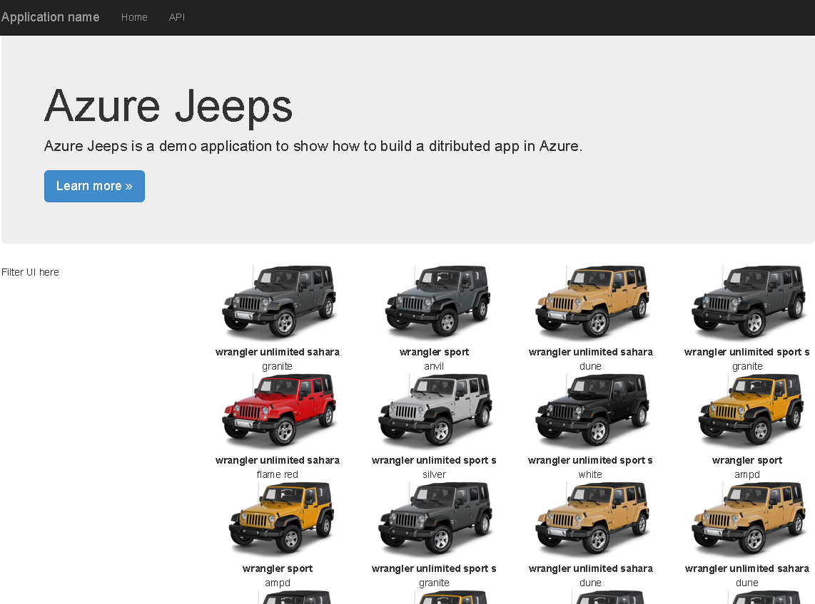

Slide 7
Introduction
DocumentDB
Azure Search
Where might you use each?

Slide 8
DocumentDB
Notes:
Let’s quickly look at how we can set up and configure a DocumentDB

Slide 9
How to set up DocumentDB

Slide 10
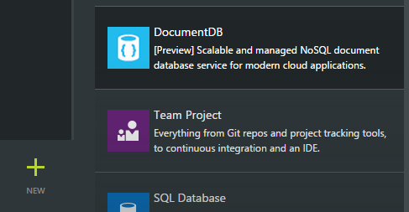
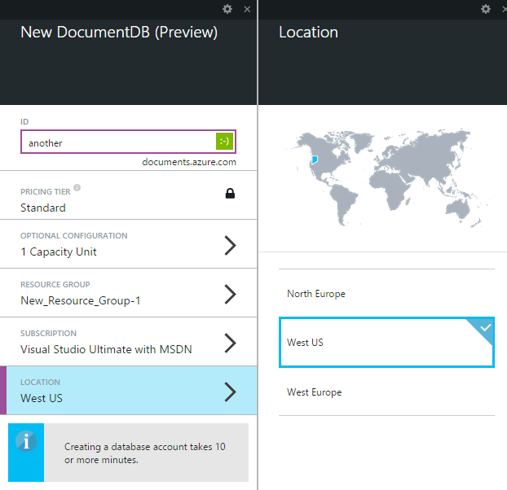
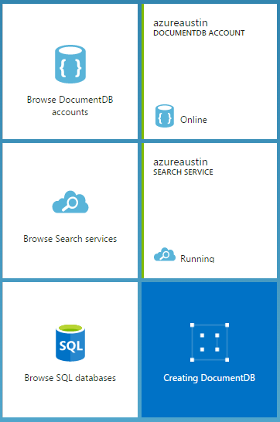
Creating a document DB
Notes:
In case the internet is down, some screen shot quick steps for setting up a documentdb

Slide 11
Let’s create a new Document DB
…is Azure up and available?
Notes:
Now let’s jump out to Azure and see if we can actually create a new documentdb

Slide 12
DocumentDB high points
Has a Microsoft provided SDK via Nuget
Uses auth key for security
Everything is based on a capacity unit
Up to 5 capacity units available for preview
10GB per capacity unit
2000 requests per second
$.73/day ($22.50 per month)
Average operations per second per capacity unit
Based on simple structure
2000 read of a single document
500 inserts, replaces, or deletes
1000 queries returning a single document
Notes:
All the marketing specs around DocumentDB. Everything is capacity unit based. Speed specs assume simple document structure.

Slide 13
Elastic SSD
Makes collection truly elastic
Add/Remove documents grows/shrinks collection
Tested with real-world clients from gigabytes to terrabytes

Slide 14
Automatic Indexing
Indexing on by default
Can optimize for performance and storage tradeoffs
Index only specific paths in your document
Synchronous indexing at write time by default
Can be Asynchronous for boosted write performance
Eventually consistent

Slide 15
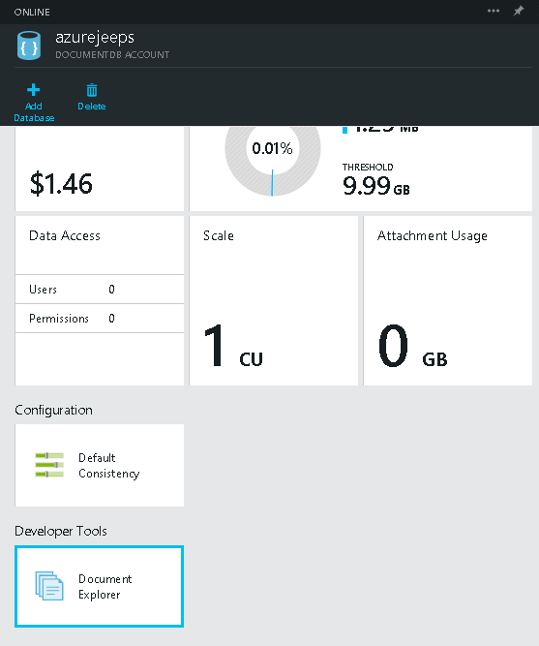
Document Explorer
There is a tool to manage docs
Not terribly useful!
…yet

Slide 16
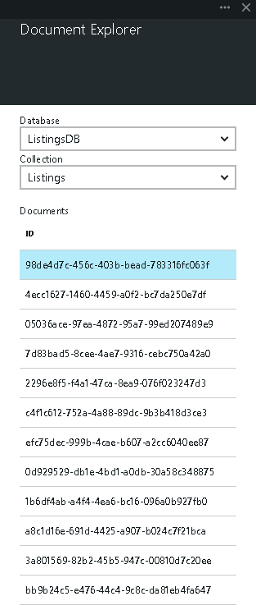
…not yet that useful

Slide 17
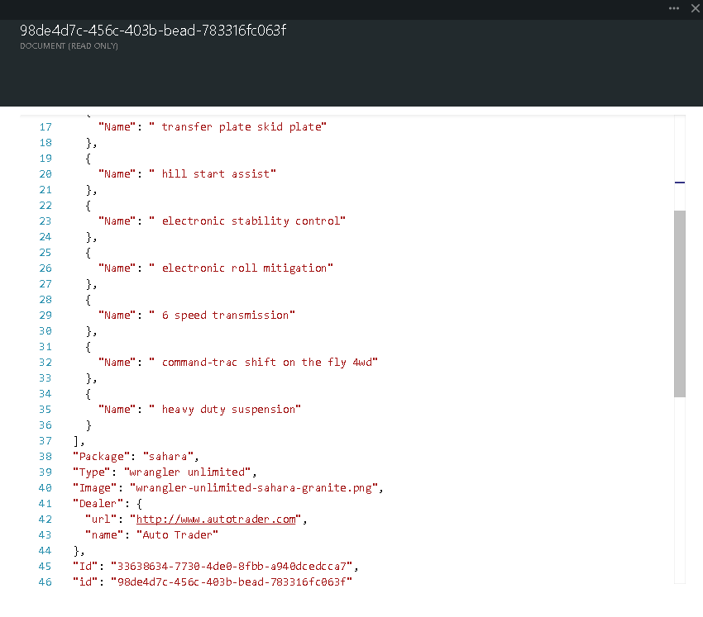

Slide 18
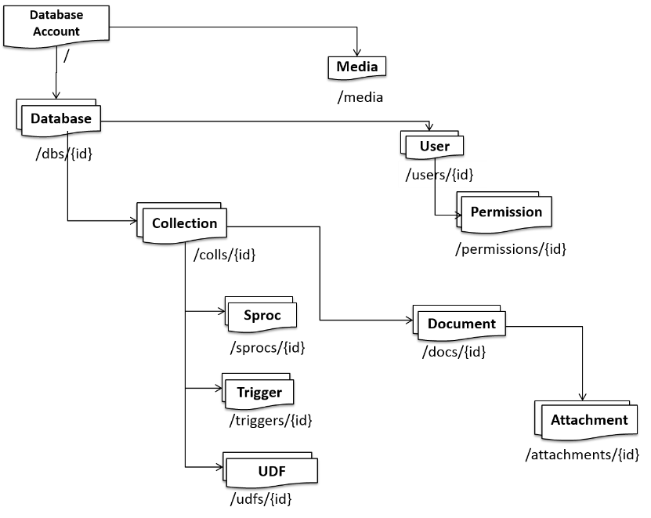
Understanding the DocumentDB structure
Notes:
http://azure.microsoft.com/en-us/documentation/articles/documentdb-interactions-with-resources/

Slide 19
Structure: Database
The container that houses your data
/db/{id} is not your ID
Hash known as a “Self Link”

Slide 20
Structure: Media
Video
Audio
Blob
Etc.

Slide 21
Structure: User
Invite in an existing azure account
Allows you to set permissions on each concept of the database

Slide 22
Structure: Permission
Authorization token
Associated with a user
Grants access to a given resource

Slide 23
Structure: Collection
Most like a “table”
Structure is not defined
Dynamic shapes based on what you put in it

Slide 24
Structure: Document
A blob of JSON representing your data
Can be a deeply nested shape
No specialty types
No specific encoding types

Slide 25
Structure: Attachment
Think media – at the document level!

Slide 26
Structure: Stored Procedure
Written in javascript!
Is transactional
Executed by the database engine
Can live in the store
Can be sent over the wire

Slide 27
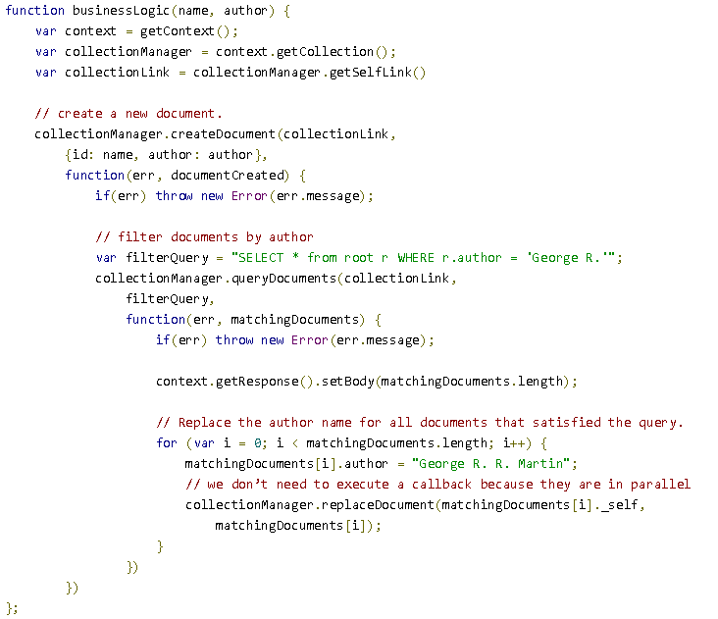

Slide 28
Structure: Triggers
Can be Pre or Post (before or after)
Can operate on the following actions
Create
Replace
Delete
All
Also written in javascript!

Slide 29
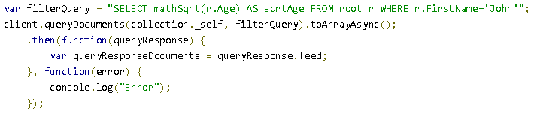
Structure: UDF
Can only be ran on a query
Modifies the result of a given query
mathSqrt()

Slide 30
Create a document store
Everything is done asynchronously!
The ID of a new database is the friendly name
database = await GetClient().CreateDatabaseAsync(new Database { Id = id });

Slide 31
Adding data
Since DocumentDB is dynamic you just throw data in
await client.CreateDocumentAsync(documentCollection.SelfLink, listing);

Slide 32
Batch operations
Not necessarily a built in operation
Can be done with a stored procedure that takes a collection of documents (JSON)

Slide 33
Querying
Everything is done asynchronously in the SDK
The ID of a new database is the friendly name
Everything references the “SelfLink”
This is the internal ID of the resource you are working with
Used to build up the API call
http://azure.microsoft.com/en-us/documentation/articles/documentdb-sql-query/

Slide 34
Querying: Simple
SELECT * FROM
var client = GetClient();
var collection = await GetCollection(client, Keys.ListingsDbName,
Keys.ListingDbCollectionName);
string sql = String.Format("SELECT * FROM {0}", Keys.ListingDbCollectionName);
var jeepsQuery = client.CreateDocumentQuery<Listing>(collection.SelfLink,
sql).ToArray();
var jeeps = jeepsQuery.ToArray();

Slide 35
Querying: More complex
Joining requires the shape to be specified
var client = GetClient();
var collection = await GetCollection(client, Keys.ListingsDbName,
Keys.ListingDbCollectionName);
string sql = String.Format(@"SELECT l.Color, l.Options, l.Package, l.Type, l.Image,
l.Dealer, l.Id
FROM {0} l
JOIN o IN l.Options
WHERE o.Name = 'hard top'", Keys.ListingDbCollectionName);
var hardtopQuery = client.CreateDocumentQuery<Listing>(collection.SelfLink,
sql).ToArray();

Slide 36
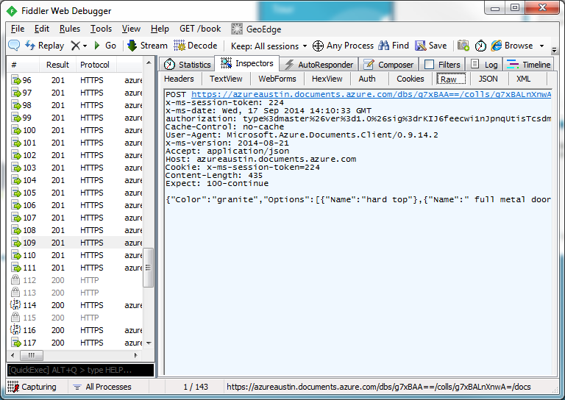
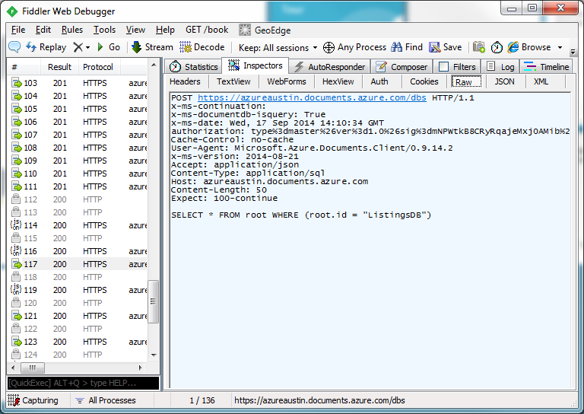
REST API
Everything is done via a REST call!
Create data request
Query data request

Slide 37
Interactive query demo online
Microsoft has provided an interactive demo for you to play with
http://www.documentdb.com/sql/demo

Slide 38
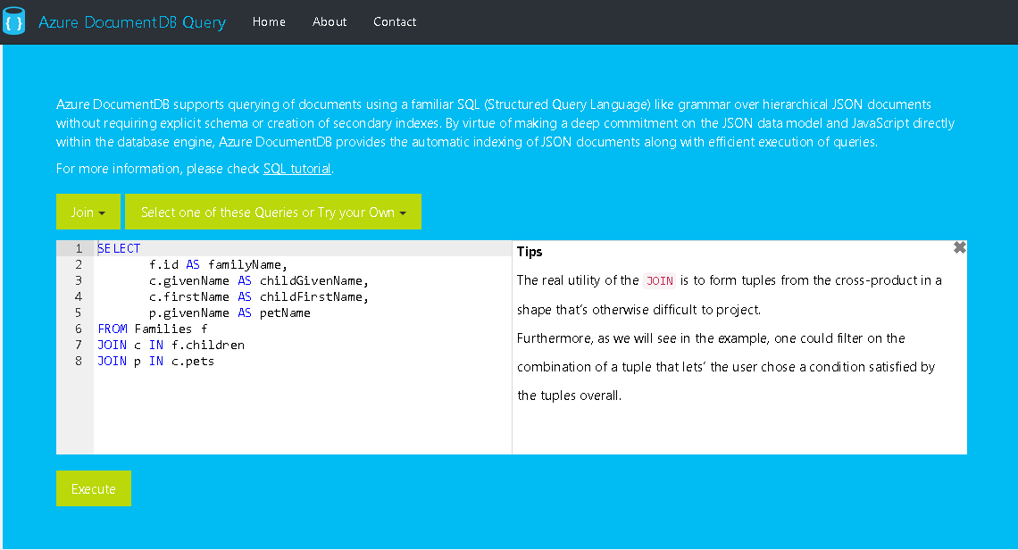

Slide 39
Quick questions on Document DB?

Slide 40
Azure Search

Slide 41
Let’s see how to setup Azure Search

Slide 42
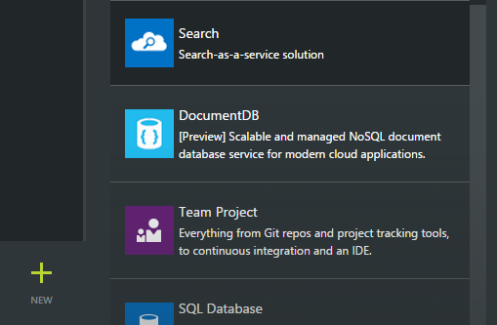
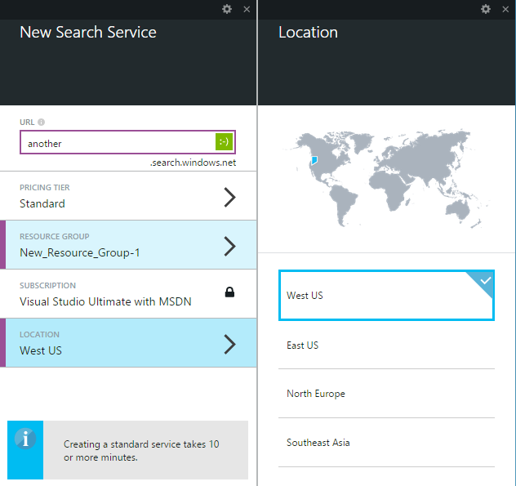
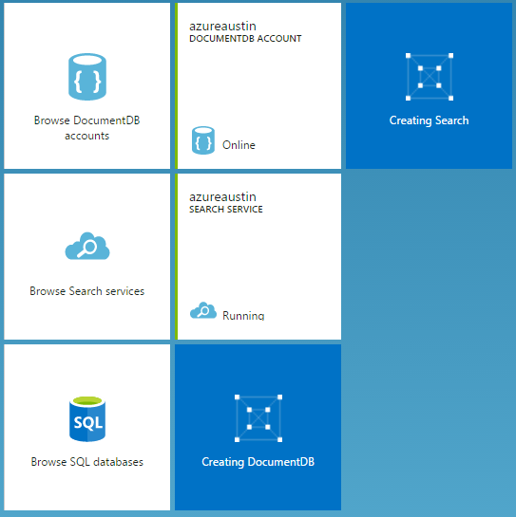
Creating a search instance

Slide 43
Let’s set up Azure Search
…is Azure up and available?
Notes:
Jump out to Azure and configure a new search index

Slide 44
Azure Search Options
“Standard” can be scaled based on workload
“Shared” is free and solely for testing (no perf guarantees)
REST API access only – no SDK from Microsoft yet
RedDog.Search is available on Nuget
Security is limited to API key

Slide 45
Quick specs
What | Free | Standard
Size | 50mb | 25gb per unit
Queries per second | N/A | 15 per unit
Number of documents | 10,000 across 3 indexes | 15M per unit, 50 index limit
Scale out limits | N/A | Up to 36 units
Price | Free | $.168/hour, $125/month

Slide 46
Understanding “units”
More replicas equals more performance
More partitions equals more documents and more space
1 replica + 1 partition = 1 search unit
6 replicas + 1 partition = (1 replica & 1 partition) + 5 replicas = 6 search units
2 replicas + 2 partitions = (1 replica & 1 partition) + (1 replica & 1 partition) = 2 search units

Slide 47
No SDK yet!
RedDog.Search
Provided via Nuget and on GitHub
Also all asynchronous
AdventureWorksCatalog – sample code
Great example of composing REST requests
http://azure.microsoft.com/en-us/documentation/articles/search-create-first-solution/

Slide 48
Azure Search is structured
A search index has a predefined structure
It is not dynamic
Each field in the index has characteristics defined when created
Filterable?
Searchable?
Faceted?
Retrievable?
Sortable?

Slide 49
Field Characteristics: Key
Required!
Can only be on one field for the document
Can be used to look up a document directly
Update
Delete

Slide 50
Field Characteristics: Searchable
Makes the field full-text-search-able
Breaks the words of the field for indexing purposes
“Big Red Jeep” will become separate components
A search for “big”, “red”, “jeep”, or “big jeep” will hit this record
Other field types are not searchable!
Searchable fields cause bloat!
Only make it searchable if it needs to be

Slide 51
Field Characteristics: Filterable
Doesn’t under go word breaking
Exact matches only
Only searches for “big red jeep” will hit a “big red jeep” record
All fields are filterable by default

Slide 52
Field Characteristics: Sortable
By default, results are sorted by score
Strings are not sortable!
All other types are sortable by default

Slide 53
Field Characteristics: Facetable
Geography points are not facetable
All other fields are facetable by default
Used to rank records by other notions
Jeeps that sold by this {dealer}
Jeeps that are this {color}

Slide 54
Field Characteristics: Suggestions
Used for auto-complete
Only for string or collection of string
False by default
Causes bloat in the index!

Slide 55
Field Characteristics: Retrievable
Allows the field to be returned in the search results
Key fields must be retrievable

Slide 56
Creating an index
var newIndex = new Index(Keys.ListingsServiceIndexName)
.WithStringField("Id", opt => opt.IsKey().IsRetrievable())
.WithStringField("Color", opt => opt.IsSearchable()
.IsSortable()
.IsFilterable()
.IsRetrievable()
.IsFacetable())
.WithStringField("Package", opt => opt.IsSearchable()
.IsFilterable()
.IsRetrievable()
.IsFacetable())
...
index = await managementClient.CreateIndexAsync(newIndex);

Slide 57
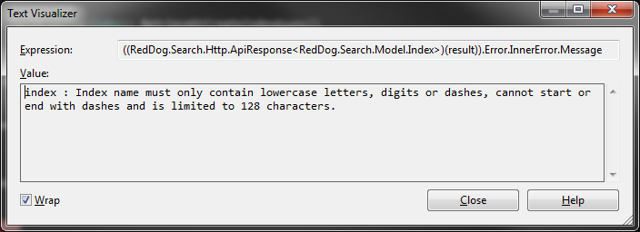
Index naming
I found this out the hard way
…index names must be all lower case, digits, or dashes – 128 character max

Slide 58
Scoring Profiles
Gives you greater control over the results
Control over boosting documents based on freshness
Distance allows you to boost documents that are “closer”
Based on geographic location
Magnitude scoring alters ranking based on a range of values
Highest rated
Produces the highest margin

Slide 59
Interpolations
Slope at which boosting increases from range start to end
Linear – constant decreasing amount
Default
Constant – constant boost is applied
Quadratic – slow to fast boost drop off
Logarithmic – fast to slow boost drop off
Notes:
Added to scoring profiles

Slide 60
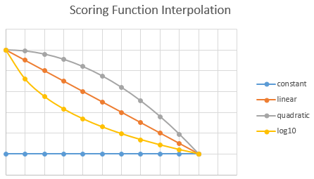
Interpolations

Slide 61
Adding a scoring profile
Can be added to the index at any time
var sp = new ScoringProfile();
sp.Name = "ByTypeAndPackage";
sp.Text = new ScoringProfileText();
sp.Text.Weights = new Dictionary<string, double>();
sp.Text.Weights.Add("Type", 1.5);
sp.Text.Weights.Add("Package", 1.5);
newIndex.ScoringProfiles.Add(sp);

Slide 62
Adding data to the index
Need to map your object to your index
var op = new IndexOperation(IndexOperationType.Upload, "Id", l.Id.ToString())
.WithProperty("Color", l.Color)
.WithProperty("Options", flatOptions)
.WithProperty("Package", l.Package)
.WithProperty("Type", l.Type)
.WithProperty("Image", l.Image);
operations.Add(op);
var result = await managementClient.PopulateAsync(Keys.ListingsServiceIndexName, operations.ToArray());

Slide 63
Batch operations
The previous code was a batch operation
You can batch up to 1000 “operations” in one call
Can be any operation in the batch
Adds
Deletes
Updates

Slide 64
Querying the index
Have to specify what fields you want returned
Can only output Retrievable fields
var conn = ApiConnection.Create(Keys.ListingsServiceUrl, Keys.ListingsServiceKey);
var queryClient = new IndexQueryClient(conn);
var query = new SearchQuery(search)
.Count(true)
.Select("Id,Color,Options,Type,Package,Image")
.OrderBy("Color");
var searchResults = await queryClient.SearchAsync(Keys.ListingsServiceIndexName, query);

Slide 65
Quick questions on Azure Search?

Slide 66
Where do I use them?

Slide 67
When is NoSQL better than N
Unstructured data
Favors a denormalized structure
Need easy scaling options – distributed replication (add nodes)
When you don’t need transactions across collections

Slide 68
When not to use NoSQL
Need to do heavy joins across collections
When many to many query depth is unknown
User has a collection of users (friends) which have a collection of users

Slide 69
When to use search
Need an easy way to score results
Fuzzy searching is easy
Finely control results around business rules
Ability to boost newer results
Built around distributed first (over SOLR, others)

Slide 70
Where does it fit?
NOSQL
SEARCH

Slide 71
Any questions on where they fit?

Slide 72
Thank you!
Code and slides are here:
https://github.com/asiemer/AzureJeeps
You can find me here:
http://www.andrewsiemer.com
http://www.siemerforhire.com
http://about.me/AndrewSiemer

