Slide 1
Test driving Azure Search and DocumentDB
Andrew Siemer
Clear Measure
asiemer@hotmail.com / @asiemer

Slide 2







Andrew Siemer
http://about.me/andrewsiemer
Notes:
Andrew Siemer, obstacle races, ranching, shooting, has 6 kids

Slide 3

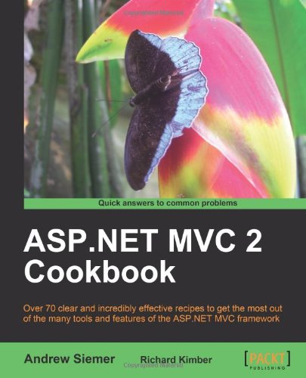


Notes:
Some books I have written or am writing

Slide 4











← We are hiring!!!
Notes:
Some places I have worked and some projects I have worked on

Slide 5


DocumentDB
Azure Search

Slide 6
DocumentDB
Notes:
Let’s quickly look at how we can set up and configure a DocumentDB

Slide 7
How to set up DocumentDB

Slide 8
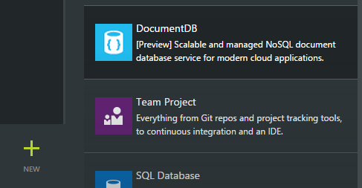
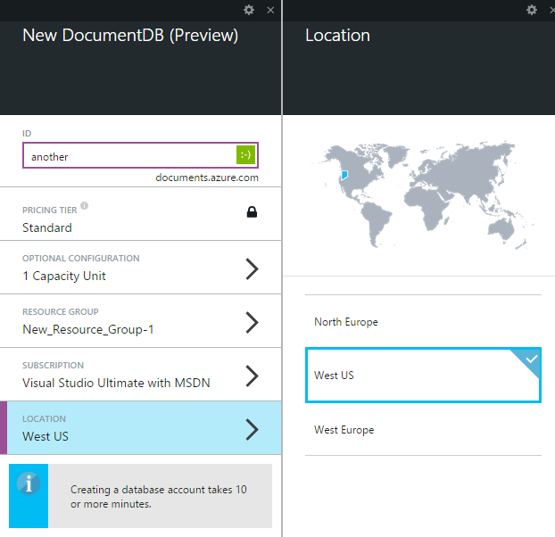
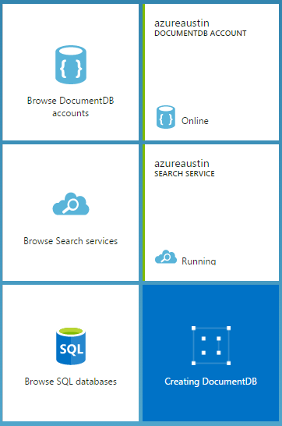
Creating a document DB
Notes:
In case the internet is down, some screen shot quick steps for setting up a documentdb

Slide 9
Let’s create a new Document DB
…is Azure up and available?
Notes:
Now let’s jump out to Azure and see if we can actually create a new documentdb

Slide 10
DocumentDB high points
Has a Microsoft provided SDK via Nuget
Uses auth key for security
Everything is based on a capacity unit
Up to 5 capacity units available for preview
10GB per capacity unit
2000 requests per second
$.73/day ($22.50 per month)
Average operations per second per capacity unit
Based on simple structure
2000 read of a single document
500 inserts, replaces, or deletes
1000 queries returning a single document
Notes:
All the marketing specs around DocumentDB. Everything is capacity unit based. Speed specs assume simple document structure.

Slide 11
Elastic SSD
Makes collection truly elastic
Add/Remove documents grows/shrinks collection
Tested with real-world clients from gigabytes to terrabytes

Slide 12
Automatic Indexing
Indexing on by default
Can optimize for performance and storage tradeoffs
Index only specific paths in your document
Synchronous indexing at write time by default
Can be Asynchronous for boosted write performance
Eventually consistent

Slide 13
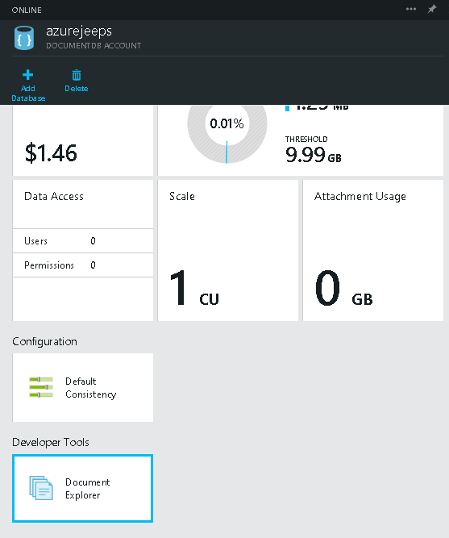
Document Explorer
There is a tool to manage docs
Not terribly useful!
…yet

Slide 14
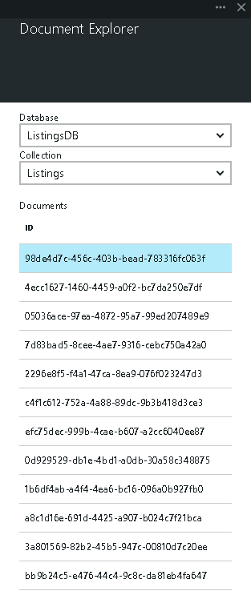
…not yet that useful

Slide 15
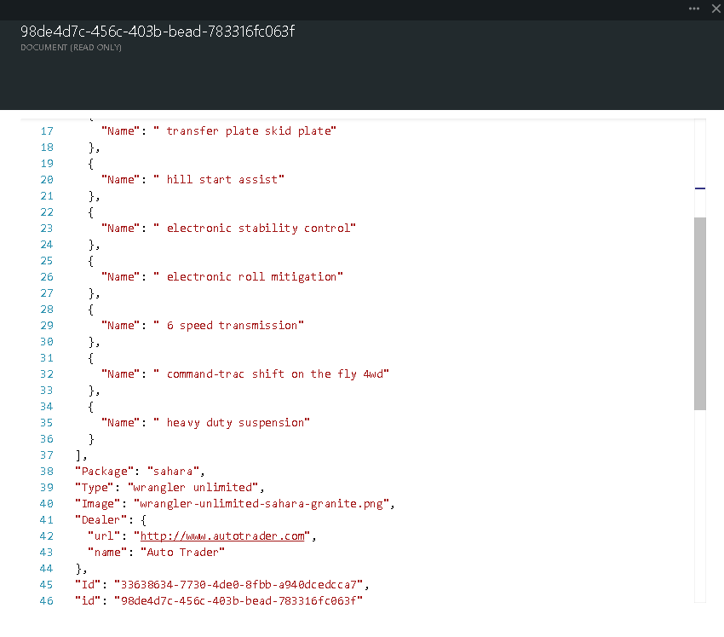

Slide 16
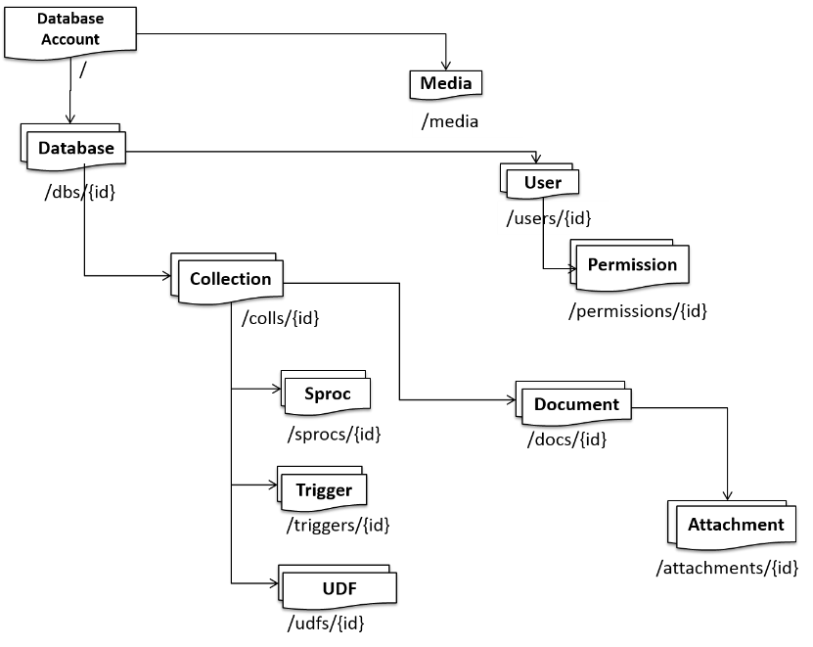
Understanding the DocumentDB structure
Notes:
http://azure.microsoft.com/en-us/documentation/articles/documentdb-interactions-with-resources/

Slide 17
Structure: Database
The container that houses your data
/db/{id} is not your ID
Hash known as a “Self Link”

Slide 18
Structure: Attachment
Video
Audio
Blob
Etc.

Slide 19
Structure: User
Invite in an existing azure account
Allows you to set permissions on each concept of db

Slide 20
Structure: Permission
Authorization token
Associated with a user
Grants access to a given resource

Slide 21
Structure: Collection
Most like a “table”
Structure is not defined
Dynamic shapes based on what you put in it

Slide 22
Structure: Document
A blob of JSON representing your data
Can be a deeply nested shape
No specialty types
No specific encoding types

Slide 23
Structure: Attachment
Think media – at the document level!

Slide 24
Structure: Stored Procedure
Written in javascript!
Is transactional
Executed by the database engine
Can live in the store
Can be sent over the wire

Slide 25
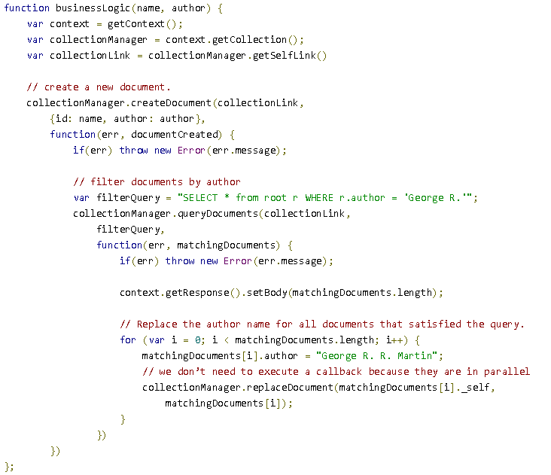

Slide 26
Structure: Triggers
Can be Pre or Post (before or after)
Can operate on the following actions
Create
Replace
Delete
All
Also written in javascript!

Slide 27
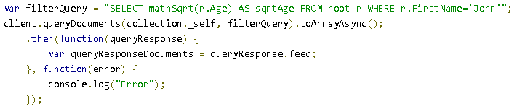
Structure: UDF
Can only be ran on a query
Modifies the result of a given query
mathSqrt()

Slide 28
Code: Create document store
Everything is done asynchronously!
The ID of a new database is the friendly name
database = await GetClient().CreateDatabaseAsync(new Database { Id = id });

Slide 29
Querying
Everything is done asynchronously in the SDK
The ID of a new database is the friendly name
Everything references the “SelfLink”
This is the internal ID of the resource you are working with
Used to build up the API call
http://azure.microsoft.com/en-us/documentation/articles/documentdb-sql-query/

Slide 30
Querying: Simple
SELECT * FROM
var client = GetClient();
var collection = await GetCollection(client, Keys.ListingsDbName,
Keys.ListingDbCollectionName);
string sql = String.Format("SELECT * FROM {0}", Keys.ListingDbCollectionName);
var jeepsQuery = client.CreateDocumentQuery<Listing>(collection.SelfLink,
sql).ToArray();
var jeeps = jeepsQuery.ToArray();

Slide 31
Querying: More complex
Joining requires the shape to be specified
var client = GetClient();
var collection = await GetCollection(client, Keys.ListingsDbName,
Keys.ListingDbCollectionName);
string sql = String.Format(@"SELECT l.Color, l.Options, l.Package, l.Type, l.Image,
l.Dealer, l.Id
FROM {0} l
JOIN o IN l.Options
WHERE o.Name = 'hard top'", Keys.ListingDbCollectionName);
var hardtopQuery = client.CreateDocumentQuery<Listing>(collection.SelfLink,
sql).ToArray();

Slide 32
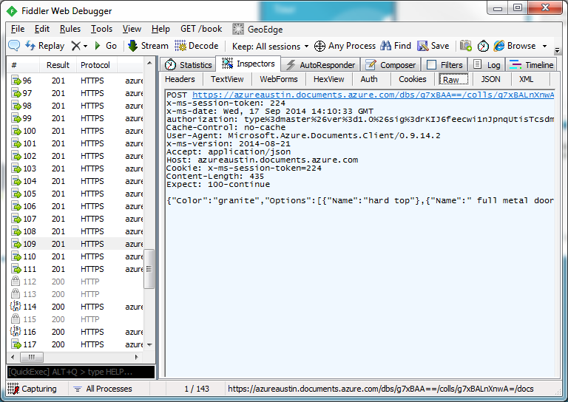
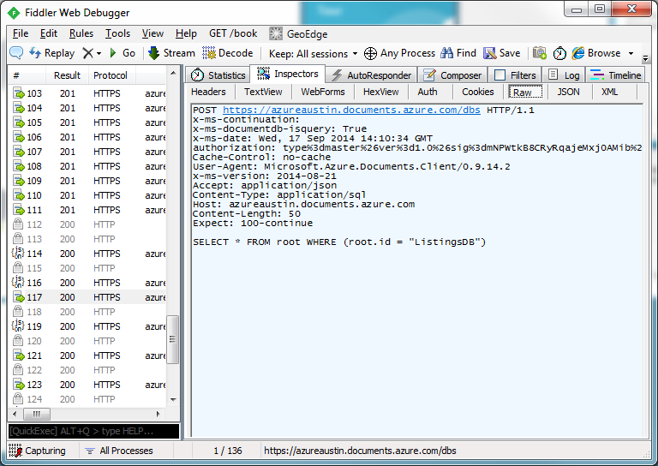
REST API
Everything is done via a REST call!
Create data request
Query data request

Slide 33
Quick questions on Document DB?

Slide 34
Azure Search

Slide 35
Let’s see how to setup Azure Search

Slide 36
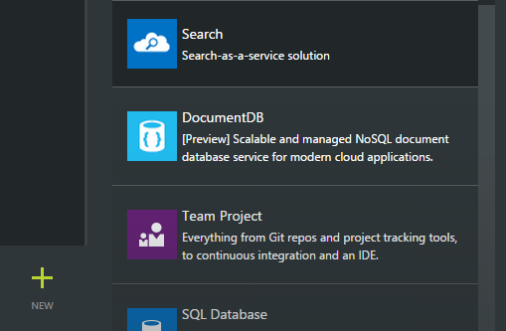
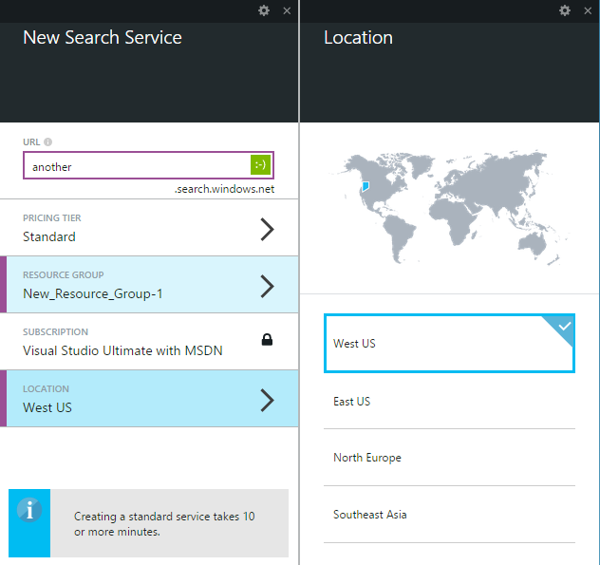
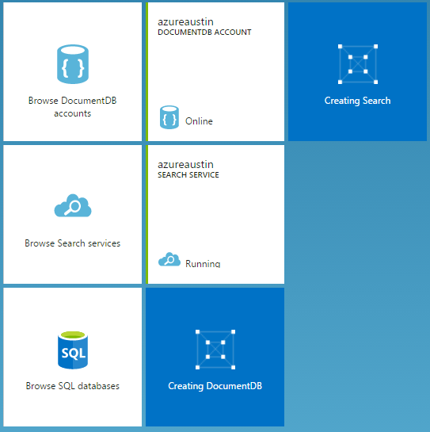
Creating a search instance

Slide 37
Let’s set up Azure Search
…is Azure up and available?
Notes:
Jump out to Azure and configure a new search index

Slide 38
Set up Azure Search
“Standard” can be scaled based on workload
“Shared” is free and solely for testing (no perf guarantees)
REST API access only – no SDK from Microsoft yet
RedDog.Search is available on Nuget
Security is limited to API key

Slide 39
Quick specs
What | Free | Standard
Size | 50mb | 25gb per unit
Queries per second | N/A | 15 per unit
Number of documents | 10,000 across 3 indexes | 15M per unit, 50 index limit
Scale out limits | N/A | Up to 36 units
Price | Free | $.168/hour, $125/month

Slide 40
Understanding “units”
More replicas equals more performance
More partitions equals more documents and more space
1 replica + 1 partition = 1 search unit
6 replicas + 1 partition = (1 replica & 1 partition) + 5 replicas = 6 search units
2 replicas + 2 partitions = (1 replica & 1 partition) + (1 replica & 1 partition) = 2 search units

Slide 41
Is structured
A search index is structured
Each field in the index has characteristics defined when created
Filterable?
Searchable?
Faceted?
Retrievable?
Sortable?

Slide 42
Field Characteristics

Slide 43
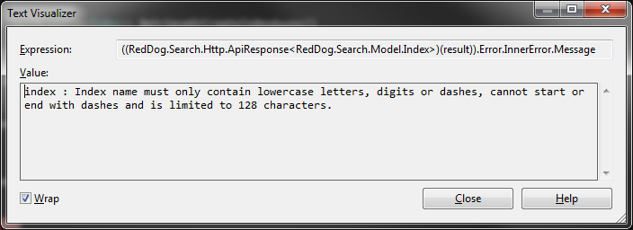
Index naming
I found this out the hard way
…index names must be all lower case, digits, or dashes – 128 character max

