Slide 1
RUBIK’S CUBE SOLVER
1705022-Solaiman Ahmed
1705031-Md.Mahedi Hasan Rigan
1705041-Asif Mustafa Hassan
CSE 316
Microprocessors, Microcontrollers, and Embedded Systems Sessional

Slide 2
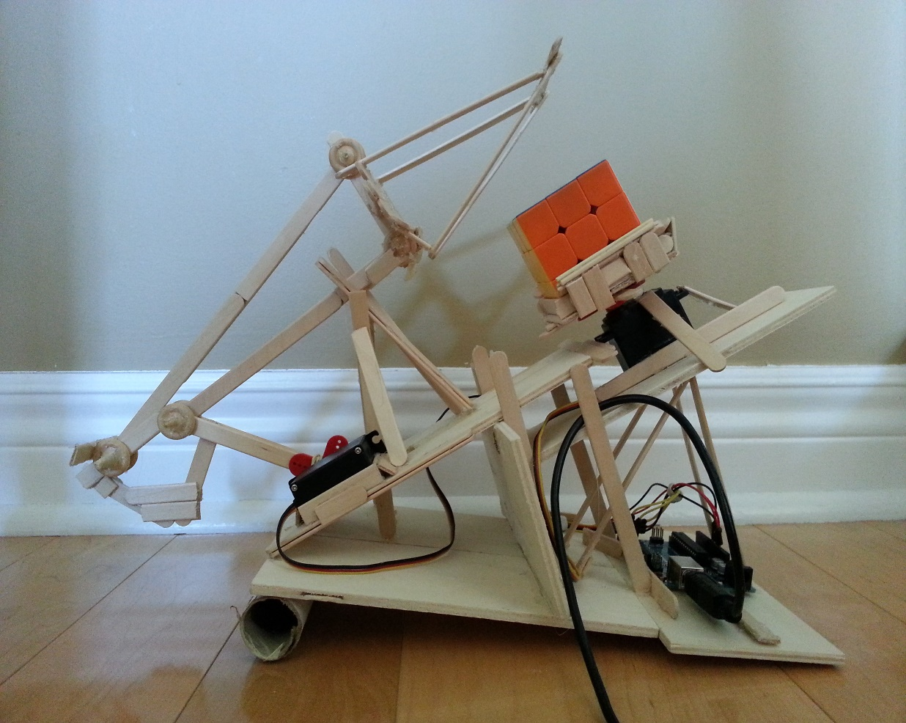
Project analysis slide 2
Rubik’s Cube Solver
Description
We want to make a robot which can solve any 3*3*3 Rubik’s cube. The robot first see all the faces of the cube and memorize it. Then, we will determine our move using an algorithm and at last to execute the planned move we will use motor to exchange the position of cube piece.

Slide 3
Project analysis slide 4
Rubik’s Cube Solver
Motivation
The goal of this project was to create a robot that could determine the state of a scrambled Rubik’s Cube and then solve it.
  Combination of hardware and software systems
  Rubik’s cube is a fascinating puzzle

Slide 4
Project analysis slide 3
Rubik’s Cube Solver
Required Components
Atmega32
Arduino UNO R3
Stepper motors
Stepper motor drivers
RGB color sensors
3D printed shaft-cube couplers
Wires
USB cable
Popsicle sticks
Wooden skewers
Rubik’s Cube

Slide 5
Thank You

