Slide 1

Hunger Express
Presentation on BPMN Diagram
CSE-326
Group: 4 (A2)
Presented by,
Souvik Das
1705031-1705034-1705041-1705049-1705054-1705059-1505048

Slide 2
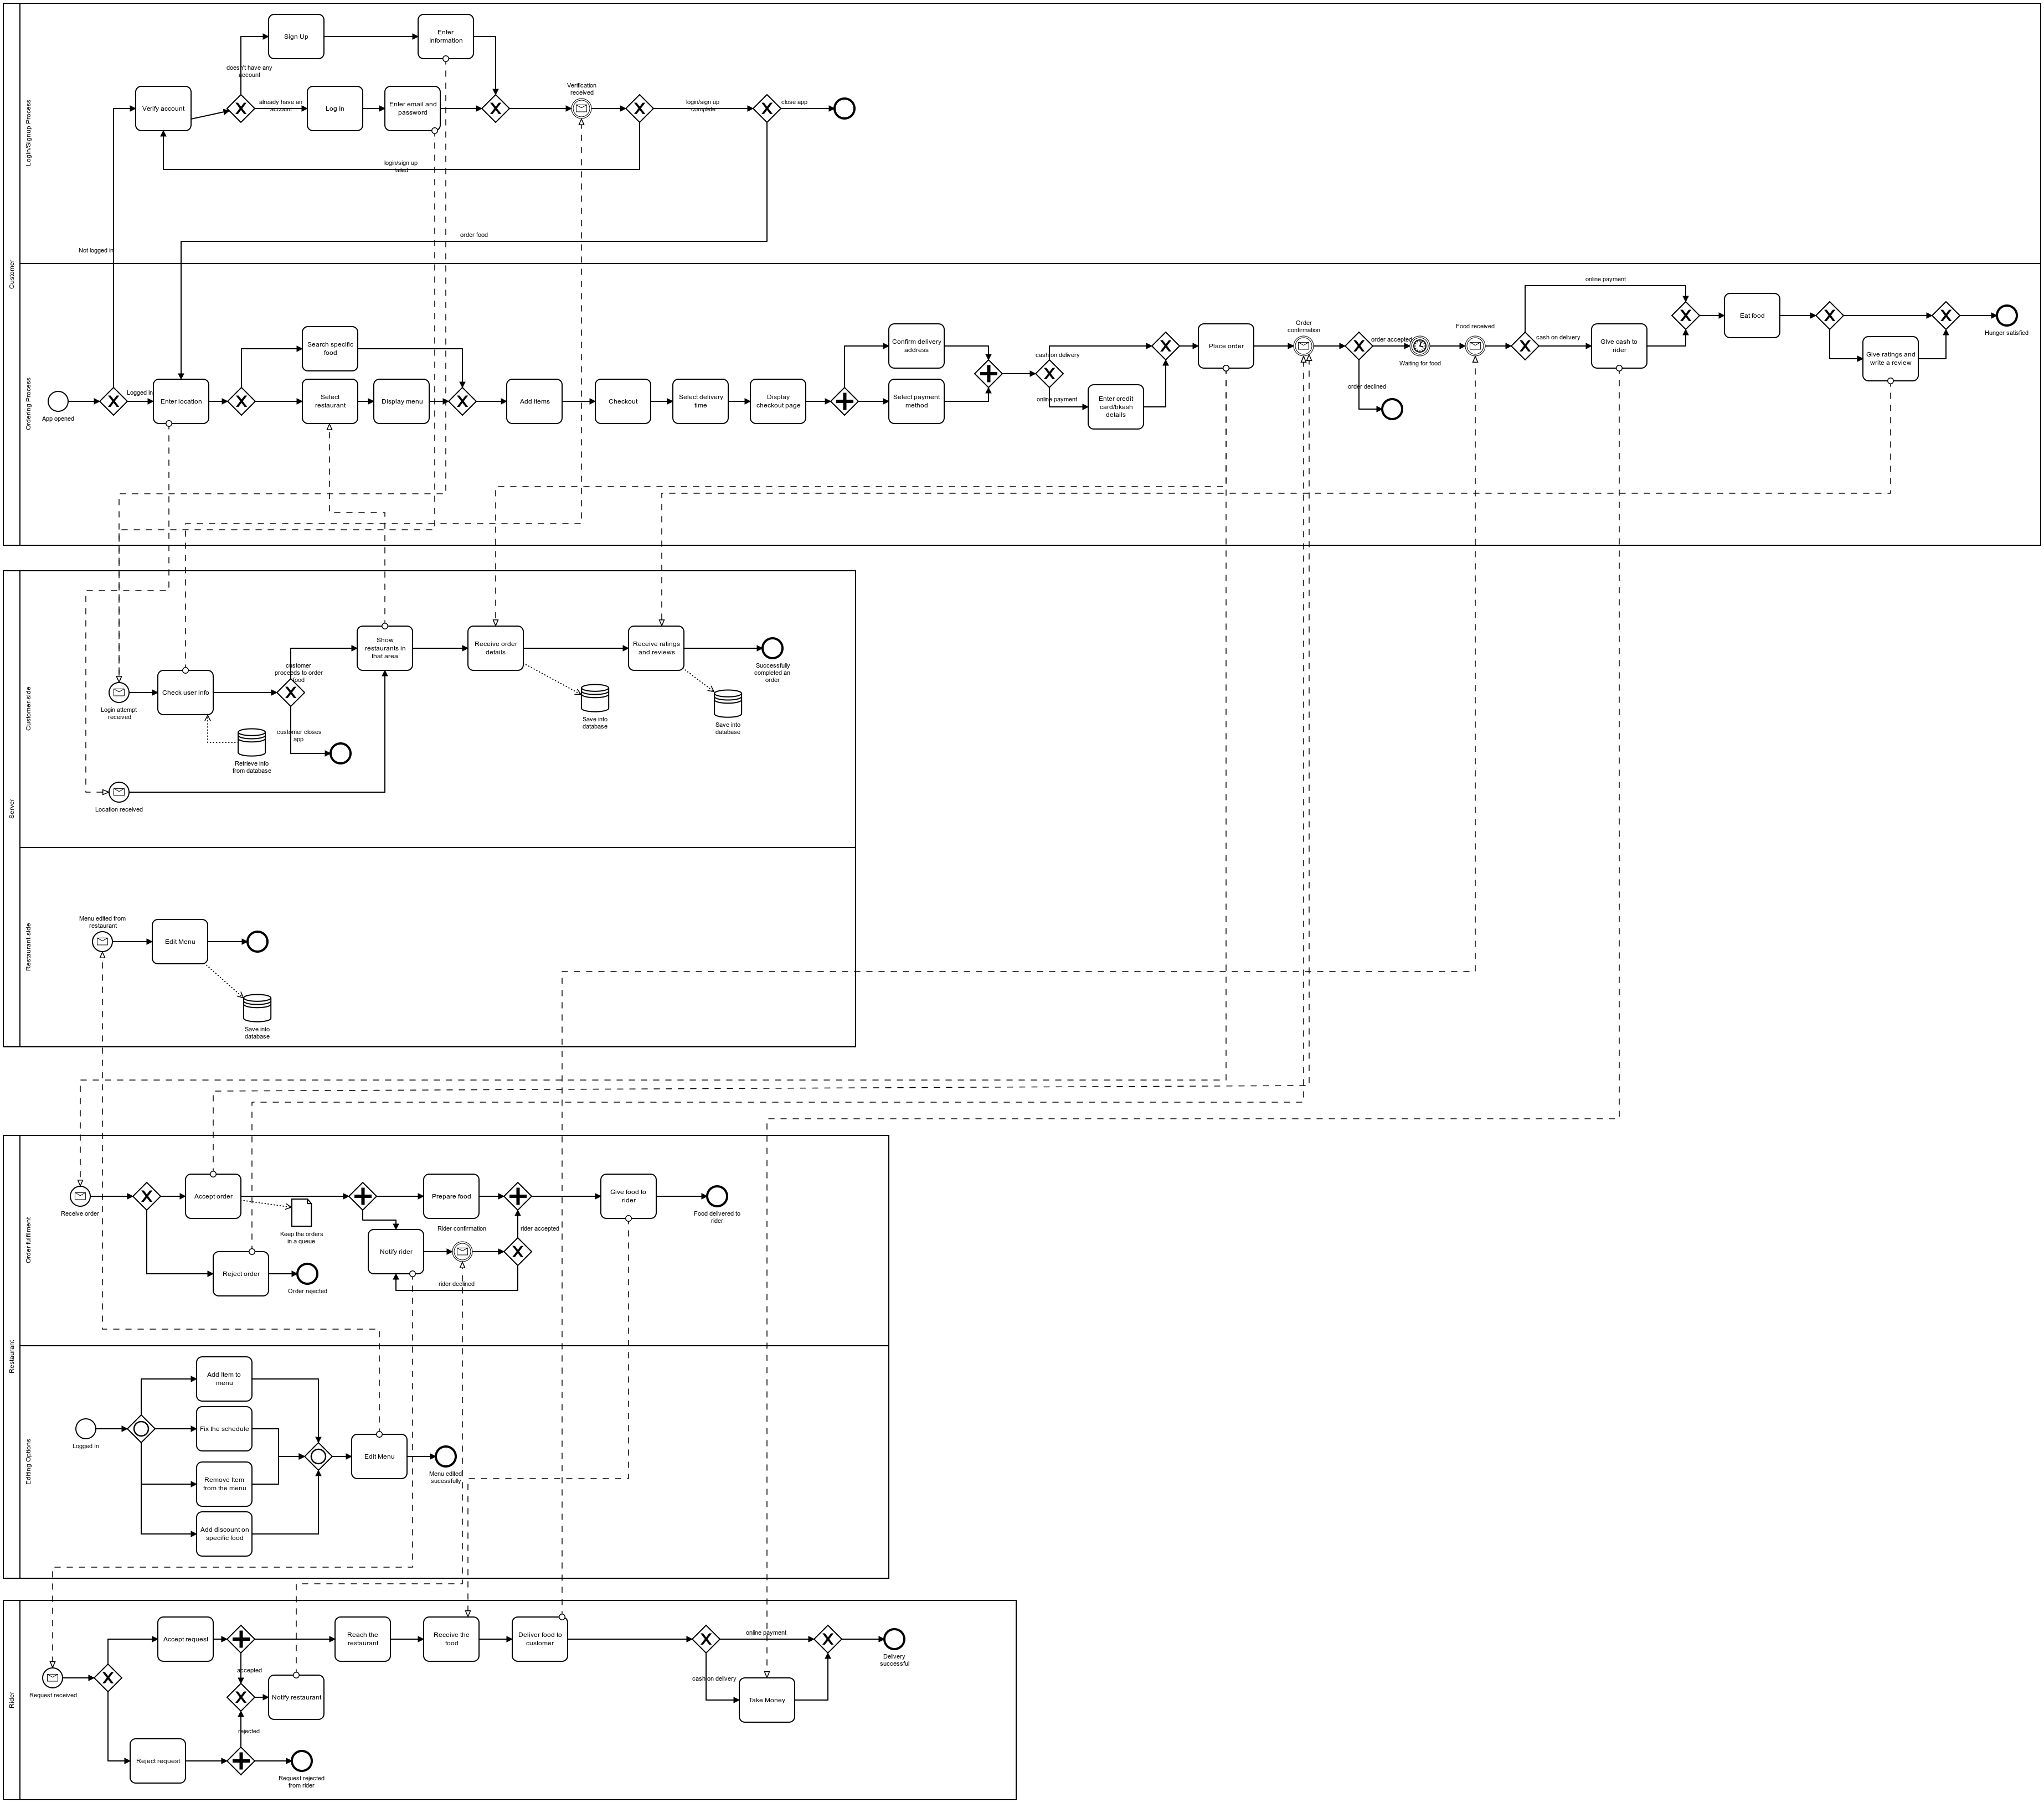
Complete BPMN Diagram
Pool 1: Customer
Pool 2: Server
Pool 3: Restaurant
Pool 4: Rider

Slide 3
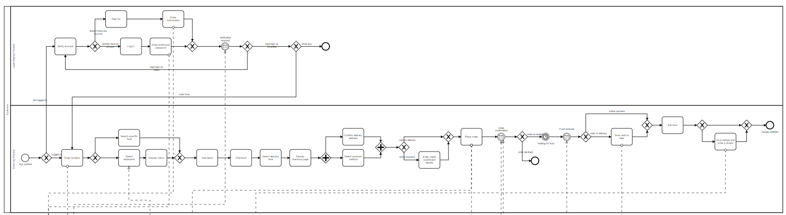
Pool 1: Customer
Lane 1: Login/Sign Up
Lane 2: Order Food

Slide 4
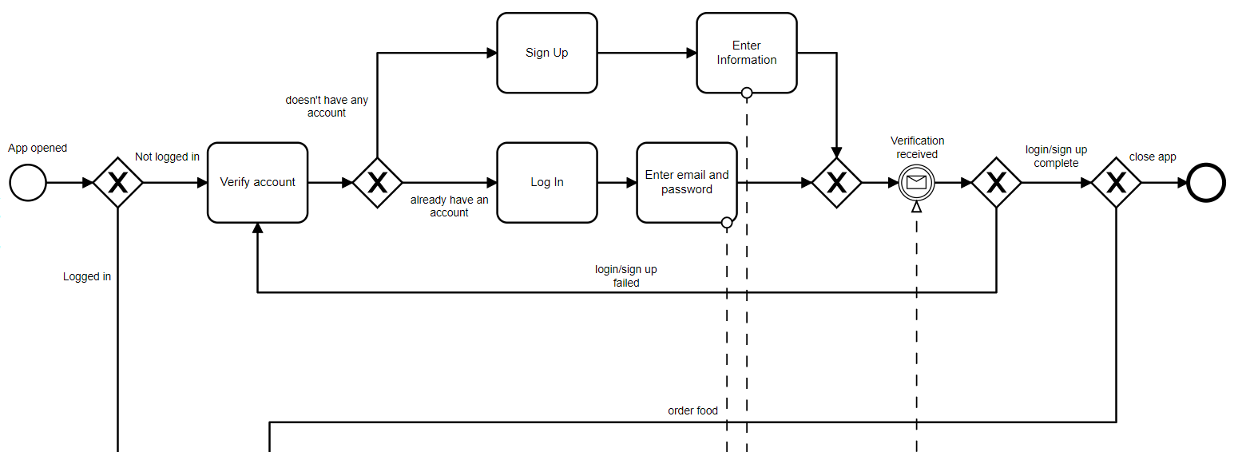
Pool 1: Customer - Lane 1: Login / Sign Up
From server
To server

Slide 5
Pool 1: Customer
Lane 1: Login/Sign Up
Lane 2: Order Food

Slide 6
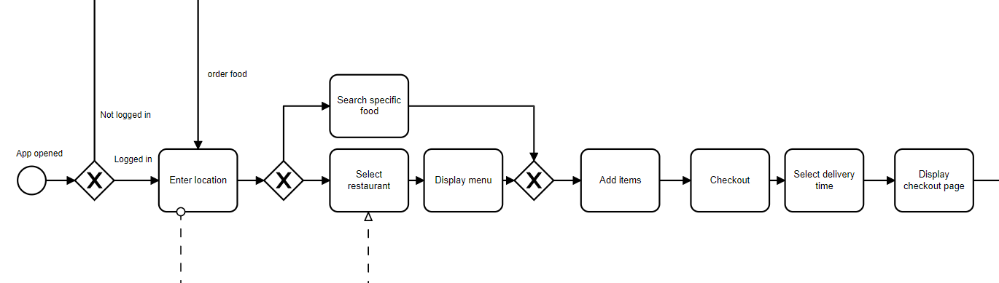
Pool 1: Customer - Lane 2: Order Food
To server
From server

Slide 7
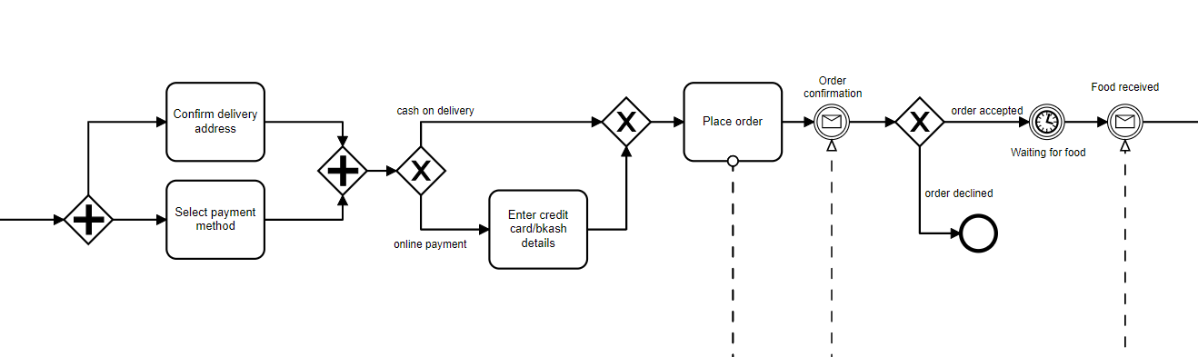
Pool 1: Customer - Lane 2: Order Food(Continued..)
From rider
From restaurant
To restaurant

Slide 8
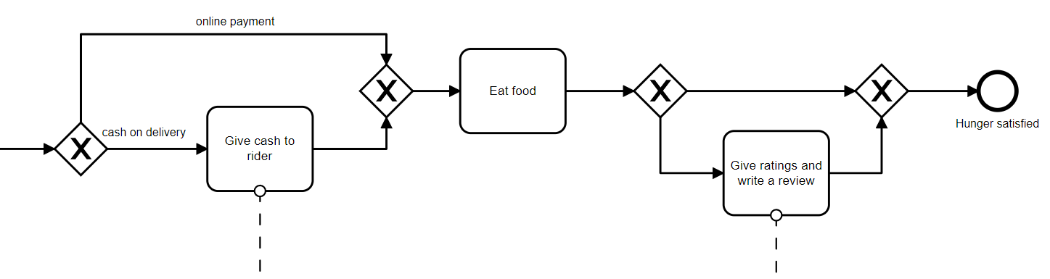
Pool 1: Customer - Lane 2: Order Food(Continued..)
To rider
To server

Slide 9
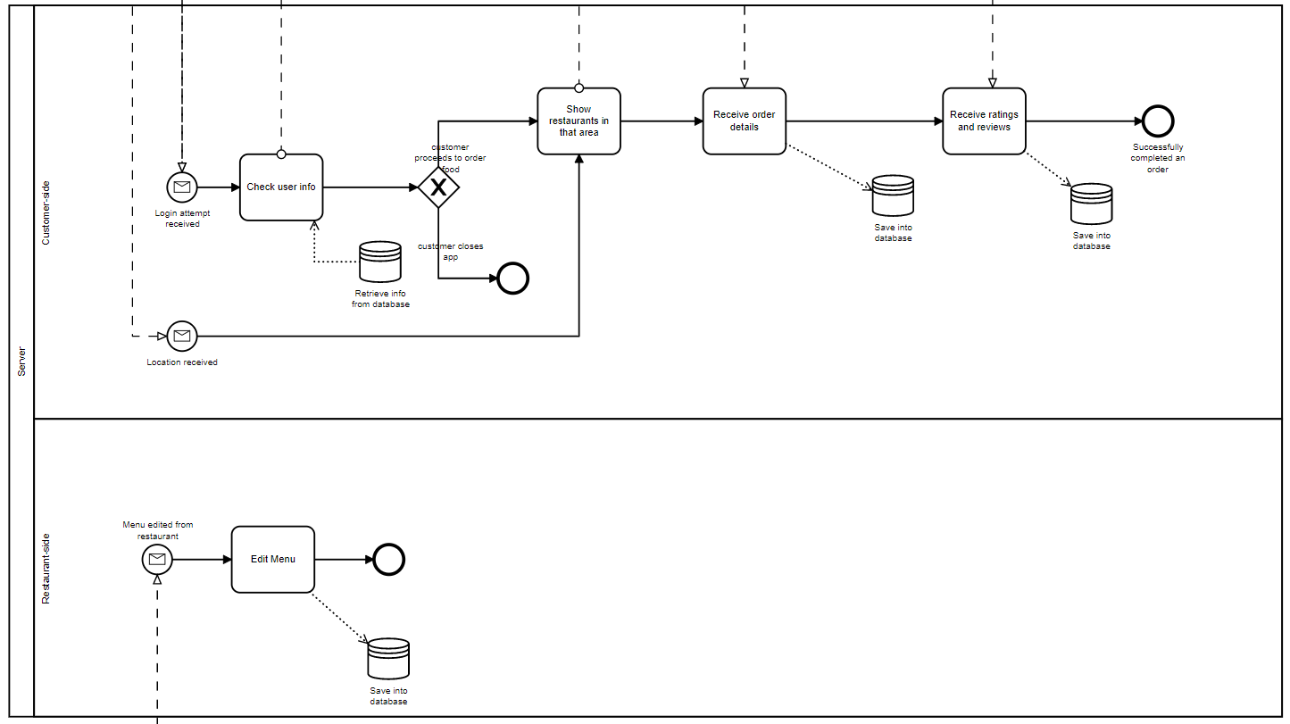
Pool 2: Server
Lane 1: Customer side
Lane 2: Restaurant side

Slide 10
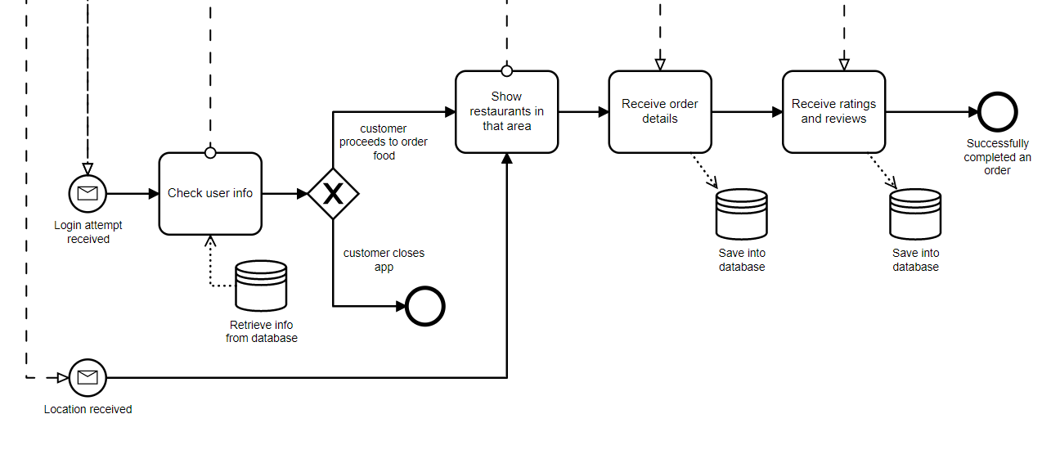
Pool 2: Server - Lane 1: Customer side
From customer
To customer
To customer
From customer
From customer

Slide 11
Pool 2: Server
Lane 1: Customer side
Lane 2: Restaurant side

Slide 12
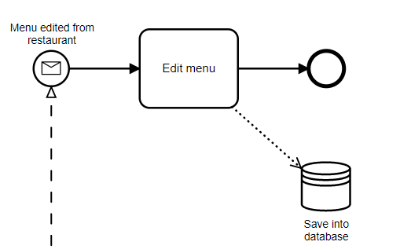
Pool 2: Server - Lane 2: Restaurant side
From restaurant

Slide 13
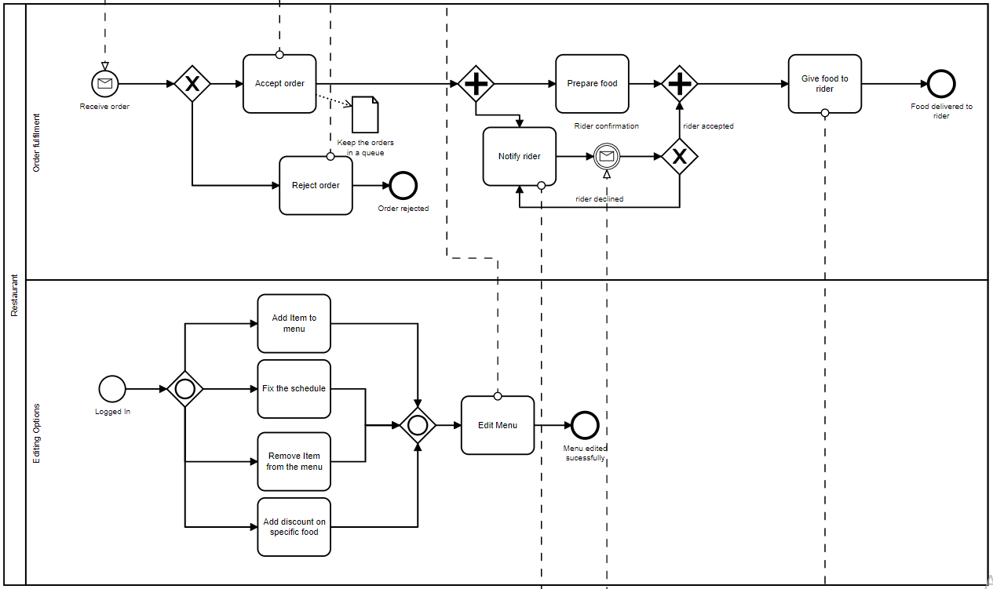
Pool 3: Restaurant
Lane 1: Order fulfilment
Lane 2: Editing option

Slide 14
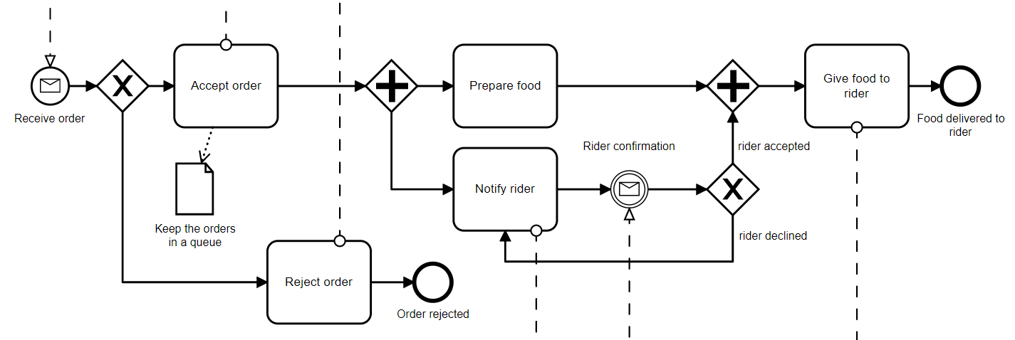
Pool 3: Restaurant - Lane 1: Order fulfilment
From customer
To customer
To customer
To rider
To rider
From rider

Slide 15
Pool 3: Restaurant
Lane 1: Order fulfilment
Lane 2: Editing option

Slide 16
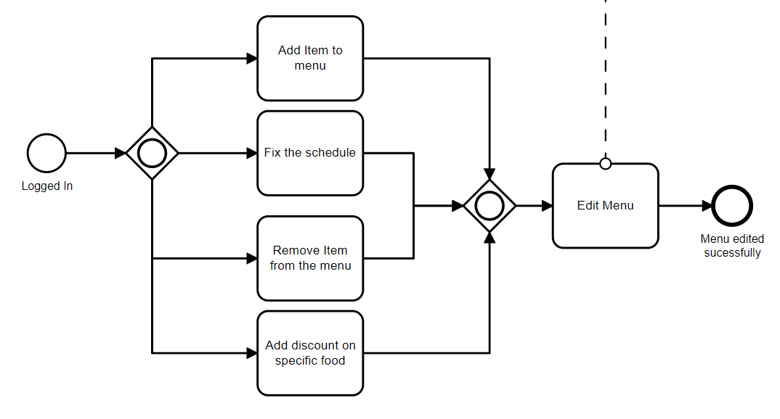
Pool 3: Restaurant - Lane 2: Editing options
To server

Slide 17
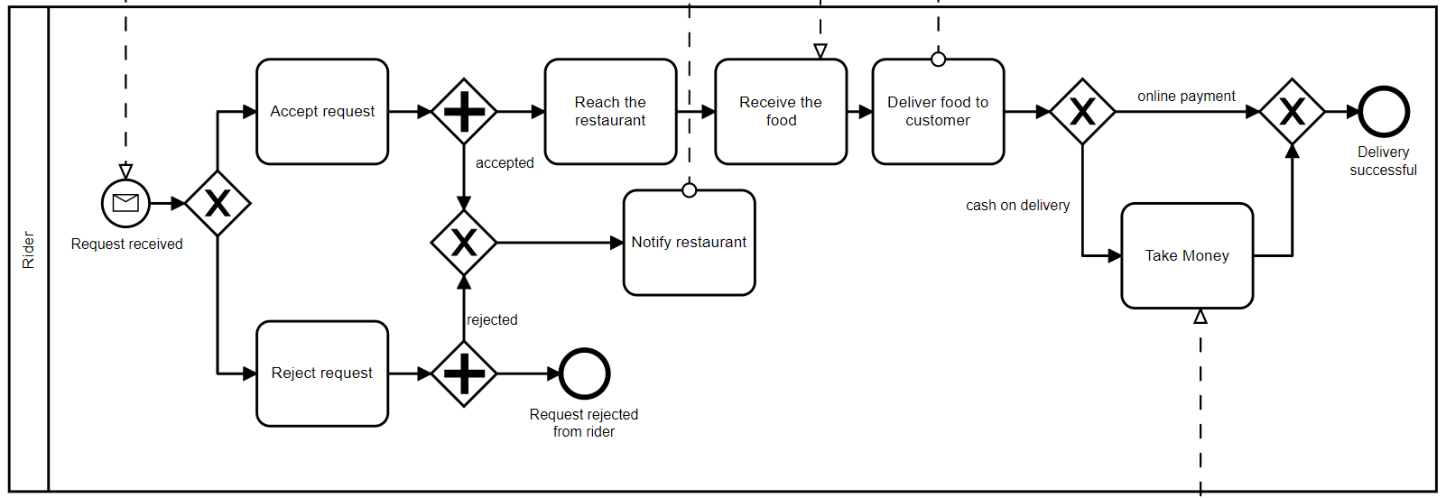
Pool 4: Rider
To restaurant
To customer
From restaurant
From restaurant
From customer

Slide 18
Complete BPMN Diagram
Pool 1: Customer
Pool 2: Server
Pool 3: Restaurant
Pool 4: Rider

Slide 19


