Slide 1
Hunger Express
Presentation On Sequence and Collaboration Diagram
CSE-326
Group: 4 (A2)
1705031
1705034
1705041
1705049
1705054
1705059

Slide 2
Sequence Diagram

Slide 3
Sequence Diagram
There are total 12 sequence diagram in our project-
Customer search and address
Create new category
Create new item
Adding item to cart
Editing cart item to cart
Customer order
Restaurant order
Rider order
Admin order
Customer feedback
Hunger express giving promo
Restaurant giving promo

Slide 4
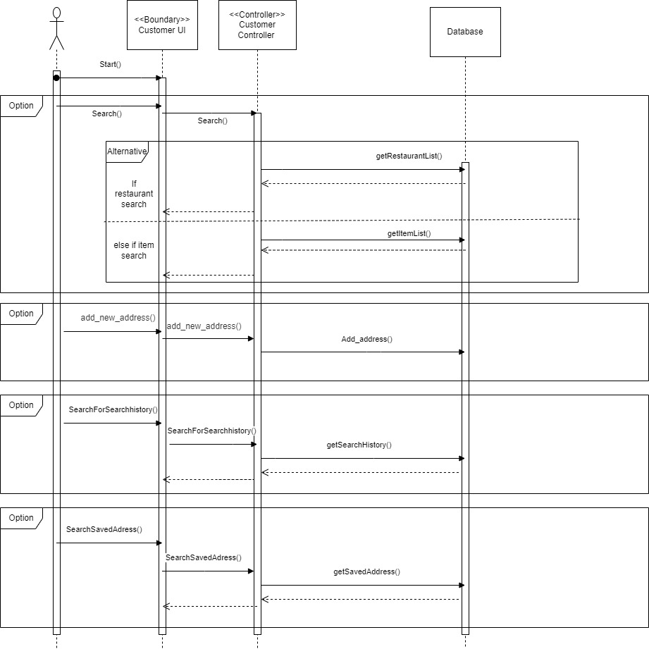
Customer Search
and Address

Slide 5
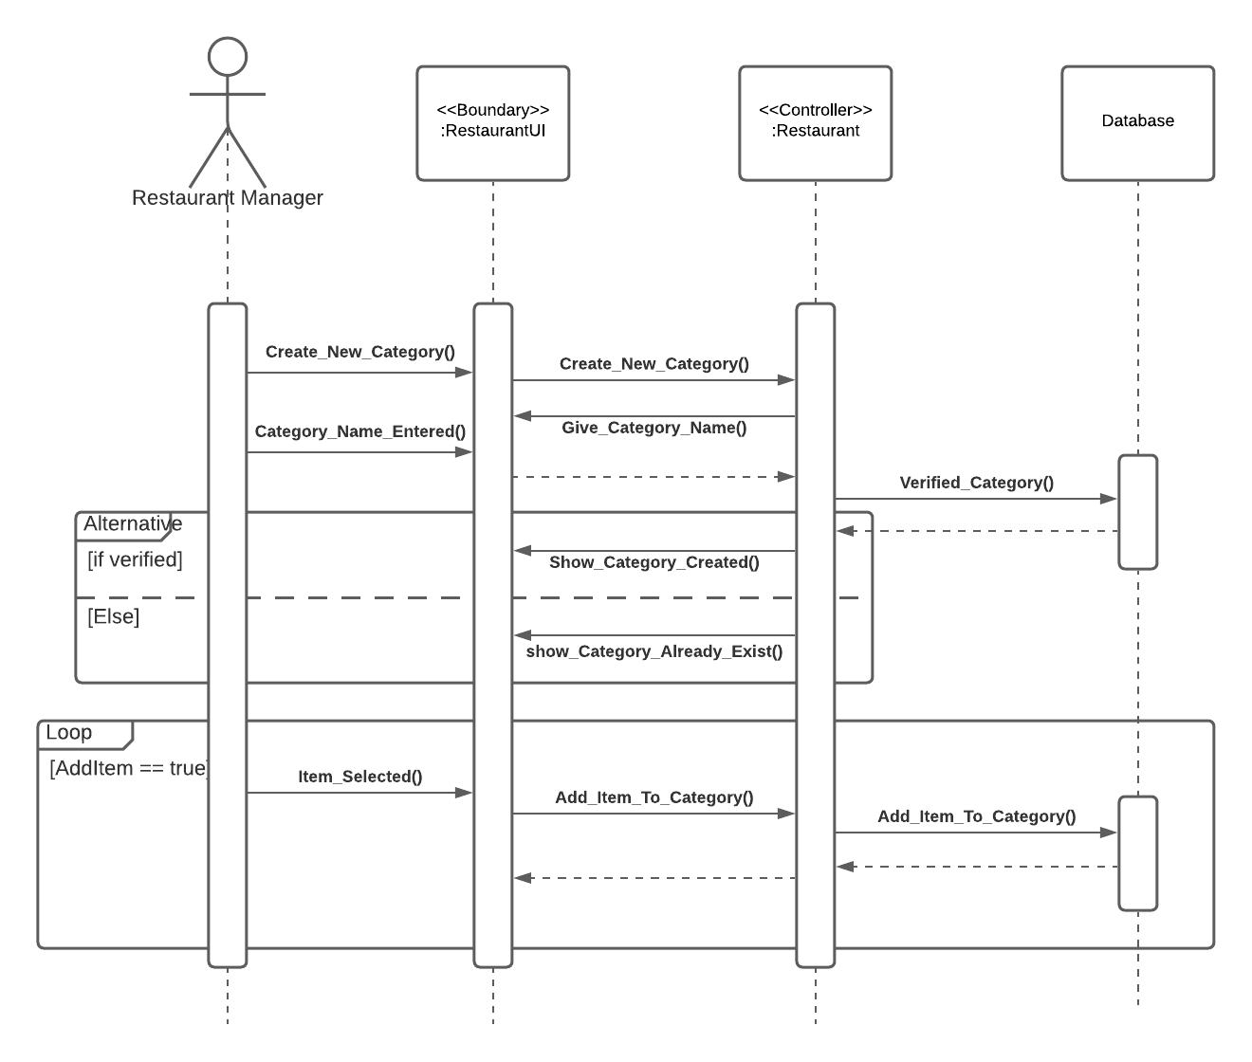
Create New Category

Slide 6
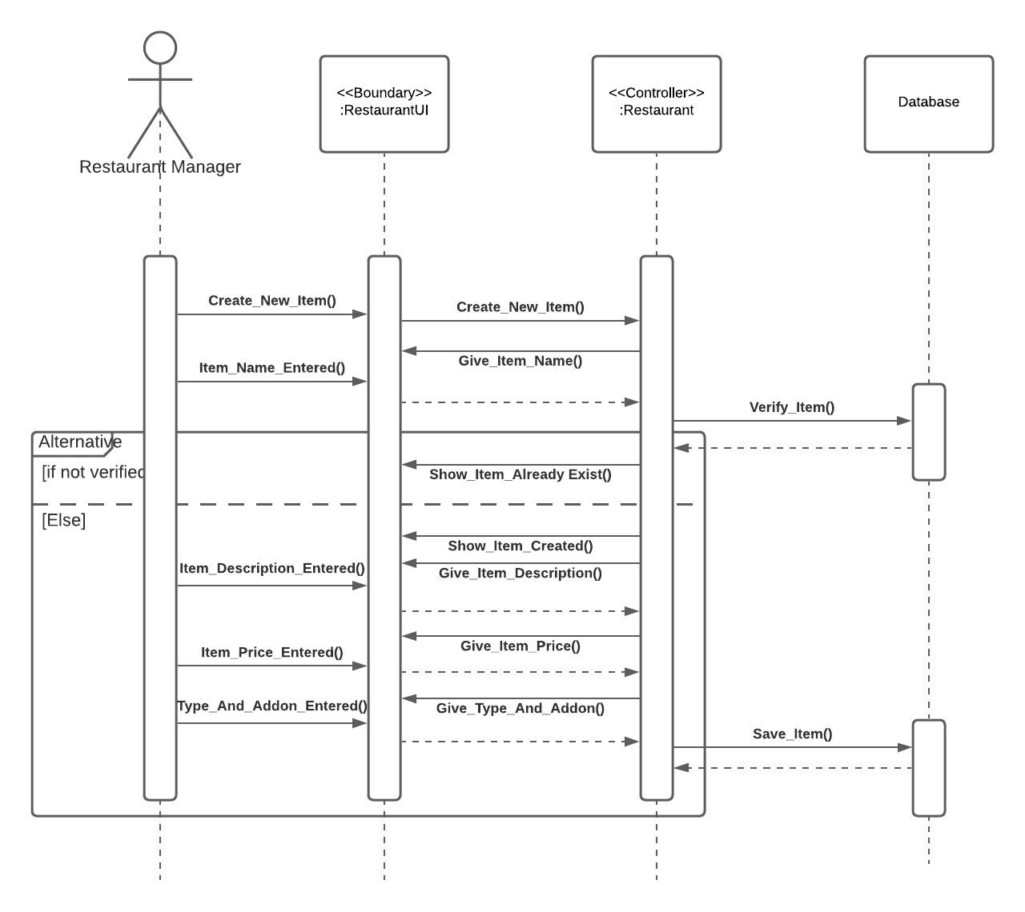
Create New Item

Slide 7
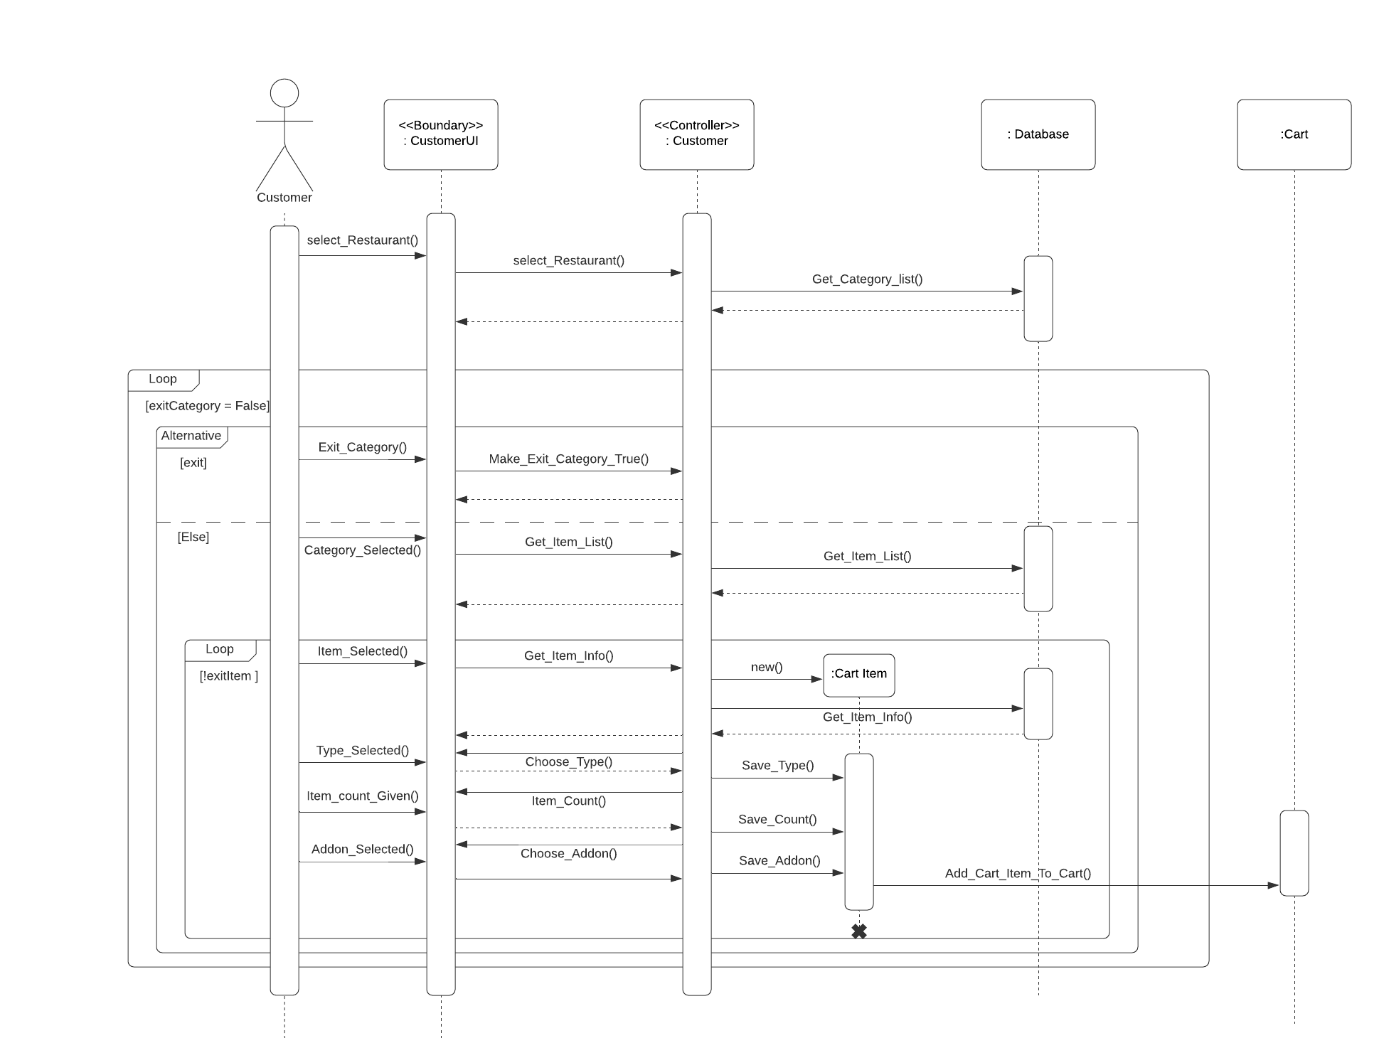
Adding item to Cart

Slide 8
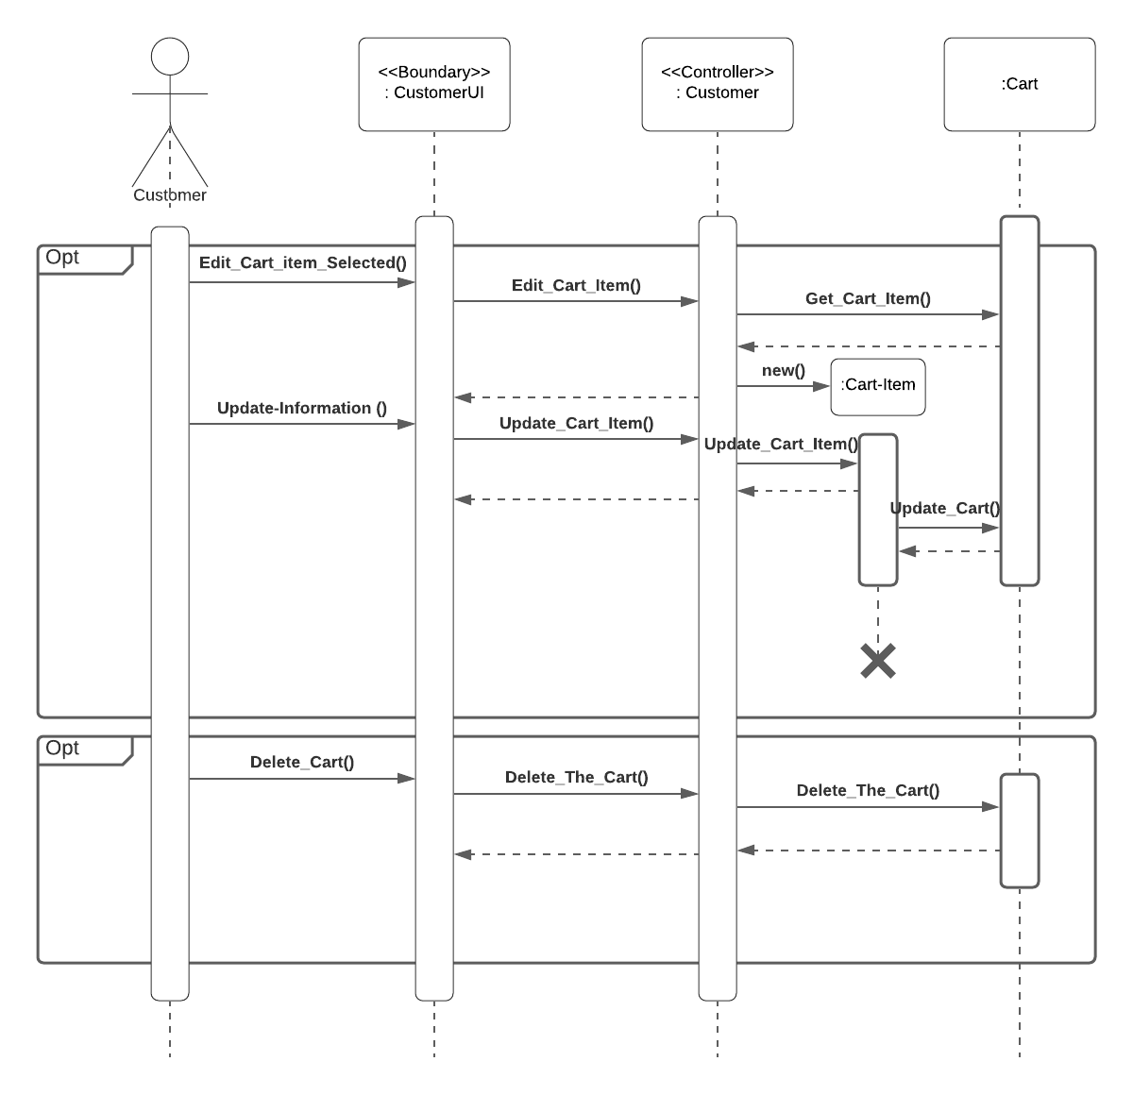
Editing Cart-item to Cart

Slide 9
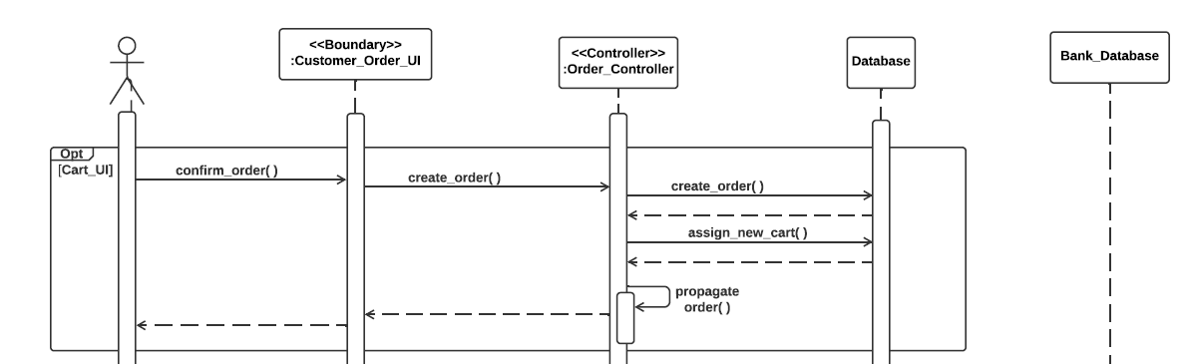
Customer Order(1)

Slide 10

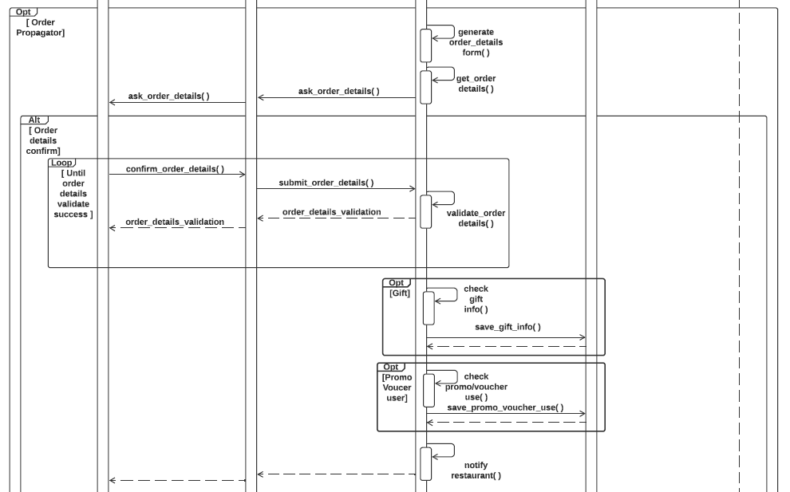
Customer Order(2)

Slide 11
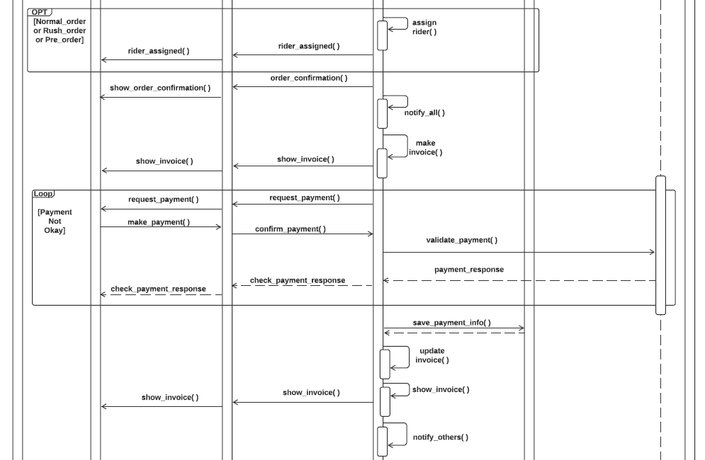
Customer Order(3)

Slide 12
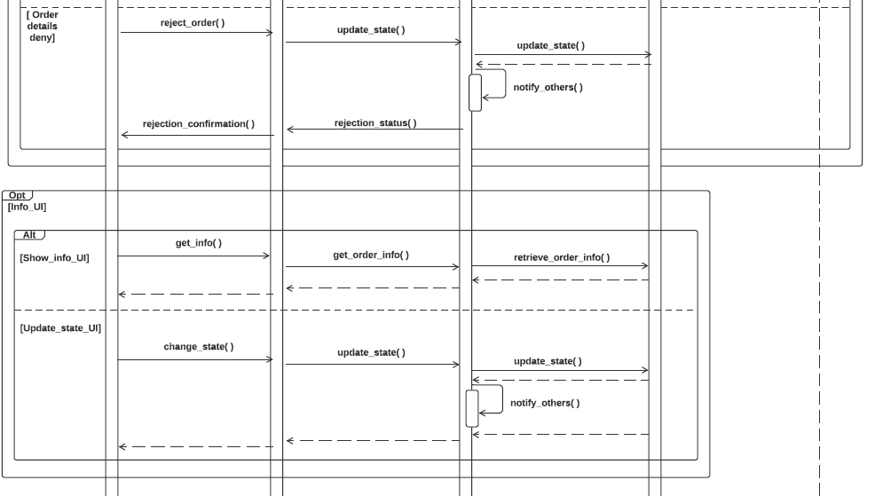
Customer Order(4)

Slide 13
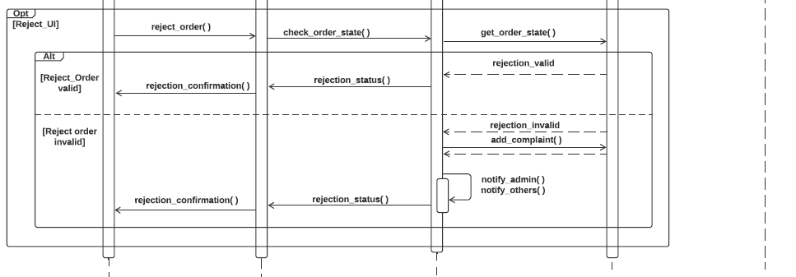
Customer Order(5)

Slide 14
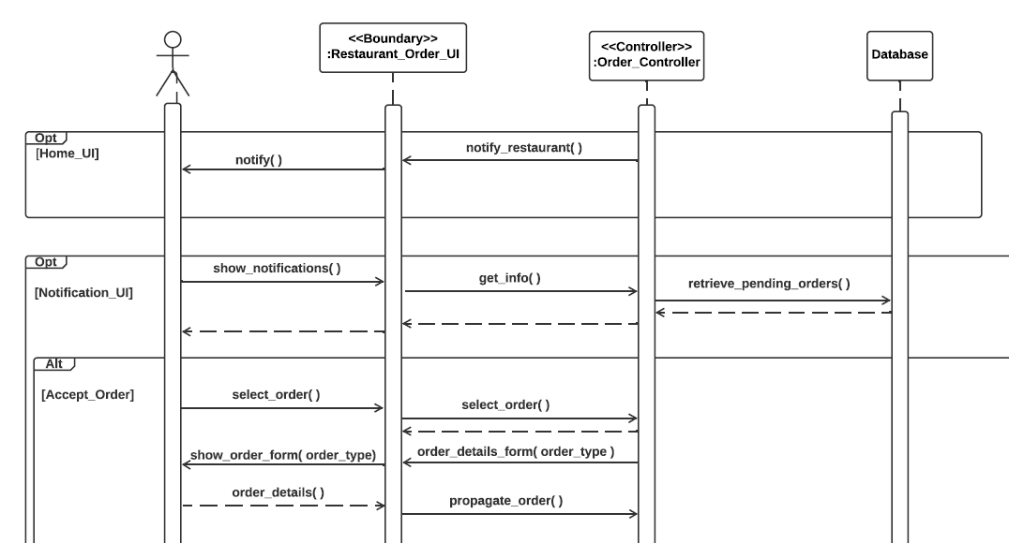
Restaurant Order(1)

Slide 15
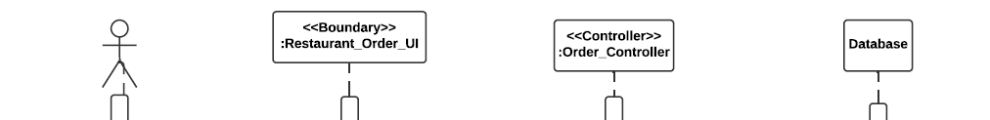
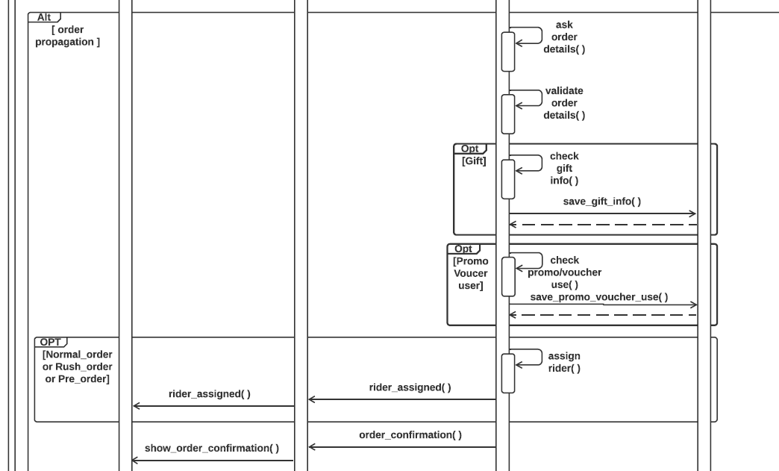
Restaurant Order(2)

Slide 16
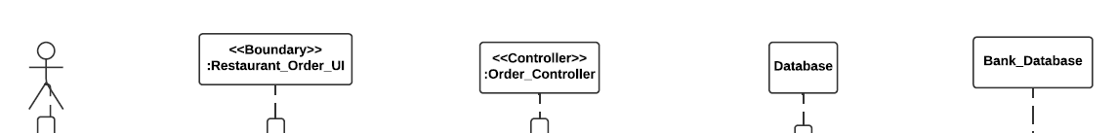
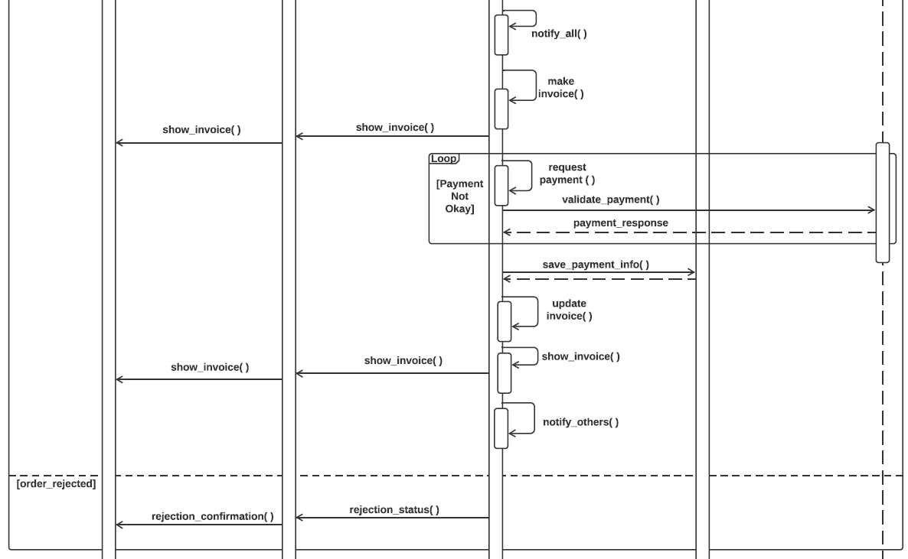
Restaurant Order(3)

Slide 17
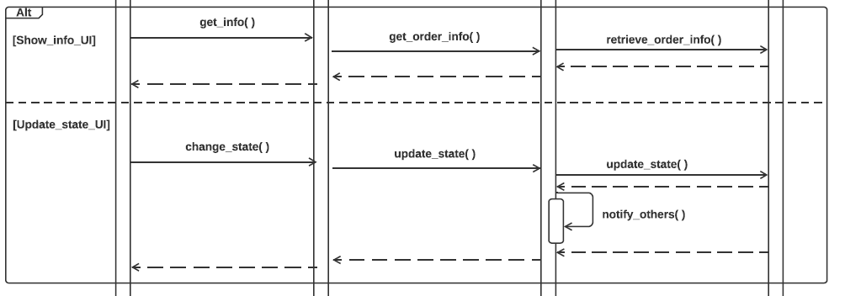
Restaurant Order(4)

Slide 18
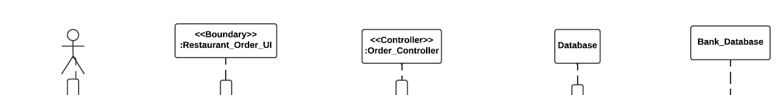
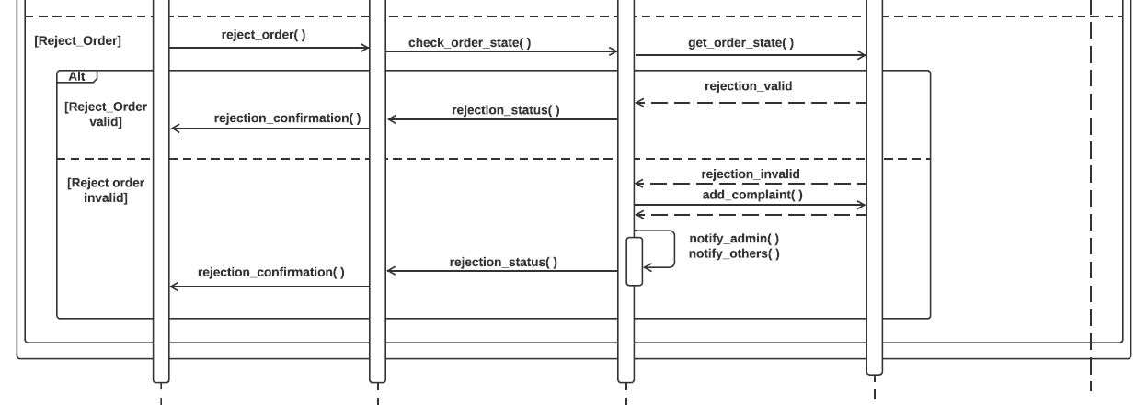
Restaurant Order(5)

Slide 19
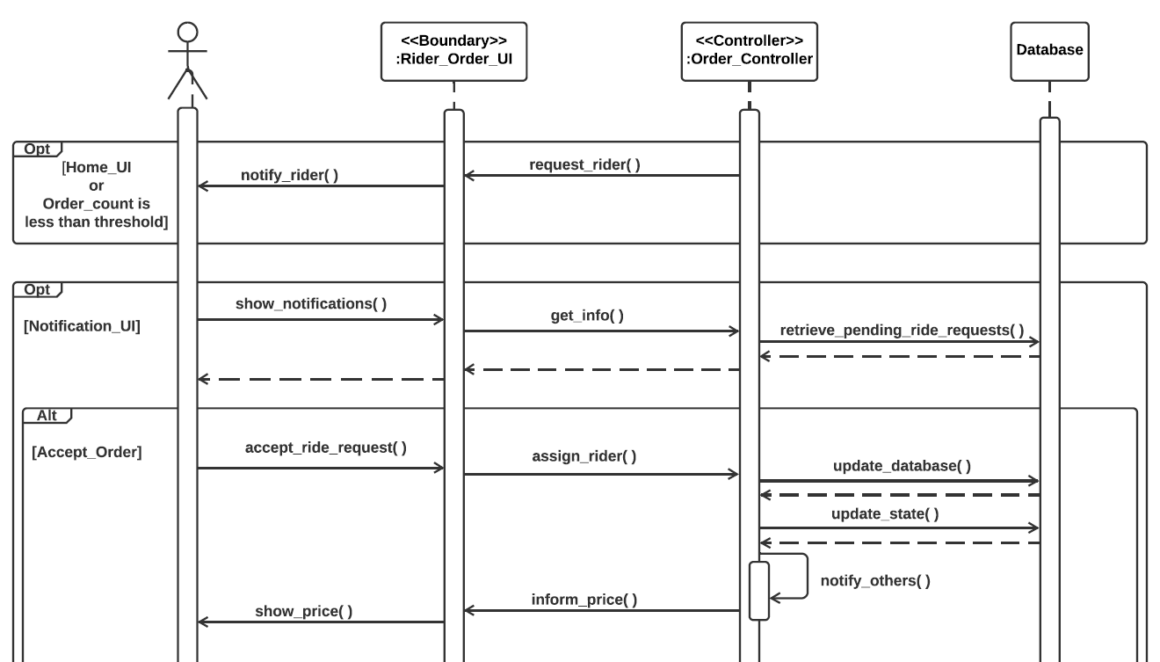
Rider Order(1)

Slide 20
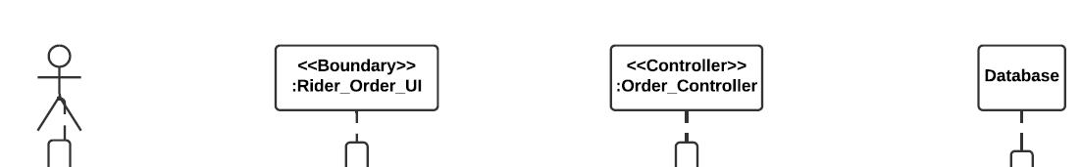
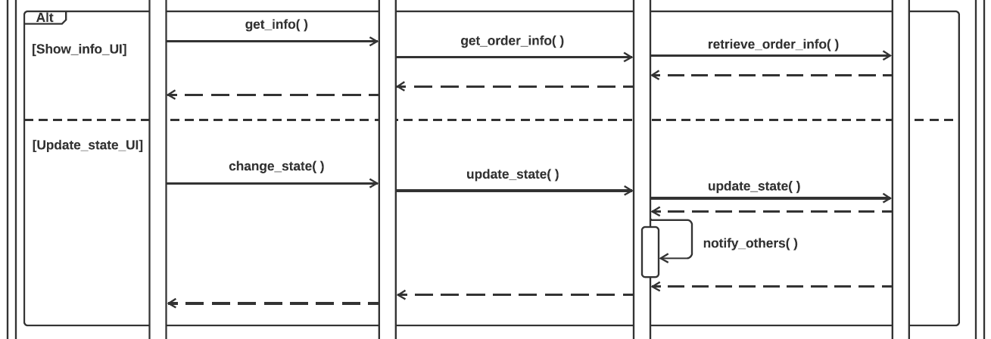
Rider Order(2)

Slide 21
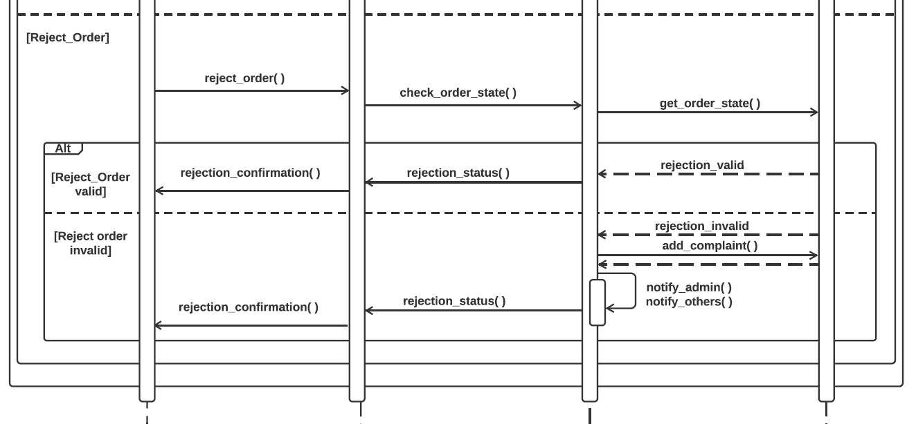
Rider Order(3)

Slide 22
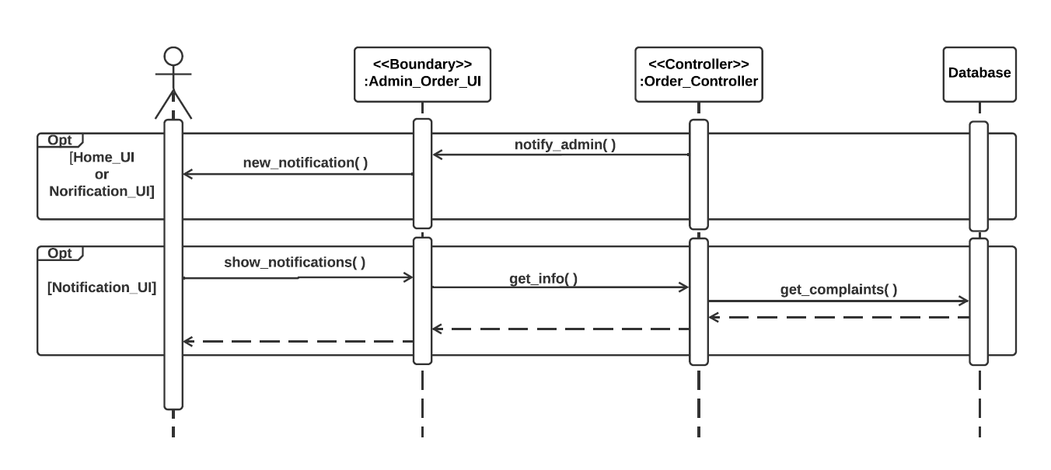
Admin Order

Slide 23
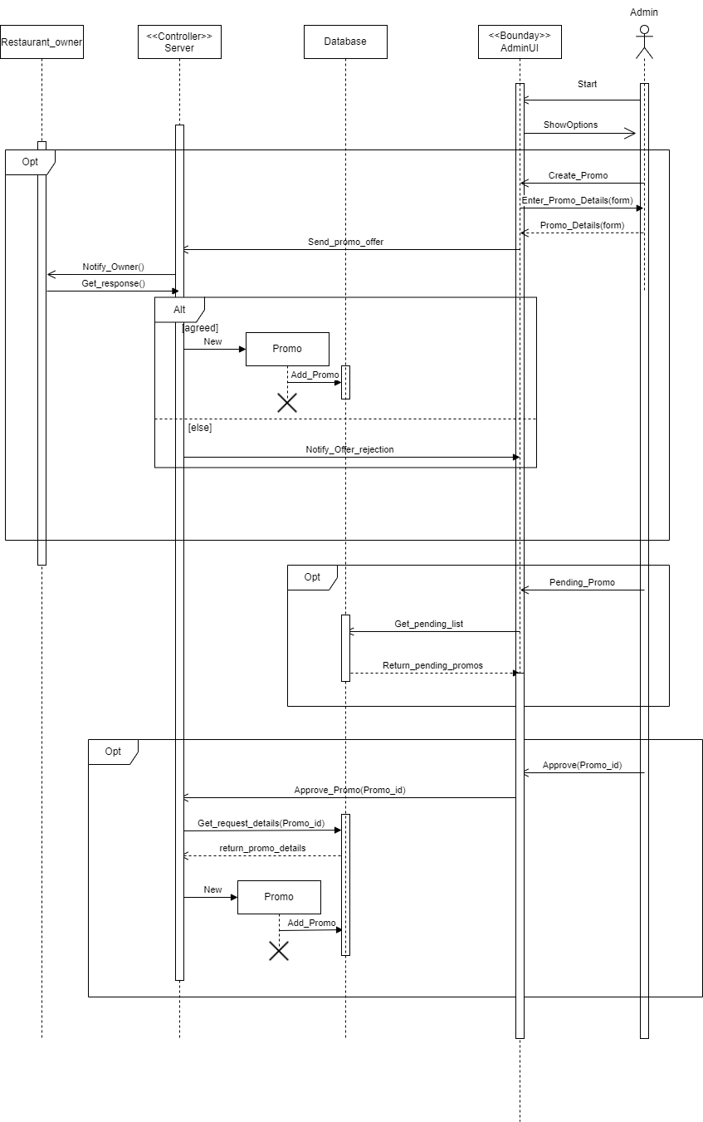
Promo code

Slide 24
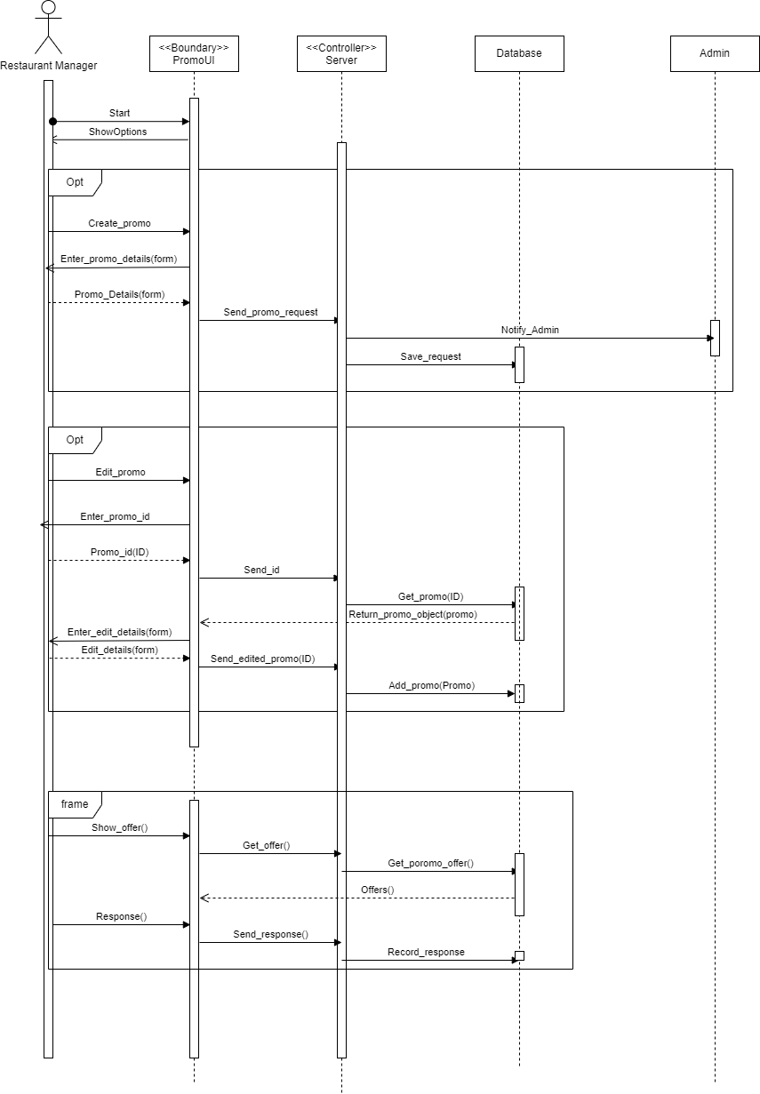

Slide 25
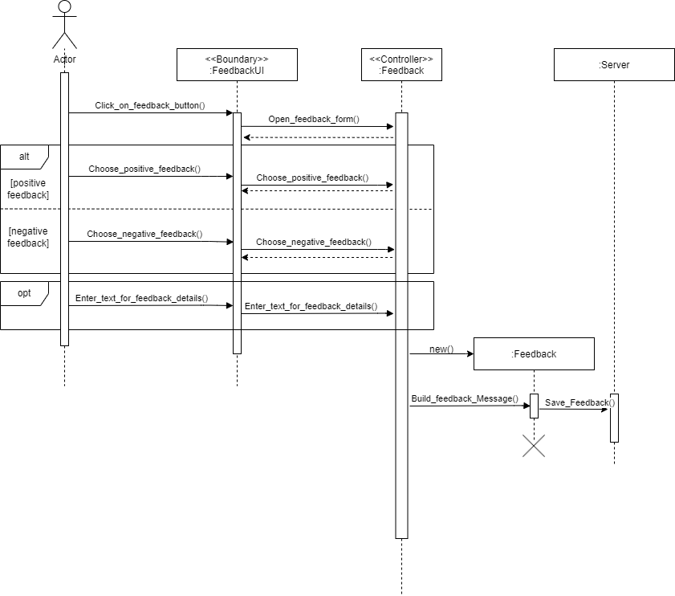
Customer Feedback

Slide 26
Collaboration Diagram

Slide 27
Collaboration Diagram
There are total 7 diagram in our project-
Customer search and address
Create new category
Adding item to cart
Ordering process
Customer feedback
Hunger express giving promo
Restaurant giving promo

Slide 28
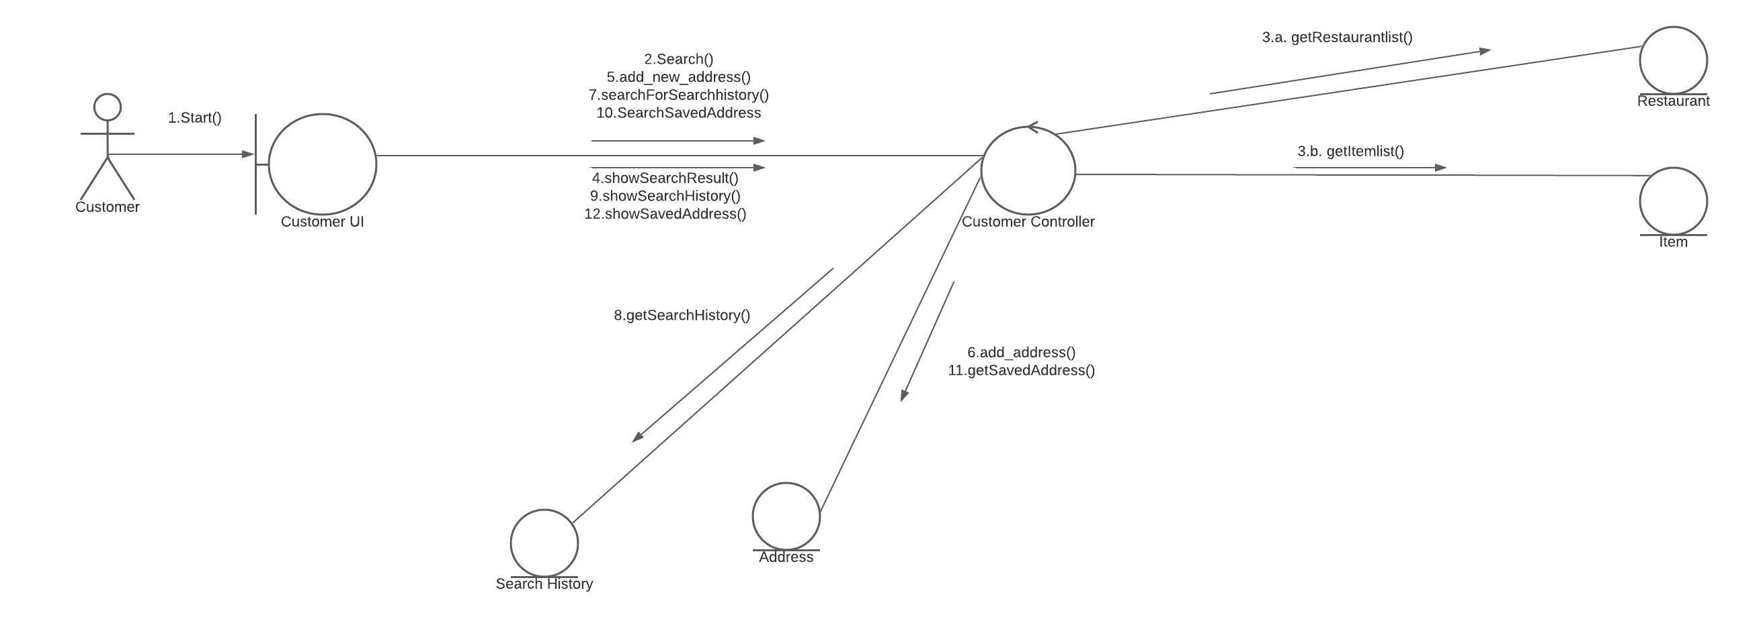
Customer Search and Address

Slide 29
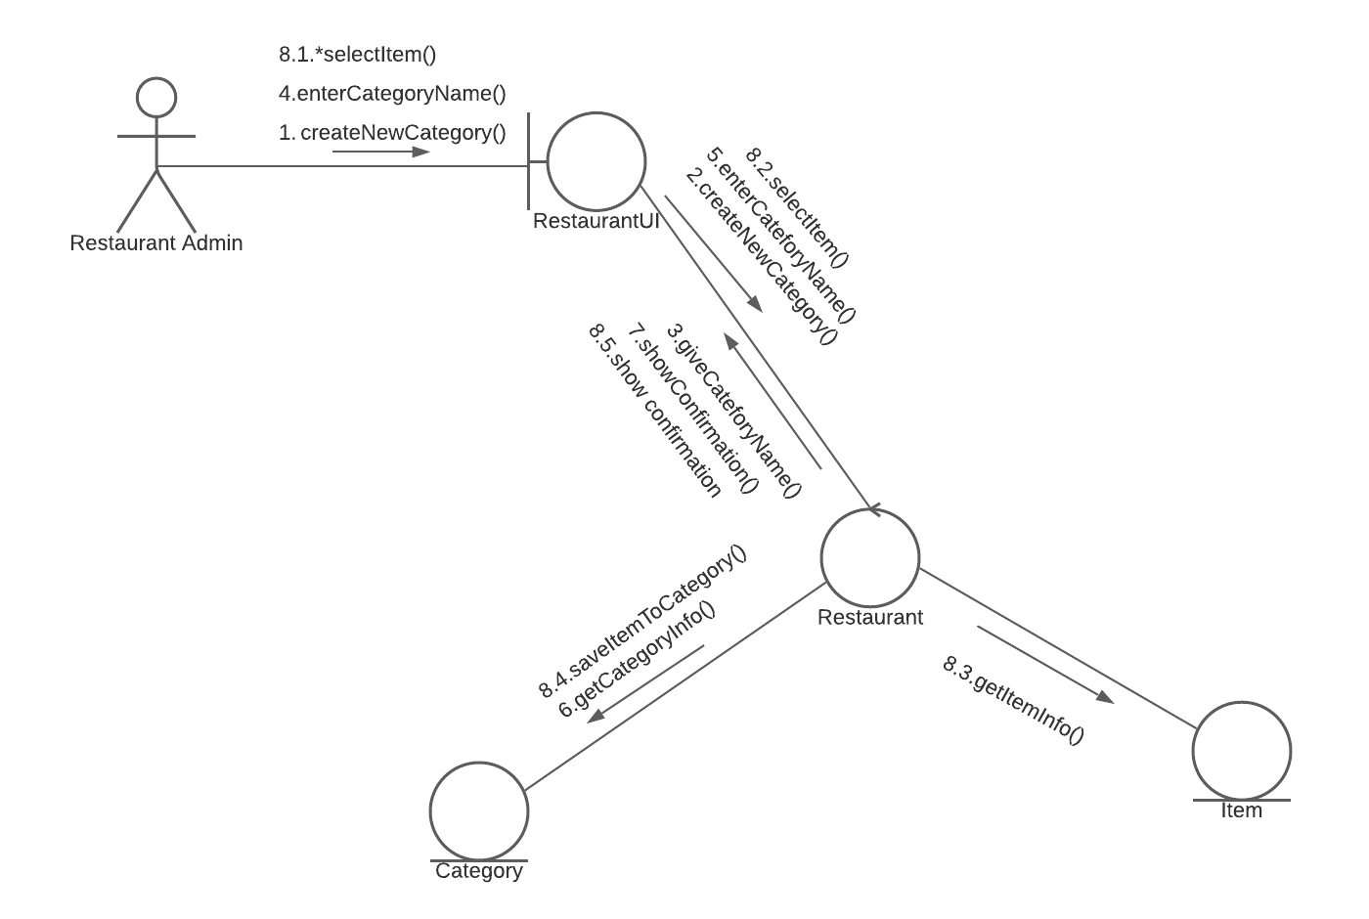
Create New Category

Slide 30
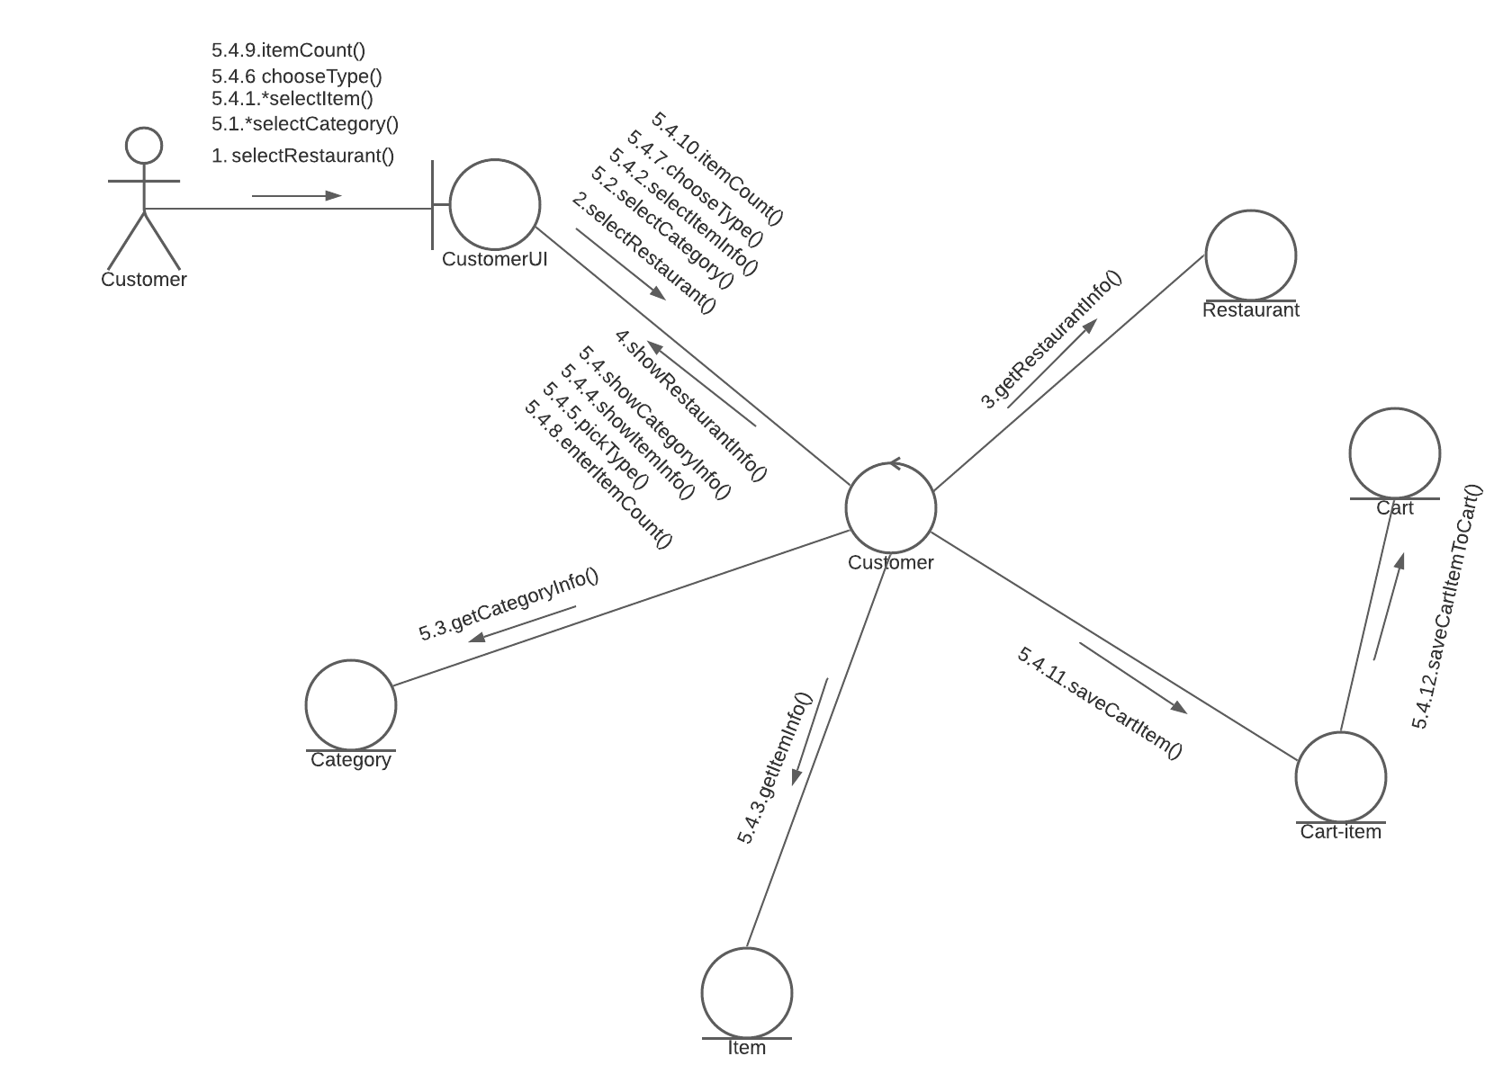
Adding Item to Cart

Slide 31
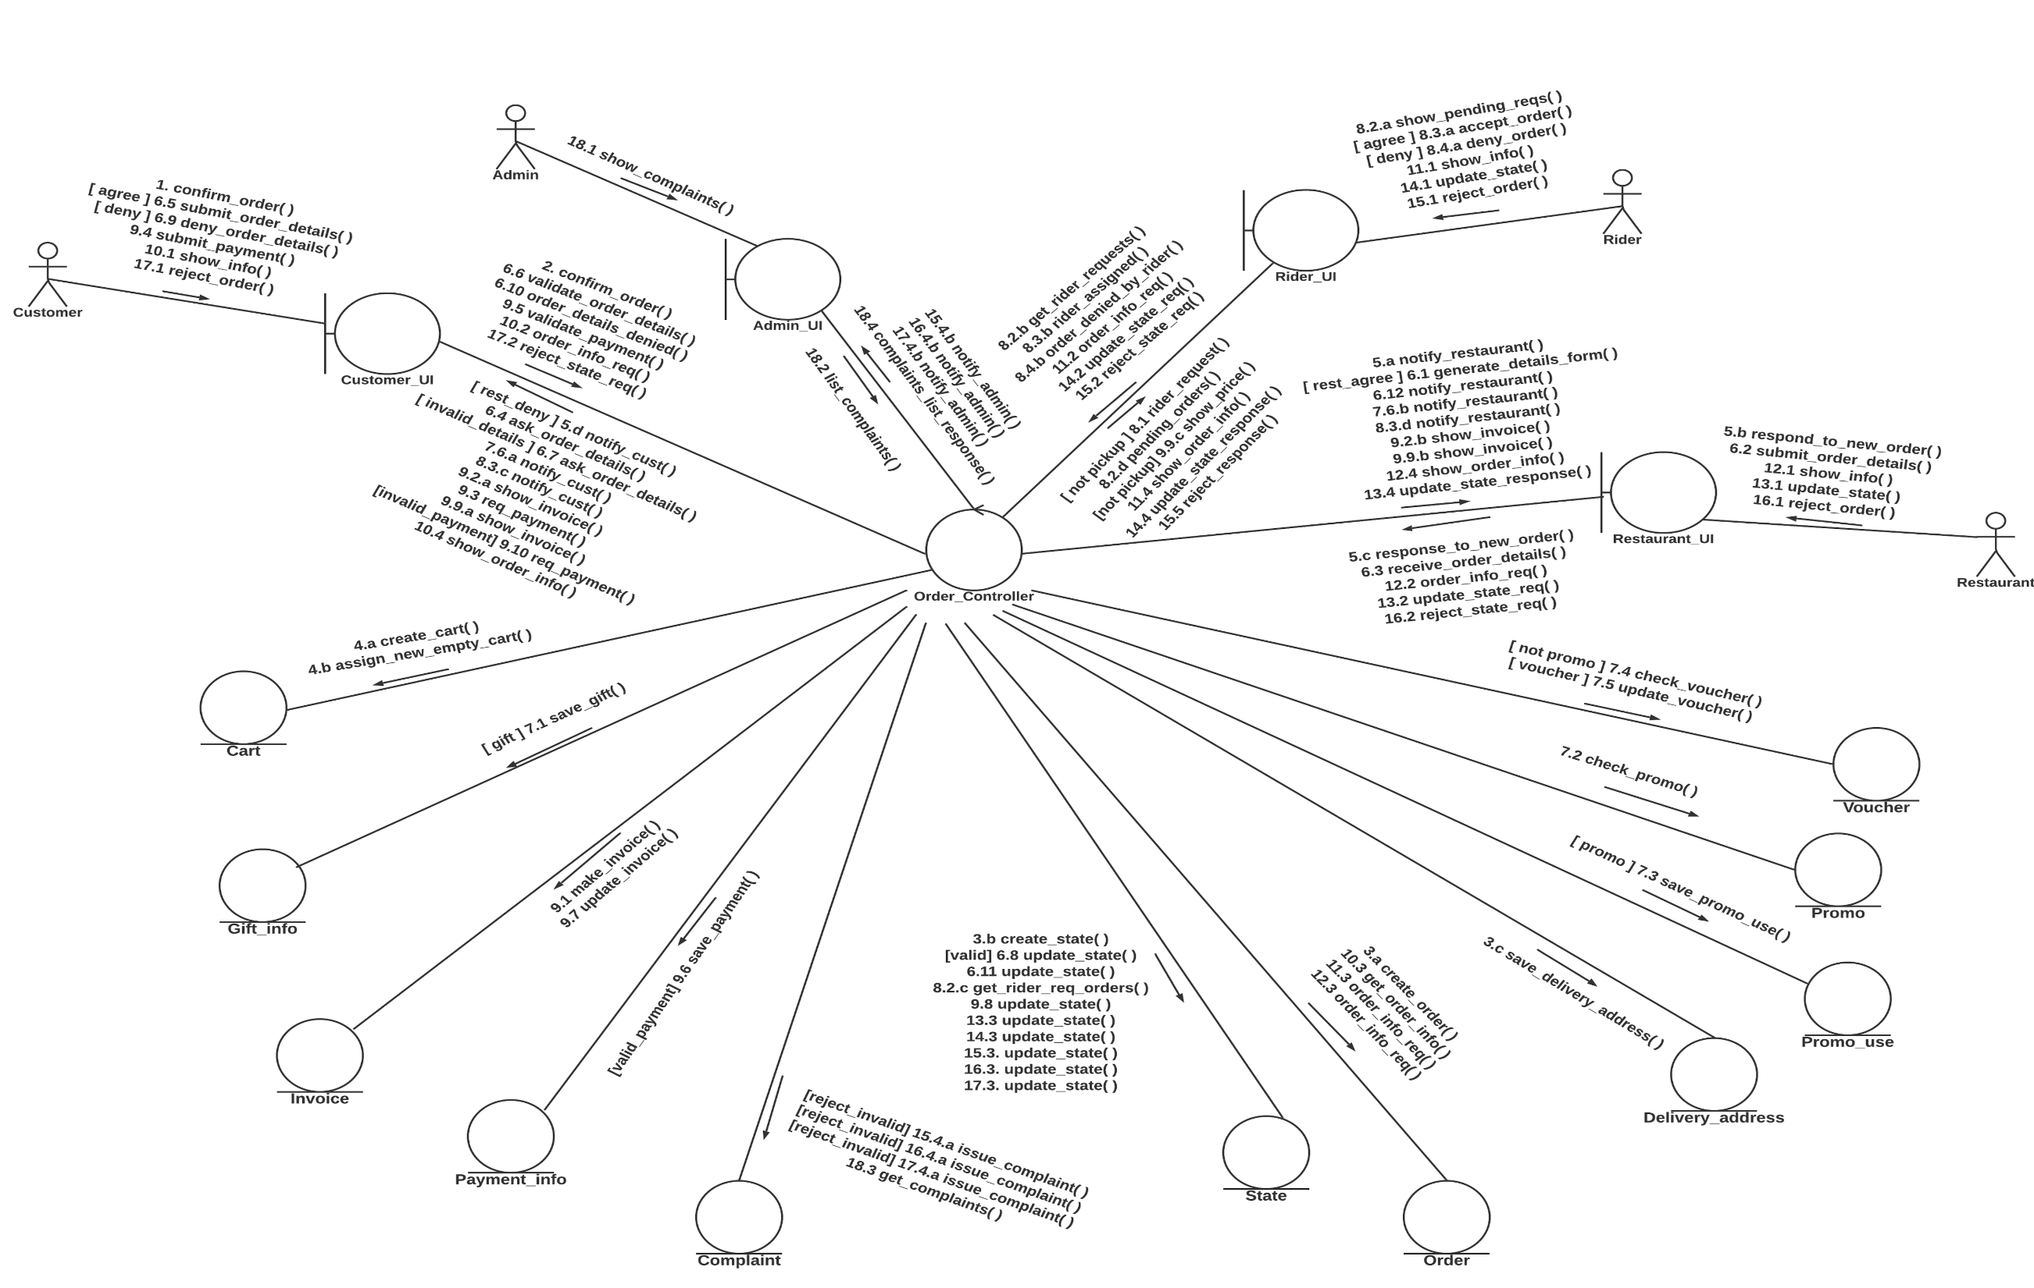
Ordering Process

Slide 32
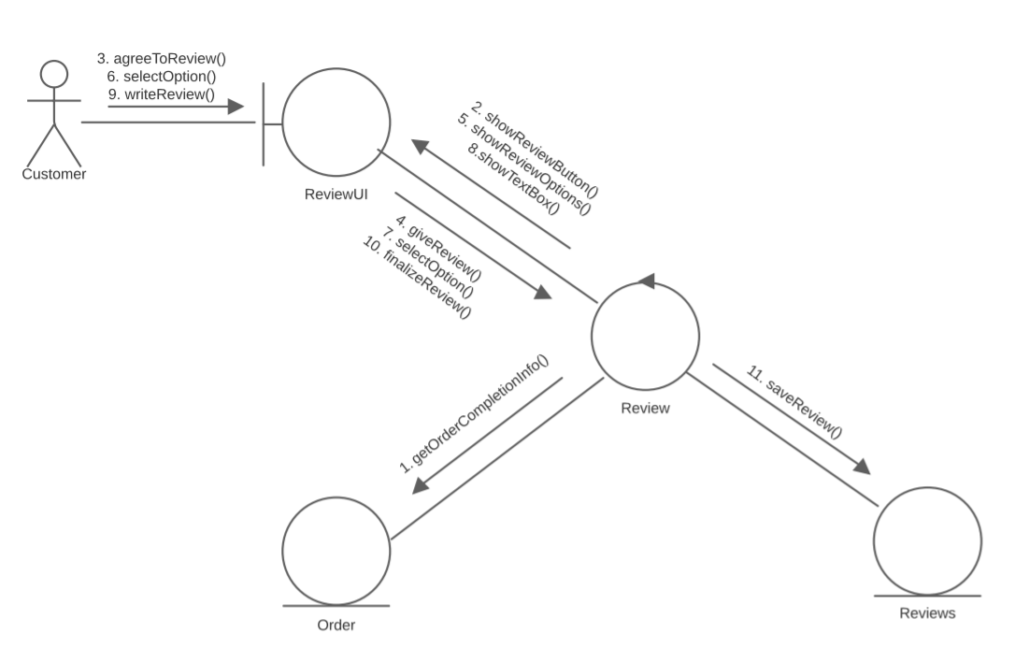
Customer Feedback

Slide 33
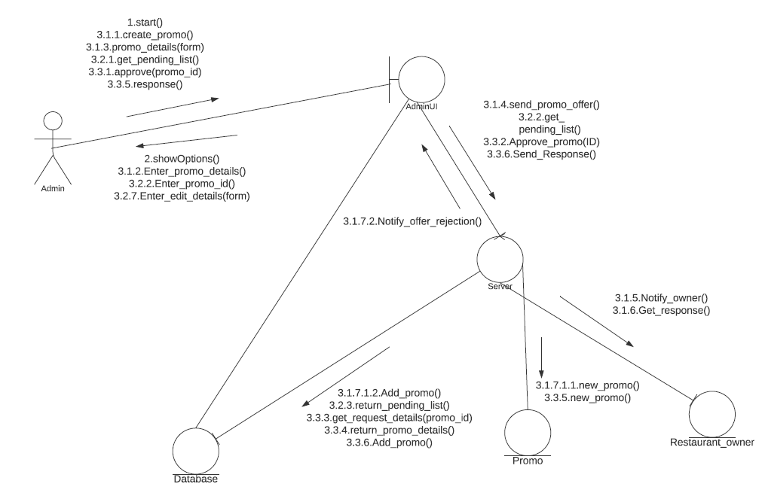
Hunger Express giving Promo

Slide 34
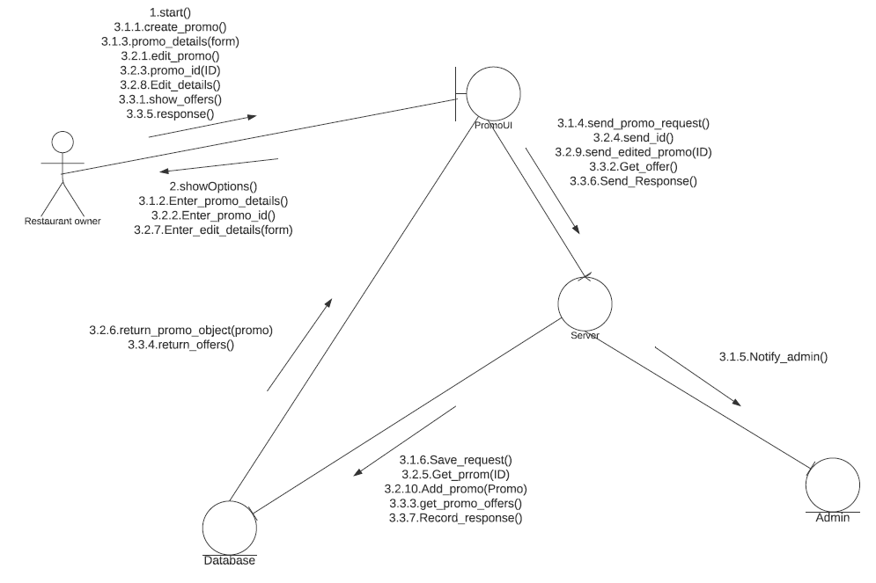
Restaurant giving Promo

Slide 35


