Slide 1
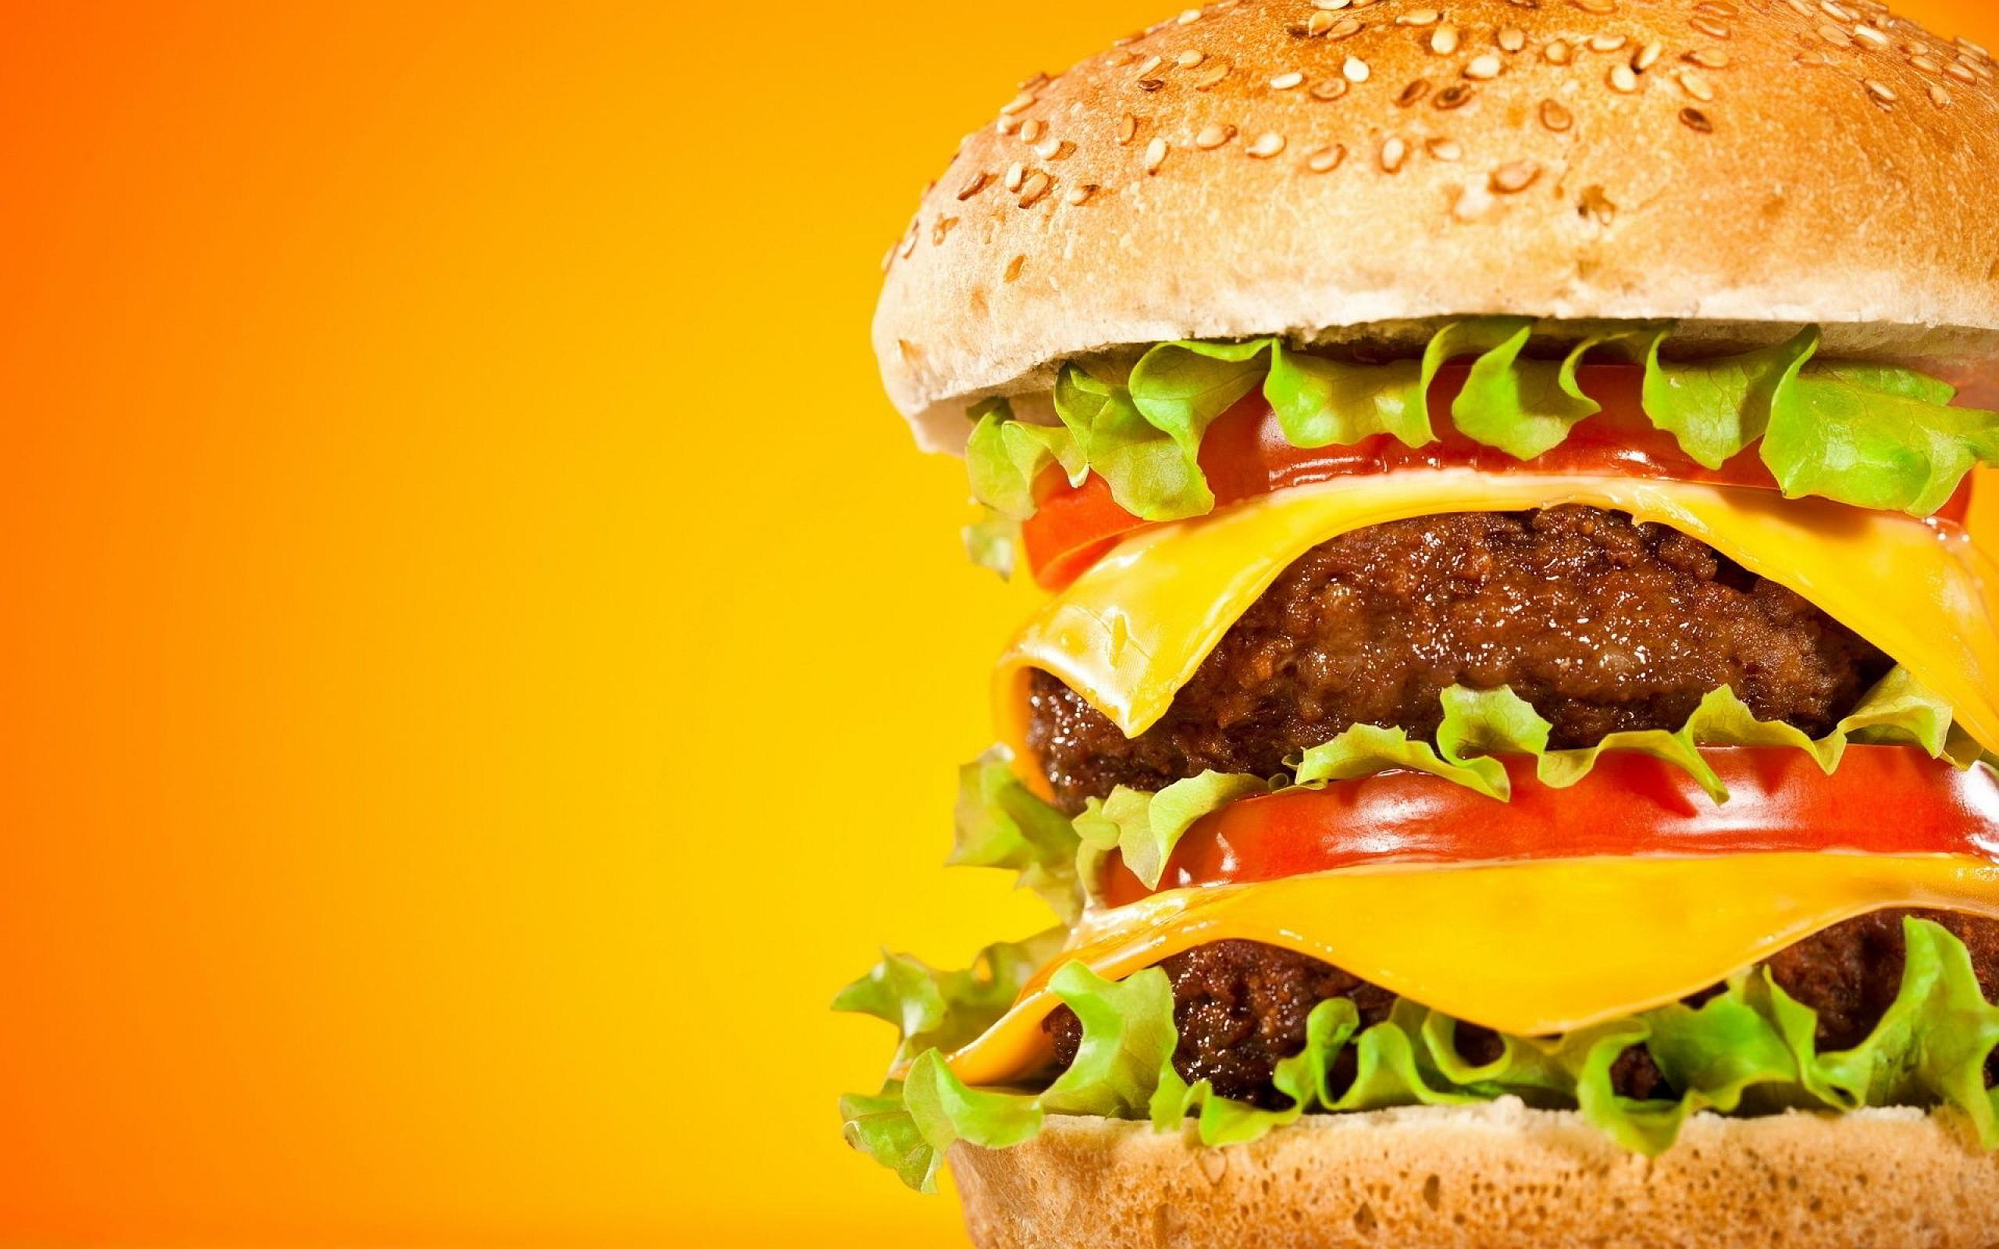
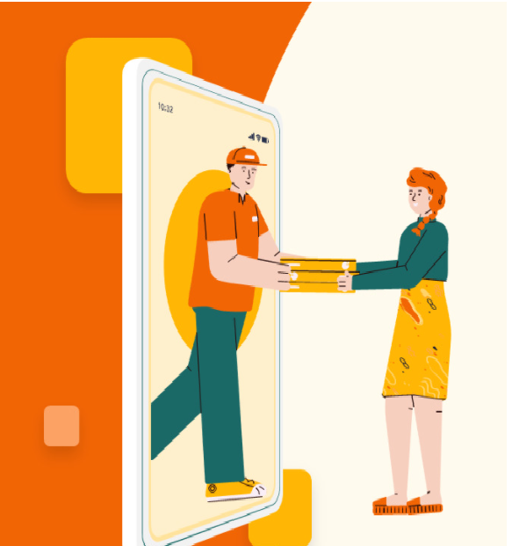
HungerExpress
CSE - 326
Prepared by:
1. 1705031
2. 1705034
3. 1705041
4. 1705049
5. 1705054
6. 1705059
7. 1505048

Slide 2

Motivation
To deliver the favourite food, necessary groceries and medicines from different restaurants and shops to the doorstep of the consumers.
It saves both time and money.
It creates employment for so many unemployed people.
It helps restaurants to grow their business and reach
a lot of customers through internet.
Cost effective promotion and a lot more service
than dine in.

Slide 3
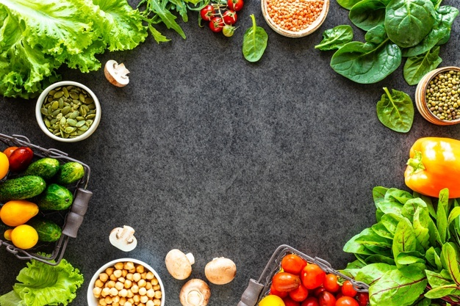
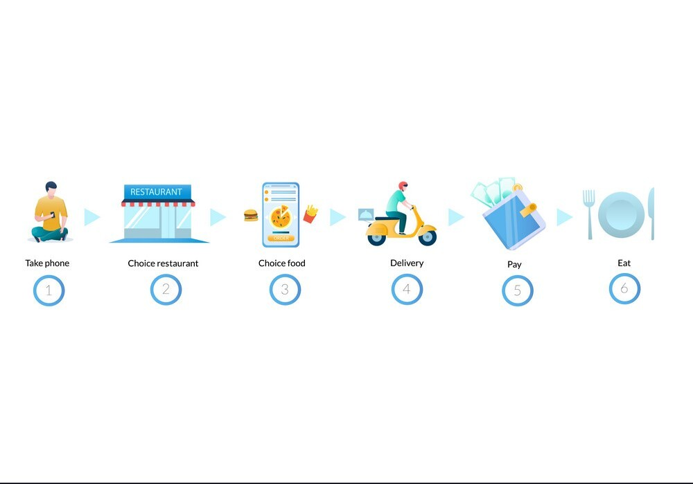
How food delivery system works

Slide 4
Major Features
For customers:
Search and navigation of food and groceries
Sorting, filtering and editing of orders
Ratings and reviews
Social media sharing
Save favourite order for future re-order
Food comparison
Rush order
Send a treat to a particular person

Slide 5
Major Features
For Restaurants:
Update and edit menus
Offer exciting deals and promotional codes
Availability and schedule
Fulfillment and delivery:
Real time tracking
Notification and alert
Confirmation of delivery

Slide 6
Major Features
Payment:
Online payment
Mobile banking
Cash on delivery
Marketing:
Gift cards
Discount coupons
Promotional codes and vouchers
Coin

Slide 7
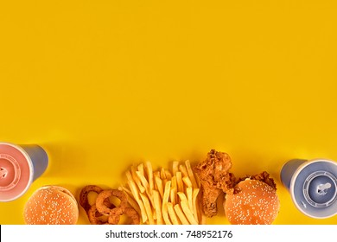


Food Comparison
Having trouble to decide which food to order?
HungerExpress helps you decide

Slide 8
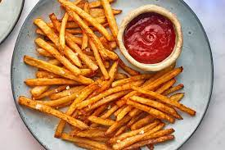
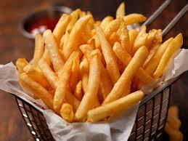
Food Comparison
Dark house Restaurant, Lalbagh
Price: 100 BDT
Total orders: 1546
Overall rating: 4.5/5
Prince Burger, Lalbagh
Price: 120 BDT
Total orders: 2130
Overall rating: 4.2/5

Slide 9


Rush Order
Oww no, guests are coming in 30 minutes, how can I manage such a large meal in this short period?? I should have got home early.
HungerExpress special feature is here to rescue.

Slide 10
Modules and Sub modules
Register and login module: Customers can register with their emails and contact numbers and riders can register with their NID, emails and contact numbers through this module.
Order module: We can create, read, update and delete order from this module.
Food item module: All the operations related to food item, will be managed by this module.

Slide 11
Modules and Sub modules
Sales module: Sales module is used to manage the sales.
Delivery module: It will be developed for managing the delivery.
Payment module: It will manage the payment.
Customer module: Customer operation will be managed by customer modules.

Slide 12






Related Examples

Slide 13
Data Collection Process
From customers:
1. Orders, review and ratings
2. Feedback
3. Social media activity and internet
From Restaurants:
1. In person data collection from different restaurants
2. Customer review, social media and internet
From Riders:
1. In person interview and information collection
2. Customer review about riders’ delivery and timeliness

Slide 14
Distribution of the upcoming presentations
Scope fixation of the project – 1705054
Presentation 1 (requirements analysis using BPMN diagram) – 1705034
Presentation 2 (Mock UI) – 1705031
Presentation 3 (Class diagram) (+ ER diagram in applicable cases) – 1705041 and 1705049
Presentation 4 (Interaction diagram) (+ State diagram in
applicable cases) – 1705059 and 1505048

Slide 15
