Slide 1
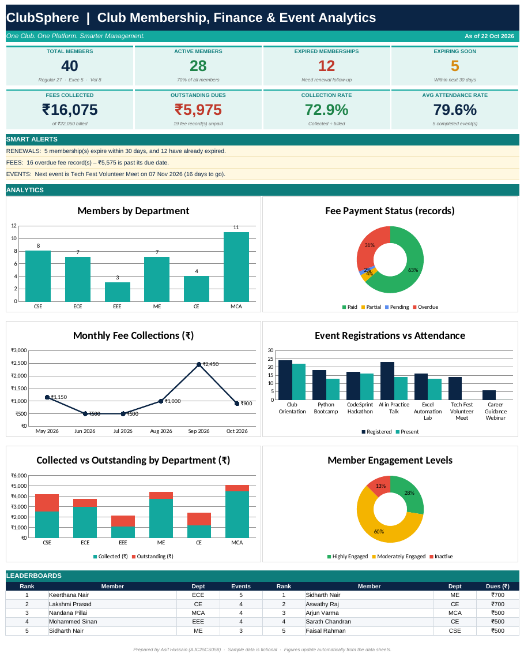
24MNC201 · ESSENTIALS OF OFFICE AUTOMATION
ClubSphere
Smart Club Membership, Finance & Event Analytics System
One Club. One Platform. Smarter Management.
Asif Hussain · AJC25CS058
Built in Microsoft Excel · No macros
Notes:
Good morning. My project is ClubSphere, a club membership, finance and event analytics system built completely in Microsoft Excel for the course Essentials of Office Automation. It uses only built-in Excel features, with no macros or programming.

Slide 2




The Problem
Who is active, expired or expiring?
Who has paid and who is overdue?
Which events and departments are active?
Can I find any member's details instantly?
Records kept in separate lists mean repeated typing, missed renewals and slow reports.
Notes:
A college club has to track members, fees, events and attendance. When these are kept in separate lists, simple questions become slow: who is active, who has paid, which events worked, and where is a member's information. Manual lists also mean typing the same data many times and missing renewals.

Slide 3






Our Solution
Club Data
Excel Processing
ClubSphere Dashboard
Members · Fees
Events · Attendance
Linked sheets · Formulas
Validation · Formatting
KPIs · Charts
Alerts · Reports
Linked by Member ID and Event ID
Statuses, balances and reports update automatically
Only built-in Excel features, no macros
Notes:
ClubSphere turns Excel into a small administration system. Club data goes in, formulas, validation and formatting process it, and a dashboard shows the results. Everything is linked through Member ID and Event ID, so changing one record updates every result, and no macros are used.

Slide 4



Workbook Structure
Dashboard
Member Register
Fee Tracker
Event Manager
KPIs, alerts, charts
Members, status, renewal
Balance, payment status
Events, attendance %
Attendance
Member Profile
Reports
Member-event records
One-page lookup
Six summary tables
Plus a Read Me sheet and a Lists sheet for dropdowns and settings.
Notes:
The workbook has seven main sheets. The Dashboard summarises everything. The Member Register, Fee Tracker, Event Manager and Attendance sheets hold the data. Member Profile gives a one-page lookup and Reports holds six summary tables. A Read Me and a Lists sheet support them.

Slide 5
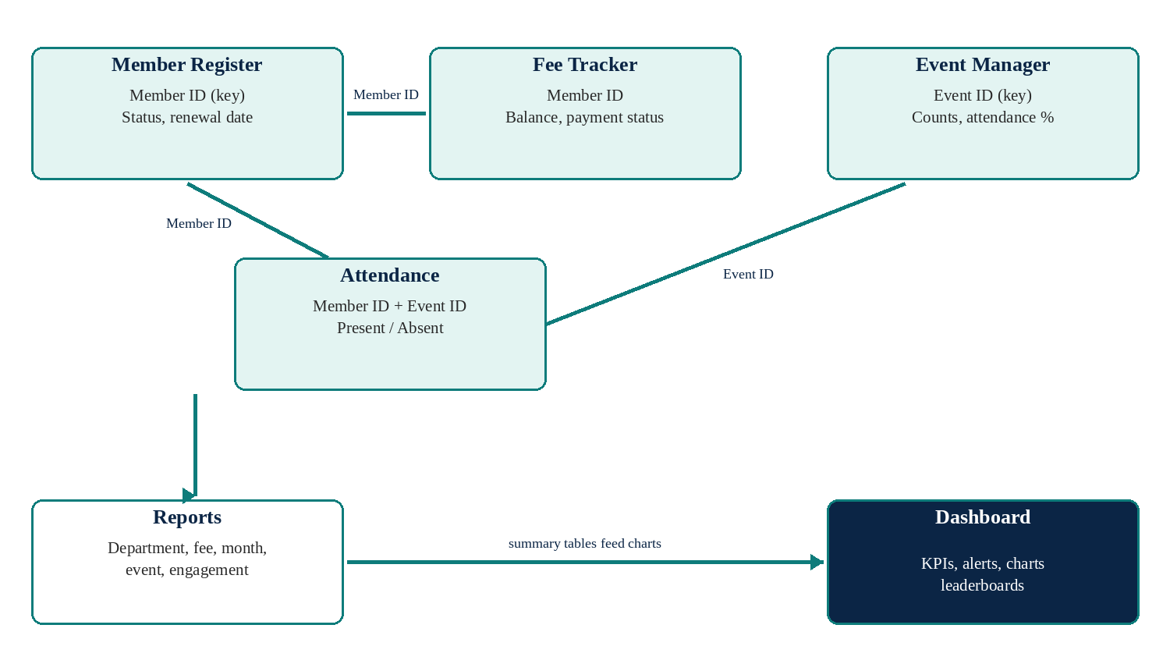
How the Sheets Link
Member ID links Register, Fees and Attendance
Event ID links Events and Attendance
Reports summarise the data and feed the Dashboard
Notes:
Each record has a unique ID. Member ID connects the register, fees and attendance. Event ID connects events and attendance. Names are looked up, never typed twice. Reports summarise the four data sheets and feed the charts on the dashboard.

Slide 6
Key Excel Features Used
EDATE + IF
Renewal date and status
SUMIFS / COUNTIFS
Totals by category
=IF(I5<ReportDate,"Expired","Active")
=SUMIFS(Paid,Dept,B5)
INDEX + MATCH
Lookup from an ID
LARGE + MATCH
Top 5 leaderboards
=INDEX(Names,MATCH(ID,IDs,0))
=LARGE(EngagementKey,k)
Data Validation
Dropdowns and rules
Conditional Formatting
Status colours and data bars
Unique ID · Paid ≤ Due
Green / amber / red / blue
Notes:
These are the main Excel features. EDATE and IF calculate the renewal date and status. SUMIFS and COUNTIFS give totals by department, type or status. INDEX and MATCH look up details from an ID. LARGE and MATCH build the leaderboards. Data validation prevents wrong entries, and conditional formatting colours the statuses.

Slide 7


The Dashboard
8 KPI cards: members, dues, collection rate
3 smart alerts: renewals, overdue fees, next event
6 charts and Top 5 leaderboards
Updates when any record changes
Notes:
This is the dashboard, the first sheet. At the top are eight KPI cards, then three smart alerts that write themselves from the data, then six charts and two leaderboards. In the video I will change a payment here and show the numbers update.

Slide 8
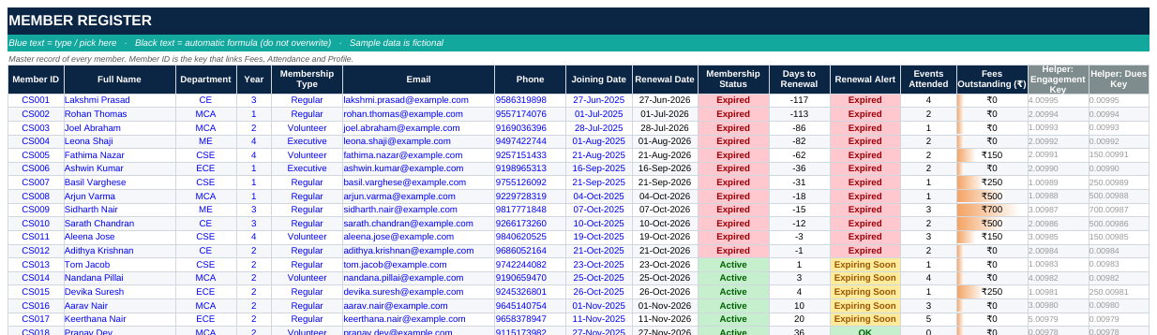
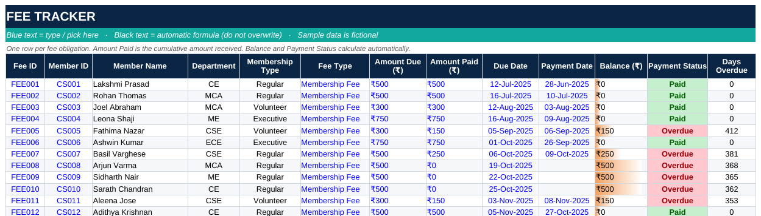
Data Sheets
Member Register
Renewal date, status and alerts are calculated
Fee Tracker
Balance and Paid / Overdue status are calculated
Dropdowns
Department, type, IDs and status
Notes:
In the Member Register, blue columns are typed and black columns are formulas. Expired and expiring memberships are highlighted. In the Fee Tracker the balance and payment status are calculated, and statuses are colour coded. Dropdown lists keep the entries consistent.

Slide 9
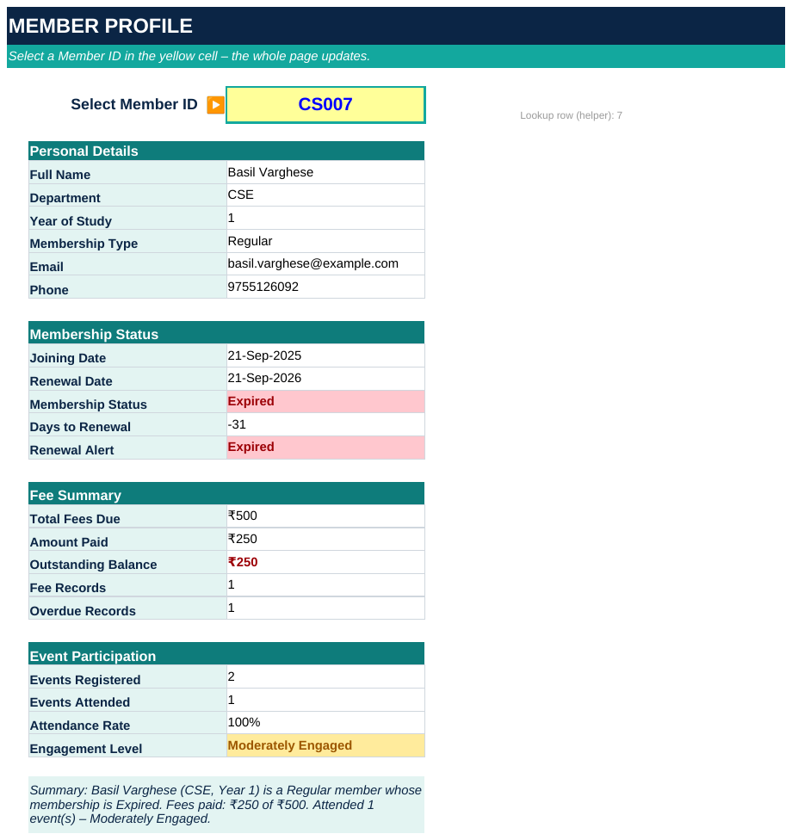
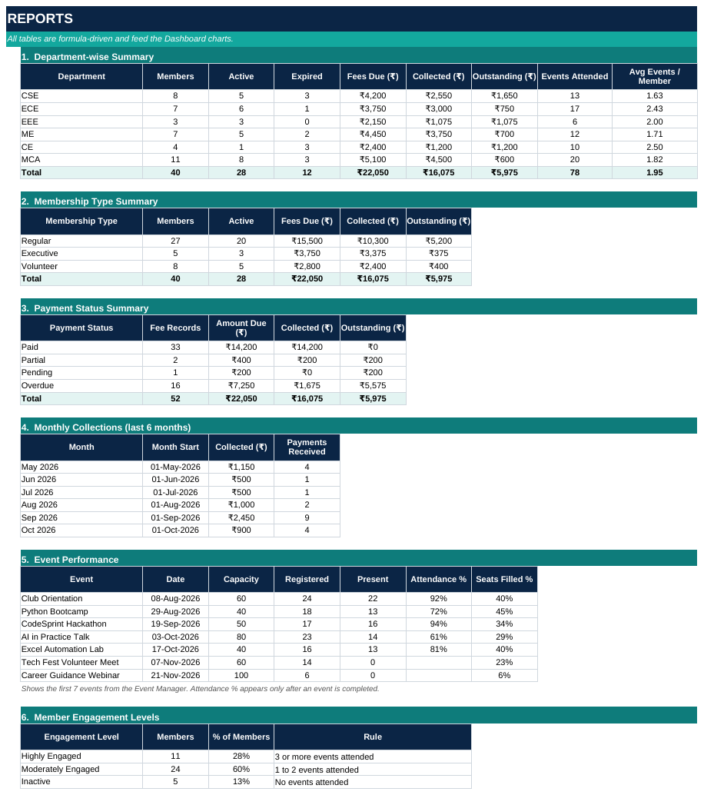
Member Profile and Reports
Member Profile
Pick an ID to see details, fees, events
Reports
Six tables by department, type, status, month and event
Notes:
Member Profile has a yellow selector. Choose any Member ID and the page shows personal details, membership status, fees, events attended and an engagement level. The Reports sheet has six formula-driven tables that feed the dashboard charts.

Slide 10
Results
40
₹16,075
members, 28 active
fees collected
₹5,975
79.6%
outstanding dues
average attendance
Notes:
With the sample data, ClubSphere reports 40 members of whom 28 are active, rupees 16,075 collected and rupees 5,975 still outstanding. The collection rate is 72.9 percent and average event attendance is 79.6 percent. The chart shows collected and outstanding fees by department. Almost all of the outstanding amount is overdue.

Slide 11
Testing
Test action | Result | Status
Mark overdue fee FEE005 as fully paid | Collected ₹16,075 → ₹16,225; dues ₹5,975 → ₹5,825 | Pass
Add new member CS041 (joined 20-Oct-2026) | Renewal 20-Oct-2027, Active; members 40 → 41 | Pass
Select Member ID CS012 on the profile | Profile shows Adithya Krishnan, fees and events | Pass
Change report date to 01-Dec-2026 | Expired 12 → 18; active 28 → 22 | Pass
Each test changed a copy of the workbook, recalculated it and compared the output with the original.
Notes:
I tested the workbook by changing data in a copy and recalculating. Marking a fee as paid raised the collected amount by 150 rupees. Adding a new member set the renewal date automatically. Selecting another ID updated the profile, and changing the report date moved memberships from active to expired.

Slide 12
Conclusion
What ClubSphere delivers
Future scope
Linked records: members, fees, events, attendance
Automatic status, balance and attendance calculations
Dashboard, reports and alerts in one place
No macros: only built-in Excel features
PivotTables and slicers
Expense tracker and event budgets
Printable membership cards and receipts
Shared online workbook
Thank you · Questions?
Notes:
To conclude, ClubSphere shows that Excel can work as a small management system when records are linked by IDs and formulas do the calculations. In future it can be extended with PivotTables, an expense tracker, printable membership cards and a shared online workbook. Thank you.

