Slide 1


Slide 2

THE SHOE SHOP

Slide 3
Group Members Introduction
Group ID: F22028CEDA
AYESHA SOHAIL F22028CEDA

Slide 4

INTRODUCTION OF PROJECT
We are going to build web based application named THE SHOE SHOP. By using this website Customer will be able to buy Ladies, Gents, Kids Casual and Party wear shoes online. This website facilitates its customers to get every type of outfits at their doorstep without visiting the market physically.

Slide 5
A user will be able to purchase / make order against available shoes after performing registration on the website and passing through the payment methods. The payment method will be either through a credit card or through cash on delivery. In addition, the website will provide interactive interfaces and a rich search facility for finding the different types of shoes through different filters. Ordering shoes online through the proposed website will eliminate the need to physically visit the market for this purpose

Slide 6
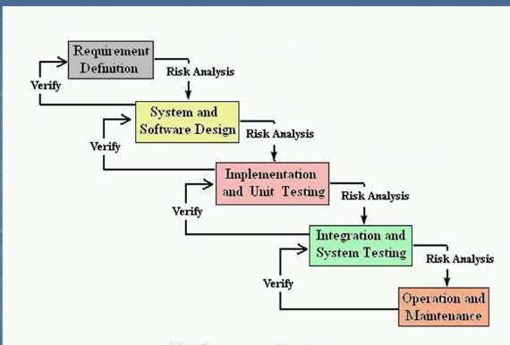
Vu model process

Slide 7
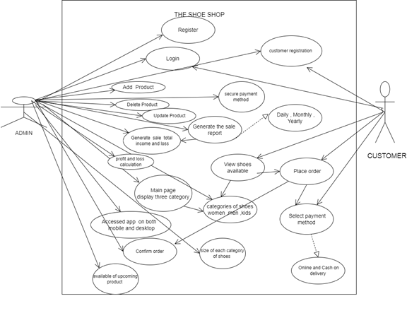
Use case diagram

Slide 8
business rules catalog
1 .Navigation through the pages should be easy.
2 . Secured payment methods.
3. Admin can add delete or modify the website according to the available products .

Slide 9
4. Admin can also keep the record of sale products, in order to watch their total income or loss.
5. Admin can generate sales report (daily, monthly and yearly).
6. Shoes should be categorized as men, women and kids. In men there should be two categories of shoes (formal and casual). In women there should be two categories (Casual and party). In kids there should be two categories (girls and boys)
7. Each category of shoes must have different sizes like 37, 38, 39, 40 and so on.

Slide 10
8. Main page must have all three categories and description of all shoes. There should be a different page for each category.
9. Each categories must have at least 10 products displayed on the page.
10. Customer can only view the available and upcoming items.
11. Customer can place order and make payment online or cash on delivery.
.

Slide 11
12. Customer must register before any order placement.
Database should be relational.
13 . This application could both be easily accessed on desktop and on mobile.

Slide 12
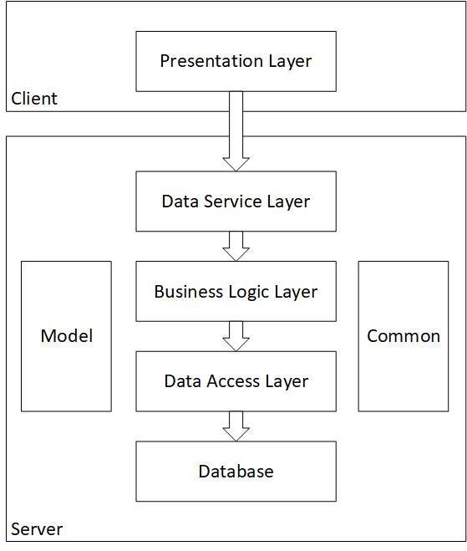
Architectural Design

Slide 13
Architectural Design
Presentation layer:
The presentation layer is also called the Translation layer. The data from the application layer is extracted here and manipulated as per the required format transmit over the network.
Logical layer:
The logical layer determines the logical transmission paths between sources and destinations. The physical layer is responsible for sending packets from one end to the other end of the logical link.
Data layer:
Data link layer performs the most reliable node to node delivery of data. It forms frames from the packets that are received from network layer and gives it to physical layer. It also synchronizes the information which is to be transmitted over the data

Slide 14
Team Structure
Supervisor
developer

Slide 15
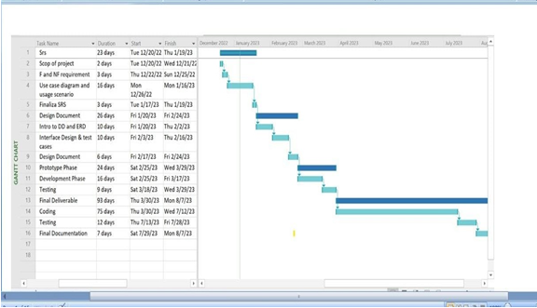
Project Schedule

Slide 16
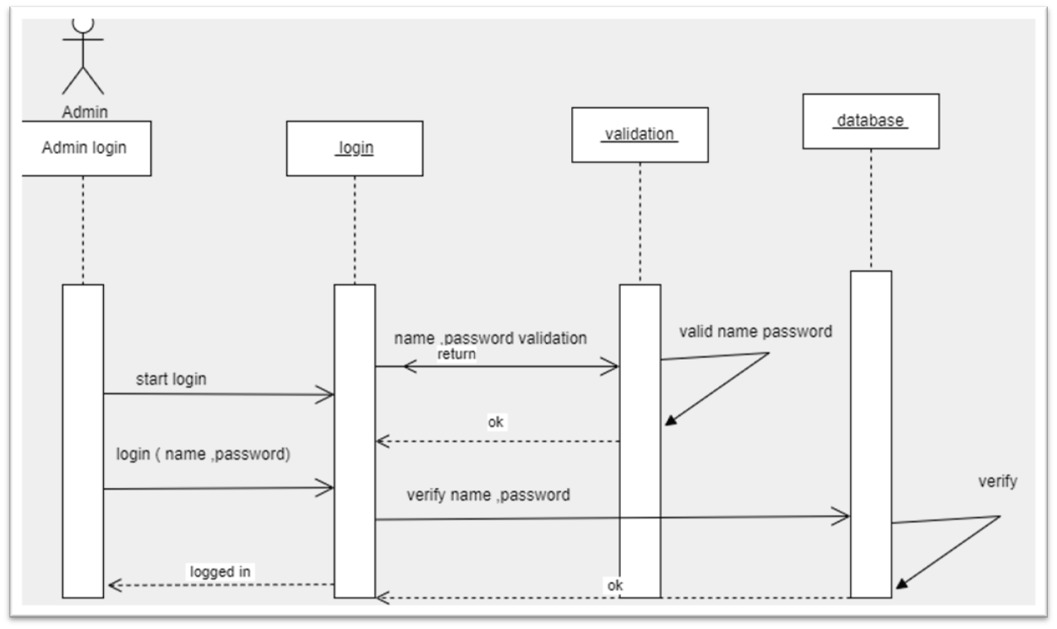
Sequence Diagrams
Admin login

Slide 17
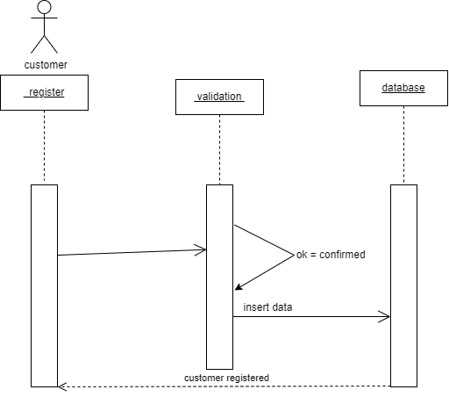
Customer register

Slide 18
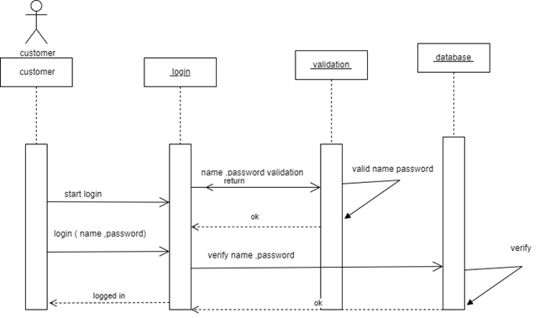
Customer login

Slide 19
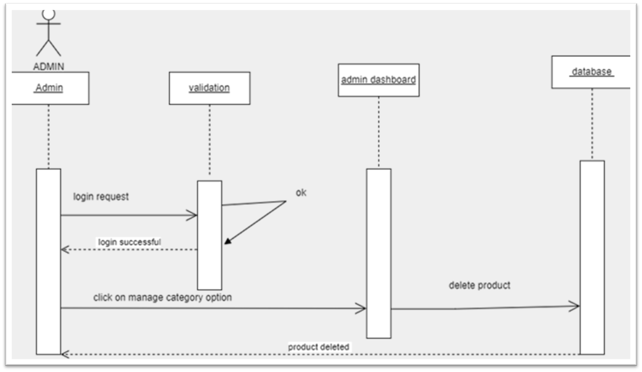
Delete product

Slide 20
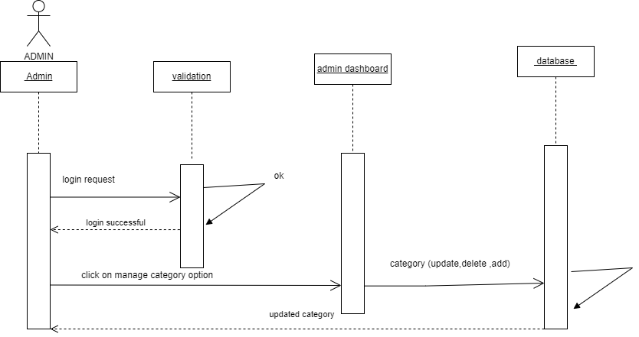
Update category

Slide 21
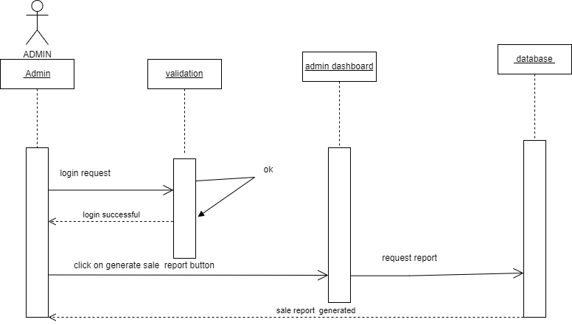
Generate sale report

Slide 22
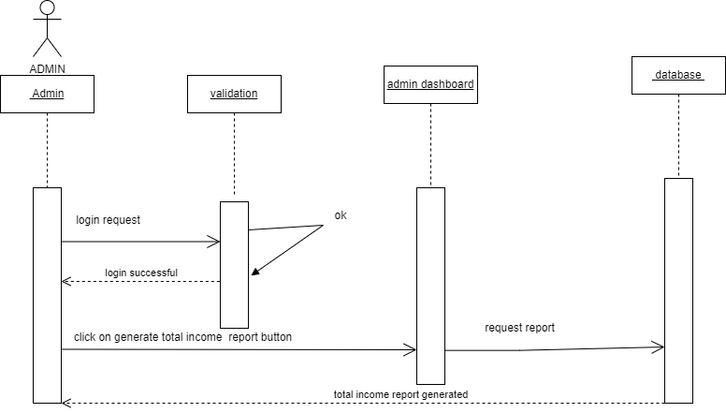
Total income report generated

Slide 23
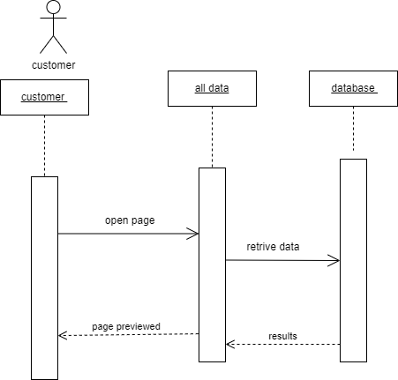
Page review

Slide 24
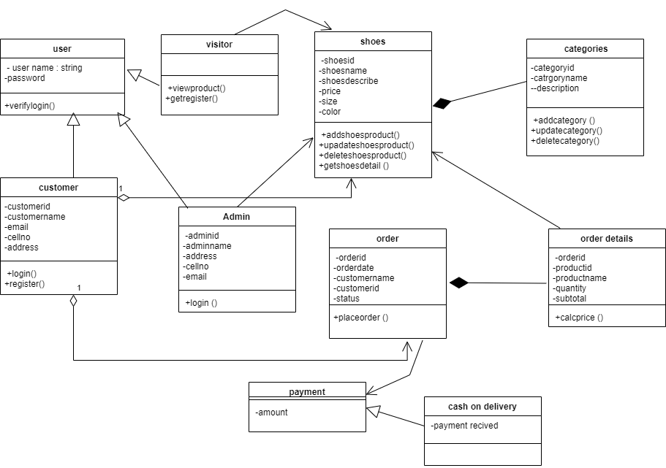
Logical Model/Class Diagram

Slide 25
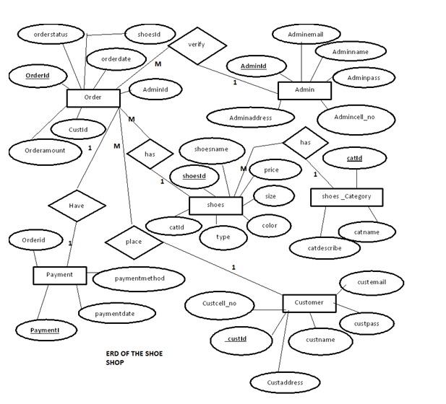
Entity-Relationship Diagram

Slide 26
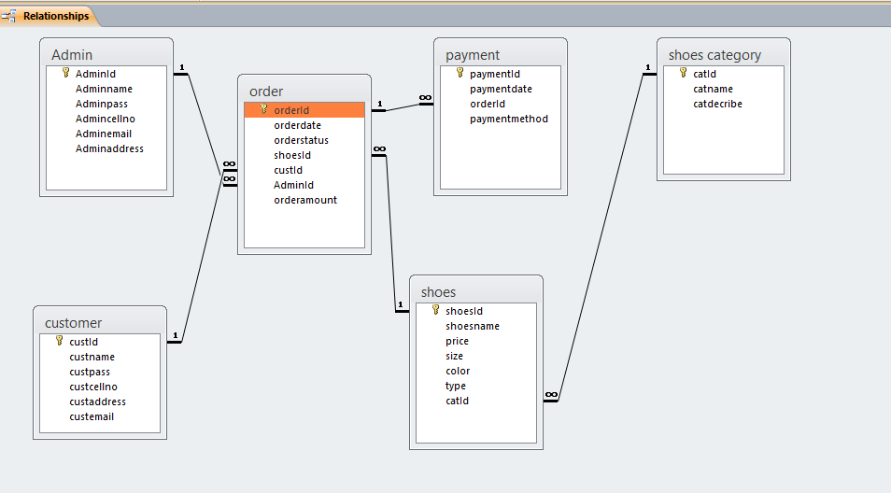
Database Diagram

Slide 27
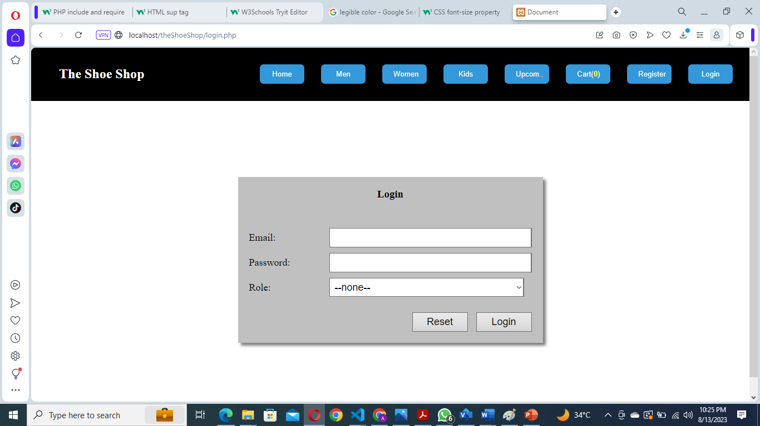
User Interfaces login form

Slide 28
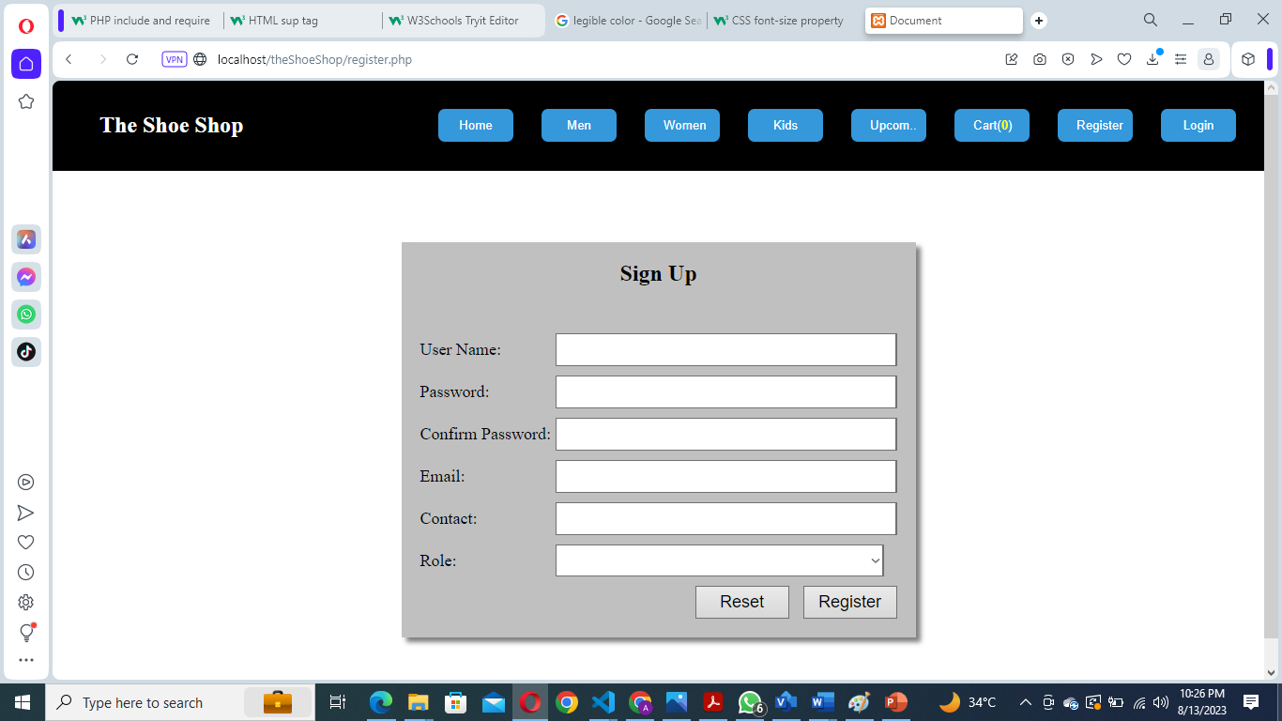
Registration form

Slide 29
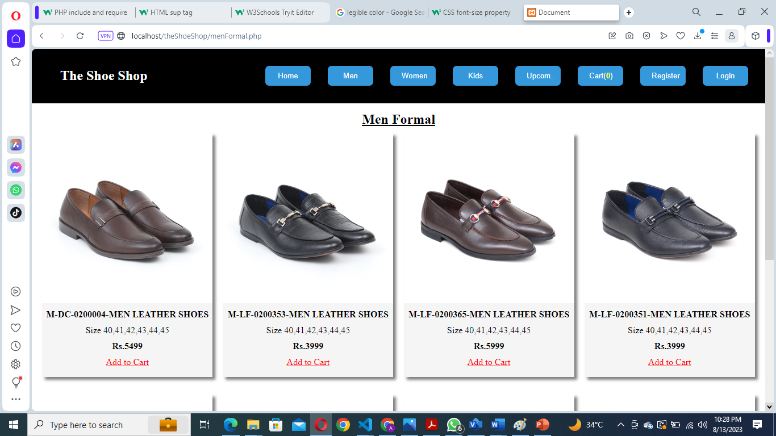
Men shoes category

Slide 30
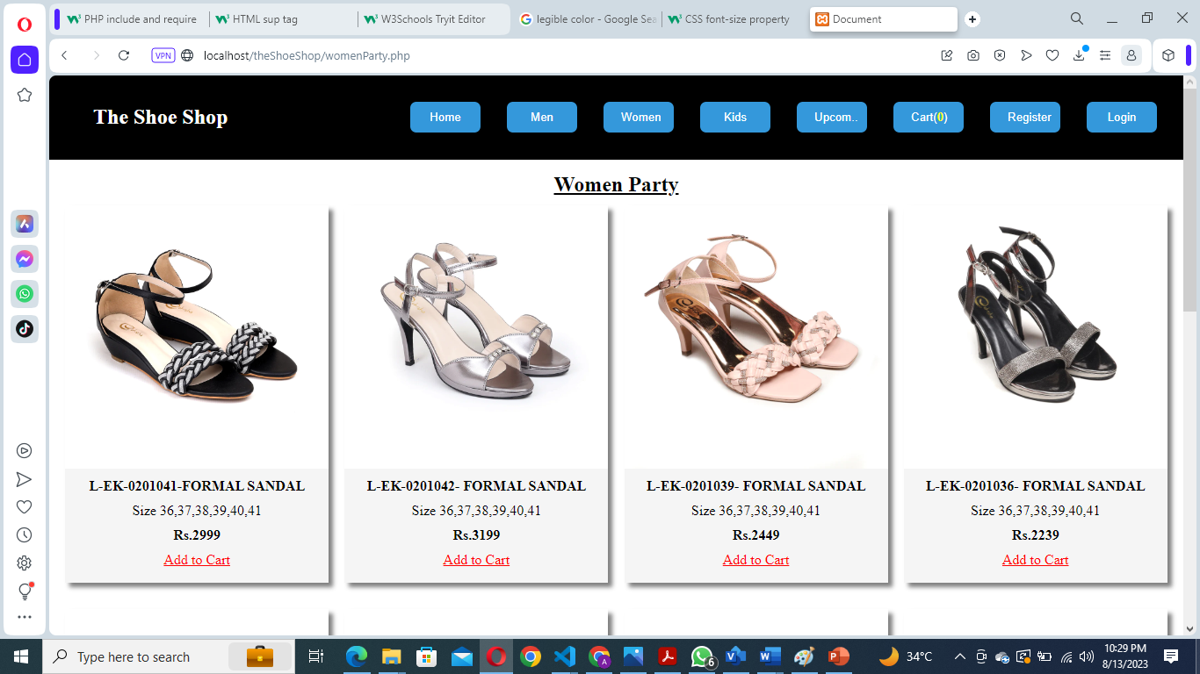
Women shoes category

Slide 31
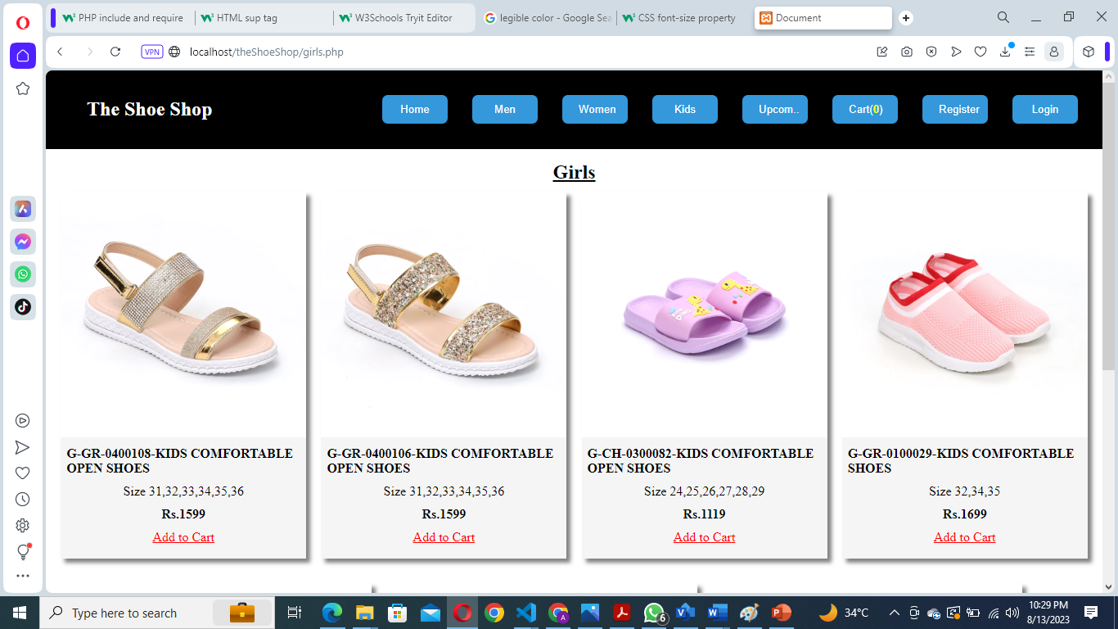
Kids shoes category

Slide 32
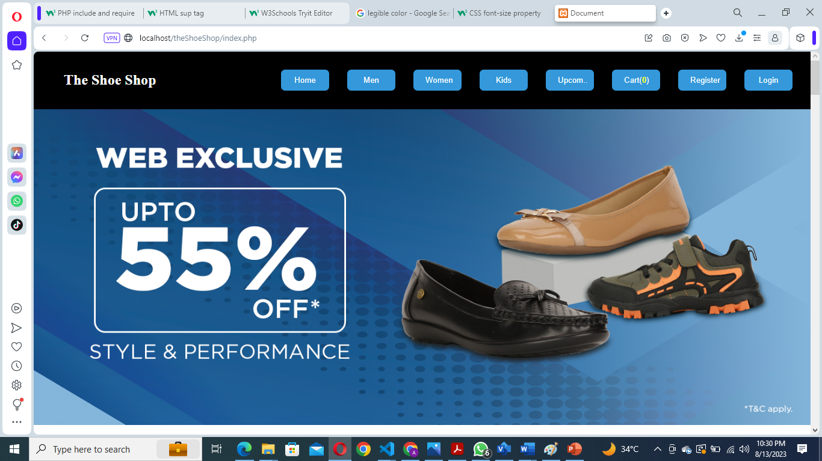
View all category

Slide 33
Tools
Visual Studio Code (Text Editor)
Chrome browser
Xampp Control panel
PHP Programming Language
MySQL database

