Slide 1


Adhoc Request Analysis
Welcome to the Atliq Technologies Adhoc Request Analysis Project, developed as part of the Codebasics program.
Atliq Hardwares is one of the leading computer Hardware companies in India, with a rapidly growing global presence.
Presented by: ASIF RAZA

Slide 2
PROBLEM STATEMENT
The management faced challenges in obtaining sufficient insights for quick decision-making.
To address this, a project was initiated covering 10 business-driven ad hoc requests in the consumer domain.
The objective is to transform raw data into meaningful and actionable insights to support effective business decisions.

Slide 3
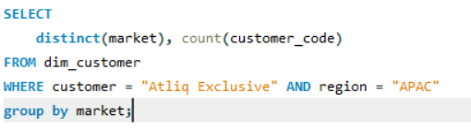
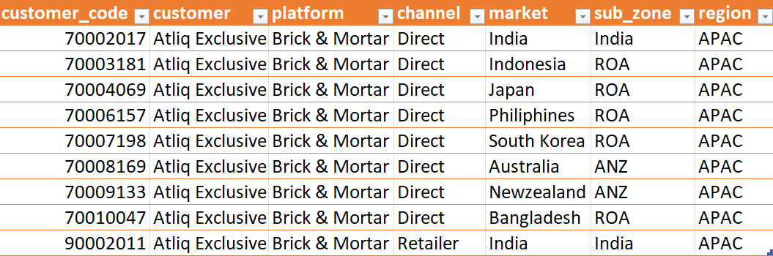
Provide the list of markets in which customer "Atliq Exclusive" operates its business in the APAC region.
1
Key Insights :- Atliq Exclusive operates in 8 APAC markets, with India having the highest presence (2 customers), while other markets have 1 customer each, showing a higher concentration in India.

Slide 4
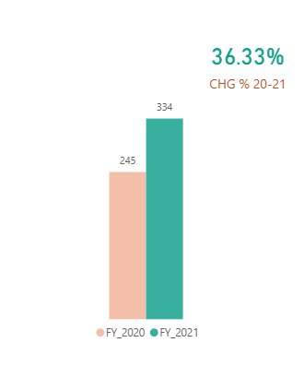
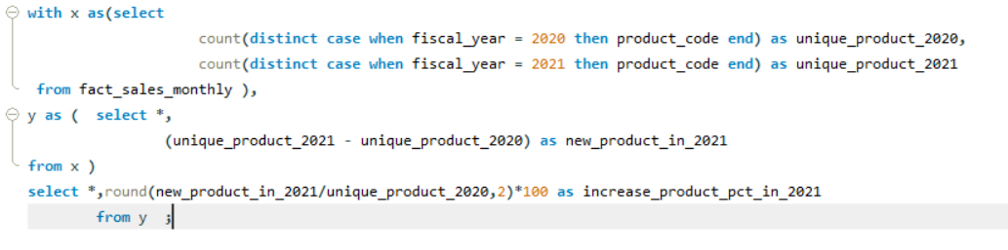
What is the percentage of unique product increase in 2021 vs. 2020? The final output contains these fields, unique_products_2020 unique_products_2021 percentage_chg %
2
Key Insights :- Unique products increased from 245 (2020) to 334 (2021), showing a 36.33% growth, indicating a strong expansion in product portfolio.

Slide 5
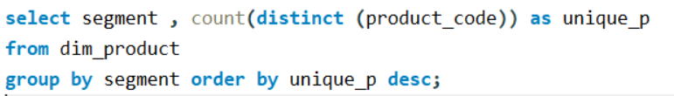
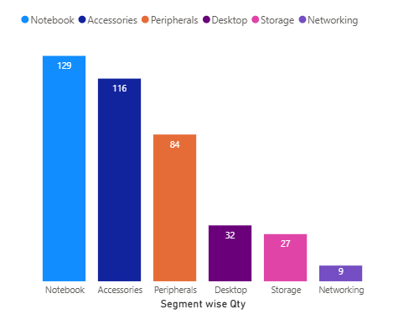
Provide a report with all the unique product counts for each segment and sort them in descending order of product counts. The final output contains 2 fields, segment , product_count
3
Key Insights :- Notebook has the highest products (129), followed by Accessories (116), while other segments have lower counts.

Slide 6
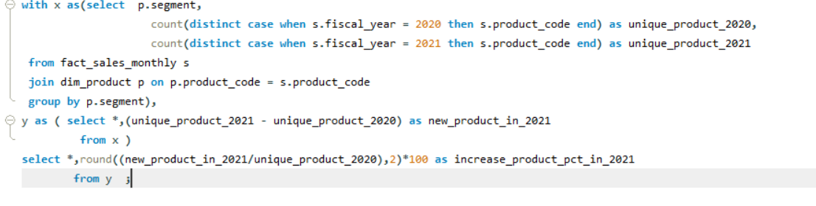
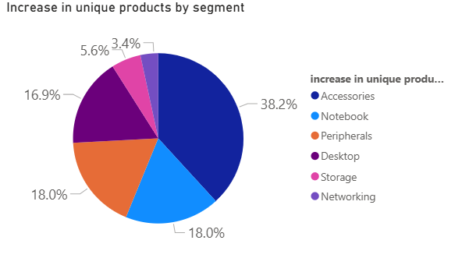
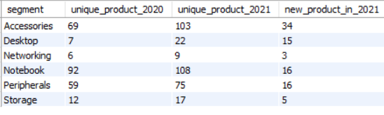
Which segment had the most increase in unique products in 2021 vs 2020? The final output contains these fields, segment , product_count_2020 , product_count_2021 difference
4
Key Insights :-Accessories segment showed the highest growth (~38.2%), followed by Notebook & Peripherals (~18%), making them the top growing segments in 2021 vs 2020.

Slide 7
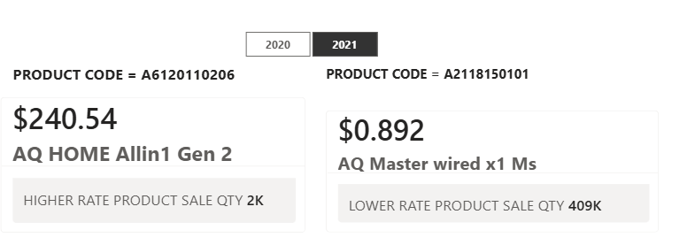
Get the products that have the highest and lowest manufacturing costs. The final output should contain these fields, product_code product manufacturing_cost
5
Key Insights :- Some products are very expensive to make ($240.54) while others are very cheap ($0.89), showing a big difference in cost

Slide 8
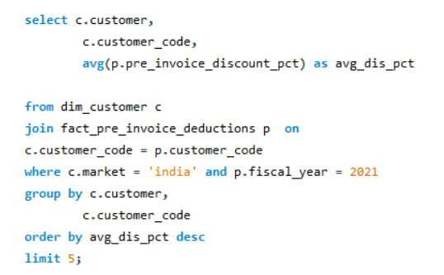
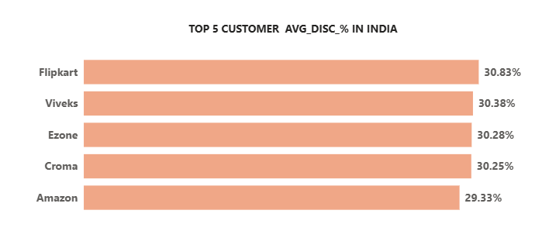
Generate a report which contains the top 5 customers who received an average high pre_invoice_discount_pct for the fiscal year 2021 and in the Indian market. The final output contains these fields, customer_code, customer, average_discount_percentage
6
Key insight :- The average discount is nearly 30% for all top customers, with Amazon slightly lower (29.33%), indicating consistent discounting across customers

Slide 9
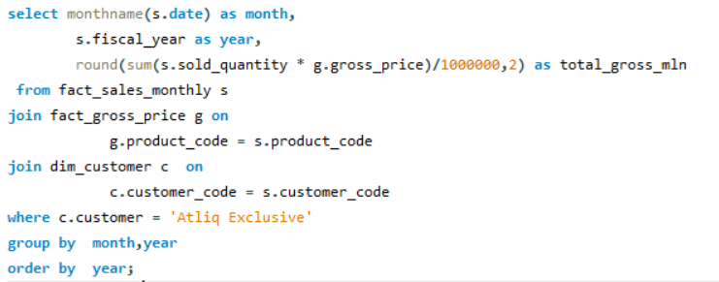
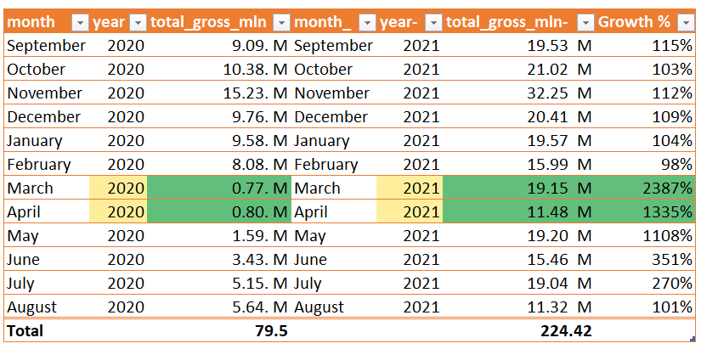
Get the complete report of the Gross sales amount for the customer “Atliq Exclusive” for each month . This analysis helps to get an idea of low and high-performing months and take strategic decisions. The final report contains these columns: Month Year Gross sales Amount
7
Key insight :- Sales increased significantly in FY2021 compared to FY2020, driven by higher demand, an increase in product offerings, and overall business expansion, with March 2021 showing the highest performance.

Slide 10
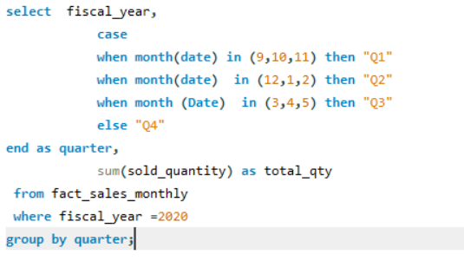
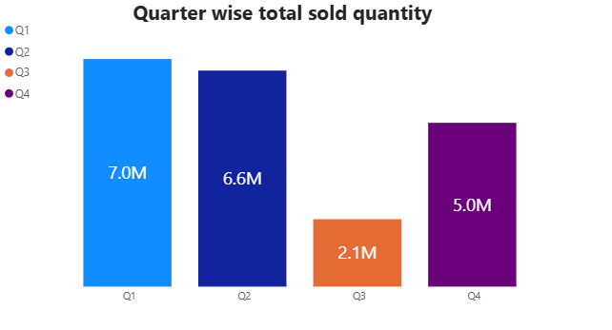
In which quarter of 2020, got the maximum total_sold_quantity? The final output contains these fields sorted by the total_sold_quantity, Quarter total_sold_quantity
8
Key insight :- In 2020, Q1 recorded the highest total sold quantity (7M), followed by Q2 (6.6M). Sales declined significantly in Q3 (2.1M), but showed a recovery in Q4 (5M), indicating a mid-year dip followed by partial recovery

Slide 11
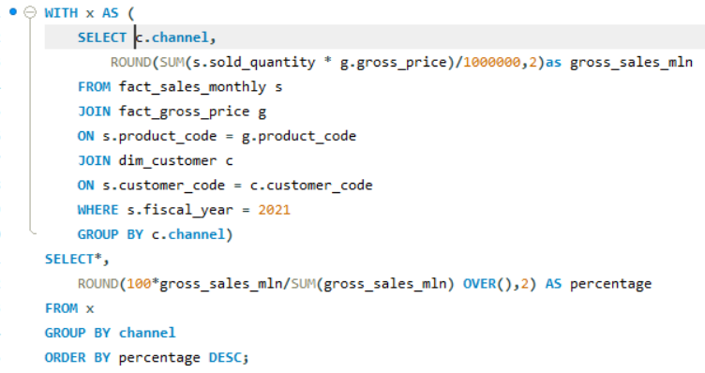
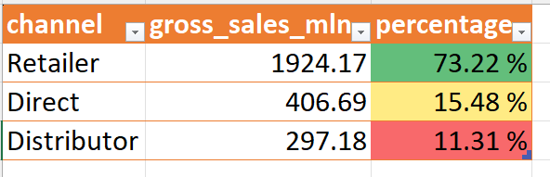
Which channel helped to bring more gross sales in the fiscal year 2021 and the percentage of contribution? The final output contains these fields, channel gross_sales_mln percentage
9
Key insight :-The Retailer channel dominates gross sales in FY2021, contributing over 73%, while Direct and Distributor channels have significantly lower contributions.

Slide 12
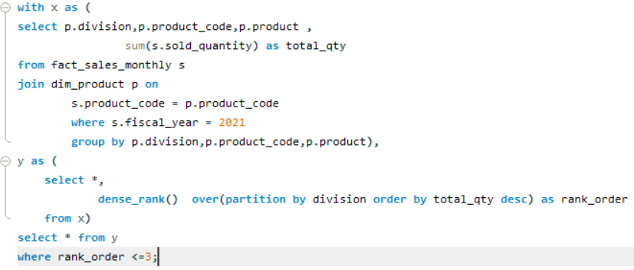
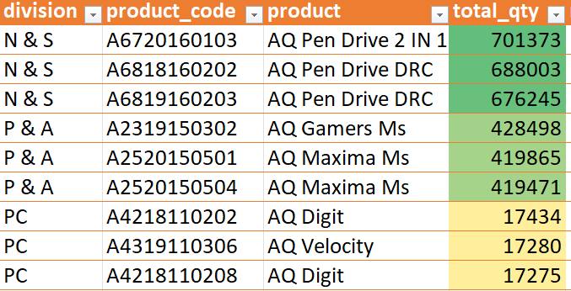
Get the Top 3 products in each division that have a high total_sold_quantity in the fiscal_year 2021? The final output contains these fields, division ,product_code ,product ,total_sold_quantity , rank_order
10
Key insight :- N & S division dominates sales (~700K units), followed by P & A (~420K units), while the PC division has very low sales (~17K units), showing a significant demand gap across divisions

Slide 13
Thank You for Your Time and Attention

