Slide 1
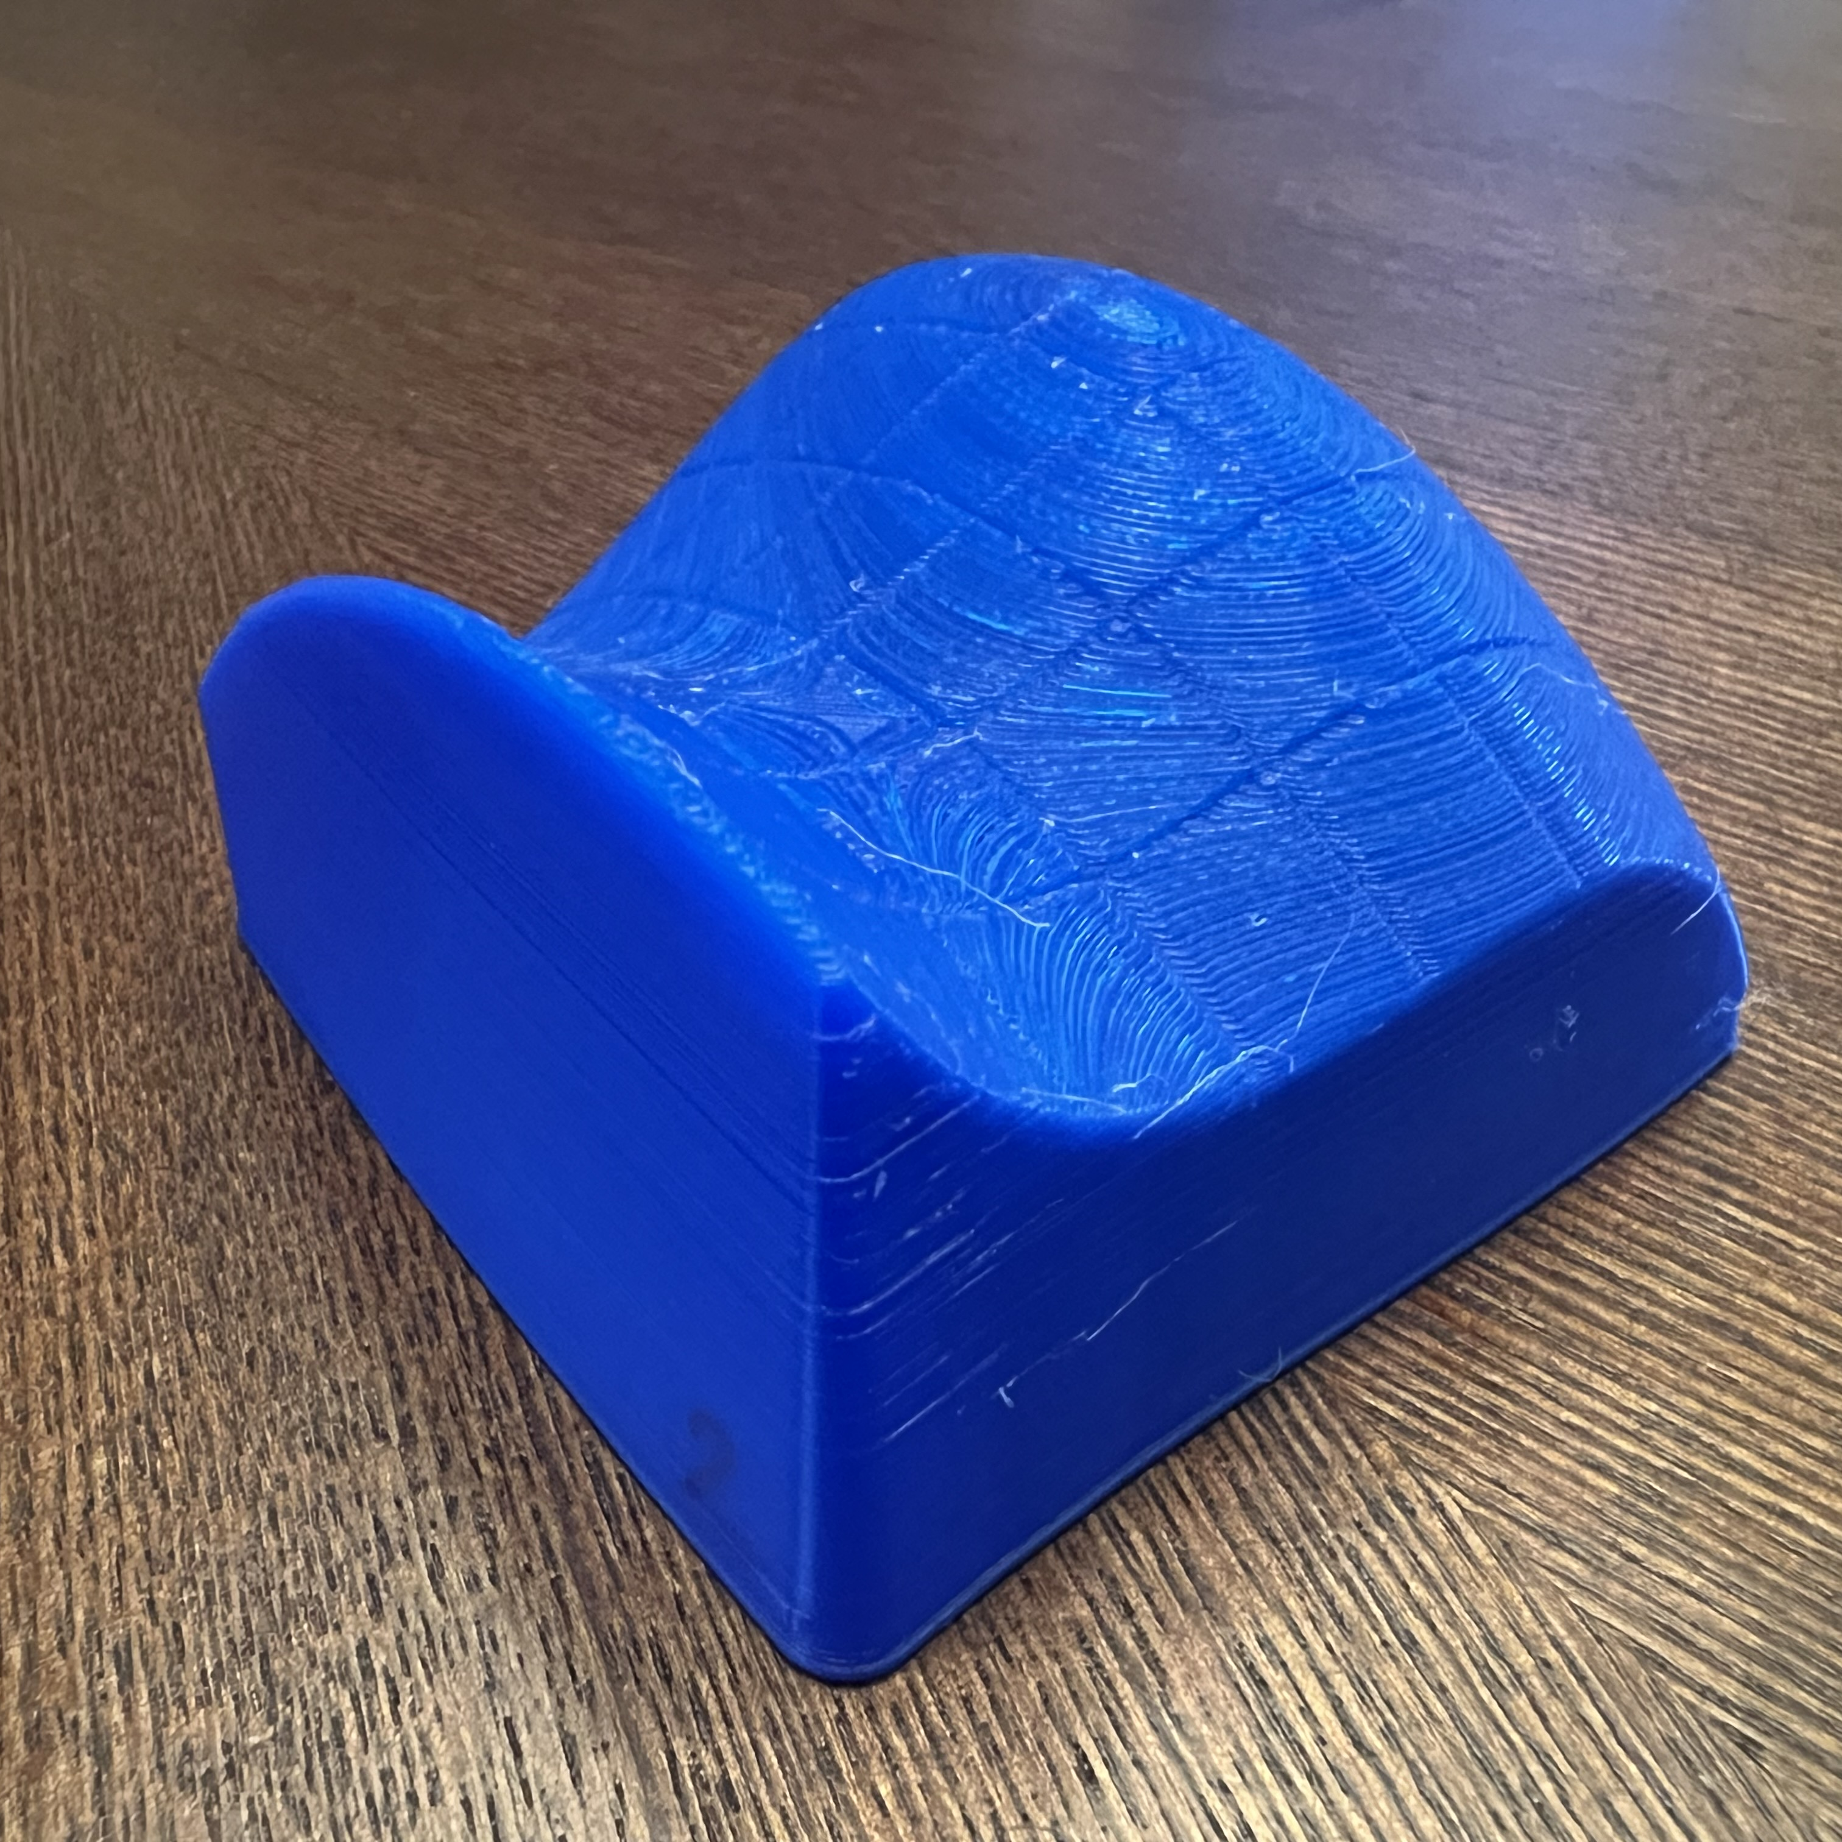
HANDS-ON OPTIMIZATION
MAT237 TUTORIAL 7

Slide 2
TEAMWORK
Decide as a team on your answers.
SCRIBE writes ideas on worksheet.
Spend about 15 minutes per page.
MESSENGER will share your group’s conclusions with the class.
BOOKWORM will search the textbook for useful facts and examples.

Slide 3
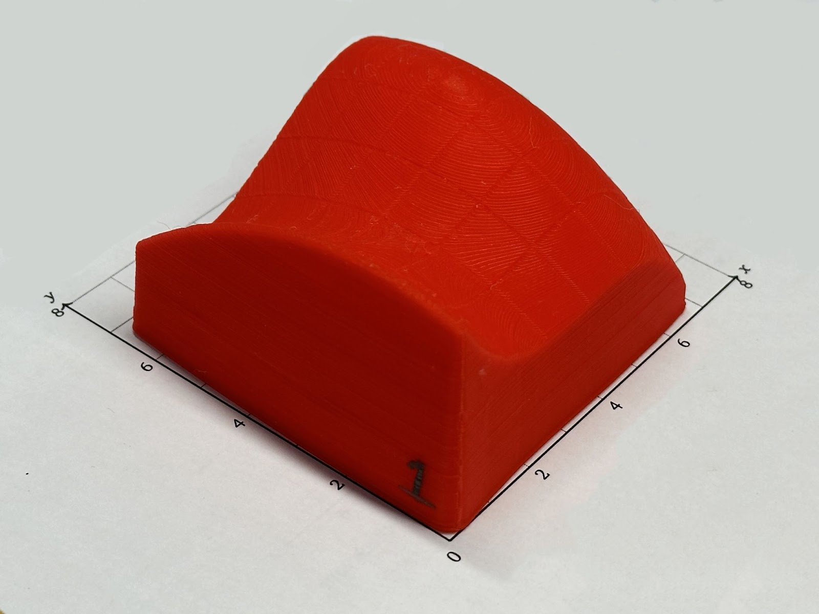
Q1. ANALYZE YOUR 3D MODEL
Orient it carefully
  Highest corner at (0,0)
  Lowest corner at (6,0)
Discuss (a)—(e) together.
Once asked, send your messenger.
Please do NOT draw on your model

Slide 4
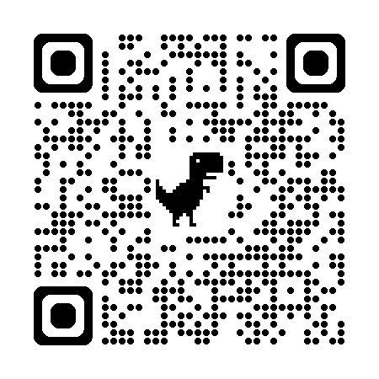
Q2. EXAMINE CRITICAL POINTS
Sketch slices & contours.
  Use your 3D model.
  Ignore exact measurements.
  Focus on overall shape & key points.
Once asked, send your messenger.
Verify with Math3D.
  Scan the QR code
  Play with the toggles and sliders
https://www.math3d.org/PGUnlp8xlx

Slide 5
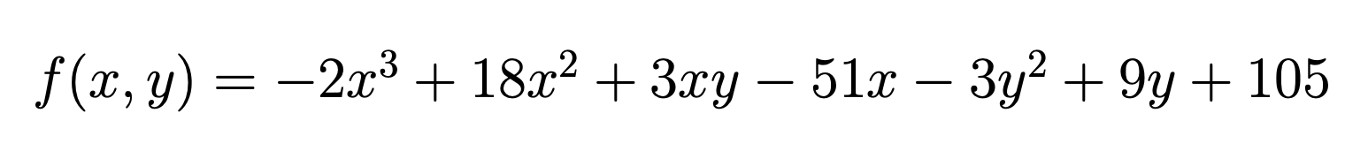
Q3. CALCULATE OPTIMAL VALUES
The function is given by the above formula. Record it.
Find the global extrema of f on D = [0,6] x [0,6].
Use WolframAlpha for basic algebraic calculations and solving systems of equations.
Afterwards, compare your calculations with Q1(e).

Slide 6
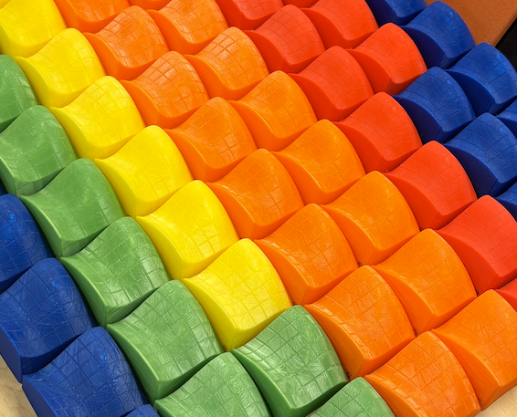
TELL US WHAT YOU THOUGHT
1. Submit this exit ticket
2. Return your 3D model
(actual QR code removed)
Your response will be anonymous!

