Slide 1
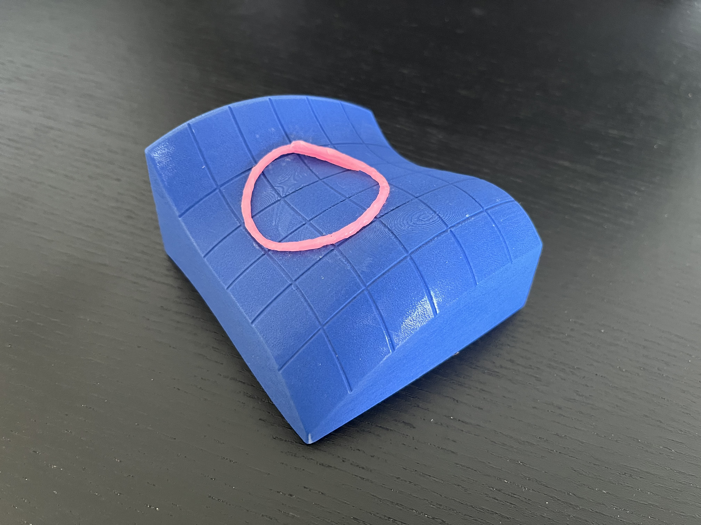
HANDS-ON LAGranGE
MAT237 TUTORIAL 10

Slide 2
TEAMWORK
Decide as a team on your answers.
SCRIBE writes ideas on worksheet.
Spend about 15 minutes per page.
MESSENGER will share your group’s conclusions with the class.
BOOKWORM will search the textbook for useful facts and examples.

Slide 3
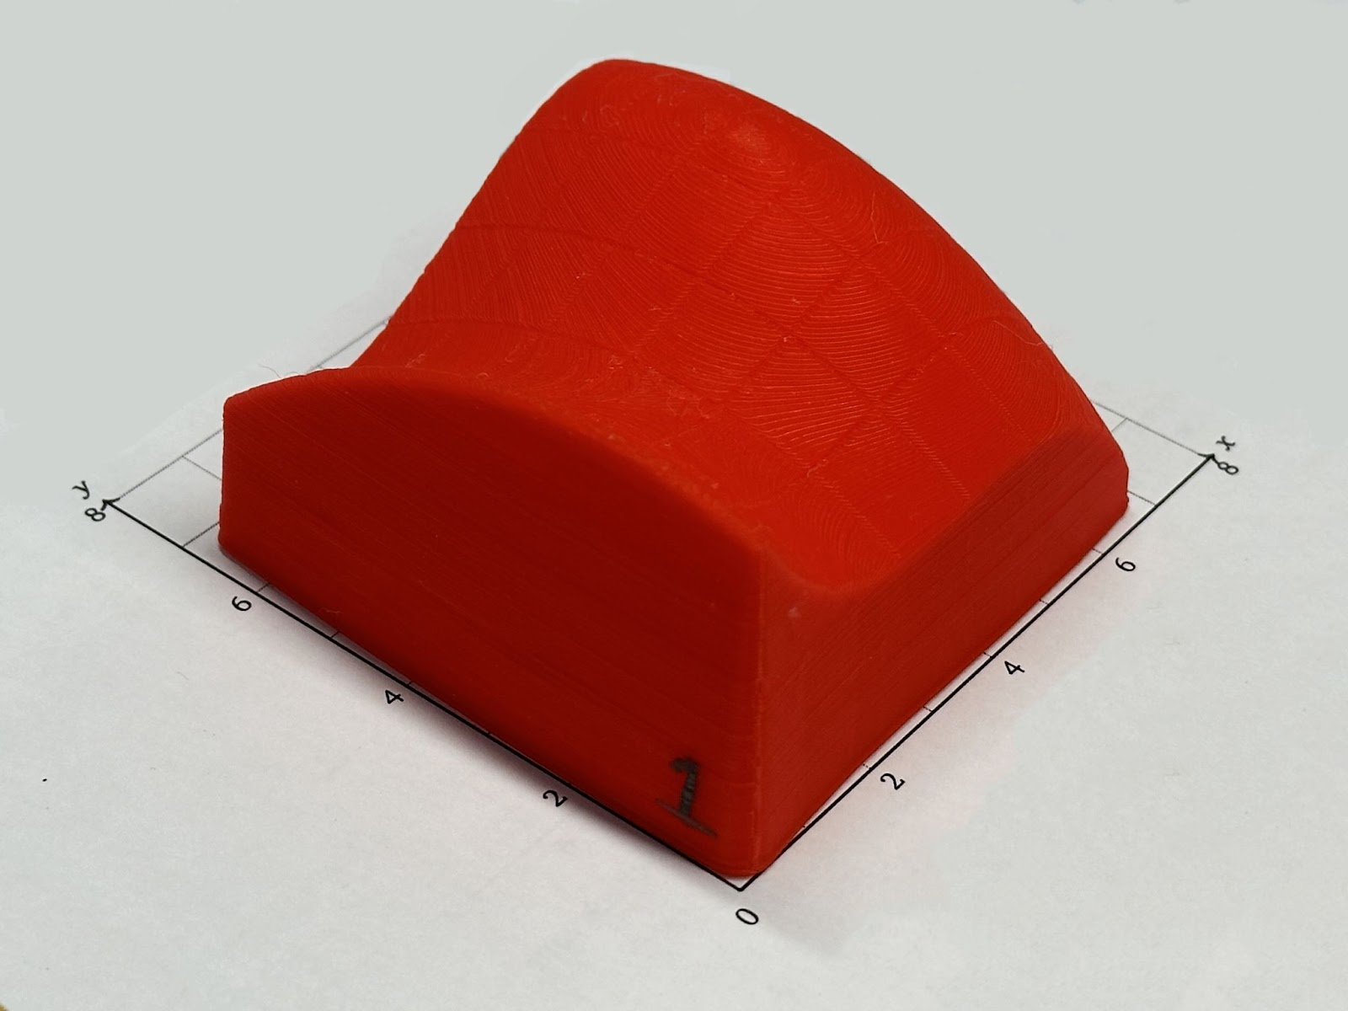
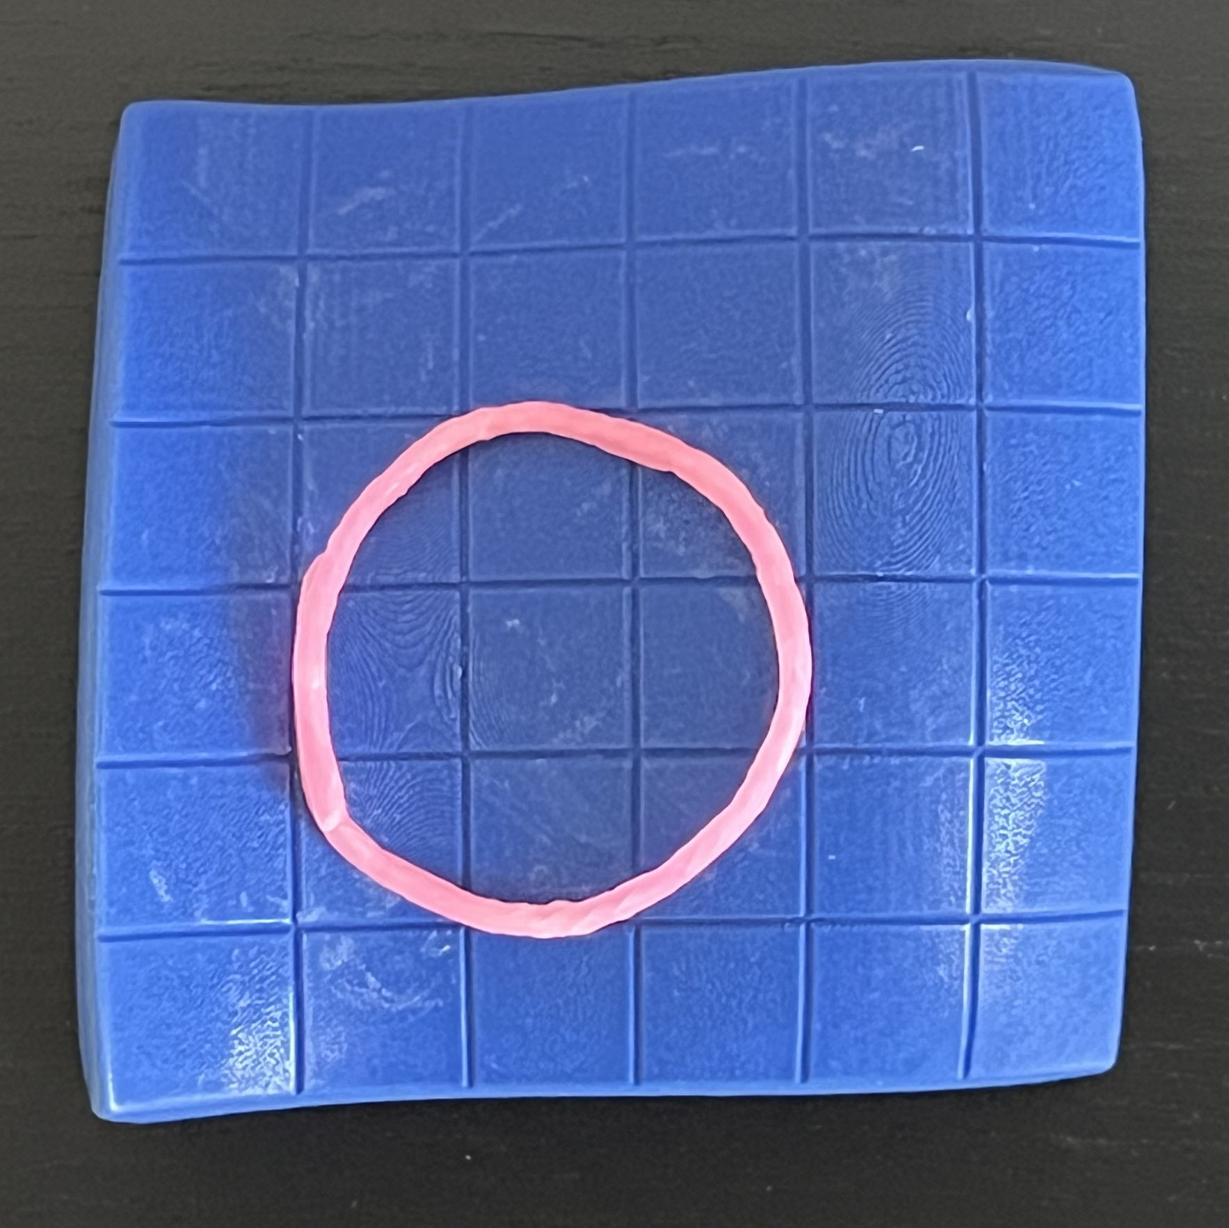
PREPARE YOUR MODEL
Please do NOT draw on your model!
Remember orientation
  Highest corner at (0,0)
  Lowest corner at (6,0)
Affix wax craft stick
  Centre at (2.5,2.5)
  Radius 1.5

Slide 4
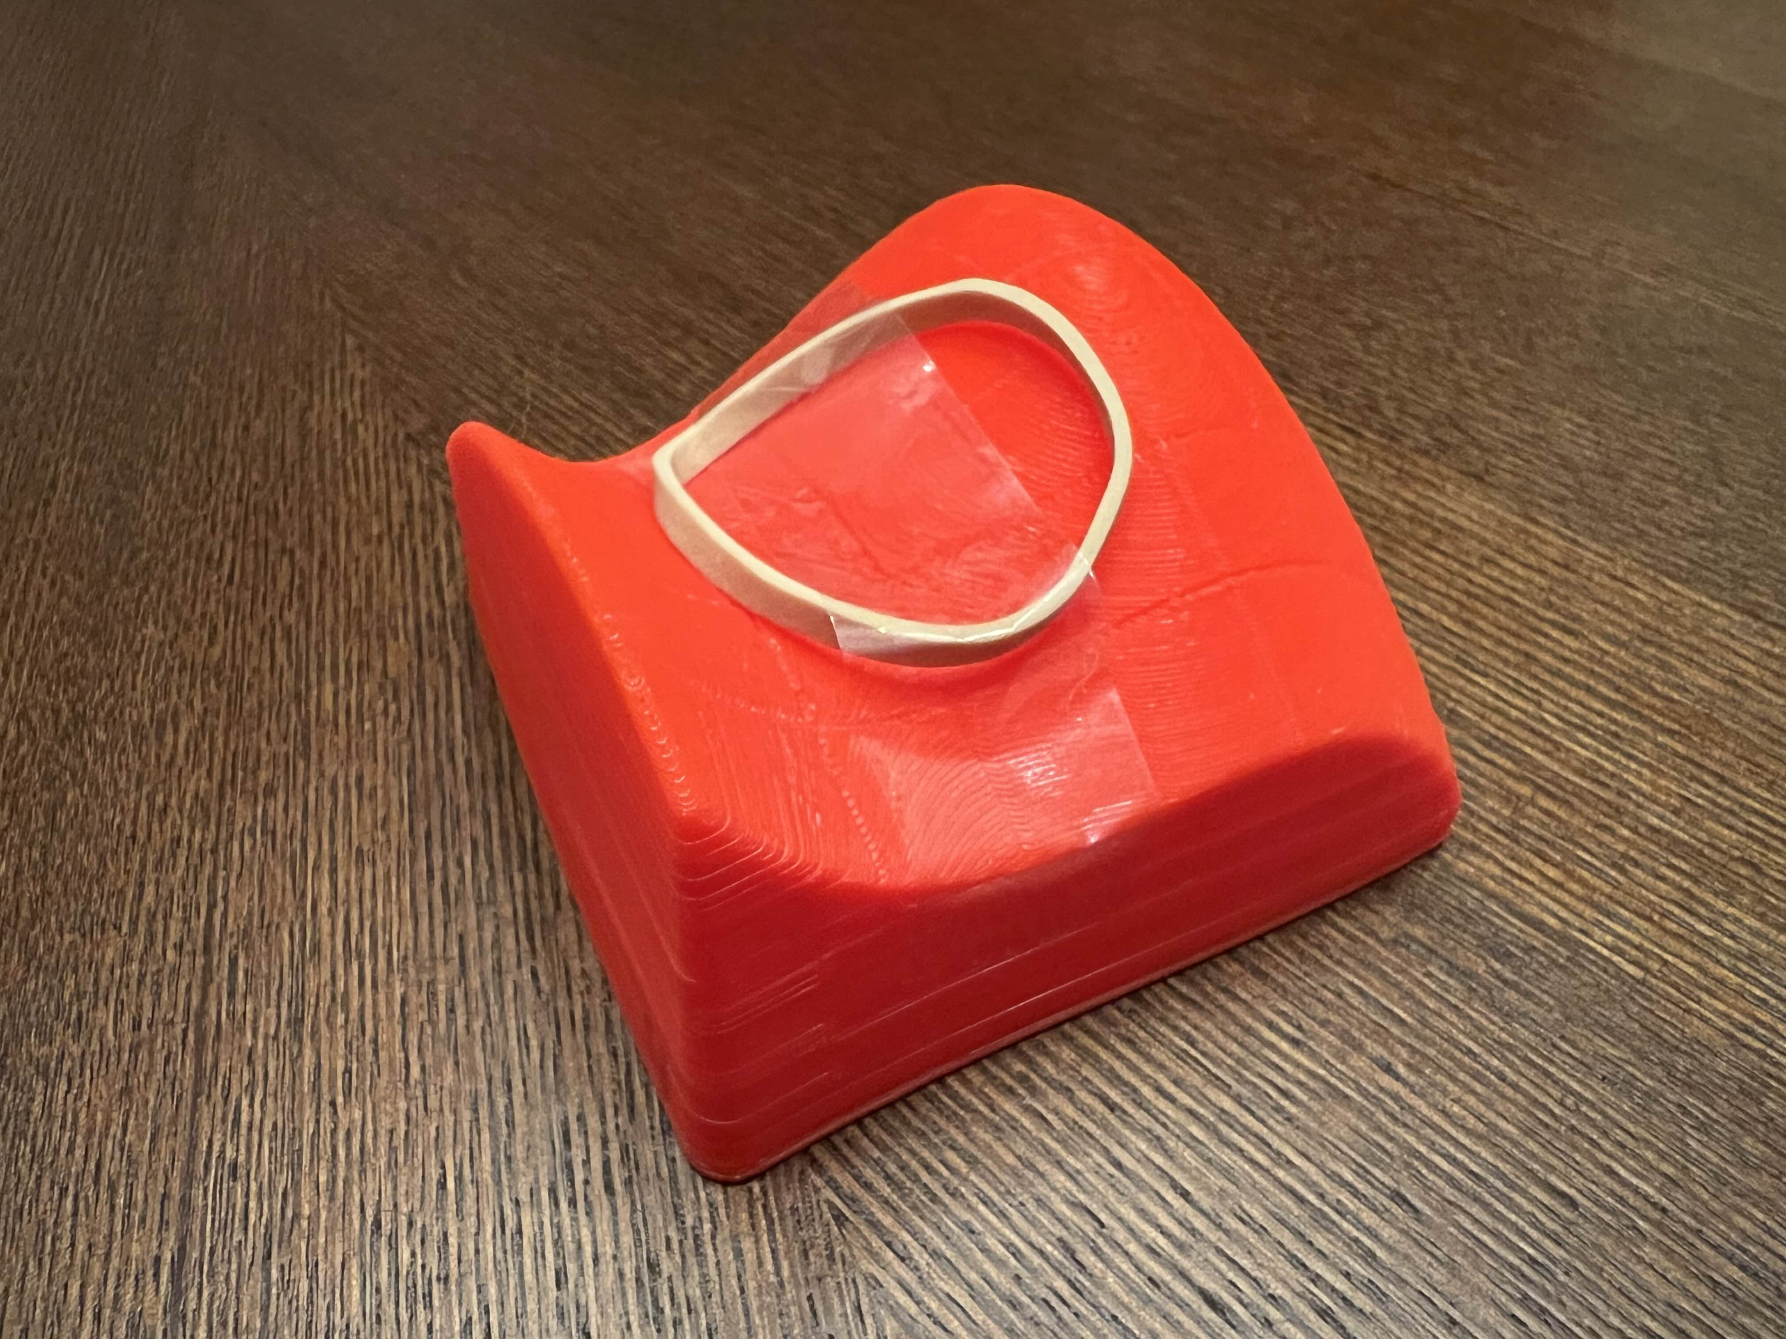
Q1. ANALYZE THE CONSTRAINT
Remember orientation
  Highest corner at (0,0)
  Lowest corner at (6,0)
Discuss (a)—(g) together.
Use Math3D links on worksheet to check your answers.
Once asked, send your messenger.
Please do NOT draw on your model!

Slide 5
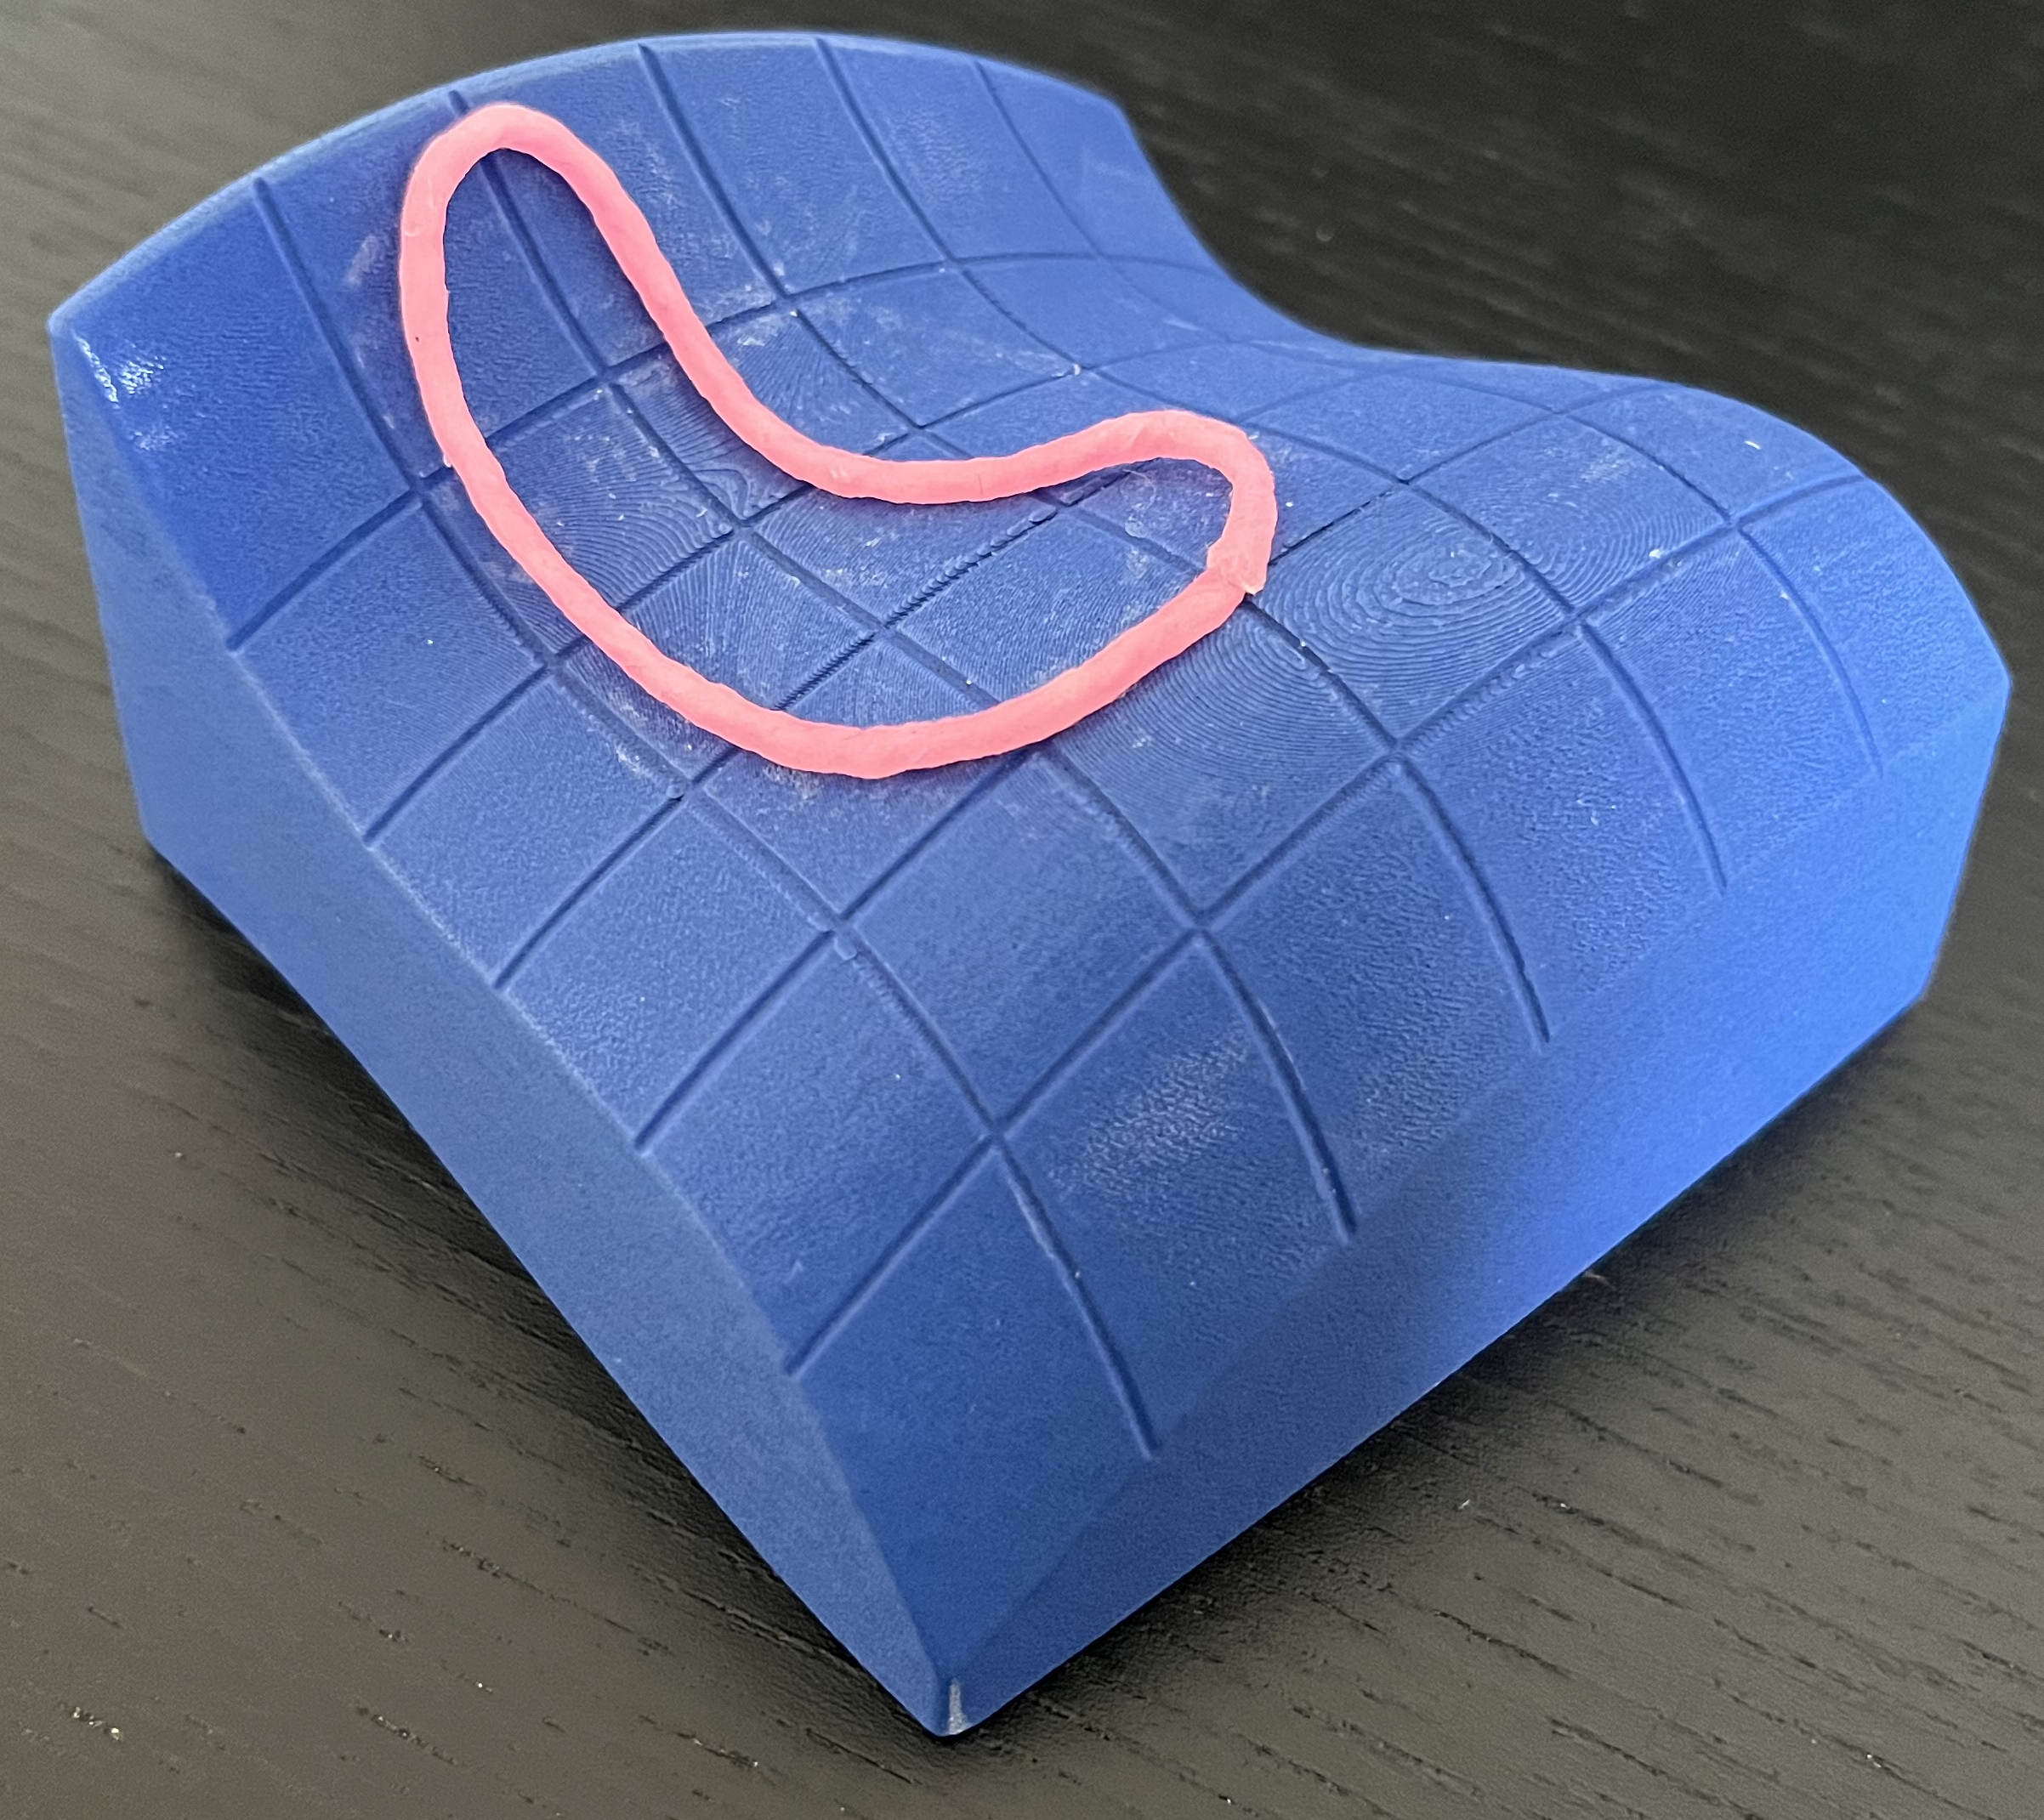
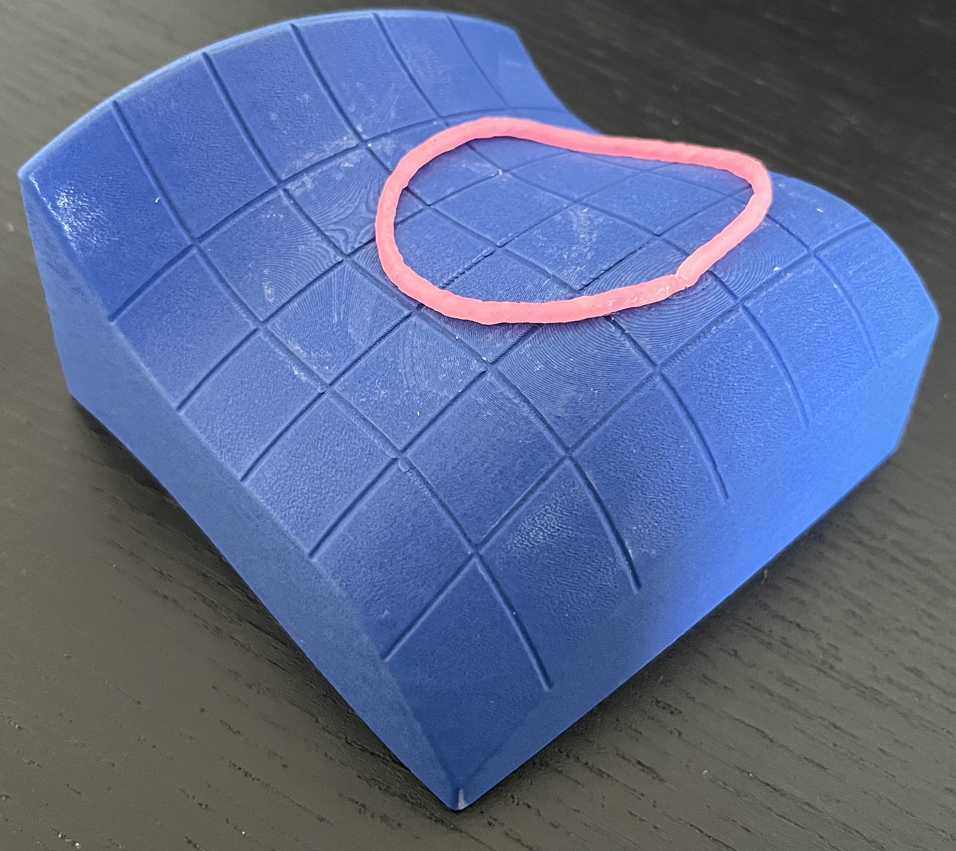
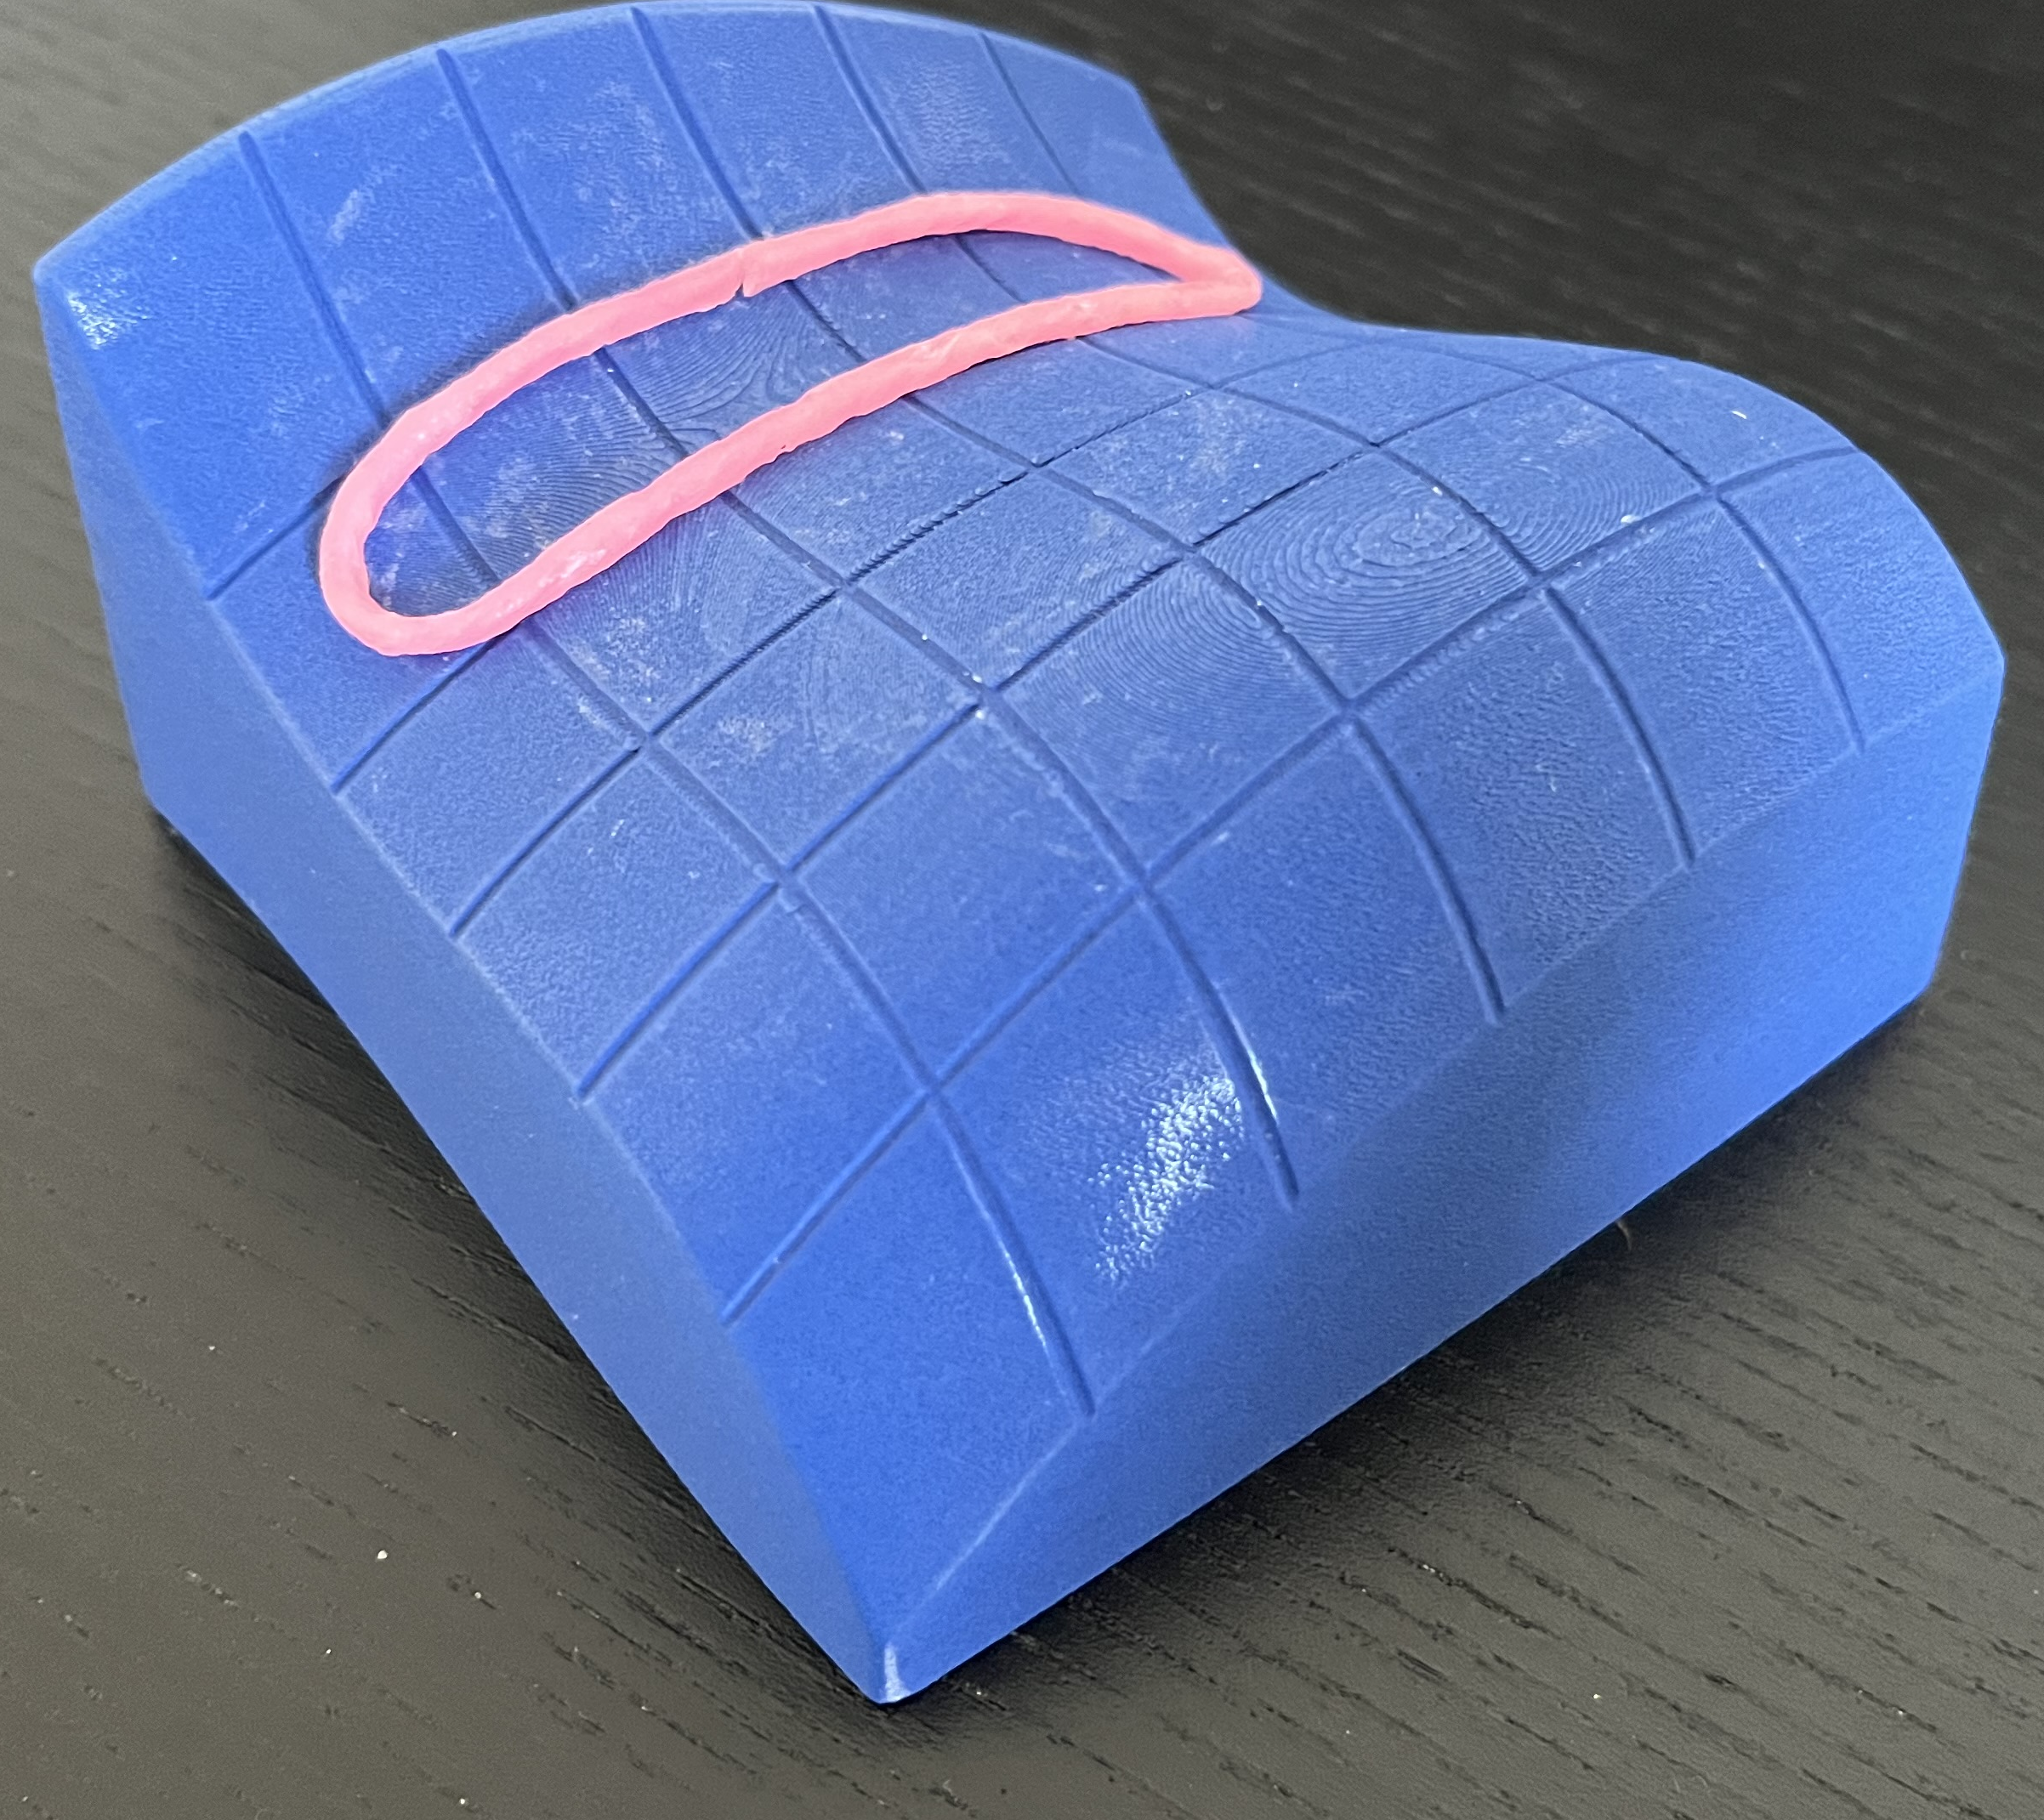
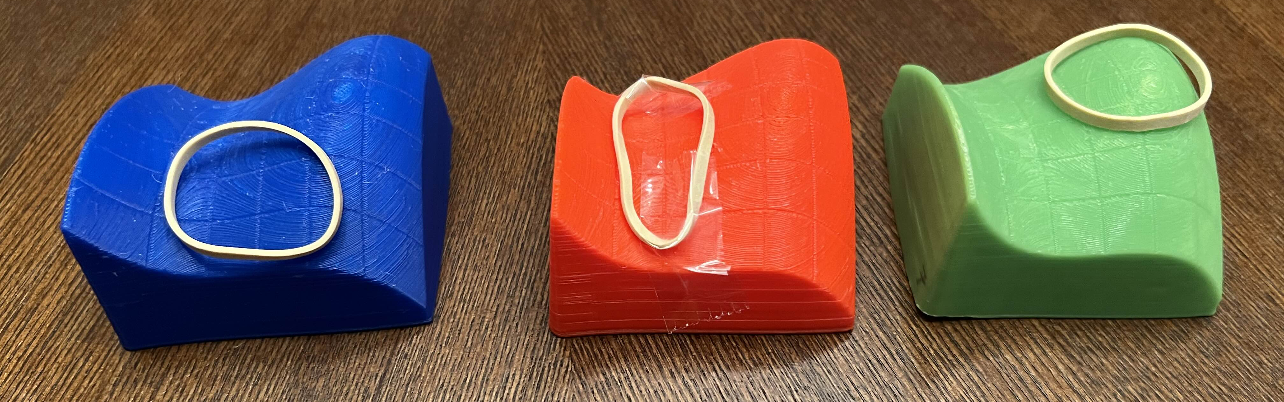
Q2. CONSTRAINT BONANZA
Remove wax craft stick.
Use craft stick to imagine new constraints!
Discuss (a) to (c) together.
If asked, send your messenger.

Slide 6
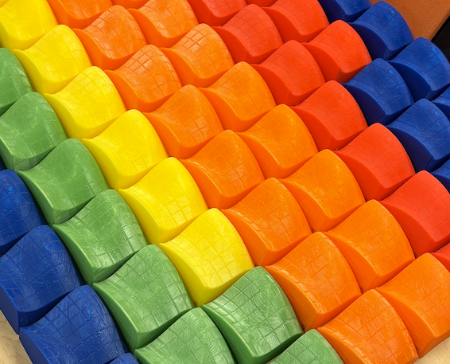
TELL US WHAT YOU THOUGHT
1. Submit this exit ticket
2. Return your 3D model and wax craft stick
(actual QR code removed)
Your response will be anonymous!

Slide 7
GOOD LUCK WITH FINALS!
See you next year ☺

