Slide 1
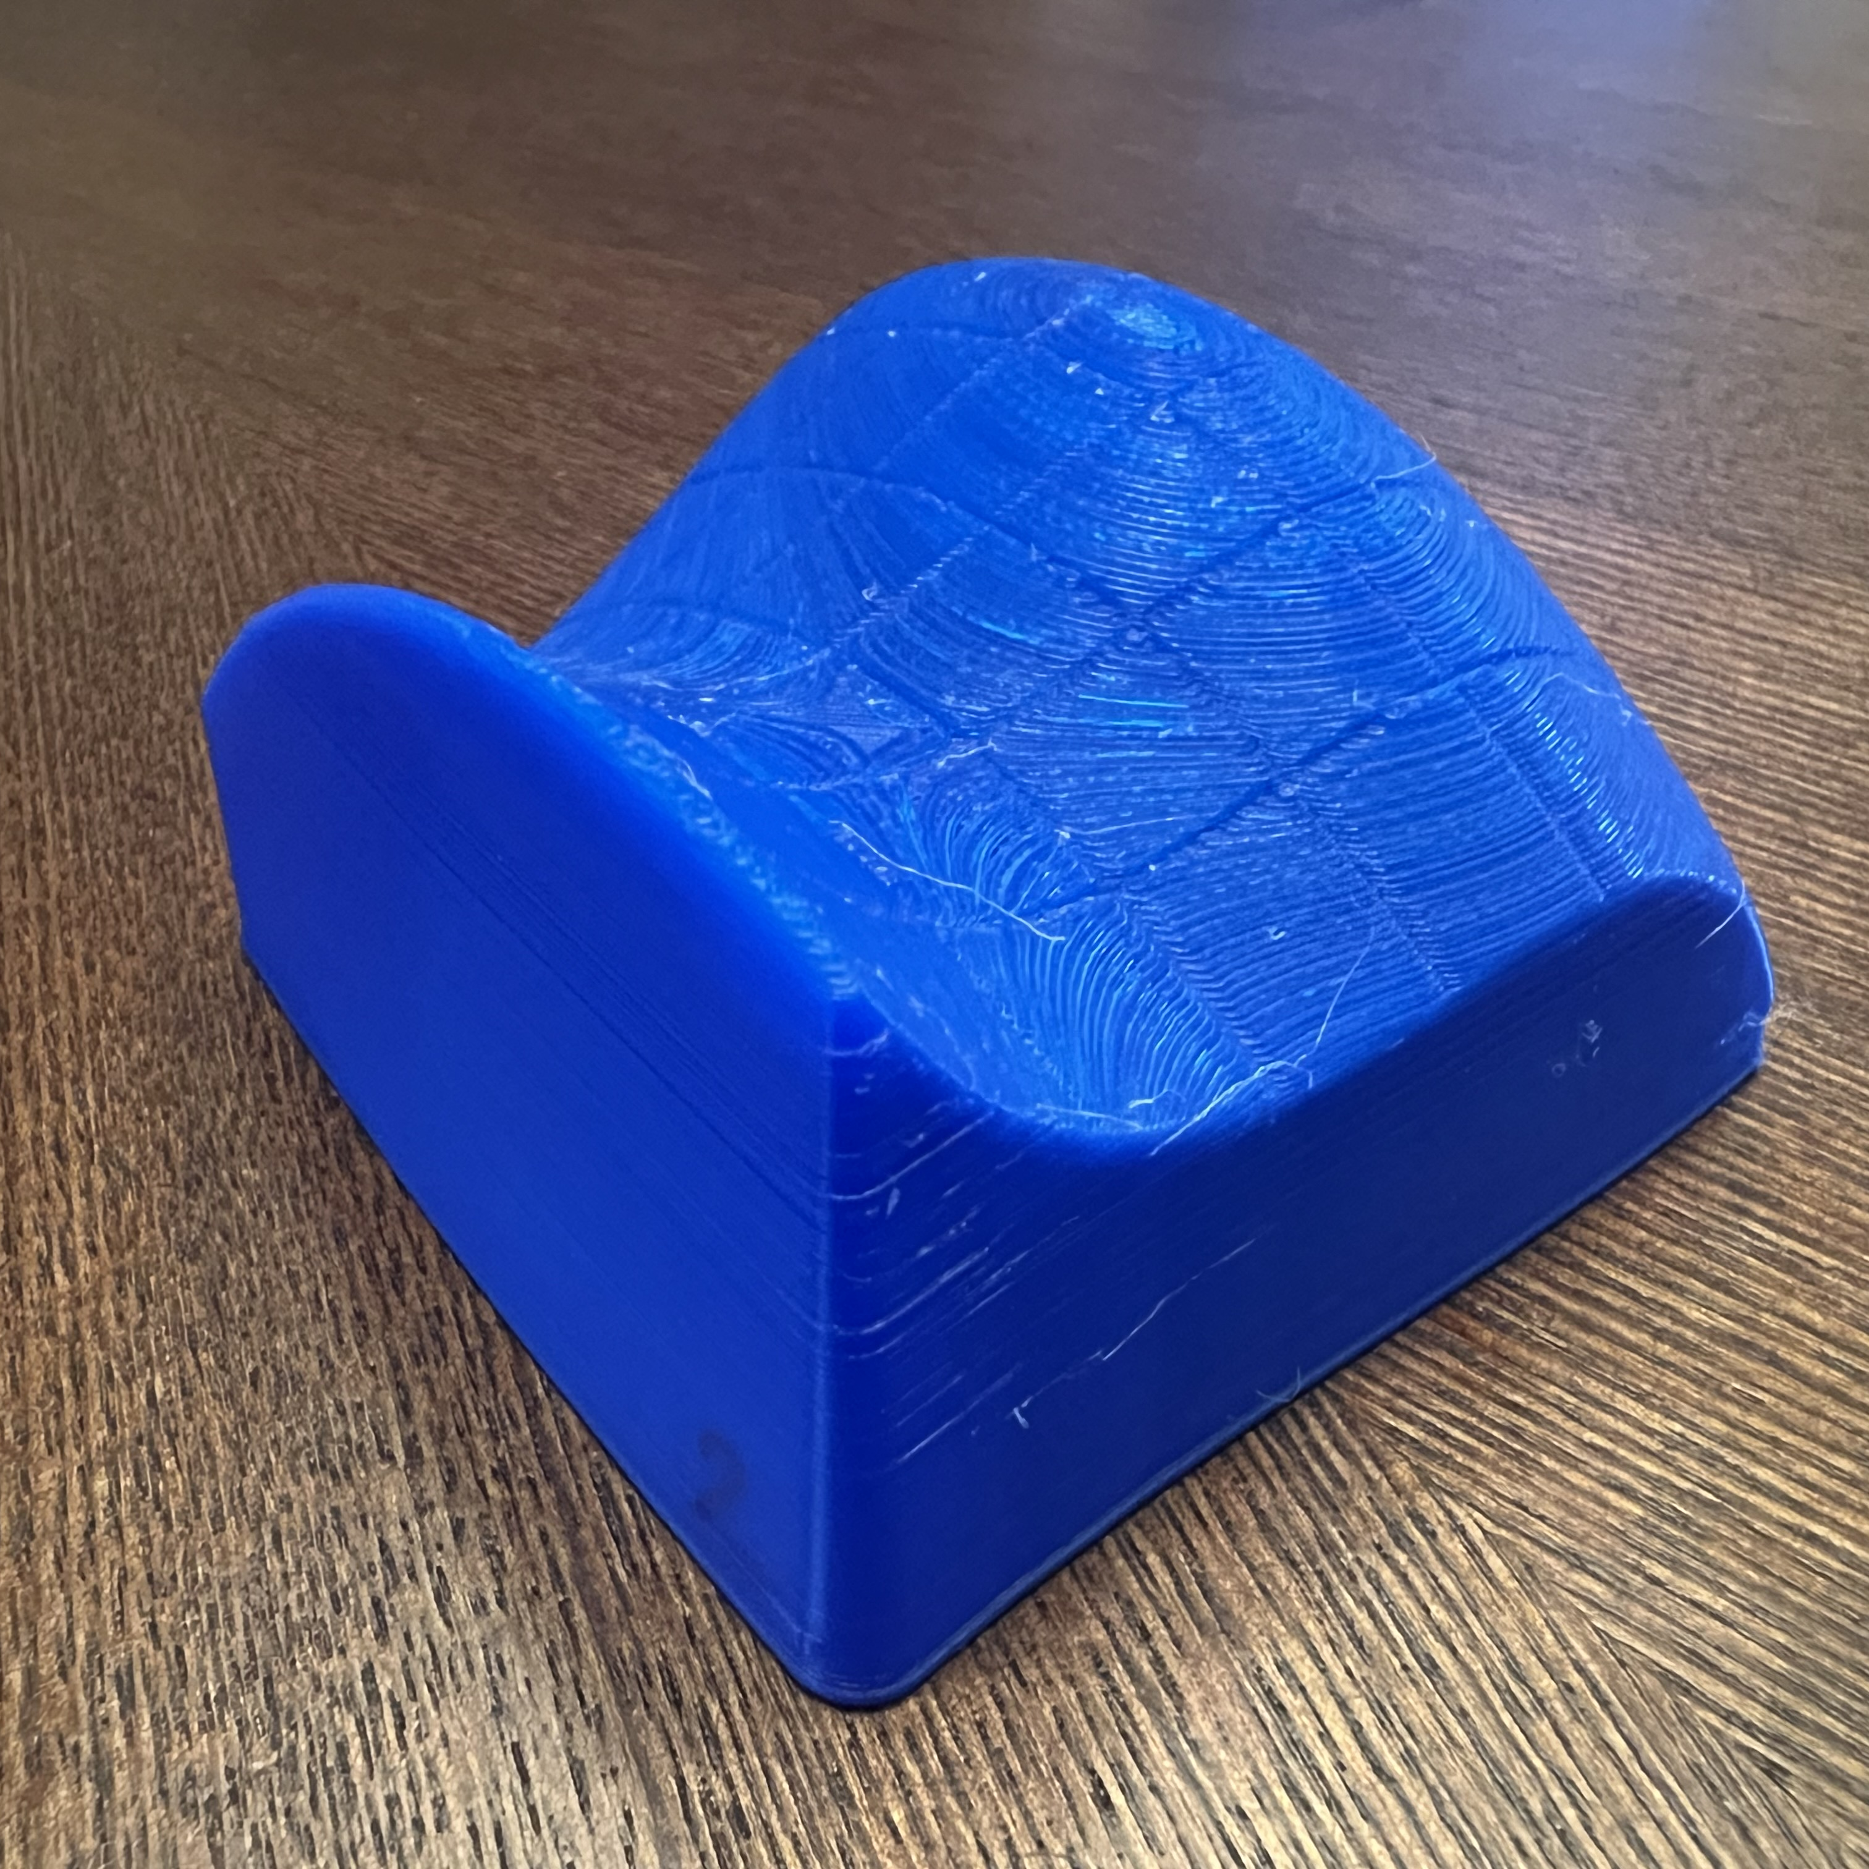
HANDS-ON INTEGRALS
MAT237 TUTORIAL 11
WELCOME BACK!!

Slide 2
TEAMWORK
Decide as a team on your answers.
SCRIBE writes ideas on worksheet.
Spend about 15 minutes per page.
MESSENGER will share your group’s conclusions with the class.
CALCULATOR will use their computer to calculate values.

Slide 3
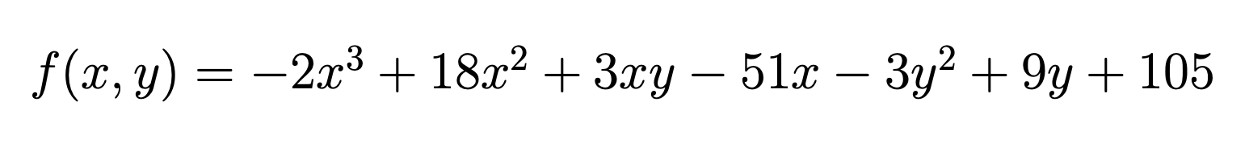
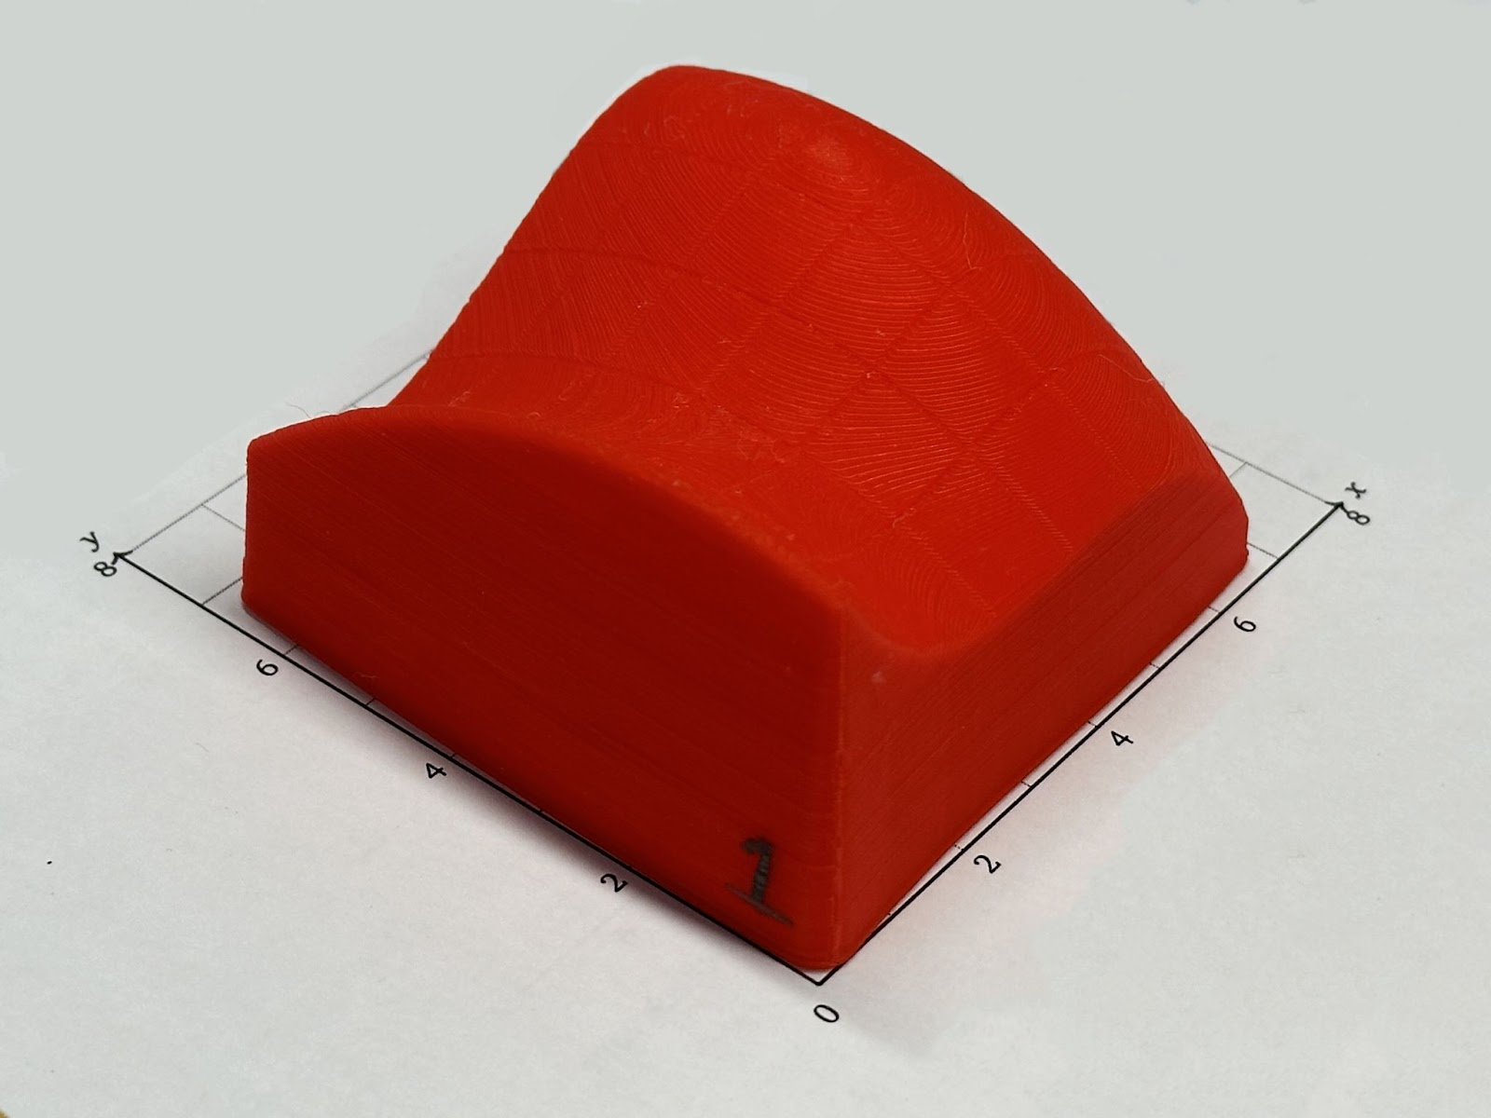
THE FUNCTION
Record this formula in your worksheet.
Please do NOT draw on your model!

Slide 4

Q1. UPPER AND LOWER SUMS
Discuss (a)—(d) together.
If asked, send your messenger.
Orient your model.
Highest corner (0,0)
Lowest corner (6,0)
Open this Desmos calculator AFTER completing part (a):
desmos.com/calculator/hywh5rjlft

Slide 5
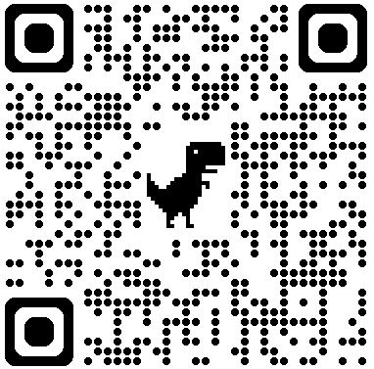
Q2. THE ENDLESS UPPER SUM
Discuss (a)—(c) together.
If asked, send your messenger.
Scan the QR code on the left to open a Desmos page for computing values of the function. You will need it a lot!
Please do NOT draw on your model
desmos.com/calculator/1qobiyezaz

Slide 6
Q3. LOOK BACK & DIG DEEPER
Discuss (a)—(c) together.
If asked, send your messenger.

Slide 7
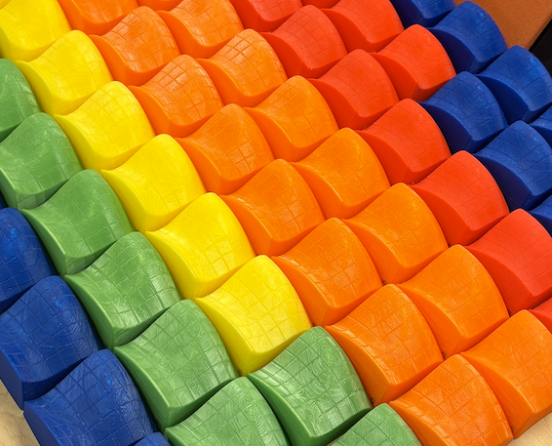
TELL US WHAT YOU THOUGHT
1. Submit this exit ticket
2. Return your 3D model
(actual QR code removed)
Your response will be anonymous!

