Slide 1
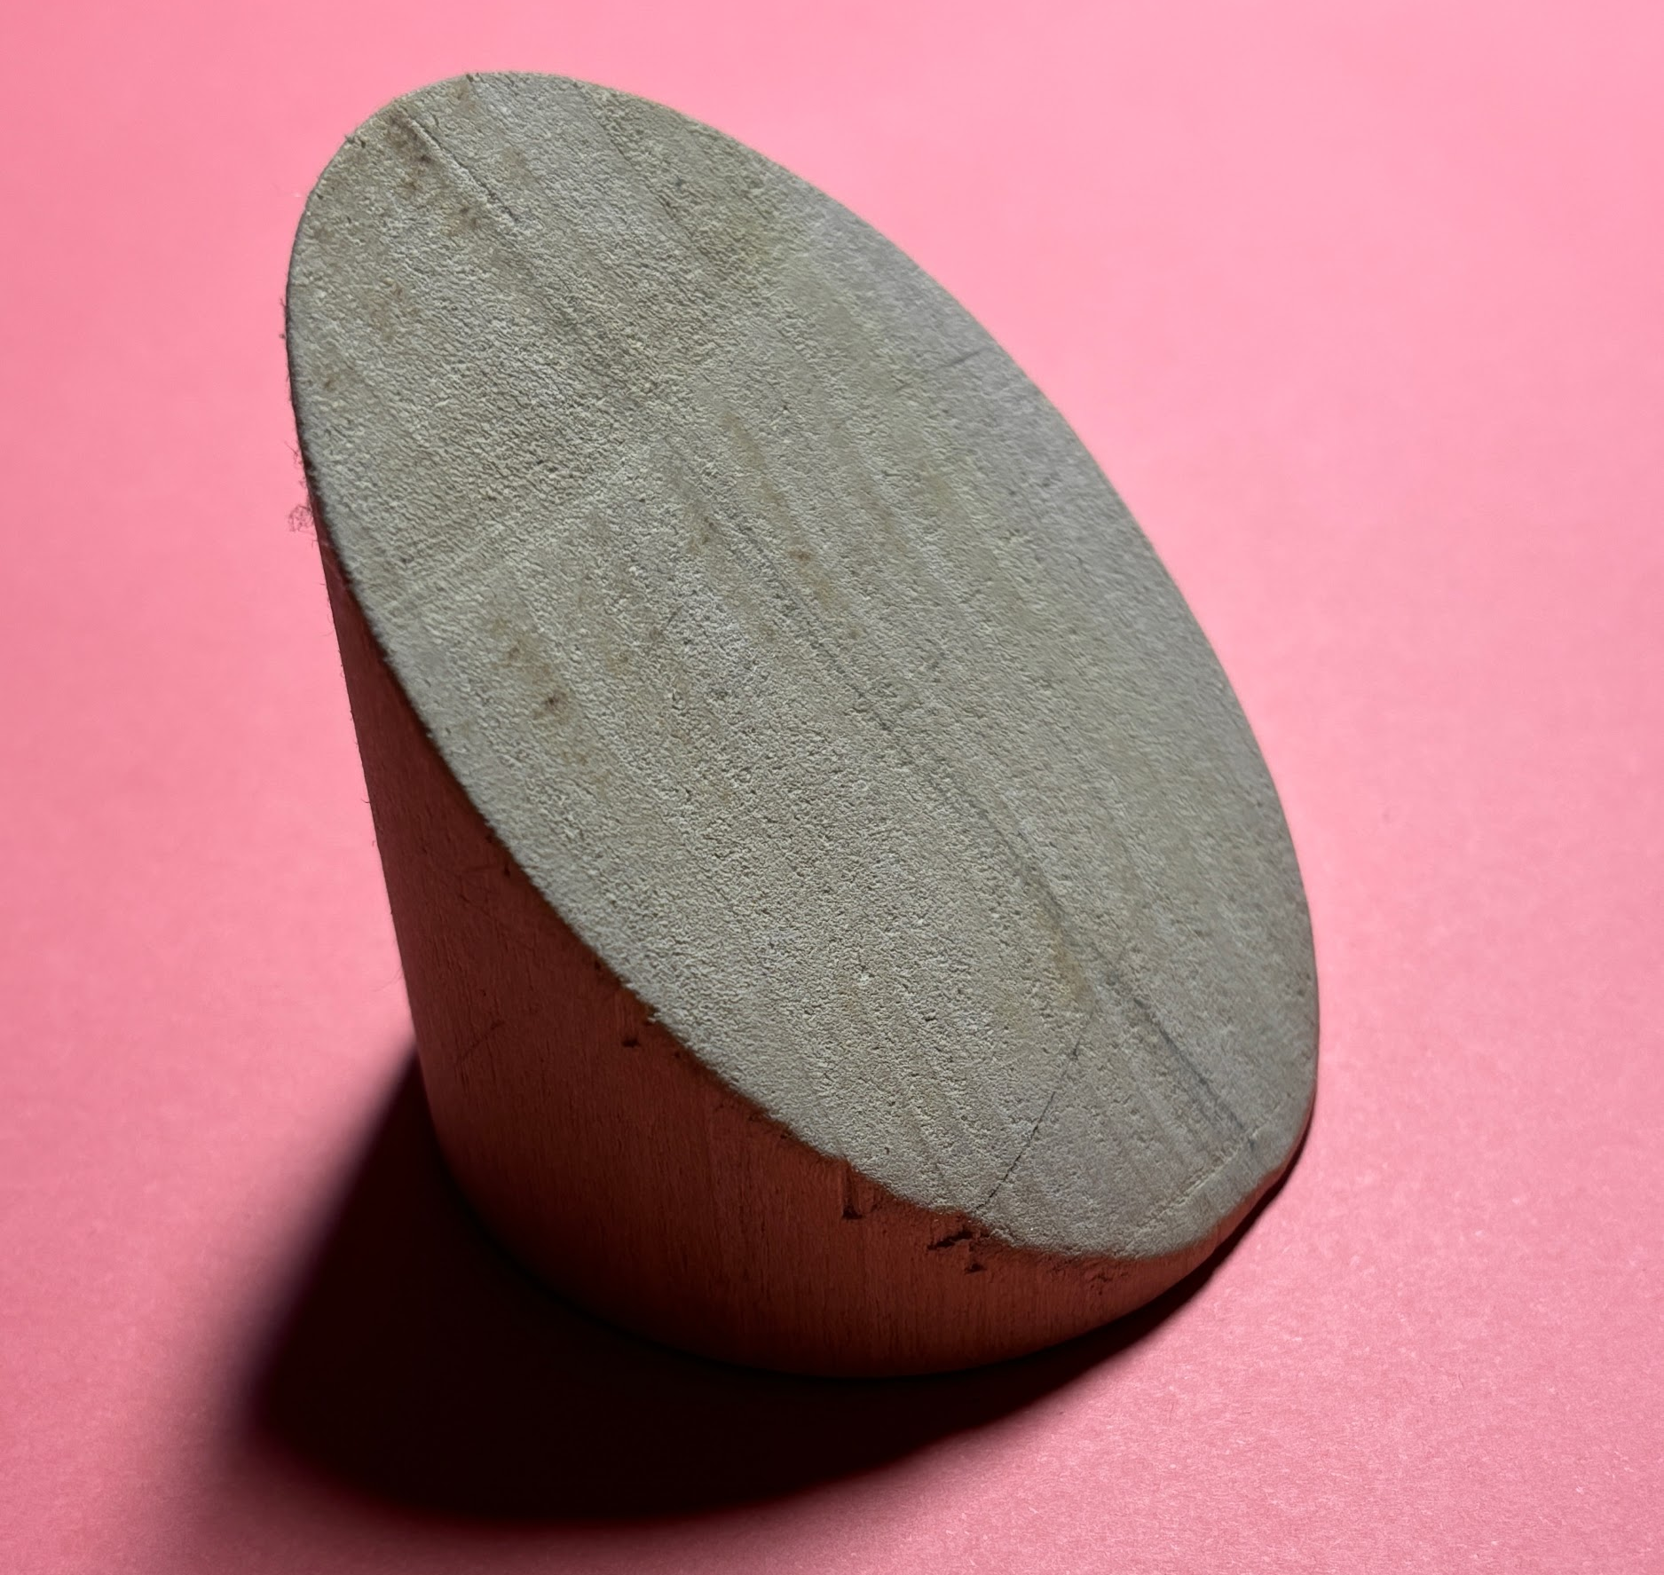
HANDS-ON
TRIPLE INTEGRALS
MAT237 TUTORIAL 15
WELCOME TO THE
CHEESE WEDGE FACTORY!!

Slide 2





TEAMWORK
Decide as a team on your answers.
Spend about 15 minutes per page.
SCRIBE writes ideas on worksheet.
BOOKWORM will use the computer for Math3D demos and textbook lookups.
MESSENGER will share your group’s conclusions with the class.

Slide 3
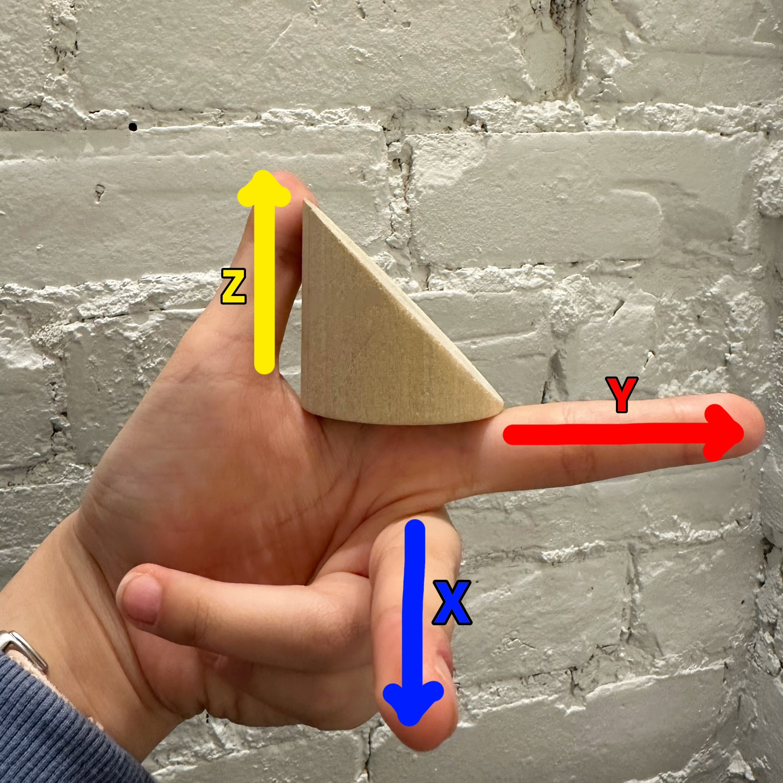
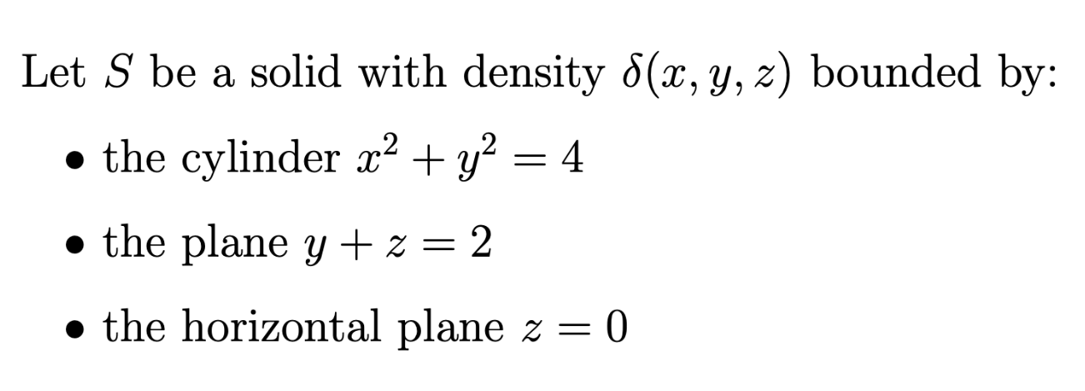
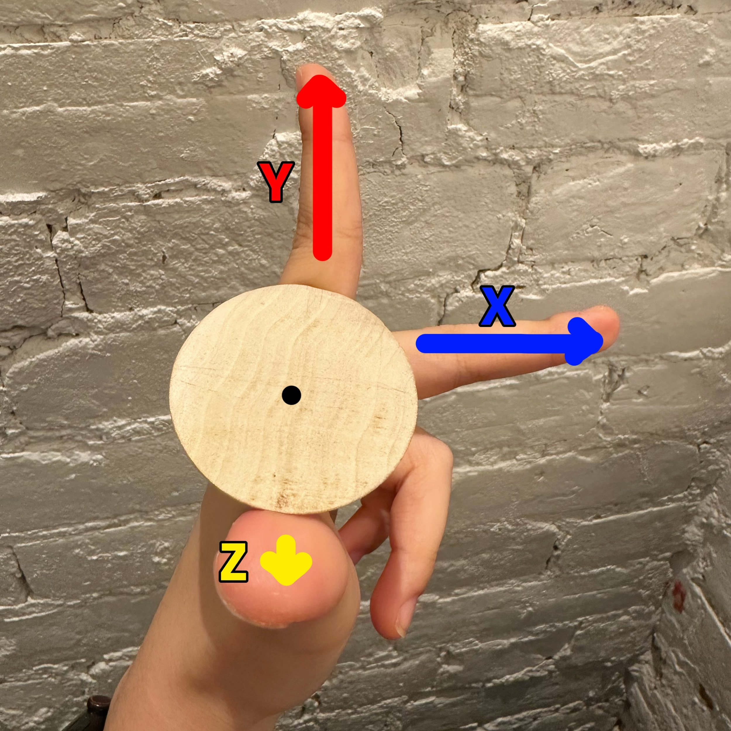
THE SOLID & ORIENTATION
Record these formulas on your worksheet. You will need them!
Use your LEFT hand!

Slide 4



Q1. SLICES & PROJECTIONS
Orient your model with your LEFT hand.
Discuss (a)—(e) together.
If asked, send your messenger.
Please DO NOT draw on your model!

Slide 5
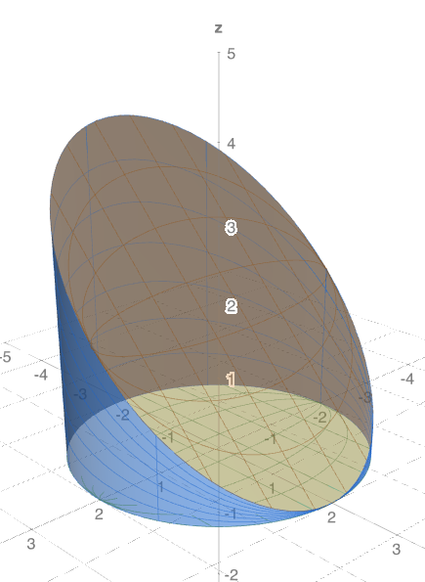
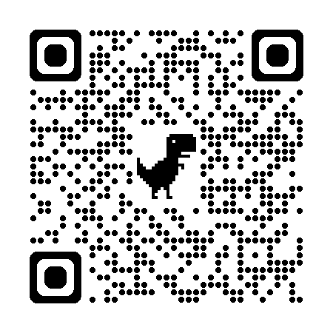
MATH3D REPLICA
Scan this QR code to open the Math3D replica if it helps!
https://www.math3d.org/7VsWfviC6y

Slide 6
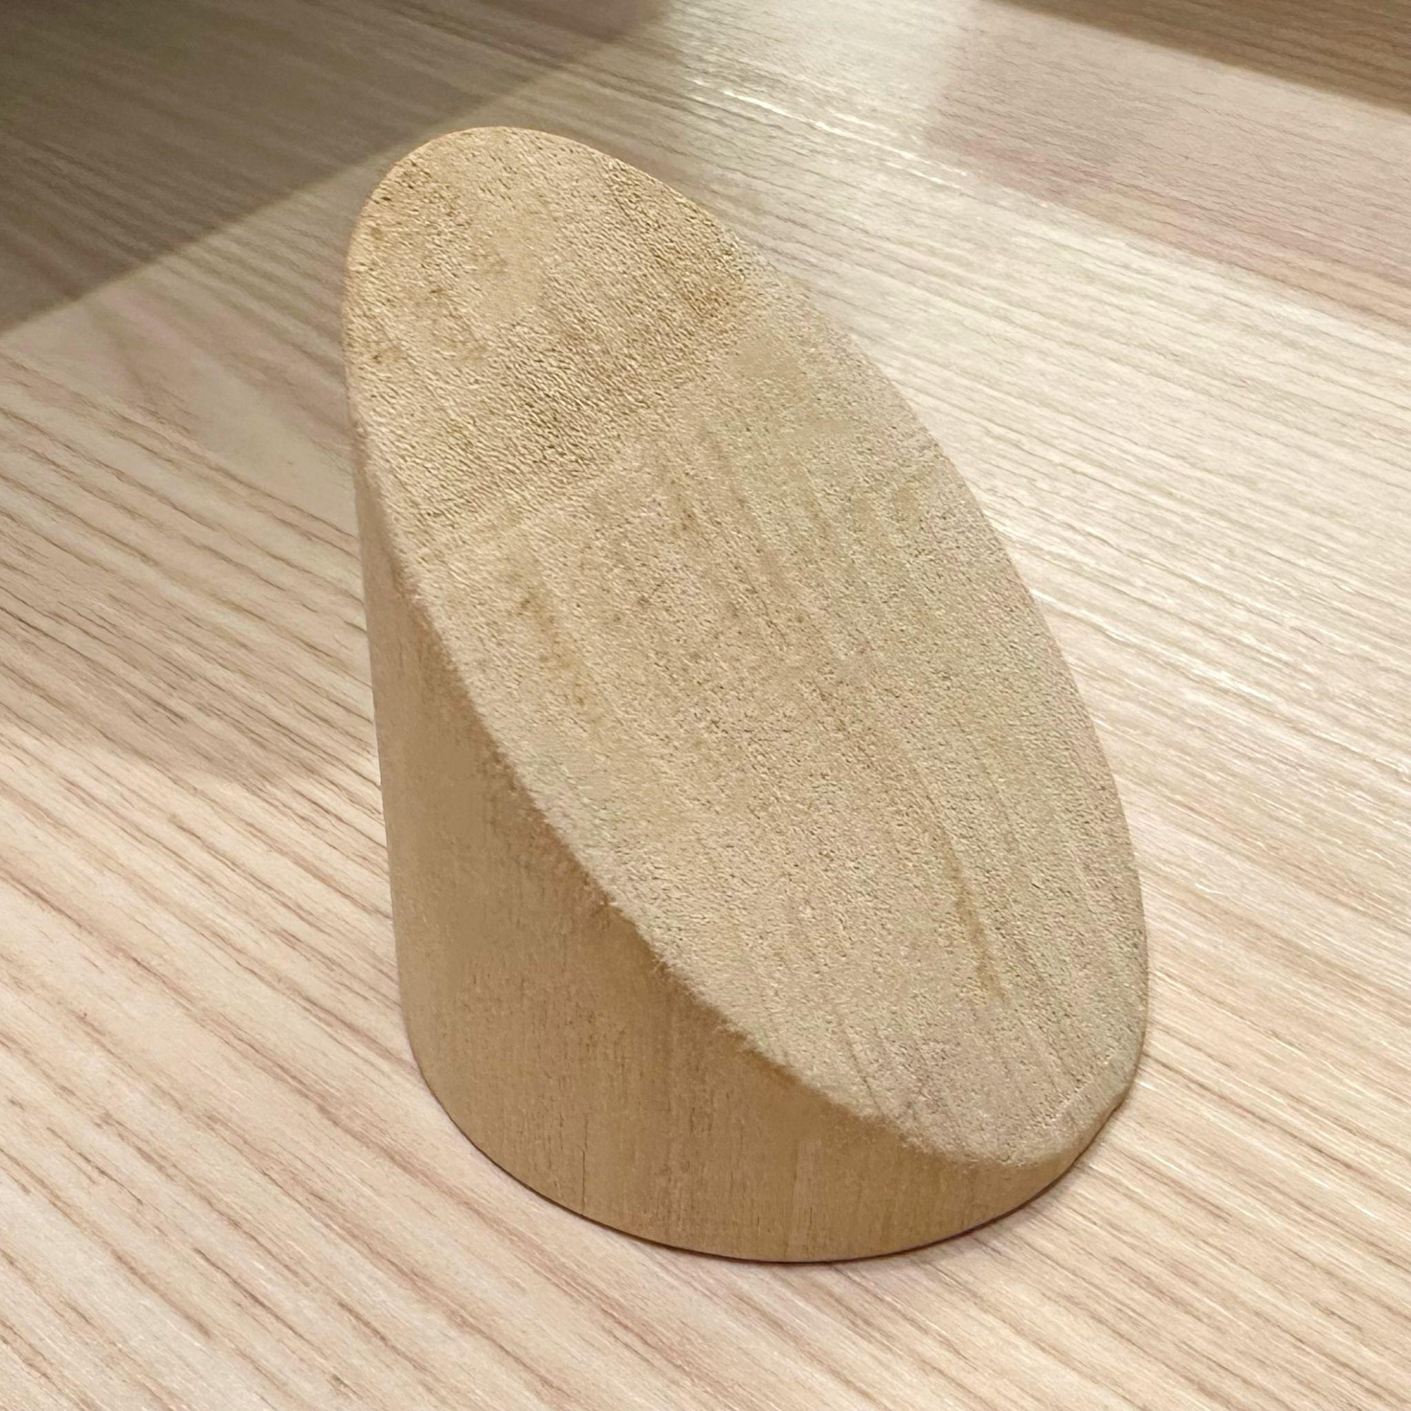
Q2. INTEGRATE dz dx dy
Do not draw on your model!
Discuss (a)—(d) together.
Work with other groups!
If asked, send your messenger.

Slide 7

Q3. INTEGRATE dx dy dz & dy dx dz
Discuss (a)—(b) together.
If asked, send your messenger.

Slide 8

PLEASE CLEAN & RETURN YOUR MODEL,
AND SUBMIT THIS EXIT TICKET!
We’d really like to hear about your tutorial experience. ☺
(actual QR code removed)

