Slide 1
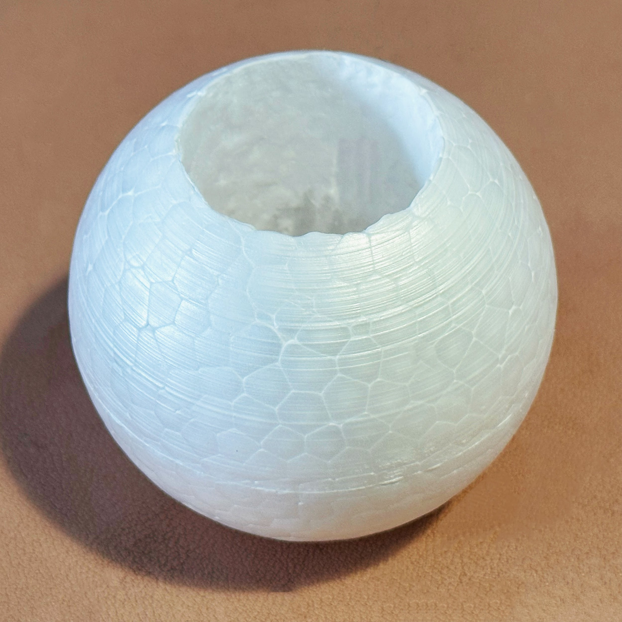
HANDS-ON
TRIPLE INTEGRALS II
MAT237 TUTORIAL 16
WELCOME TO BEADING 101!!

Slide 2





TEAMWORK
Decide as a team on your answers.
Spend about 15 minutes per page.
SCRIBE writes ideas on worksheet.
BOOKWORM will use the computer for Math3D demos and textbook lookups.
MESSENGER will share your group’s conclusions with the class.

Slide 3
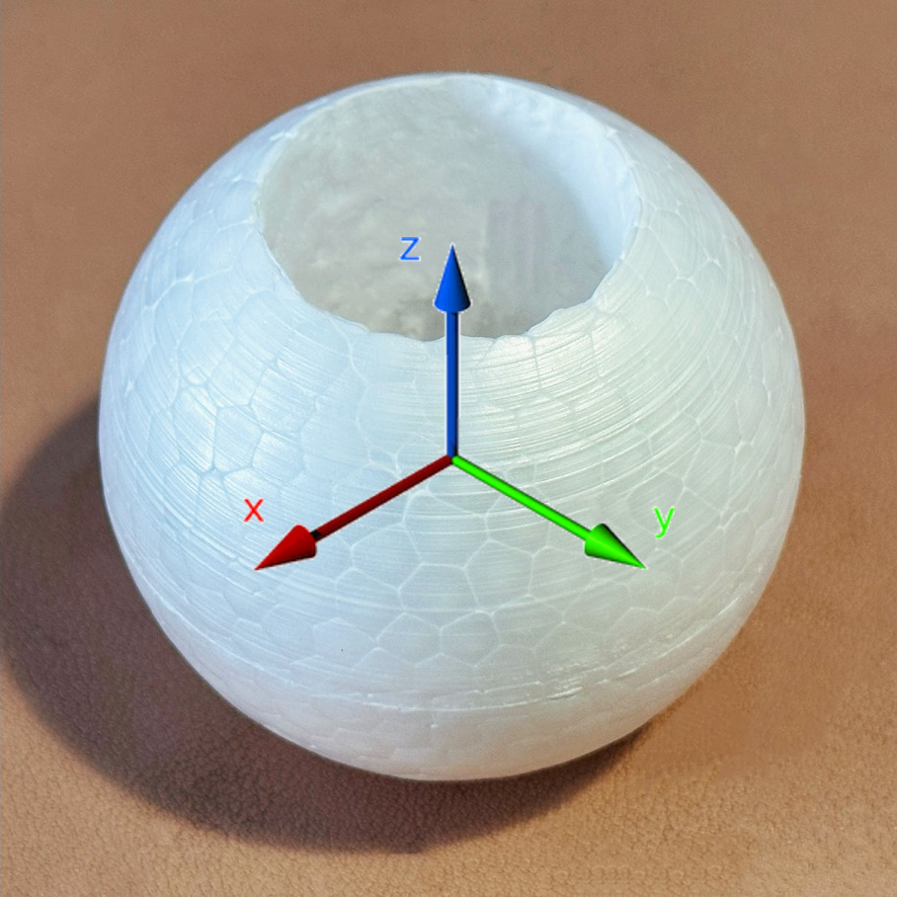
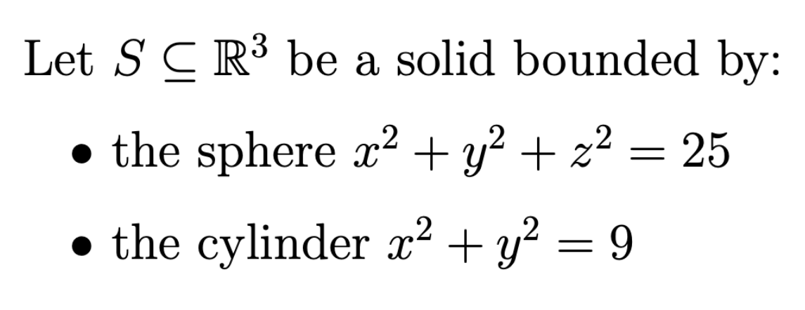
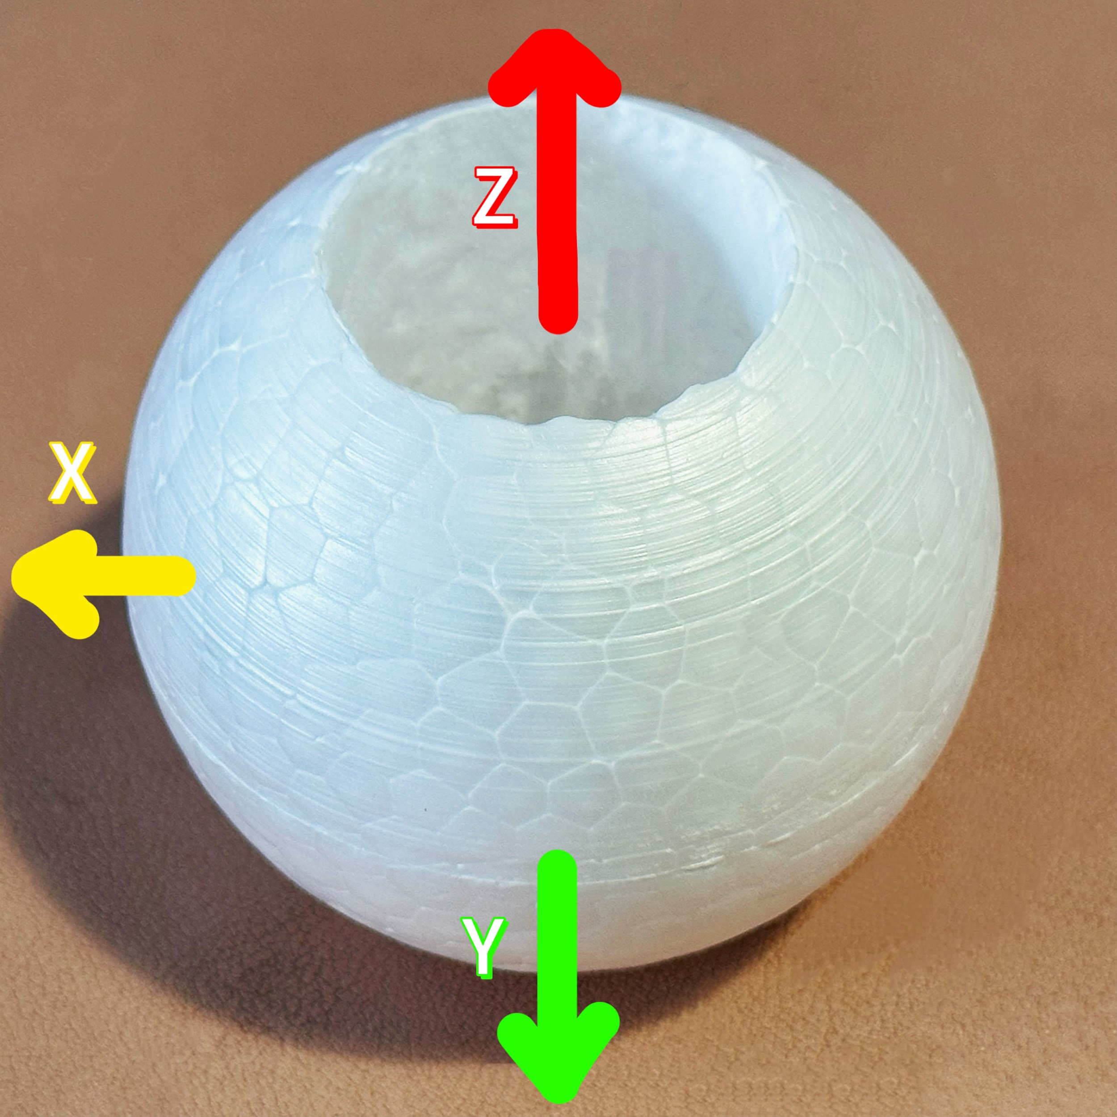
THE SOLID & ORIENTATION
Record these formulas on your worksheet. You will need them!

Slide 4



Q1. CYLINDRICAL & Q2. SPHERICAL
Orient your model.
Discuss all parts together.
If asked, send your messenger.
Please DO NOT draw on your model!

Slide 5
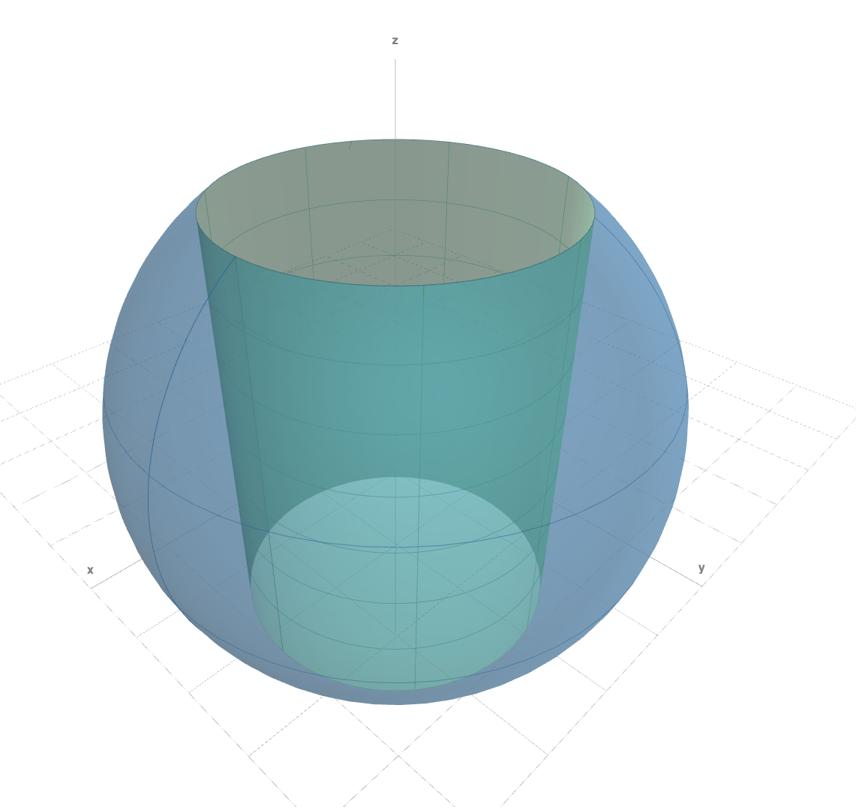


MATH3D REPLICA
Scan this QR code to open the Math3D replica if it helps!
https://www.math3d.org/L7WQUs7SRC

Slide 6

Q3. VOLUME AS TRIPLE INTEGRALS
Use your previous work in Q1 and Q2 and, if it helps, the Math3D demo.
Discuss (a)—(c) together.
If asked, send your messenger.
(same Math3D demo)

Slide 7
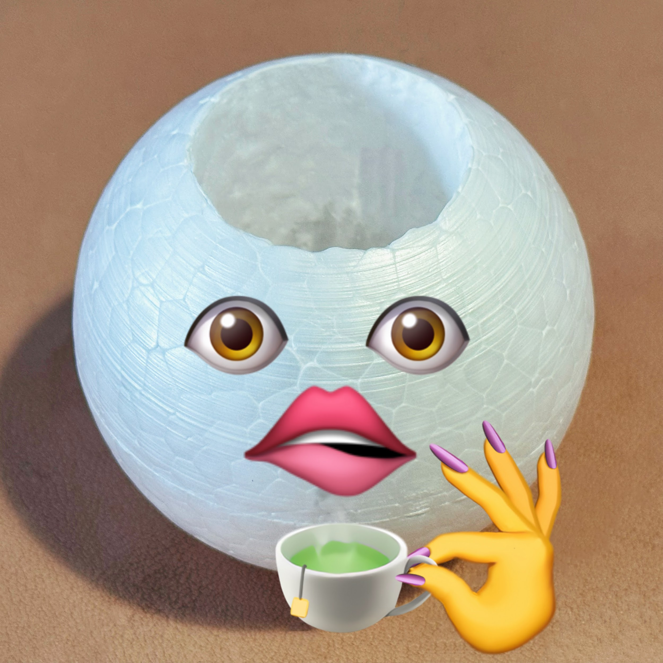
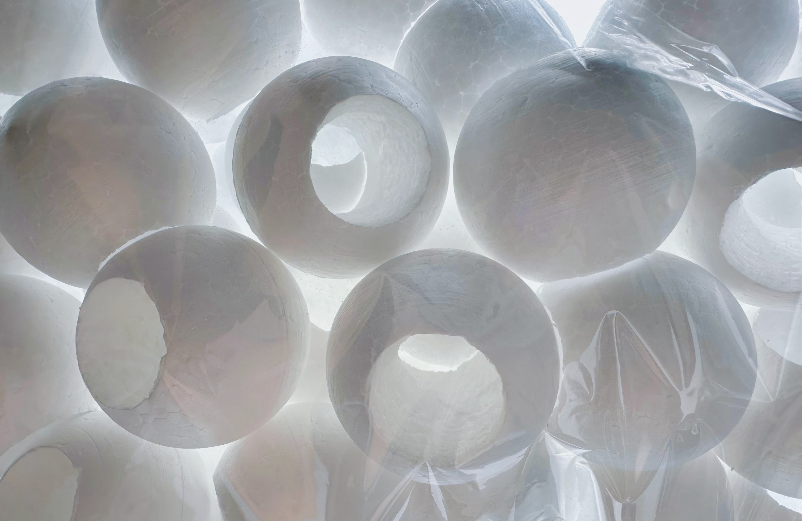
PLEASE RETURN YOUR MODEL AND SUBMIT THIS EXIT TICKET!
We’d really like to hear about your tutorial experience. ☺
(actual QR code removed)

