Slide 1



Inventory Management and Sales Visualization System
Alliance University
Alliance School of Advanced Computing
Advanced Python Programming Micro-Project
Course Code: E1CSA348
Submitted by: Hithesh Reddy(1123)
Mahammad Asif(1151)
Kishwar Sahil(1176)
Course In-charge: Dr.CHETHAN J SHELKE
Notes:
Introduce the project: a Python desktop application for inventory management and sales visualization for Advanced Python Programming (E1CSA348). Mention team members and the course in-charge.

Slide 2



Problem Statement & Objectives
Problem Statement
Objectives
Manual inventory management requires repeated stock updates, sales calculations and record checking. It can be difficult to quickly identify available stock and sales performance.
Develop a simple inventory management application.
Store product and sales information using SQLite.
Provide a user-friendly Tkinter GUI.
Automatically update stock after sales.
Analyze sales using Pandas.
Visualize category-wise sales using Matplotlib.
Stock updates
Sales calculations
Record checking
Notes:
Left: the problem with manual inventory management. Right: the six objectives, each matched by a feature in the application.

Slide 3






Technology Stack & System Architecture
Python
User
Core programming
Tkinter GUI
Tkinter
Graphical User Interface
App Class
SQLite
Persistent database
Inventory Class
Pandas
Data analysis
SQLite Database
Matplotlib
Data visualization
Pandas Analysis
OOP
Matplotlib Visualization
Program structure
Notes:
Left: the six technologies and what each does. Right: the architecture, top to bottom. The user works through the Tkinter GUI; the App class handles the interface, the Inventory class handles database operations on SQLite; Pandas analyses the sales data and Matplotlib draws the chart.

Slide 4
System Design & Workflow
Add Product
Enter Name / Category / Price / Stock
Store in SQLite
1
2
3
Inventory Class
Database operations
Product management
Sales processing
Display Inventory
Record Sale
Check Product & Stock
4
5
6
Calculate Sale Amount
Update Stock
Store Sale
7
8
9
App Class
GUI creation
User interaction
Analytics display
Analyze Sales
Generate Chart
10
11
Notes:
Follow the numbered steps. Steps 1-4 cover adding products and displaying inventory; steps 5-9 cover a sale: check product and stock, calculate the amount, update stock, store the sale; steps 10-11 are analysis and the chart. On the right, the Inventory class does database work and the App class builds the GUI and shows analytics.

Slide 5
Implementation & Sales Analytics
OOP
SQLite
Pandas
Matplotlib
Inventory class
App class
products table
sales table
DataFrame
Total revenue
Best-selling product
groupby()
Category-wise sales bar chart
PRODUCTS table
SALES table
ID
Name
Category
Price
Stock
Product
Category
Quantity
Total
Notes:
Top row: the four implementation pieces: OOP classes, the two SQLite tables, Pandas (DataFrame, total revenue, best-selling product via groupby) and the Matplotlib category-wise bar chart. Bottom: the structure of the products and sales tables; the empty rows only illustrate the table layout.

Slide 6
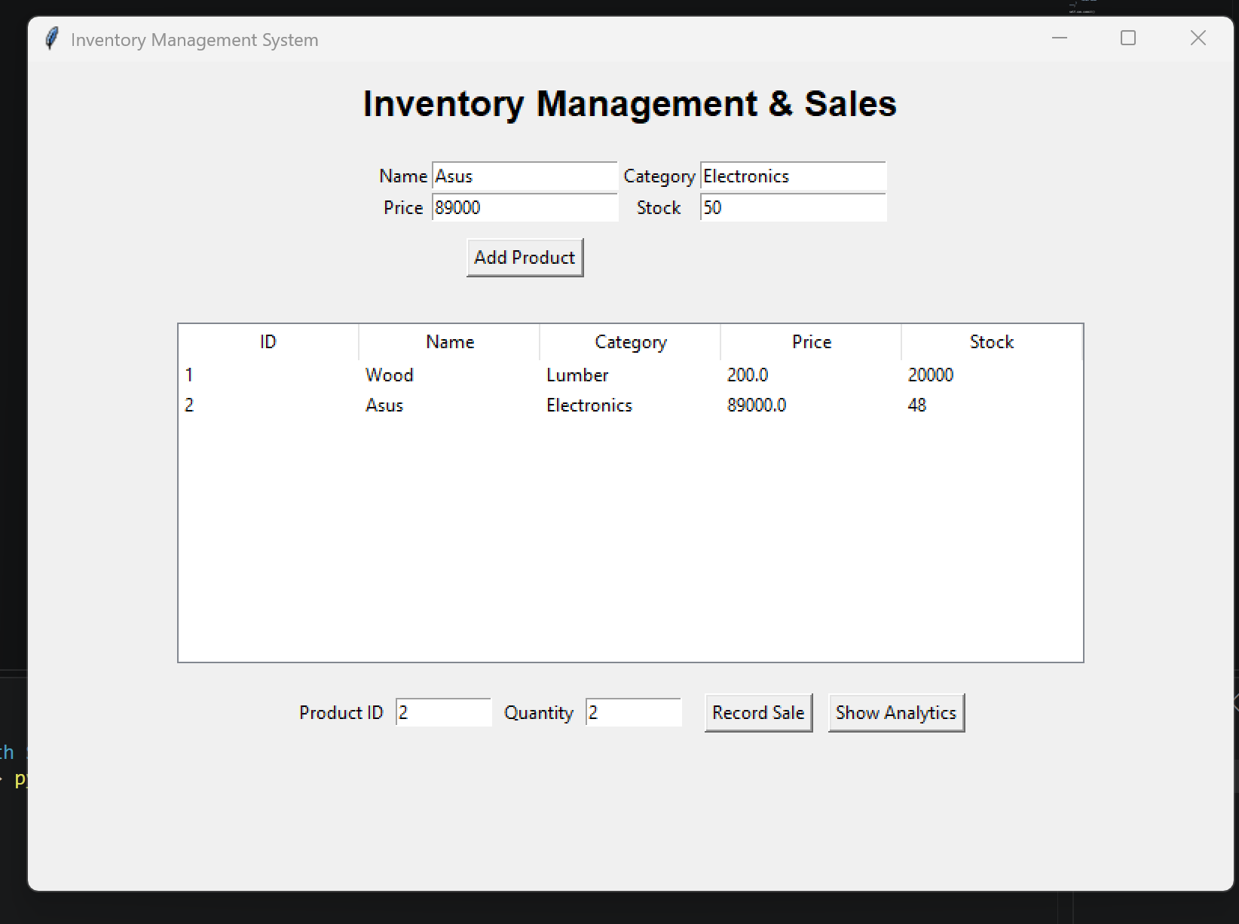
GUI Output & Results
Results
Products stored successfully
Inventory displayed through GUI
Sales recorded successfully
Stock reduced automatically
Revenue calculated
Best-selling product identified
Category-wise sales visualized
The screenshot should show: product input fields, inventory table, Product ID and Quantity fields, Record Sale and Show Analytics buttons.
Notes:
Replace the dashed placeholder with the real screenshot of the application window (it should show the input fields, inventory table, Product ID and Quantity, and the Record Sale and Show Analytics buttons). Delete the caption if the screenshot already makes this obvious. Demonstrate the results listed on the right.

Slide 7
Conclusion & Future Scope
Conclusion
Future Scope
The project successfully integrates Python, OOP, Tkinter, SQLite, Pandas and Matplotlib into a practical inventory and sales management application.
Possible future improvements, not implemented
Product search and filtering
Update and delete products
Low-stock alerts
Monthly sales reports
CSV/PDF export
Web-based multi-user version
Advanced sales forecasting
The system provides:
Inventory management
Sales recording
Automatic stock updates
Basic sales analytics
Data visualization
THANK YOU
Notes:
Conclusion: the project integrates Python, OOP, Tkinter, SQLite, Pandas and Matplotlib into a practical application. Future scope items are proposals only; none are implemented. Thank the audience and invite questions.

