Slide 1

Statistics is a branch of science dealing with the collection of data, organizing summarizing, presenting and drawing valid conclusions and thereafter making reasonable decisions on the basis of such analysis.
Frequency distribution is the arranged data, summarized by distributing it into classes or categories with their frequencies.
Graphical representation. It is often useful to represent distribution by means of a diagram. The different types of diagram are
Histogram
Frequency polygon
Frequency curve
Cumulative frequency curve
Bar chart
Pie chart

Slide 2
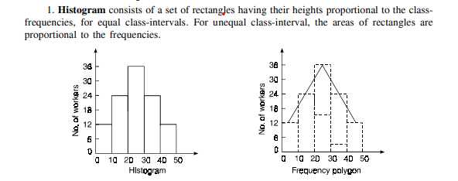


Slide 3
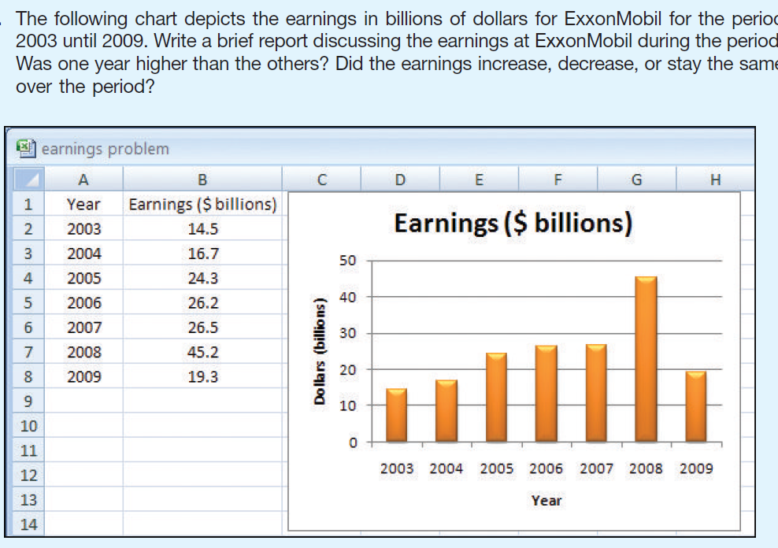
BAR CHART
BAR CHART

Slide 4
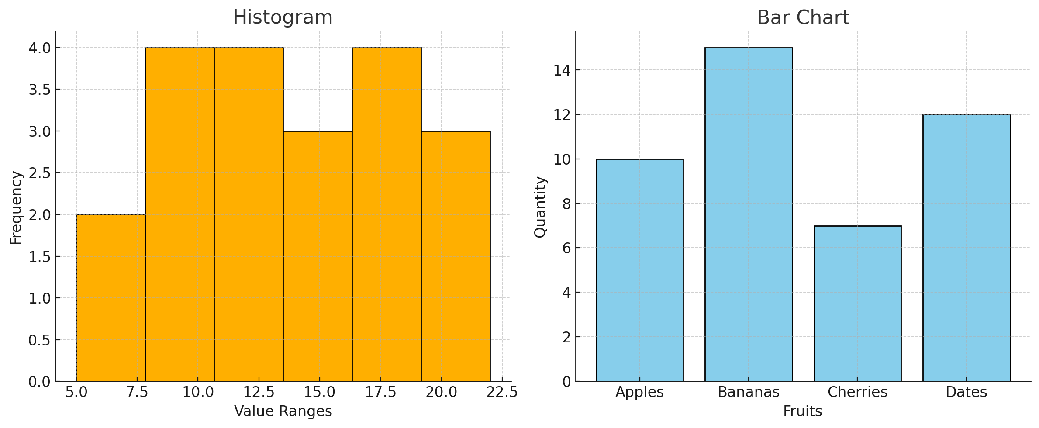
Here’s a side-by-side comparison of a histogram and a bar chart:
Histogram (left): Used to represent continuous data. The bars touch each other to show that the data is in intervals (e.g., ages, heights, test scores). Each bar represents the frequency of data within a certain range.
Bar Chart (right): Used for categorical data. The bars are separated because the categories are distinct and not part of a continuous range (e.g., types of fruits, departments, colors).

Slide 5
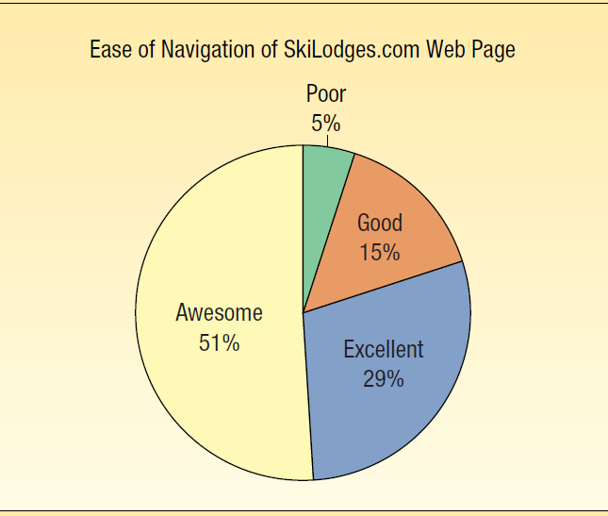
Pie chat

Slide 6
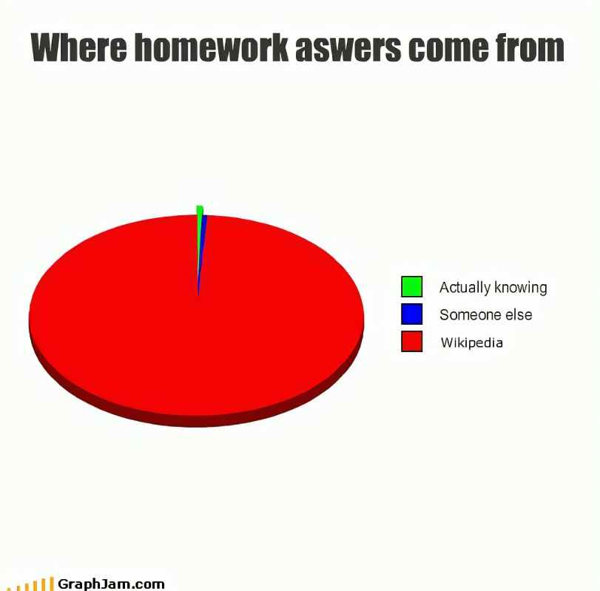
Chat-gpt

Slide 7
40 students were asked about their favorite movie genre. The responses are:
M,N,M,M,M,M,M,N,N,R,R,R,R,M,R,R,R,M,M,R,M,R,N,N,N,M,M,M,N,N,M,R,R,R,R,N,N,M,M,R.
(Where: M = MESSY, R= RONALDO, N= NEYMAR)
a) Prepare a frequency and percentage distribution table. b) Draw a bar diagram. c) Draw a pie chart.

Slide 8
Marks (Class Interval) | 0 – 10 | 10-20 | 20-30 | 30-40 | 40-50 | 50-60
Frequency | 4 | 5 | 7 | 8 | 3 | 1
a) Draw a histogram for the above data. b) Draw a frequency polygon on the same graph.
Histogram = Bars
Frequency Polygon = Points + Lines

Slide 9
Present the following data using appropriate diagram
Department | Number of Students
Mathematics | 120
Physics | 95
Computer Science | 140
Chemistry | 80
Statistics | 70
Present the following data using Pie chart
Activity | Hours | Percentage
Sleeping | 8 | 33.3%
Studying | 6 | 25%
Leisure | 4 | 16.7%
Eating | 2 | 8.3%
Exercise | 2 | 8.3%
Others | 2 | 8.3%

Slide 10
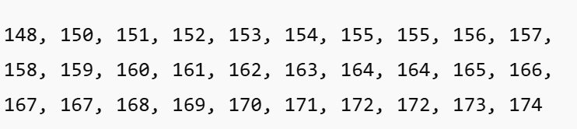
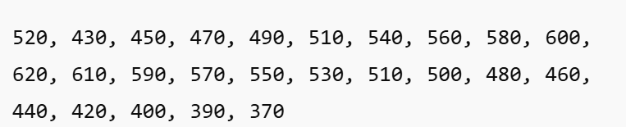
1) Heights of 30 Students (in cm)
1) Make a frequency distribution table
2) Present the data using histogram and frequency polygon
2) Daily Sales (in Taka) of a Shop for 25 Days
1) Make a frequency distribution table
2) Present the data using histogram and frequency polygon

Slide 11
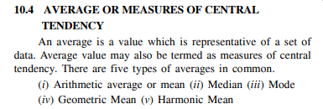
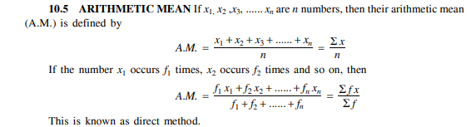

Slide 12
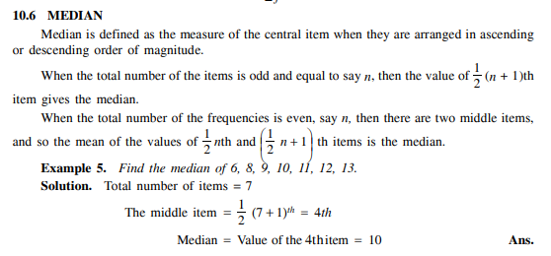

Slide 13
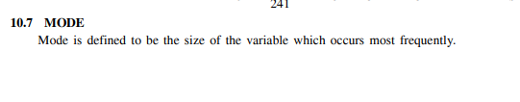
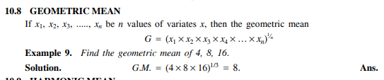
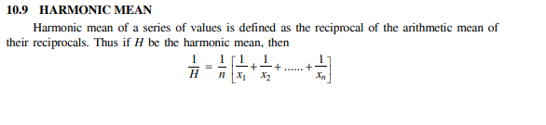

Slide 14
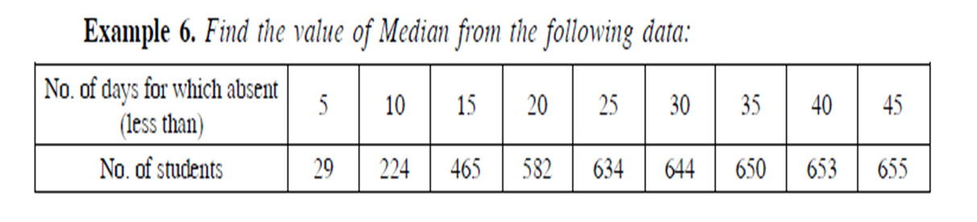
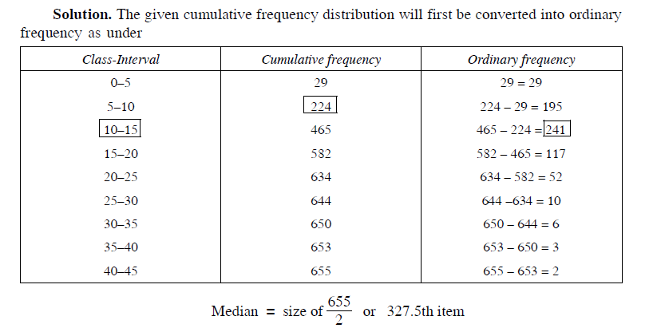
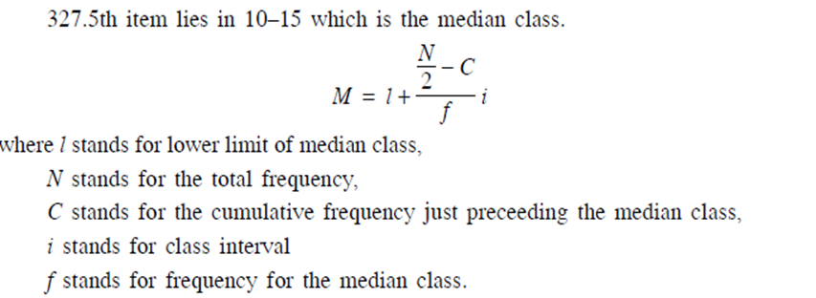

Slide 15
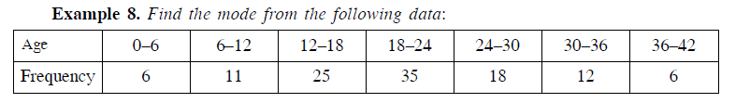
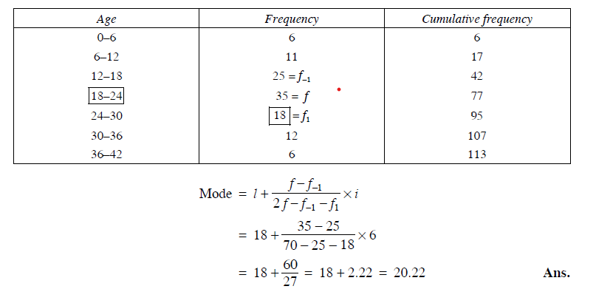
Calculate the A.M ,H.M and G.M for the following data:
2,5,7,6

Slide 16
Find the mean and mode of the following data
MONEY(Thousands) | 0-5 | 5-10 | 10-15 | 15-20 | 20-25 | 25-30 | 30-35 | 35-40 | 40-45
people | 5 | 7 | 10 | 14 | 18 | 23 | 15 | 9 | 6
Find the mean and mode of the following data
AGE | 0-10 | 10-20 | 20-30 | 30-40 | 40-50 | 50-60 | 60-70 | 70-80
Frequency | 15 | 17 | 19 | 25 | 17 | 13 | 11 | 5

Slide 17
STANDARD DEVIATION
NAZMUL KADER CHOWDHURY

Slide 18
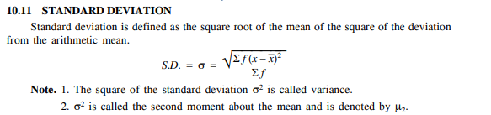
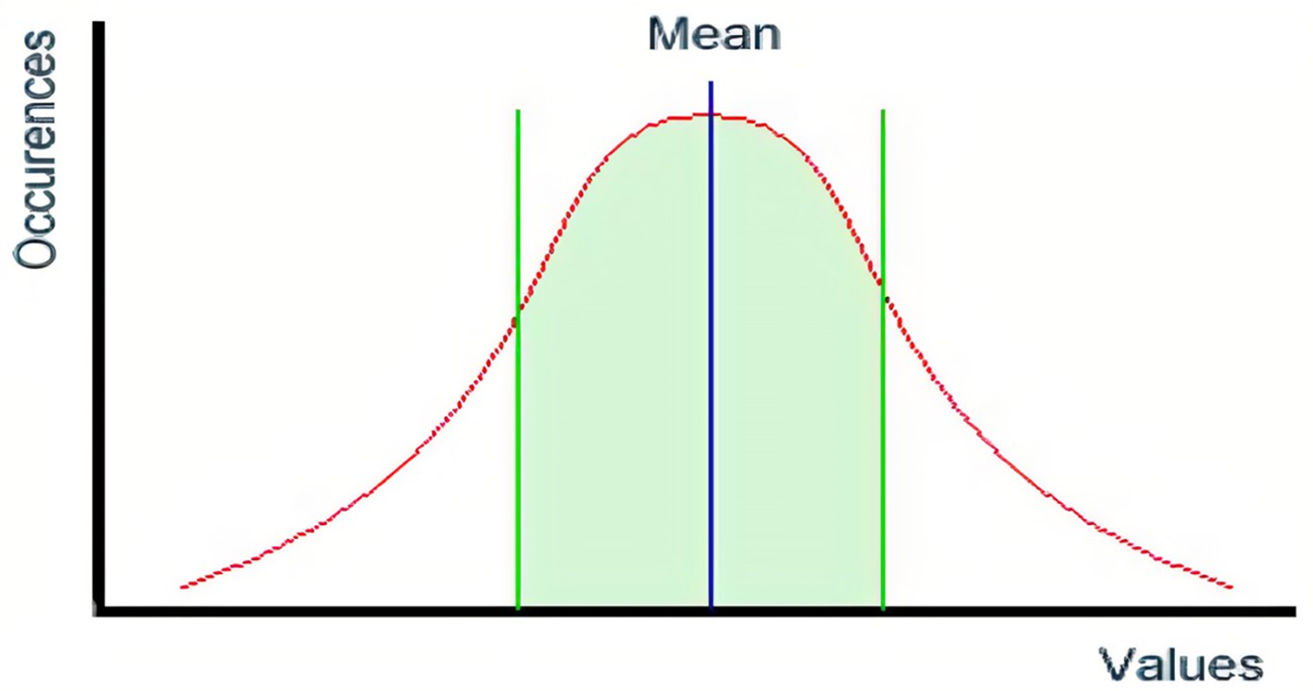

Slide 21
