Slide 1

WELCOME

Slide 2


TOPIC

Slide 3













Contents
Introduction
Definition
Types Of Correlation Correlation Coefficient
Types of Correlation Coefficient
Limitation Of Correlation Applications

Slide 4
Introduction
The word Correlation is made of Co- (meaning "together"), and Relation
One of the best statistical tests out there, in my opinion, is the correlation. Correlation is a mutual relationship between two variables.
Correlation analysis show us how to determine both the nature and strength of relationship between two variables.

Slide 5


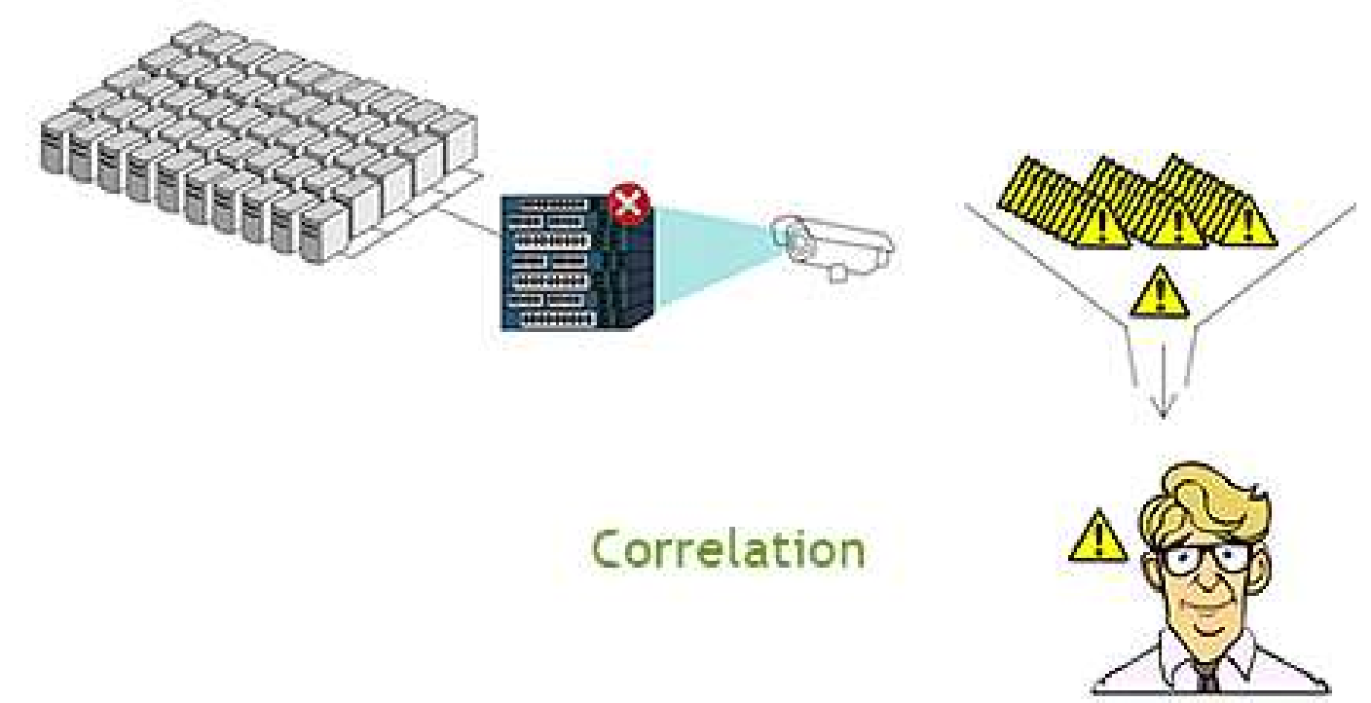
DEFINITION
A correlation is a linear relationship between two variables. Correlation measures the linear association between two variables.

Slide 6
Types of correlation
On the basis of degree of correlation
On the basis of linearity
On the basis of number of variables
Positive
correlation
Negative correlation
Simple
correlation
Linear
correlation
Partial correlation
Non – linear correlation
Multiple correlation

Slide 7

POSITIVE CORRELATION
It is a relationship between two variables where if one variable increases, the other one also increases. A positive correlation also exists in one decreases and the other also decreases.
.
y
x

Slide 8

Negative Correlation
THAT MEANS THERE IS AN INVERSE RELATIONSHIP BETWEEN TWO VARIABLES - WHEN ONE VARIABLE DECREASES, THE OTHER INCREASES
y
x

Slide 9
CORRELATION COEFFICIENT
The Coefficient of Correlation (r) is a measure of the strength of the linear relationship between two variables.
A decimal number between .00 and +1.00 or –1.00 that indicates the degree to which two quantitative variables are related.
-1.00
0.00
+1.00
strong negative
strong positive
no relationship

Slide 10
TYPES OF CORRELATION COEFFICIENT
Perfect Positive correlation
Perfect negative correlation
Moderately Positive correlation
Moderate negative correlation
Absolute no correlation

Slide 11
Limitations of Correlation
Although correlation is a powerful tool, there are some limitations in using it:
Correlation does not completely tell us everything about the data. Means and standard deviations continue to be important.
The data may be described by a curve more complicated than a straight line, but this will not show up in the calculation of r.
Just because two sets of data are correlated, it doesn't mean
that one is the cause of the other.

Slide 12
Application
REAL LIFE Application Of Positive Correlation :
As the number of trees cut down increases, the probability
of erosion increases.
As a student’s study time increases, so does his test
average.
As a child grows, so does his clothing size.
As her salary increased, so did her spending.

Slide 13
Application
REAL LIFE Application Of Negative Correlation:
student absences --------- grades
weather cooling --------air conditioning costs
train speed -------- length of final point
chicken age --------amount of eggs producing

Slide 14
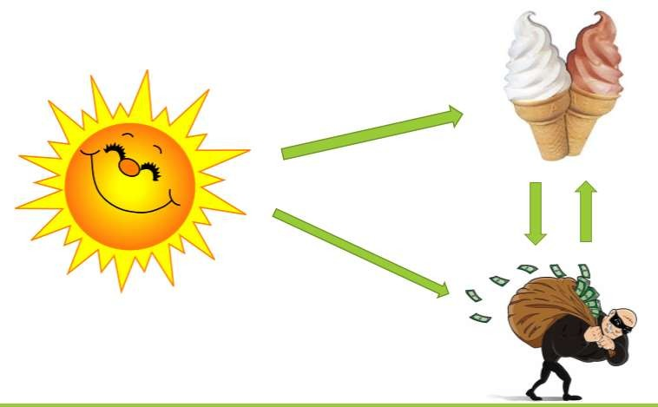
Application
##Temperature
--- Sales Income
Temperatu Sales re in ˚C
17.2 ˚C
22.6 ˚C
18.1 ˚C
23.4 ˚C
25.1 ˚C
19.4 ˚C
22.1 ˚C
18.5 ˚C
15.2 ˚C
11.9 ˚C
16.4 ˚C
14.2 ˚C
$408
$445
$421
$544
$614
$412
$522
$406
$332
$185
$325
$215

Slide 15
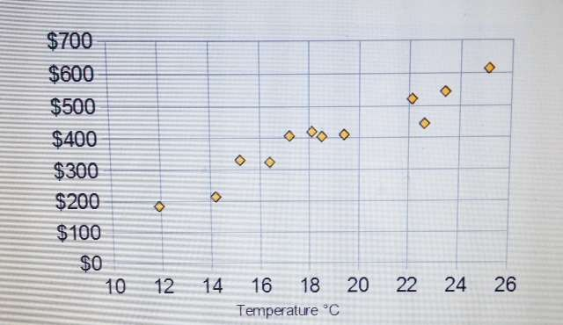
Application
On a scatter plot, here is the same data:
So, we can see that more sales occur during warmer weather

Slide 16
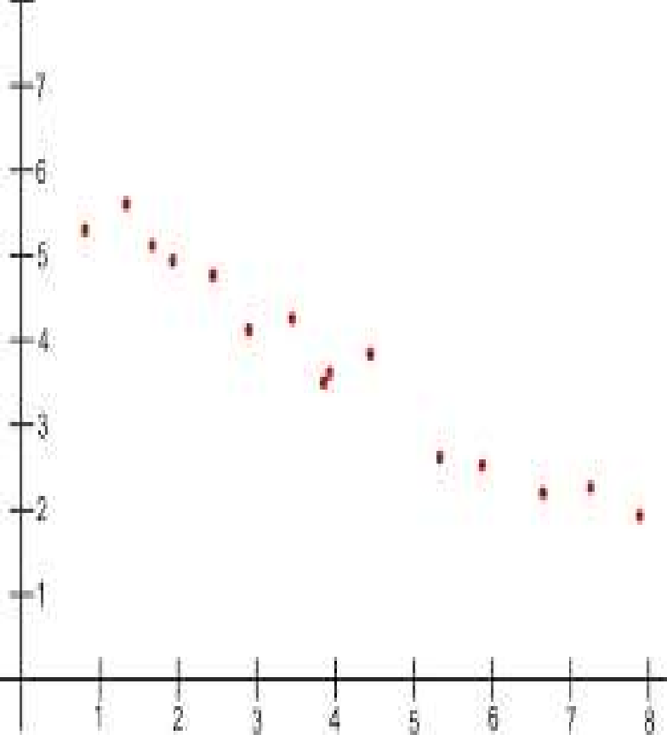


Application
##amount of exercise
---- % body fat
Body fat
Hours of exercise

Slide 17

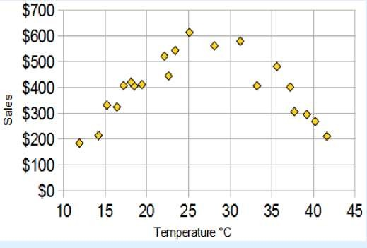

Application
Weather gets so hot--- sales start
Here is the latest graph:
The correlation is now 0: "No Correlation" ... !

Slide 18

The End
Thank You

