Slide 1


Correlation Analysis
Nazmul Kader Chowdhury

Slide 2
Definition of Correlation
Correlation is the degree of association between two or more variables.
If two or more quantities vary so that movements in one tend to be accompanied by movements in other, then they are said to be correlated.
Coefficient of correlation is a numerical measure of the degree of association between two or more variables.

Slide 3
Meaning
Correlation is the most popular statistical measure that indicates the relationship between two or more variables.
It is concerned with finding:
Whether or not the relationship exist?
Degree of the correlation?
Direction of relationship within the variables (Direct or indirect)?
Relationship is strong or Weak?

Slide 4
Examples
Relationship between income and years of experience
Relationship between amount of rainfall and yield of rice
Relationship between price and demand of a commodity
Relationship between nature of work and motivation to work
Relationship between height and weight

Slide 5
Scope of Correlation Analysis
The existence of correlation between two (or more) variables only implies that these variables:
Either tend to increase or decreased together
An increase (or decrease) in one is accompanied by the corresponding decrease (or increase) in the other.
Correlation analysis does not answer the questions like why there is cause and effect between two variables.
It may be due to following reasons:

Slide 6
Scope of correlation analysis
One of the variable may be affecting the other. A correlation calculated from the data on demand and price will only show that degree of association between demand and price is high. It will not show why it happens.
The two variables may act upon each other. Cause and effect is here also, but it is difficult to find which variable is independent and which is dependent.
The two variables may be acted upon by the outside influence. Such correlation is called spurious or nonsense correlation.
A high value of the correlation may be due to sheet coincidence ( or pure chance)

Slide 7
Types of correlation
On the basis of direction of change
On the basis of number of variables
On the basis of proportion
Positive correlation
Negative correlation
Perfectly Positive
Perfectly Negative
Zero Correlation
Simple correlation
(only 2 variables)
Partial correlation
(Effect of only two is studied while others are kept constant)
Multiple correlation
(More than 2 variables)
Linear correlation (amount of change in constant ratio)
Non – linear correlation

Slide 8
Types of Correlation
Correlation on the basis of direction of change is as following:
Positive Correlation
Negative Correlation
Perfectly Positive Correlation
Perfectly Negative Correlation
Zero Correlation

Slide 9
Positive Correlation
When two variables move in the same direction then the correlation between these two variables is said to be PositiveCorrelation.
When the value of one variable increases, the value of other value also increases at the same rate.
For example :
Training( Rs.) : | 350 | 360 | 370 | 380
performance( Kg.) : | 30 | 40 | 50 | 60

Slide 10
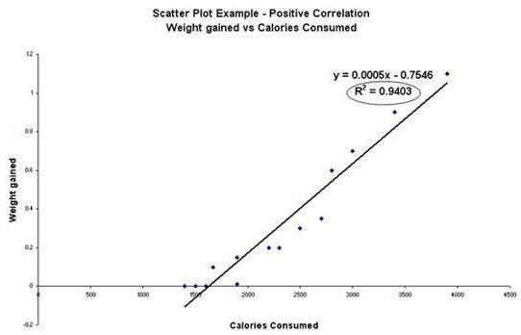
Positive Correlation

Slide 11
Negative Correlation
In this type of correlation, the two variables move in the opposite direction.
When the value of one variable increases, the value of the other variable decreases.
For example, the relationship between price and demand.

Slide 12
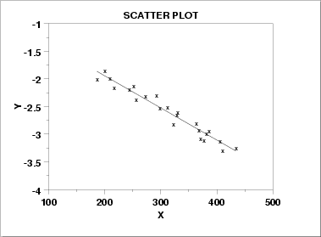
Negative Correlation

Slide 13
Perfect Positive Correlation
When there is a change in one variable X, and if there is equal proportion of change in the other variable say Y in the same direction, then these two variables are said to have a Perfect Positive Correlation.

Slide 14
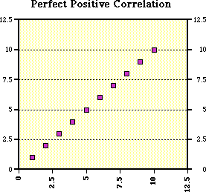
Perfect Positive Correlation

Slide 15
Perfectly Negative Correlation
Between two variables X and Y, if the change in X causes the same amount of change in Y in equal proportion but in opposite direction, then this correlation is called as Perfectly Negative Correlation.

Slide 16
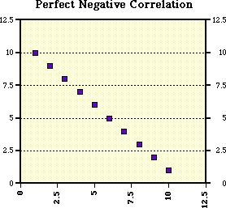
Perfectly Negative Correlation

Slide 17
Zero Correlation
When the two variables are independent and the change in one variable has no effect in other
variable,
then the correlation between these two variable is known as Zero Correlation.

Slide 18
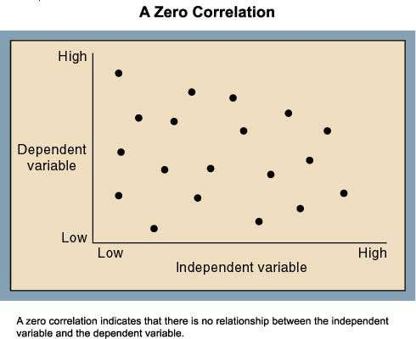
Zero Correlation

Slide 19
Methods of studying correlation
Methods of studying correlation
Graphical
method
Algebraic
method
Scatter diagram
Karl
Pearson’s method
Rank method
Concurrent deviation

Slide 20
Karl Pearson’s Coefficient of Correlation
It is the most widely used method of measuring linear relationship between two variables.
Assumptions of Karl Pearson’s Coefficient:
There is linear relationship between variables.
There is cause and effect relationship

Slide 21
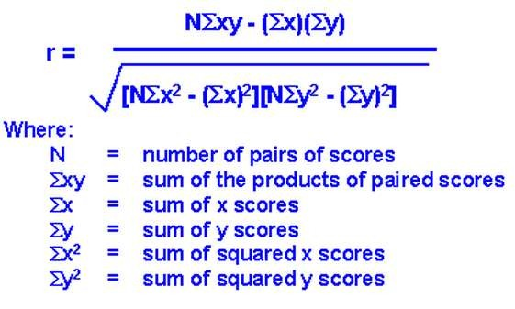
Calculating the Co-efficient of Correlation by Karl Pearson Method

Slide 22
Example
From the following sets of observations, find the coefficients of correlation:
(a) X : 25
Y : 40
35 (b) X : 8 11
41 Y : 190 100
Ans: (a) r = 1 (b) r = -1
So, in case (a) the variable X and Y are perfectly positive correlated to each other.
And in case (b) the variable X and Y are perfectly negative correlated to each other.

Slide 23
Features of coefficient of correlation
Ranges between -1 and 1.
Closer to -1, stronger the negative relationship
Closer to 1, stronger the positive relationship
Closer to 0, weaker the relationship
If r=0 there is no relationship between variable
If +0.75≤ r ≤+1 there exist high positive relationship.
If -0.75≥r≥-1 there exist high negative relationship.

Slide 24
Scatter Diagram
The first step in determining whether there is a relationship between two variable is to examine the graph of observed data.
The graph or chart is called scatter diagram.
A scatter diagram gives us information about patterns that indicates that variables are related.

Slide 25
Scatter Plot ( Scatter diagram or dot diagram )
In this method the values of the two variables are plotted on a graph paper. One is taken along the horizontal (x-axis) and the other along the vertical (y- axis).
By plotting the data, we get points (dots) on the graph which are generally scattered and hence the name ‘Scatter Plot’.
The points plotted on graph may cluster around a straight line or a curve or may not show any tendency of association.

Slide 26
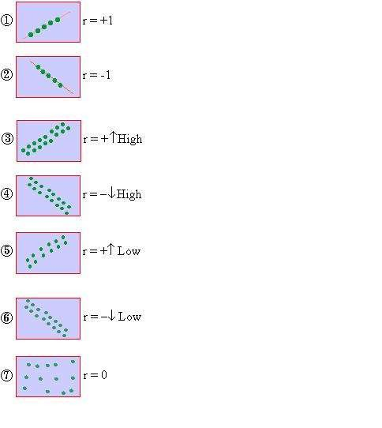
If all points lie on a rising straight line the correlation is perfectly positive and r = +1 (see fig.1 )
If all points lie on a falling straight line the correlation is perfectly negative and r = -1 (see fig.2)
If the points lie in narrow strip, ri correlation is high degree of positive (see
If the points lie in a narrow strip, f the correlation is high degree of negative
If the points are spread widely over a upwards, the correlation is low degree p
If the points are spread widely o falling downward, the correlation is l (see fig.6)
If the points are spread (scatte
specific pattern, the correlation is absent. i.e. r = 0. (see fig.7)
sing upwards, the
fig.3)
alling downwards, (see fig.4)
broad strip, rising ositive (see fig.5)
ver a broad strip, ow degree negative
red) without any

Slide 27
Scatter diagram continue…
A scatter diagram of the data helps in having a visual idea about the nature of association between two variables.
If the point cluster along the straight line the association
between variable is linear.
If the points cluster along the a curve, the association is non- linear or curvilinear.
If the points neither cluster along a straight line nor along a curve, there is absence of any association between the variables.
When the low/high value of one variable is associated with low/high value of other variable respectively, the association is called positive.
In contrast if low/high value of one variable is associated with high/low value of other variable respectively, the association is called negative.

Slide 28
Example
Draw a scatter diagram from following data and indicate whether the correlation between the variable is positive or negative.
Height (inch) | 62 | 72 | 70 | 60 | 67 | 70 | 64 | 65 | 60 | 70
Weight ( kgs.) | 50 | 65 | 63 | 52 | 56 | 60 | 59 | 58 | 54 | 65

Slide 29
Standard Error
Standard error of coefficient of correlation is used to find out probable error of coefficient of correlation.
Where r = coefficient of correlation
N = Number of observed pairs
So S.E. = 1-r² / N

Slide 30
Probable Error
The probable error of coefficient of correlation is an amount which if added to or subtracted from values of r gives upper limit and lower limit within which this coefficient is expected to be.
Probable error is 0.6745 time of Standard Error
That means Probable error = 0.6745 (S.E.)

Slide 31
Use of probable error
It is used to determine the reliability of coefficient of correlation.
For ex. If ratio of r and P.E. is greater than 6 then coefficient is reliable, i.e. there is relationship between variable.
If ratio of r and PE is less than 6 then coefficient is not reliable, i.e. there is no relationship between variable.

Slide 32
Example
If r = 0.8 and N = 36, find
Standard Error
Probable Error
Check reliability Ans. (a) 0.06
(b) 0.04
(c) ratio of r to PE is 20 so coefficient is reliable

