Slide 1
Asymptotes
Nazmul Kader Chowdhury

Slide 2
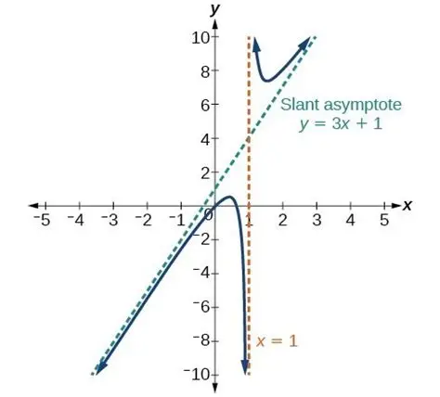
What is asymptote?
An asymptote is a straight line that constantly approaches a given curve but does not meet at any infinite distance.

Slide 3
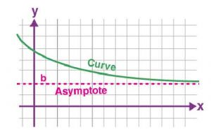

Slide 4
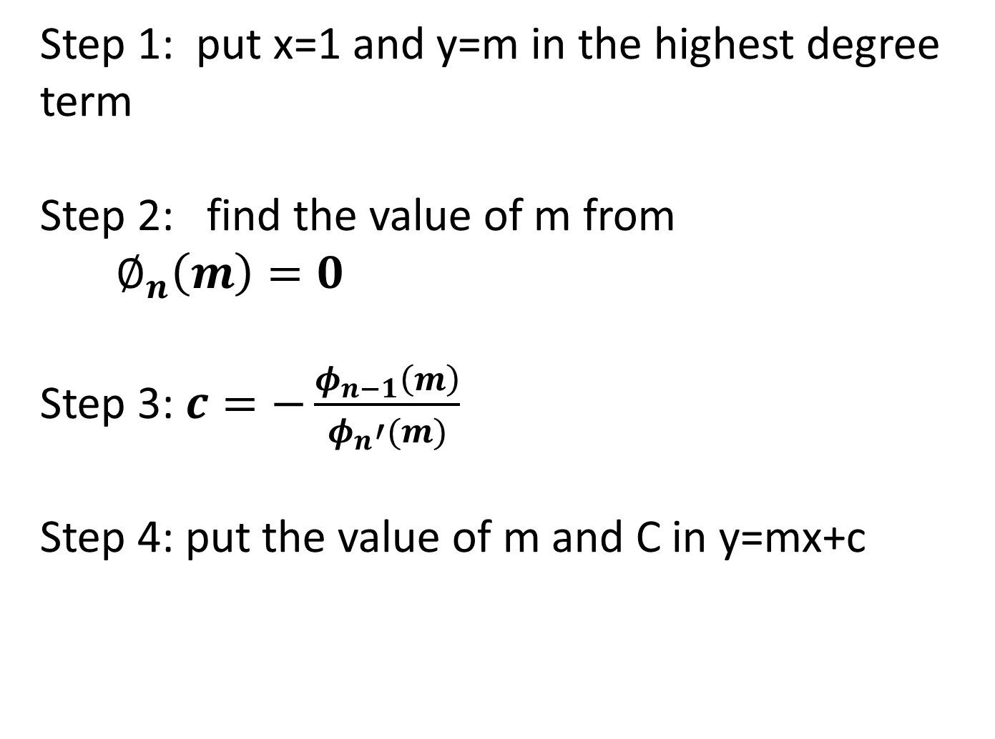
Step 1: put x=1 and y=m in the highest degree term
Step 2: find the value of m from
$∅_{n}\left(m\right)=0$
Step 3: $c=−\frac{φ_{n−1}\left(m\right)}{φ_{n}′(m)}$
Step 4: put the value of m and C in y=mx+c

Slide 5
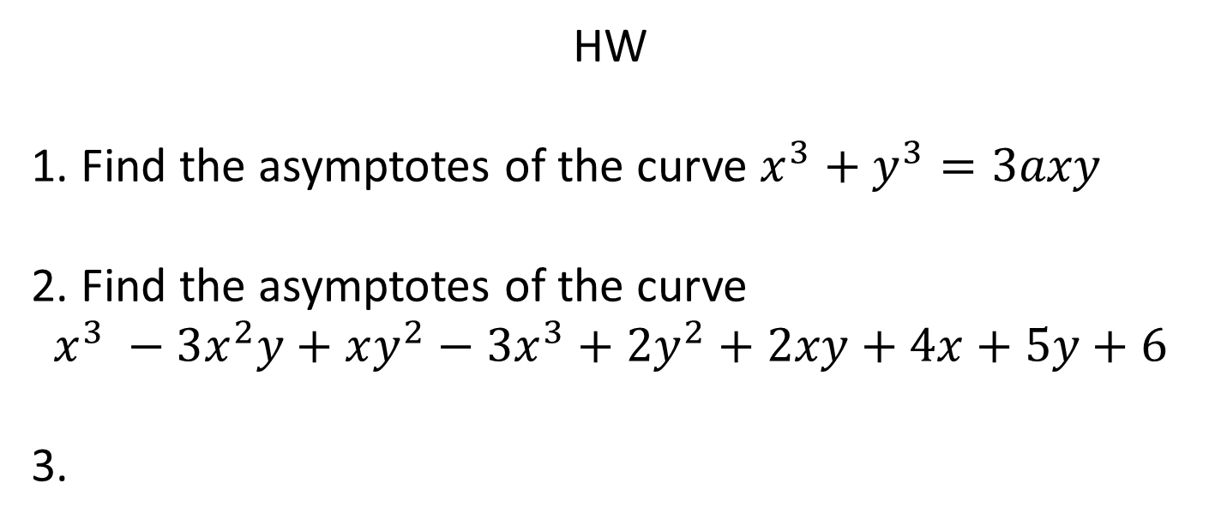
HW
1. Find the asymptotes of the curve $x^{3}+y^{3}=3axy$
2. Find the asymptotes of the curve
$$x^{3} −3x^{2}y+xy^{2}−3x^{3}+2y^{2}+2xy+4x+5y+6$$
3.

