Slide 1
Differentiability
Nazmul Kader Chowdhury

Slide 2
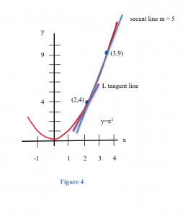
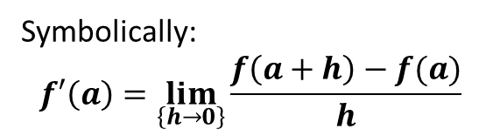
Introduction to Differentiability
Definition: A function f(x) is differentiable at a point x= a if its derivative exists at that point.
Geometric meaning: The curve has a well-defined, unique tangent line at x = a.
Symbolically:
$$f′\left(a\right)=\lim_{\left\{h→0\right\}}{\frac{f\left(a+h\right)−f(a)}{h}}$$

Slide 3
Conditions for Differentiability
A function f(x) is differentiable at x =a if:
It is defined at x= a.
It is continuous at x=a.
Left-hand derivative (LHD) and Right-hand derivative (RHD) both exist.
LHD = RHD

Slide 4
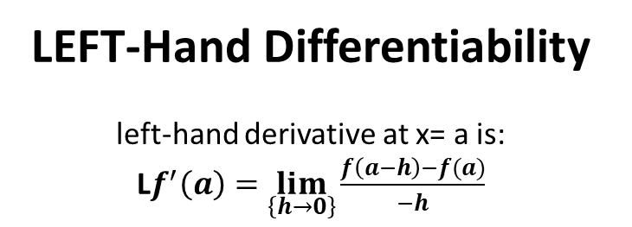
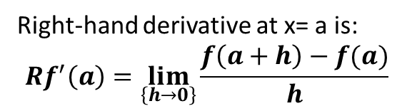
Right-Hand Differentiability
Right-hand derivative at x= a is:
$$Rf^{′}\left(a\right)=\lim_{\left\{h→0\right\}}{\frac{f\left(a+h\right)−f(a)}{h}}$$
LEFT-Hand Differentiability
left-hand derivative at x= a is:
L$f^{′}\left(a\right)=\lim_{\left\{h→0\right\}}{\frac{f\left(a−h\right)−f(a)}{−h}}$

Slide 5
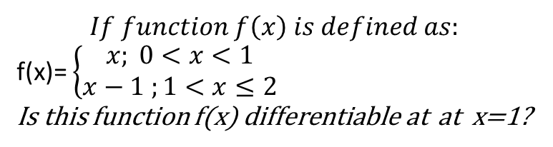
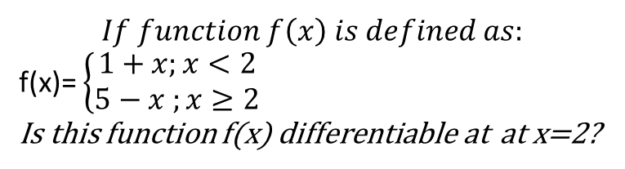
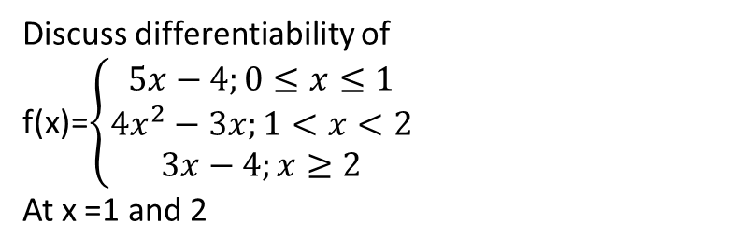
Problems
$$If function f\left(x\right) is defined as:$$
f(x)= $\left\{\begin{aligned}1+x;x<2 \\ 5−x ;x≥2\end{aligned}\right.$
Is this function f(x) differentiable at at x=2?
$$If function f\left(x\right) is defined as:$$
f(x)= $\left\{\begin{aligned}x; 0<x<1 \\ x−1 ;1<x≤2\end{aligned}\right.$
Is this function f(x) differentiable at at x=1?
Discuss differentiability of
f(x)=$\left\{\begin{aligned}5x−4;0≤x≤1 \\ 4x^{2}−3x;1<x<2 \\ 3x−4;x≥2\end{aligned}\right.$
At x =1 and 2

Slide 6
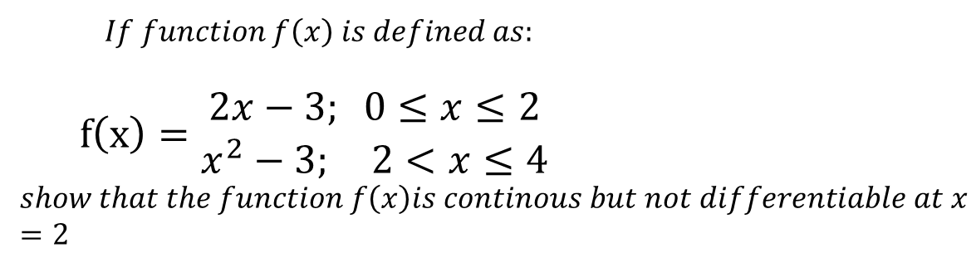
$$If function f\left(x\right) is defined as:$$
$$f\left(x\right)=\begin{matrix}2x−3; 0≤x≤2 \\ x^{2}−3; 2<x≤4\end{matrix}$$
$$show that the function f\left(x\right)is continous but not differentiable at x=2$$

