Slide 1
PROBABILITY
NAZMUL KADER CHOWDHURY

Slide 2
Introduction to Probability
What is Probability?
Probability is the measure of the likelihood that an event will occur. It ranges from 0 to 1.
Types of events (certain, impossible, likely)
Types of Events:
Certain event: Always happens (P = 1)
Impossible event: Never happens (P = 0)
Random event: Has uncertain outcomes
Random variables (definition)
A variable that takes different values based on the outcome of a random phenomenon.
Example:

Slide 3
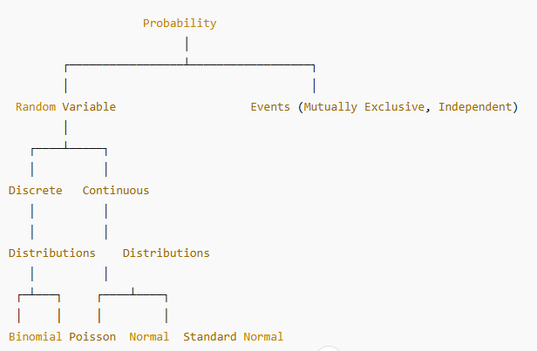

Slide 4
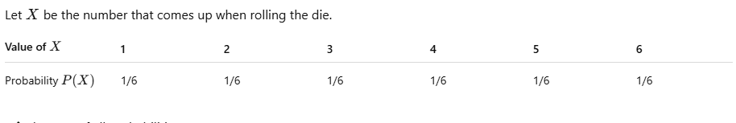
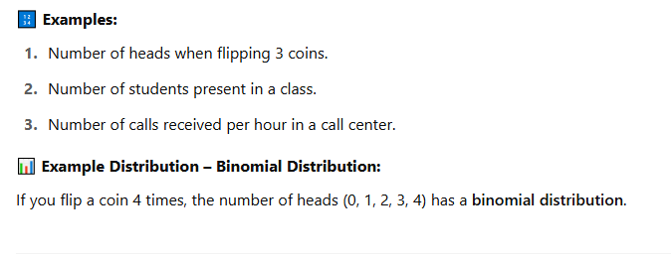
Discrete Probability Distribution

Slide 5
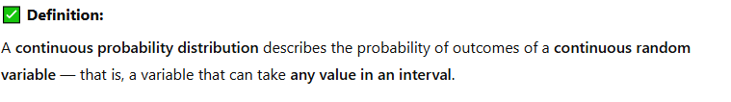
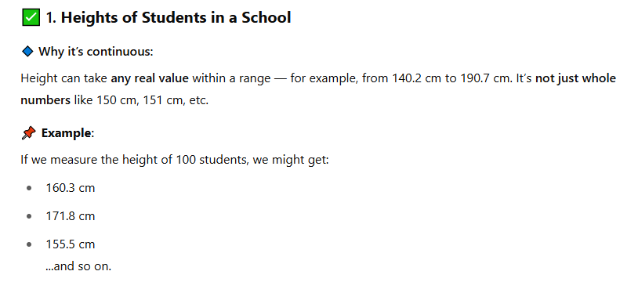
Continuous Distribution

Slide 6
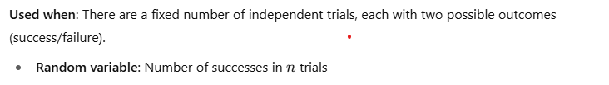
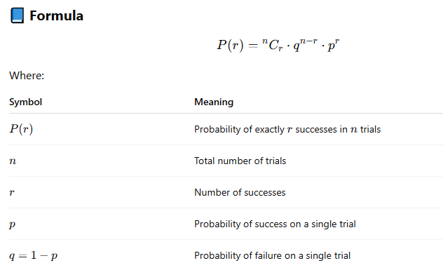
1a) Binomial Distribution
Example: Tossing a coin 10 times and counting the number of the heads

Slide 7
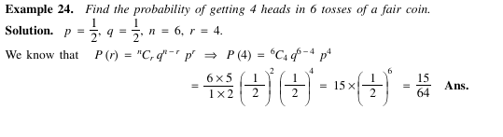

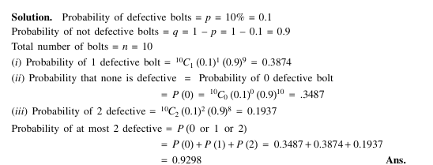

Slide 8
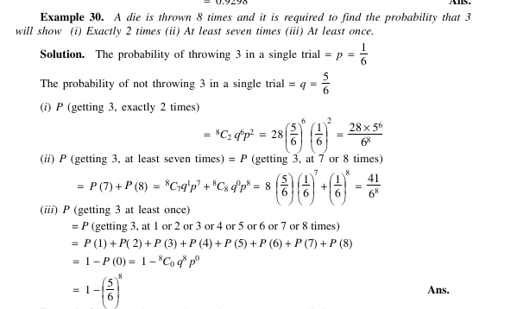

Slide 9
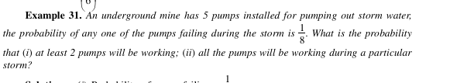

Slide 10
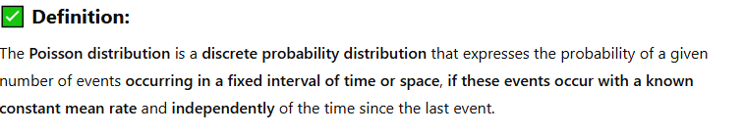
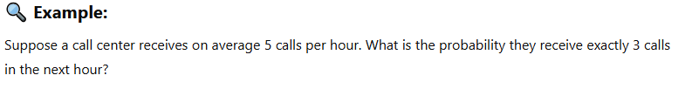
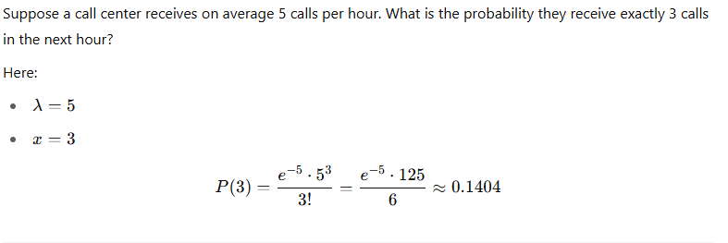
Poisson distribution

Slide 11
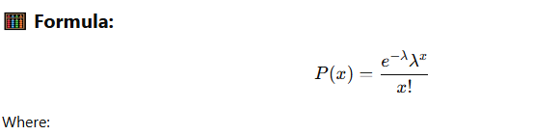
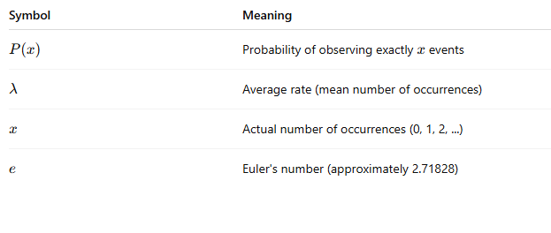

Slide 12
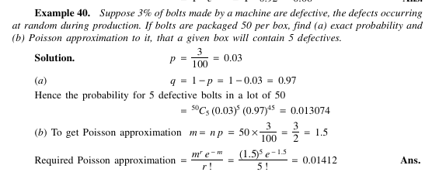

Slide 13
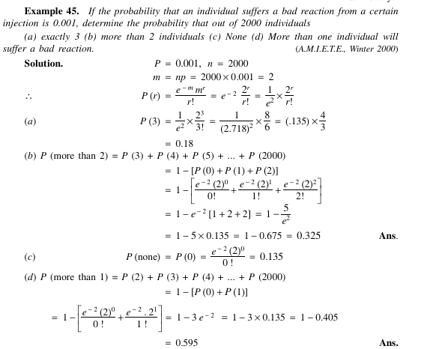

Slide 14
