Slide 1
EXPONENT
Nazmul kader Chowdhury

Slide 2
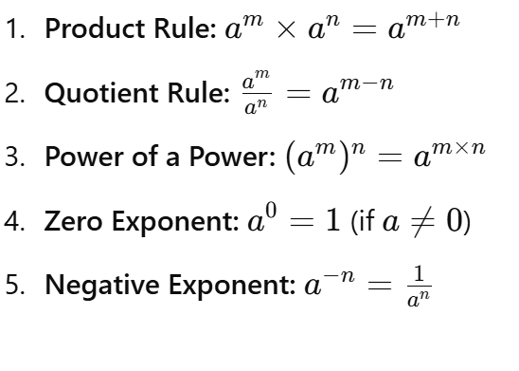

Slide 3








Examples

Slide 4
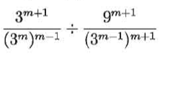


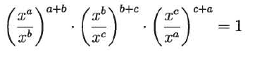

Simplify
Prove

