Slide 1
Paper Review
Course Title: CSE424
Reviewer:
Name: Md. Asif Shahriar
Id: 20301328
Sec: 01

Slide 2
“Script Based Pattern Recognition for Portrait Tracking System on
Broadcast Online Scenes”
Author: Qinyun Liu and Xiaopeng Xu
Publication Name: IEEE

Slide 3
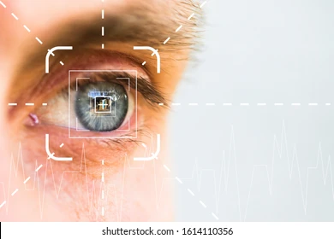
Introduction
Script based pattern recognition is a cutting-edge technology that holds great potential for a portrait tracking system. This system utilizes advanced algorithms to analyze and identify patterns in scripts, enabling accurate and efficient tracking of individuals in various scenarios. In this page, we will explore the importance and relevance of this system in the field of surveillance, security, and data analysis.

Slide 4
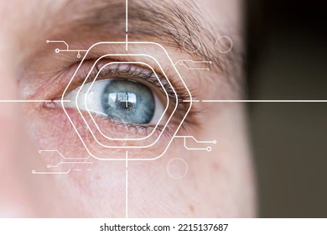
Portrait Tracking System
A portrait tracking system is a technology that enables the identification and tracking of individuals' faces in images or videos. It uses advanced pattern recognition algorithms to analyze facial features and match them against a database of known individuals. The system consists of several components that work together to achieve accurate and reliable face tracking.

Slide 5
Components of a Portrait Tracking System
1. Facial Detection: The system uses computer vision techniques to detect and locate faces in images or videos. This component is responsible for identifying the presence of a face in a given frame.
2. Facial Recognition: Once a face is detected, the system analyzes the facial features and compares them to a database of known individuals. It uses pattern recognition algorithms to match the detected face with the closest match in the database.
3. Tracking and Monitoring: The system tracks the movement of the identified face across multiple frames in a video or image sequence. It continuously updates the position and orientation of the face to enable real-time tracking and monitoring.
4. Database Management: The system maintains a database of known individuals' faces and their corresponding information. It allows for the storage, retrieval, and updating of face data for efficient and accurate recognition.

Slide 6
Script-Based Approach
In a script-based approach to pattern recognition for a portrait tracking system, patterns are identified and tracked using predefined scripts or rules.
Advantages
1. Accuracy: The script-based approach can provide high accuracy in pattern recognition as it relies on predefined rules and scripts.
2. Speed: Since the patterns are recognized based on predefined scripts, the process can be faster compared to other approaches.
3. Flexibility: The script-based approach allows for easy customization and adaptation to different patterns and tracking requirements.
Disadvantages
1. Limited Generalization: The script-based approach may struggle with recognizing patterns that are not covered by the predefined scripts.
2. Maintenance: As the patterns and tracking requirements evolve, the scripts need to be updated and maintained, which can be time-consuming.
3. Complexity: Developing and fine-tuning the scripts for accurate pattern recognition can be a complex task, requiring expertise and resources.

Slide 7
Online Scenes
Challenges
1. Variability in Scene Content
Online scenes can vary greatly in terms of content, making it difficult to develop a single script that can accurately recognize patterns in all scenarios.
2. Real-Time Processing
Processing online scenes in real-time requires efficient algorithms and computational resources to handle the high volume of data.
3. Noise and Distortions
Online scenes often contain noise and distortions, such as compression artifacts or low lighting conditions, which can affect the accuracy of pattern recognition.

Slide 8
Solution
1. Adaptive Scripts
Develop adaptive scripts that can dynamically adjust to different scene contents, allowing for more accurate pattern recognition.
2. Parallel Processing
Utilize parallel processing techniques to distribute the computational load across multiple processors or machines, enabling real-time processing of online scenes.
3. Preprocessing Techniques
Apply preprocessing techniques, such as noise reduction algorithms or image enhancement methods, to mitigate the effects of noise and distortions in online scenes.

Slide 9
Conclusion
In conclusion, script based pattern recognition for a portrait tracking system has the potential to revolutionize various industries and applications—-------

Slide 10
Potential Applications
This technology can be applied in various fields, including:
Security and Surveillance: Script based pattern recognition can enhance facial recognition systems for improved security and surveillance measures.
Marketing and Advertising: This technology can be used to analyze customer reactions and engagement with advertisements and marketing campaigns.
Healthcare: Script based pattern recognition can assist in medical diagnoses and monitoring patient conditions.
Entertainment and Gaming: This technology can enhance interactive experiences in virtual reality and gaming applications.

Slide 11
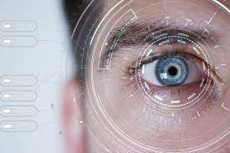
Future Developments
As script based pattern recognition continues to evolve, future developments may include:
Improved Accuracy: Advancements in machine learning algorithms and data collection techniques can lead to higher accuracy in recognizing and tracking facial patterns.
Real-time Analysis: Future developments may focus on real-time analysis of facial expressions and emotions for immediate response and feedback.
Integration with IoT: Script based pattern recognition can be integrated with Internet of Things (IoT) devices for seamless tracking and analysis in various environments.

Slide 12


