Slide 1
Talk Show

Slide 2


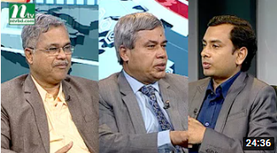
Placement options
The Chief Executive Show
Brand Practioner bd & Daily Star
Business Bangladesh,
Boishakhi TV
Biz Time
NTV

Slide 3


Placement options
Business Talk
RTV
ATN BUSINESS and FINANCE,
ATN Bangla

Slide 4
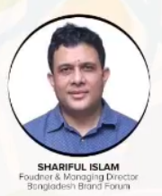
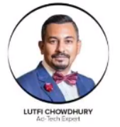

Panel members
Collaboration with Brand Practioners Bd to onboard panel members
Probable panel members

Slide 5
Thank You

