Slide 1

Placement & Internship Tracking System
A Database Management System (DBMS) Project
MD Asif
Member 1
Kunal Agratam
Member 2
Manish Singh
Member 3
Manas
Member 4

Slide 2

Problem Statement
Universities and colleges face significant challenges in managing placement and internship activities across hundreds of students and multiple companies simultaneously.
Manual Inefficiency
Data Redundancy
Poor Visibility
No centralized system to track applications, interview schedules, and final results.
Repeated and inconsistent data across spreadsheets and physical records.
Students and coordinators lack real-time status updates on placement outcomes.

Slide 3


Key Objectives
Centralized Database
Maintain a single, structured database for all student, company, placement, and internship records.
Real-Time Tracking
Enable coordinators and students to monitor application status and selection outcomes instantly.
Relationship Mapping
Accurately capture relationships between students, companies, internships, placements, and interviews using ER modeling.
Data Integrity
Eliminate redundancy and ensure consistency through normalized relational database design.

Slide 4
Entities & Their Attributes
🎓 Student
🏢 Company
📋 Placement
Student_ID (PK)
Name
Email
CGPA
Department
Company_ID (PK)
Company_Name
Industry_Type
Location
HR_Contact
Placement_ID (PK)
Student_ID
Internship_ID
Date_of_Selection
Final_Result
💼 Internship
🎤 Interview
Internship_ID (PK)
Company_ID
Stipend
Duration
Internship_Role
Interview_ID (PK)
Placement_ID
Interview_Date
Round_Type
Result

Slide 5
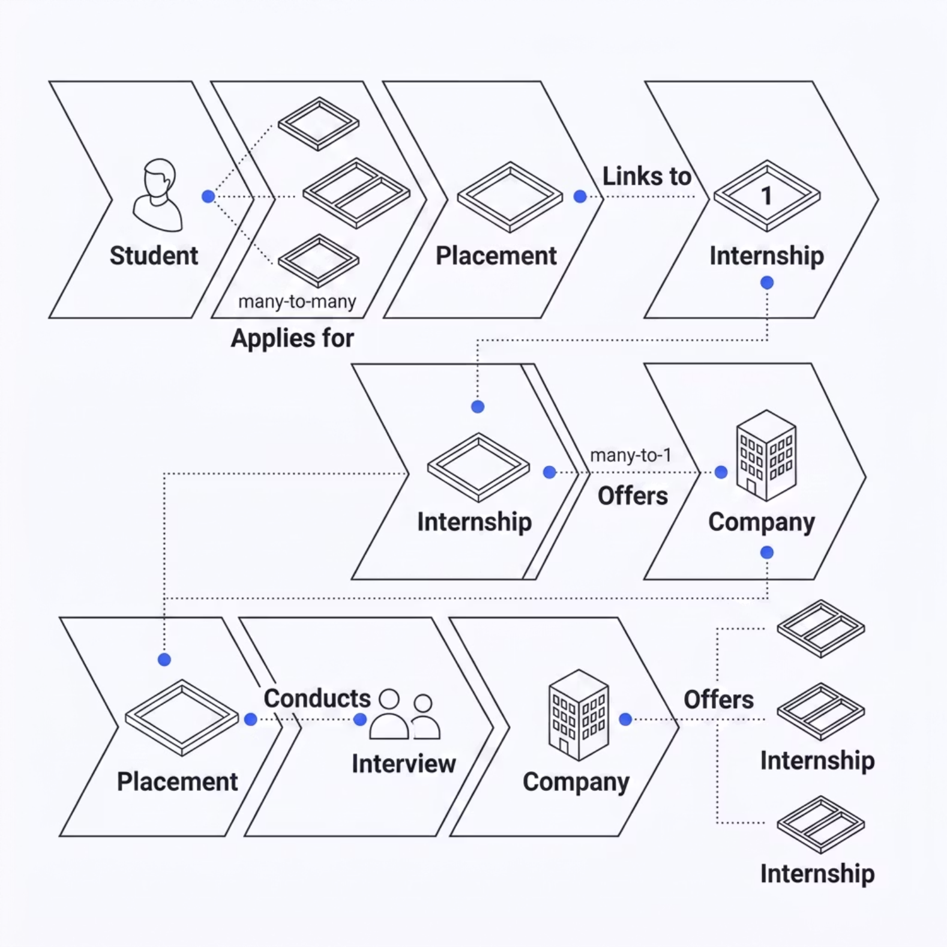

Relationships Between Entities
Applies For
Has Interview
Student → Placement: A student applies for one or more placement opportunities (Many-to-Many).
Placement → Interview: Each placement process involves interview rounds (One-to-Many).
Offers
Linked To
Company → Internship: A company offers multiple internship roles (One-to-Many).
Placement → Internship: A placement record is associated with a specific internship (Many-to-One).

Slide 6
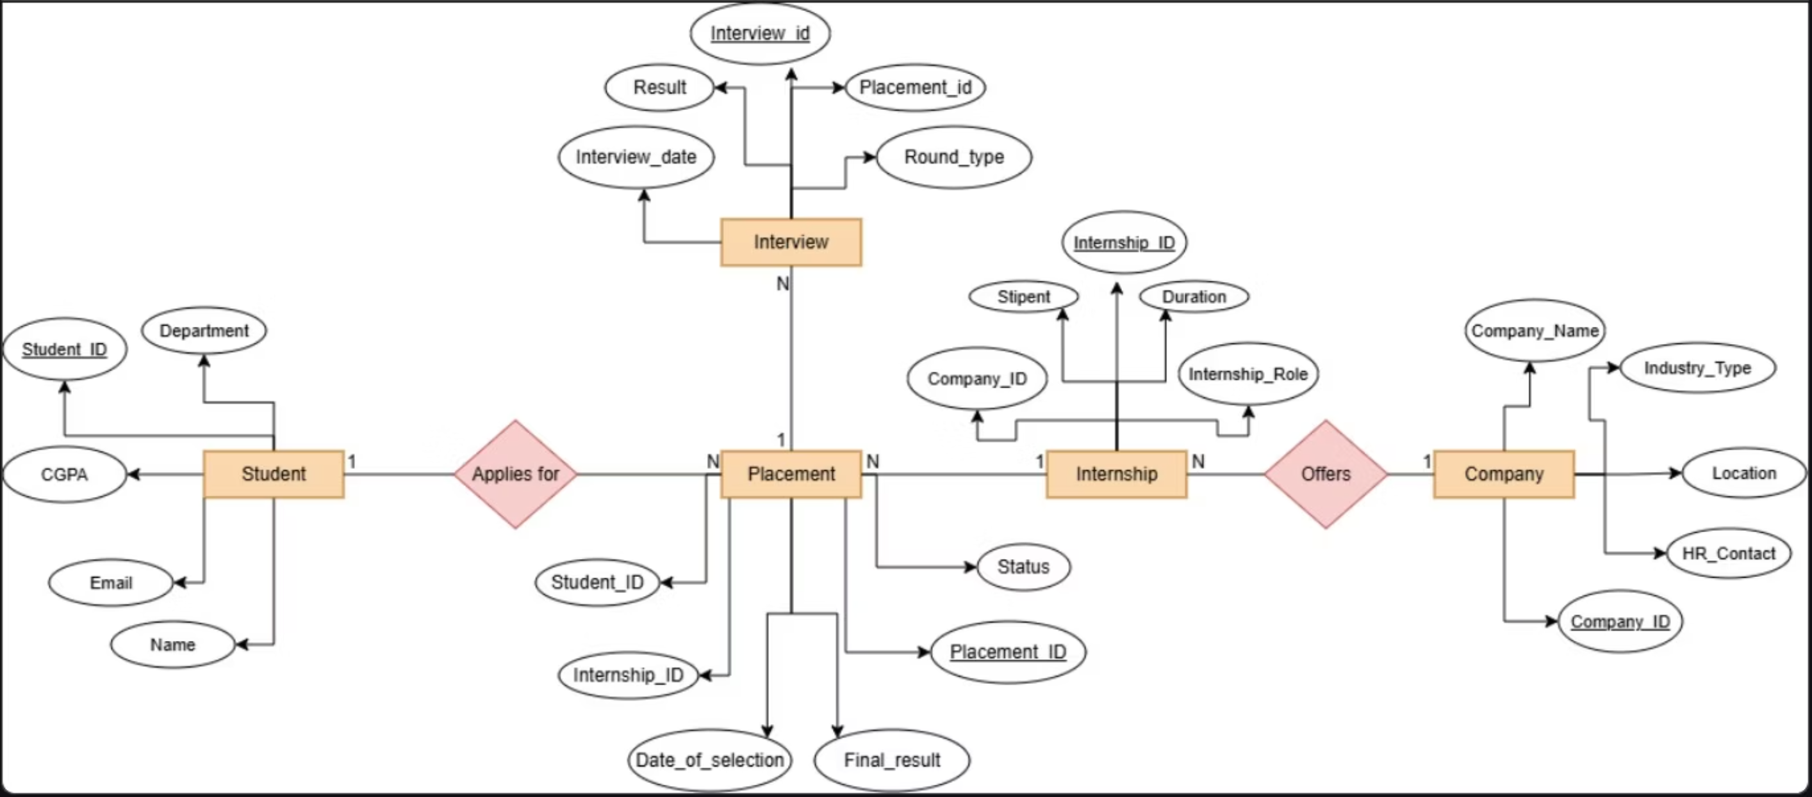
ER Diagram
The ER diagram above captures all five entities — Student, Placement, Interview, Internship, and Company — along with their attributes and inter-relationships, forming the conceptual backbone of the database design.

Slide 7

Database Schema Design
Normalization
Table Creation
Constraint Definition
ER Modeling
Each entity is mapped to a relational table with appropriate primary and foreign keys. Normalization to Third Normal Form (3NF) eliminates redundancy and ensures data integrity across all tables.

Slide 8
Data Implementation
Sample Table: Student
Key SQL Operations
Student_ID
Name
Dept
CGPA
01
DDL Statements
S001
MD Asif
CSE
8.5
CREATE TABLE with PRIMARY KEY and FOREIGN KEY constraints for all 5 entities.
S002
Kunal A.
IT
8.1
S003
Manish S.
CSE
7.9
02
S004
Manas
ECE
8.3
DML Operations
Sample Table: Internship
INSERT, UPDATE, DELETE to manage student and placement records dynamically.
Internship_ID
Role
Stipend
Duration
03
I001
Dev Intern
₹15,000
3 months
JOIN Queries
I002
Data Analyst
₹12,000
6 months
INNER JOIN across Student, Placement, and Company tables to generate placement reports.

Slide 9

Conclusion
The Placement & Internship Tracking System demonstrates a practical application of DBMS concepts in solving a real-world academic challenge.
ER Modeling
Normalization
5 well-defined entities with clear attributes and relationships.
Schema designed in 3NF to ensure minimal redundancy and maximum integrity.
Real-World Impact
Enables efficient, transparent placement management for academic institutions.

