Slide 1
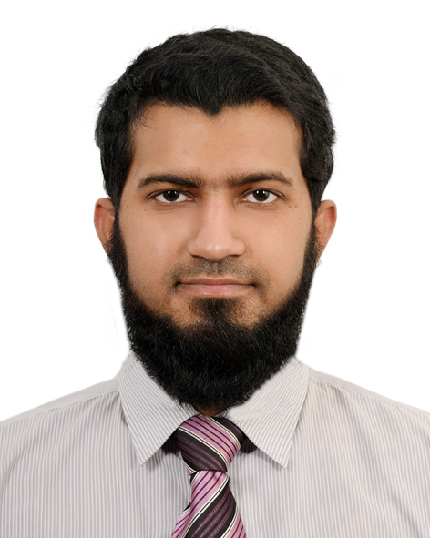
Md Golam Muktadir Asif
Career Objectives
To utilize my knowledge and skills to help an organization grow and build sustainable competencies.
Education
Master of Business Administration
Institute of Business Administration, University of Dhaka
Year: 2021 January – 2022 December
Major: Marketing
CGPA: 3.32
Date of Birth
21 November 1995
Bachelor of Business Administration
North South University
Year: 2016 January – 2019 December
Major: Human Resource Management
CGPA: 3.77
Contact
Address:
House no: 1993, Road: 28, Block: L,
Bashundhara Residential Area,
Dhaka – 1229
Phone:
01751634503
Email:
muhammad2111.asif@gmail.com
Advanced Level (Edexcel)
Academia
Passing Year: 2014 (January)
Subject: Science
Grades: (Mathematics: B, Physics: C, Chemistry: C)
Ordinary Level (Edexcel)
Maple Leaf International School
Passing Year: 2011 (June)
Subject: Science
Grades: ( Physics: A*, Chemistry: A*, Biology: A*,
Mathematics: A*, Bengali: A*, English: B, Pure Mathematics: B)
Experience
First Security Islamic Bank
Internship (October 2019 – December 2019)
My responsibilities included checking and analyzing various papers,
updating different registers, helping clients create their bank
accounts, etcetera.
Skills
Skilled in Microsoft Office Suite and Microsoft Power BI
Skilled in Adobe Illustrator, After Effects, and Premiere Pro
Skilled in Canva
Skilled in Python programming language with a good understanding of the Python Pandas, Matplotlib, Numpy, and Scikit learn libraries.
Certificates
DataCamp: Introduction to Python
DataCamp: Intermediate Python
DataCamp: Data Manipulation with Pandas

