Slide 1
B.Tech Project Report
Project Title:
Face Aging using Identity Preserved conditional Generative Adversarial Network
Team Members:
Aryan Mehta(B17EE012)
Asif Ahmed(B17EE013)
Project Supervisor:
Dr. Himanshu Kumar

Slide 2
Objectives :
Introduction
Motivation
Methodology
Results
References
End

Slide 3
Introduction
Face aging has many applications in todays world like for finding missing children, entertainment.
But currently existing models, most of them require sequential data for every person, which is not easy to collect and organize, so we need to find a solution to that.

Slide 4
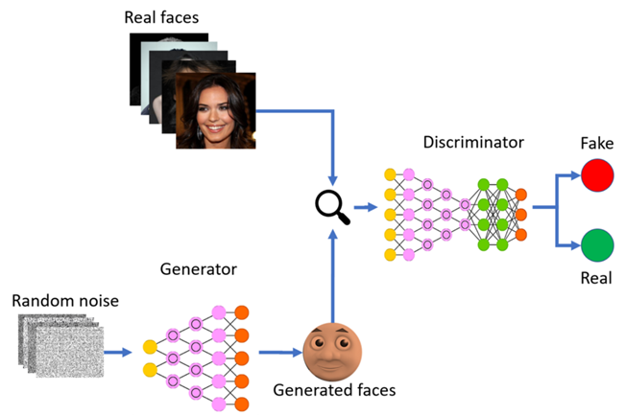
Basic Functioning of GANs

Slide 5
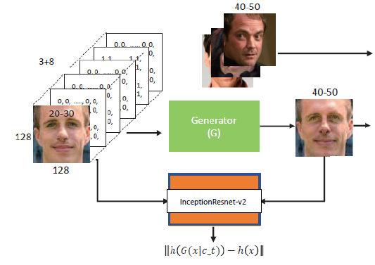
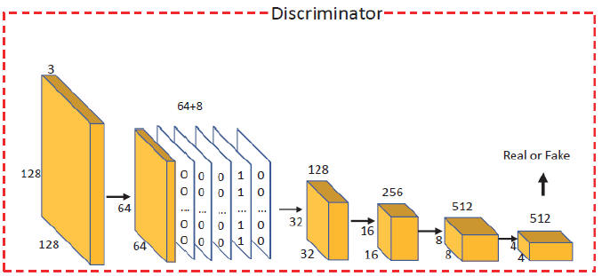
Our cGAN Model
Generator Discriminator
LG=1/2(Ex~p(x))[D(G(x|Ct)-1)²] LD=1/2(Ey~p(y))[(D(y|Ct)-1)^2] +
1/2(Ex~p(x))[(D(G(x|Ct))^2] + Lage
Lage = Σyꞓp(y) l(D(y|Ct),Ct)

Slide 6
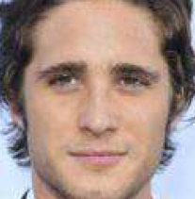
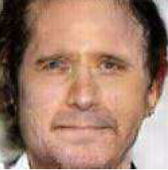
Problem??
The major concern in the pre-existing models as described in previous slide is that face is aged but identity is not preserved.

Slide 7

Resolving the Problem
When we added preservation loss as an extra factor, resulting image was identifiable as person in input image.

Slide 8
cGAN with Identity Preservation
Generator Discriminator
LG=1/2(Ex~p(x))[D(G(x|Ct)-1)²] LD=1/2(Ey~p(y))[(D(y|Ct)-1)^2] +
Lidentity= Σxꞓp(x) || h(x)-h(G(x|Ct)) ||^2 1/2(Ex~p(x))[(D(G(x|Ct))^2] + Lage
Lage = Σyꞓp(y) l(D(y|Ct),Ct)

Slide 9
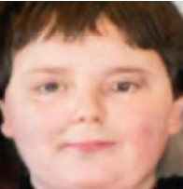
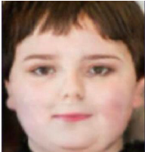
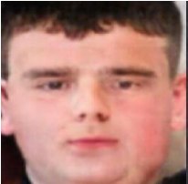
Improvement and Modification
We observed that in young age region the features of male and female are very similar, to overcome that providing an extra condition of gender improved the model.
Target=Female
Target=Male

Slide 10
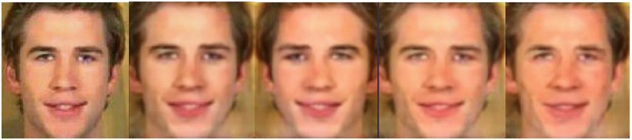
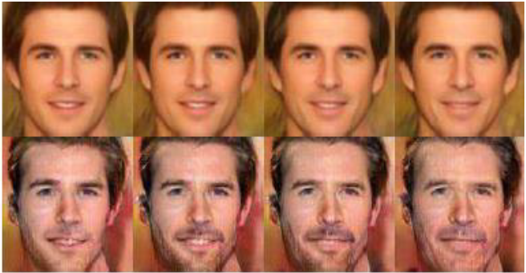
Result and Conclusion
Our model’s results:
Input 10-20 20-40 40-50 50+

Slide 11
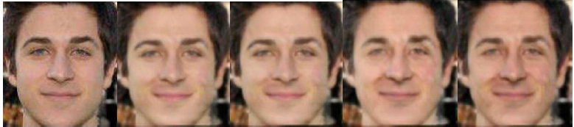
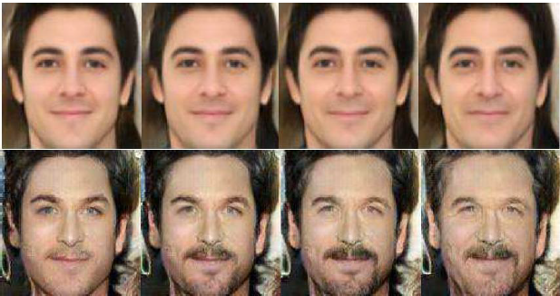
Result and Conclusion
Our model’s results:
Input 10-20 20-40 40-50 50+

Slide 12
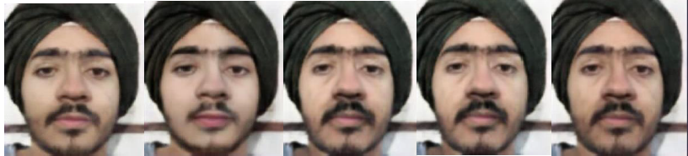
Result and Conclusion
Our model’s results on our faces:
Input 10-20 20-40 40-50 50+

Slide 13
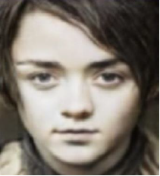
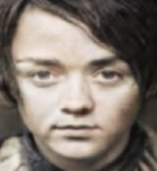
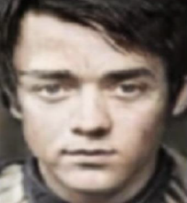
Result and Conclusion
Improvement result:
Target=Female
Target=Male

Slide 14
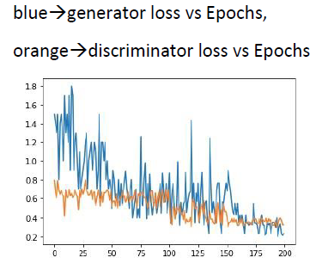
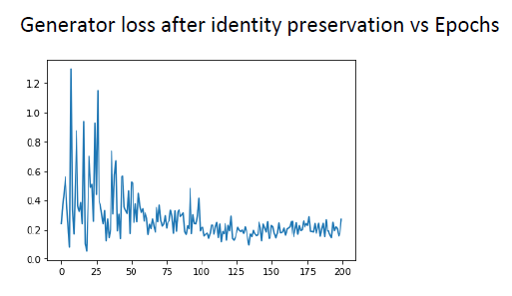
Result and Conclusion
Loss Graph:

Slide 15
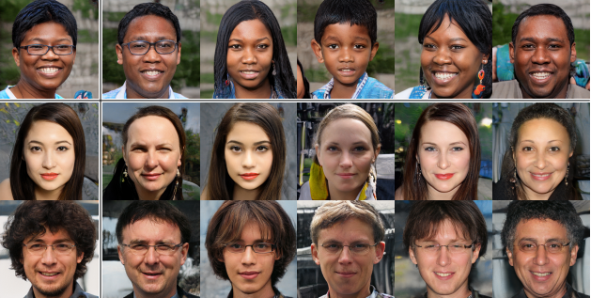
Conclusion and Future Scope
Conclusion:
We conclude that conditional GANs are very useful when synthesizing images with desired properties as seen in case of IPCGANs.
Further improvement that could have been made that we identified was to create a dataset with ethnicity labels and shape our model to learn aging pattern based on ethnicity also.

Slide 16
References and Acknowledgements
X. Tang, Z. Wang, W. Luo and S. Gao, "Face Aging with Identity-Preserved Conditional Generative Adversarial Networks," 2018 IEEE/CVF Conference on Computer Vision and Pattern Recognition, Salt Lake City, UT, 2018, pp. 7939-7947, doi: 10.1109/CVPR.2018.00828.
Dataset: IMDB-wiki
Antipov, G., Baccouche, M., & Dugelay, J. (2017, May 30). Face Aging With Conditional Generative Adversarial Networks, from https://arxiv.org/abs/1702.01983
Tsang, S. (2020, April 18). Review: CGAN - Conditional GAN (GAN), from https://medium.com/ai-in-plain-english/review-cgan-conditional-gan-gan-78dd42eee41
Elhamraoui, Z. (2020, May 16). InceptionResNetV2 Simple Introduction, from https://medium.com/@zahraelhamraoui1997/inceptionresnetv2-simple-introduction-9a2000edcdb6

Slide 17
Thank You

