Slide 1

Integrated Development Project
on
IOT based Smart Home Automation Using Blynk & ESP8266
Course Code: ICE-3000
Department of Information and Communication Engineering (ICE)
Supervised By Presented By
Name: Rajia Sultana Rinky | Name: Ahmad Sifat
ID: 20205005 | ID: 20205003
Dept. of ICE | Dept. of ICE
 | MD. Arafat Hossain
 | Lecturer
 | Dept. of ICE

Slide 2
Presentation Outline
Overview
Introduction
Summary of Literature Review
Critical Analysis
Proposed Work
Block diagram of proposed model
Methodology
Flow chart
Result Achieved
Budget Management
Milestone
Conclusion
Reference
Department of Information and Communication Engineering (ICE)

Slide 3


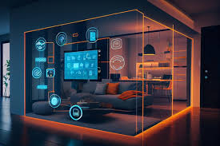
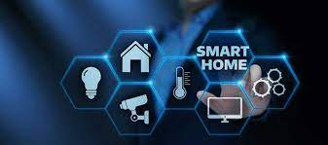
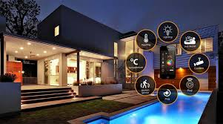
HOME AUTOMATION USING NODE
MCU AN OVERVIEW
Department of Information and Communication Engineering (ICE)

Slide 4
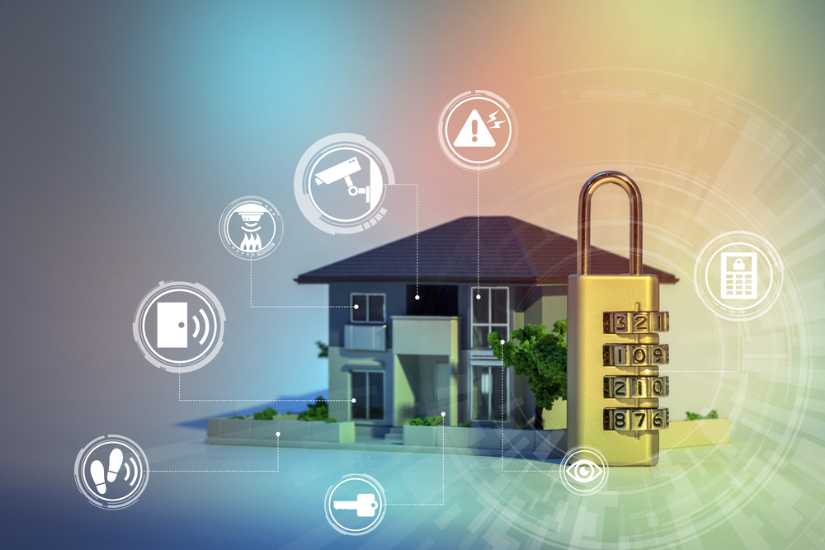
INTRODUCTION
A system is being designed which will control electrical appliances by smart phone and android app.
Components like NODE MCU use android application.
There are 1 wi-fi connections at NODE MCU end.
This device can also work from a long distance.
Automatic and electronic control of household features, activity and appliances
It can be controlled by any smartphone from anywhere
Department of Information and Communication Engineering (ICE)

Slide 5
LITERATURE VIEW (SUMMARY)
S.no | Paper and Publication | Author | Content
1. | lot based Simple Home Automation using NODE MCU | Aditya Vikram Jajodia, Suprabhat Das | Focuses on the idea of creating and deploying a simple home automation system with minimum cost and simple programming.
2. | Designing Of Smart Home Automation System Based On NODE MCU | Ravi Prakash Saini, Bhanu pratap singh, Mahesh kumar sharma, N. Leeprechanon. | Smart home automation systems are being adopted to achieve flexibility, scalability, security in the sense of data protection through the cloud-based data storage protocol, reliability, energy efficiency, etc.
3. | A Smart Home Automation technique with NODE MCU using IoT | Vamsikrishna Patchava, Hari babu Kandala, p Ravi Babu | NODE MCU operates and controls motion sensors and video cameras for sensing and surveillance.
4. | Classroom Attendance Using Face Detection | Priya Pasumarti, P. Purna Sekhar | In this proposed system we take the attendance using face recognition which recognizes the face of each.
5. | Smart Home Automation System Using Bluetooth Technology | Sandile Zondo, Kingsley Ogudo | There used various kind of sensor which make it more useful and easy. They used ultrasonic sensor for measuring the water level.
Department of Information and Communication Engineering (ICE)

Slide 6
Critical Analysis
People usually are outside the home for many reasons like travelling and they want to control some devices from a far distance. Examples:
Want to fill the water tank.
Want to turn off the light and electronic devices at rooms.
Get feedback about the temperature.
If somebody at your home.
Total control on your home.
Department of Information and Communication Engineering (ICE)

Slide 7
PROPOSED WORK
Energy Saving.
1
Give us excellent control over switch.
2
It also provides a perfect protection to houses.
3
Department of Information and Communication Engineering (ICE)

Slide 8
BLOCK DIAGRAM OF PROPOSED MODEL
OR
MOBILE
PC
POWER SUPPLY
NODE MCU
WI-FI
BULB
RELY
DRIVER
Telegram App
FAN
DOOR
Department of Information and Communication Engineering (ICE)

Slide 9

METHODOLOGY
A coding is written in the python language, which is than given into the NODE MCU module.
1
The connections are made as per the connection diagram shown in the real time application.
2
3
Source supply is provided to the bulb.
4
With the help of application in the android, the switching of bulb can be controlled
Department of Information and Communication Engineering (ICE)

Slide 10

FLOW CHART
Telegram App connected
Module connected to network
START
By Application command are given to module
Relay switch react on that command
Stop
Module give command to relay switch
Department of Information and Communication Engineering (ICE)

Slide 11
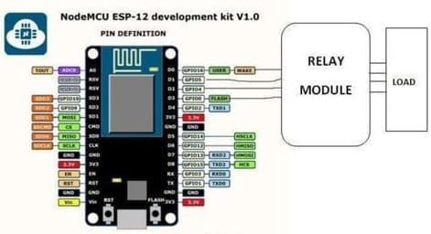
REAL TIME APPLICATION
We have designed this project to reduce human efforts and
provide home security.
Department of Information and Communication Engineering (ICE)

Slide 12
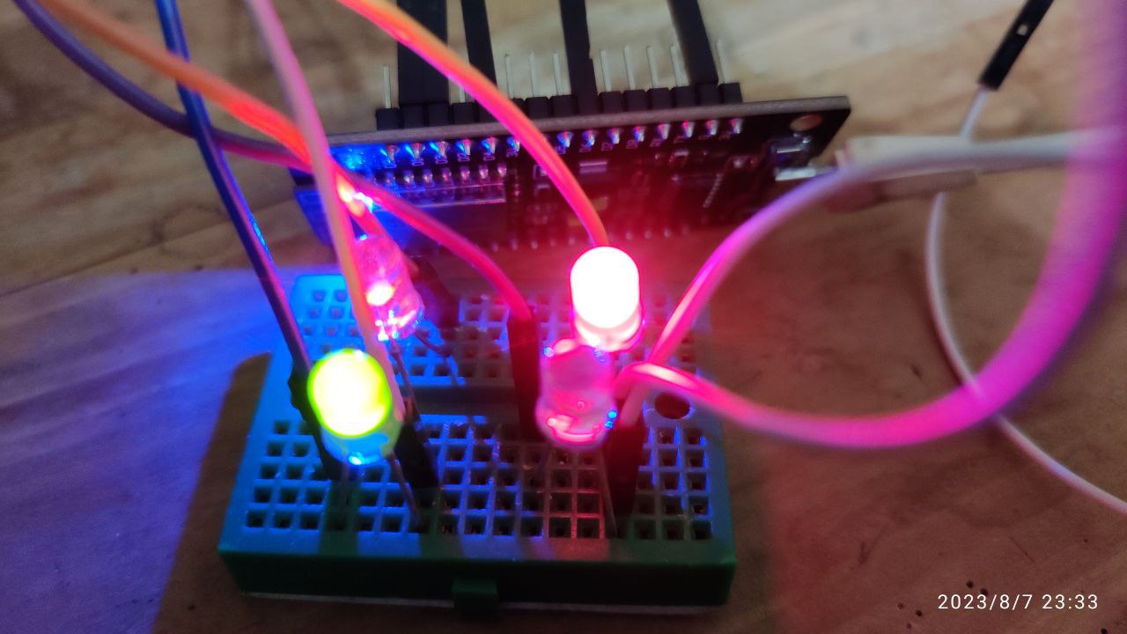
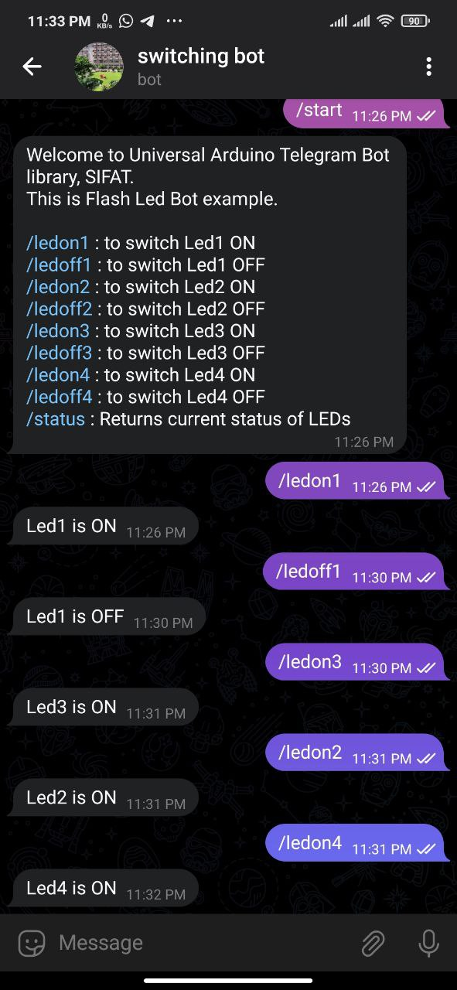
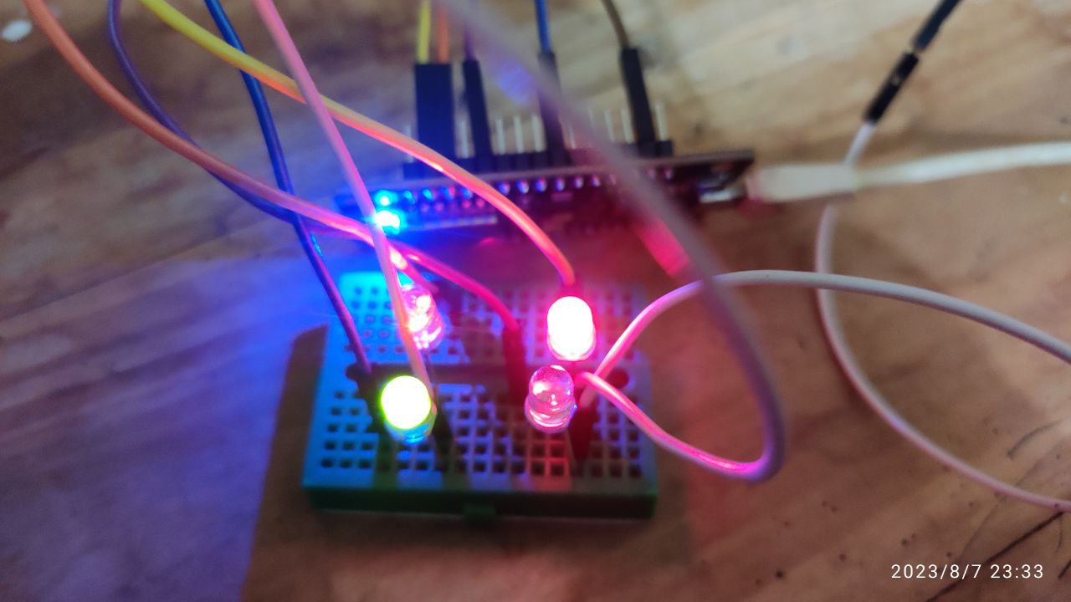
RESULT
We have worked on a technology that would make our lives easier as the regulation and control of all the electrical devices connected in the house can now be controlled with the help of an android application.
Department of Information and Communication Engineering (ICE)

Slide 13
Milestone (BLUETOOTH MODULE)
No | Activities | Week
 |  | 1 | 2 | 3 | 4 | 5 | 6 | 7 | 8 | 9 | 10 | 11 | 12 | 13 | 14
1 | Tittle Selection
2 | Preliminary Research and Literature review
3 | System Design
4 | Arduino board and Bluetooth module Programming
5 | Experimental Set-up
Department of Information and Communication Engineering (ICE)

Slide 14
Milestone (WI-FI MODULE)
No | Activities | Week
 |  | 1 | 2 | 3 | 4 | 5 | 6 | 7 | 8 | 9 | 10 | 11 | 12 | 13 | 14
1 | Research and Planning
2 | Setting up Blynk Server and Setting up ESP8266
3 | Building the Circuit (Connecting ESP8266 to Blynk)
4 | Configuring Blynk App
5 | Testing and Debugging
Department of Information and Communication Engineering (ICE)

Slide 15
Conclusion
The Internet of Things involves an increasing number of smart interconnected devices and sensors (e.g. cameras, biometric and medical sensors) that are often non-intrusive, transparent and invisible. lOT has been bringing new set of technological changes in our daily lives, which in turn helping us to make our life simpler and more comfortable.
In conclusion, the combination of Blynk and ESP8266 is an innovative and cost-effective solution for modernizing homes and provides a simple and reliable way to control home appliances and devices from anywhere, using a smartphone or tablet.
Department of Information and Communication Engineering (ICE)

Slide 16
References
[1] A Smart Home Automation technique with NODE MCU using loT By vamsikrishna patchava,hari babu kandala,p ravi babu Publisher IEEE,Date of conference-21-23 dec,2015
[2] Sukhan Lee and George N. Saridis, "Title of paper" IEEE Transactions on Automatic Control, Vol. 29, Issue No 4. pp. 290-302, April 1984.
[3] S. Mahmud, S. Ahmed, and K. Shikder, “A Smart Home Automation and Metering System using Internet of Things (IoT),” in 2019 International Conference on Robotics,Electrical and Signal Processing Techniques (ICREST), Dhaka, Bangladesh, Jan. 2019, pp. 451–454. doi: 10.1109/ICREST.2019.8644232.
[4] Mohamed Abd El-LatifMowad, Ahmed Fathy, Ahmed Hafez “Smart Home Automated Control System Using Android Application and Microcontroller” International Journal of Scientific & Engineering Research, Volume 5, Issue 5, May-2014 ISSN 2229- 5518
[5] loT based Simple Home Automation using NODEMCU by Aditya Vikram Jajodia, Suprabhat Das, December 2017 DOI: 10.14445/22315381/IJETT-V53P222
[6] Folea, S. ; Autom. Dept., Tech. Univ. of Cluj-Napoca, Cluj-Napoca, Romania ; Bordencea, D. ; Hotea, C. ; Valean, H – “Smart home automation system using Wi-Fi low power devices” Published in: Automation Quality and Testing Robotics (AQTR), 2012 IEEE International Conference on Date of Conference: 24- 27 May 2012 Page(s): 569 – 574 Print ISBN:978-1- 4673-0701-7 ; INSPEC Accession Number: 12853582 Conference Location :Cluj-Napoca ; DOI:10.1109/AQTR.2012.6237775 ; Publisher: IEEE
[7] Ming Yan and Hao Shi “SMART LIVING USING BLUETOOTH BASED ANDROID SMARTPHONE” International Journal of Wireless & Mobile Networks (IJWMN) Vol. 5, No. 1, February 2013 DOI : 10.5121/ijwmn.2013.5105 65
[8] Designing Of Smart Home Automation System Based On MCU by Ravi Prakash Saini, Bhanu pratap singh,Mahesh kumar sharma,N. leeprechanon, Conference: ADVANCEMENT IN SCIENCE AND TECHNOLOGY: Proceedings of the 2nd International Conference on Communication Systems (ICCS-2015), At Rajasthan, India, Volume: AIP Conference Proceedings 1715(1):020016.
Department of Information and Communication Engineering (ICE)

Slide 17


17

Slide 18

18

