Slide 1

ICE 4262: Internet and Web Programming
Bangladesh Army University of Engineering and Technology (BAUET)
Qadirabad Cantonment, Natore.
Department of Information and Communication Engineering (ICE)
Lab Experiment-05
Experiment Name: Utilizing HTML Registration Form Concept and Development of Codes for Creating a Registration Form.
Prepared By
Mehedi Hasan Imran
Lecturer, BAUET
Dept. of ICE
Email: imran02@bauet.ac.bd

Slide 2
Course Outcome (CO) & mapping
Course Outcomes (CO) | Statements | PO/ WA | POI Code | Bloom’s Taxonomy Level | WK | WP | EA | Delivery methods and activities | Assessment Tools
CO1 | Develop fundamental principles, typical characteristics, mechanisms and ethical use of internet and relate it to the web programming concept. | 08 | P.08.2 | A4 | KP7 |  |  | Demonstration, Problem Solving & Experiment Report Writing | Sessional Class Observation, Lab Reports, Lab Test, Project,
CO2 | Design a web-based project using modern tools and apply appropriate technique according to different stakeholders that achieve complex engineering problem. | 10 | P.10.3 | A2 |  |  | EA2, EA4 | Demonstration, Problem Solving & Experiment Report Writing | Project Showcasing, Project Presentation

Slide 3
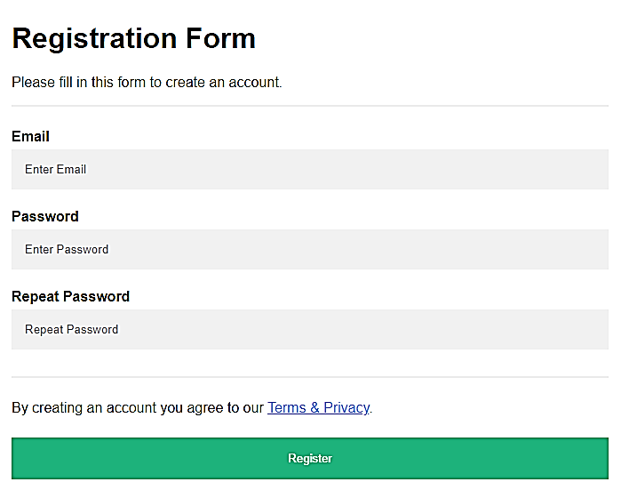
How To Create a Register Form

Slide 4
How To Create a Register Form
<!DOCTYPE html>
<html>
<head>
<meta name="viewport" content="width=device-width, initial-scale=1">
<style>
body {
font-family: Arial, Helvetica, sans-serif;
background-color: black;
}
* {
box-sizing: border-box;
}
/* Add padding to containers */
.container {
padding: 16px;
background-color: white;
}
/* Full-width input fields */
input[type=text], input[type=password] {
width: 100%;
padding: 15px;
margin: 5px 0 22px 0;
display: inline-block;
border: none;
background: #f1f1f1;
}

Slide 5
How To Create a Register Form
.registerbtn:hover {
opacity: 1;
}
/* Add a blue text color to links */
a {
color: dodgerblue;
}
/* Set a grey background color and center the text of the "sign in" section */
.signin {
background-color: #f1f1f1;
text-align: center;
}
</style>
</head>
input[type=text]:focus, input[type=password]:focus {
background-color: #ddd;
outline: none;
}
/* Overwrite default styles of hr */
hr {
border: 1px solid #f1f1f1;
margin-bottom: 25px;
}
/* Set a style for the submit button */
.registerbtn {
background-color: #04AA6D;
color: white;
padding: 16px 20px;
margin: 8px 0;
border: none;
cursor: pointer;
width: 100%;
opacity: 0.9;
}

Slide 6
How To Create a Register Form
<body>
<form action="/action_page.php">
<div class="container">
<h1>Registration Form</h1>
<p>Please fill in this form to create an account.</p>
<hr>
<label for="email"><b>Email</b></label>
<input type="text" placeholder="Enter Email" name="email" id="email" required>
<label for="psw"><b>Password</b></label>
<input type="password" placeholder="Enter Password" name="psw" id="psw" required>

Slide 7
How To Create a Register Form
<label for="psw-repeat"><b>Repeat Password</b></label>
<input type="password" placeholder="Repeat Password" name="psw-repeat" id="psw-repeat" required>
<hr>
<p>By creating an account you agree to our <a href="#">Terms & Privacy</a>.</p>
<button type="submit" class="registerbtn">Register</button>
</div>
<div class="container signin">
<p>Already have an account? <a href="#">Sign in</a>.</p>
</div>
</form>
</body>
</html>

Slide 8
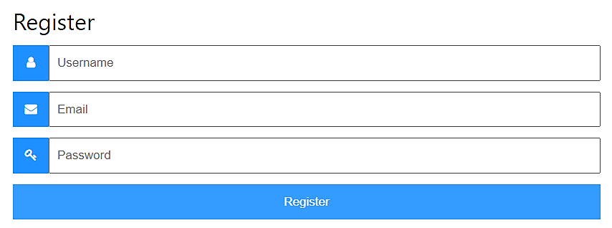
How To - Form with Icons
Notes:
<!DOCTYPE html>
<html>
<head>
<meta name="viewport" content="width=device-width, initial-scale=1">
<!-- Add icon library -->
<link rel="stylesheet" href="https://cdnjs.cloudflare.com/ajax/libs/font-awesome/4.7.0/css/font-awesome.min.css">
<style>
body {font-family: Arial, Helvetica, sans-serif;}
* {box-sizing: border-box;}
.input-container {
display: -ms-flexbox; /* IE10 */
display: flex;
width: 100%;
margin-bottom: 15px;
}
.icon {
padding: 10px;
background: dodgerblue;
color: white;
min-width: 50px;
text-align: center;
}
.input-field {
width: 100%;
padding: 10px;
outline: none;
}
.input-field:focus {
border: 2px solid dodgerblue;
}
/* Set a style for the submit button */
.btn {
background-color: dodgerblue;
color: white;
padding: 15px 20px;
border: none;
cursor: pointer;
width: 100%;
opacity: 0.9;
}
.btn:hover {
opacity: 1;
}
</style>
</head>
<body>
<form action="/action_page.php" style="max-width:500px;margin:auto">
<h2>Register Form</h2>
<div class="input-container">
<i class="fa fa-user icon"></i>
<input class="input-field" type="text" placeholder="Username" name="usrnm">
</div>
<div class="input-container">
<i class="fa fa-envelope icon"></i>
<input class="input-field" type="text" placeholder="Email" name="email">
</div>
<div class="input-container">
<i class="fa fa-key icon"></i>
<input class="input-field" type="password" placeholder="Password" name="psw">
</div>
<button type="submit" class="btn">Register</button>
</form>
</body>
</html>

Slide 9
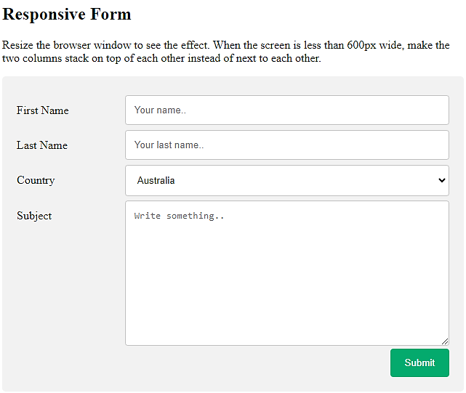
Responsive Form
Notes:
<!DOCTYPE html>
<html>
<head>
<meta name="viewport" content="width=device-width, initial-scale=1">
<style>
* {
box-sizing: border-box;
}
input[type=text], select, textarea {
width: 100%;
padding: 12px;
border: 1px solid #ccc;
border-radius: 4px;
resize: vertical;
}
label {
padding: 12px 12px 12px 0;
display: inline-block;
}
input[type=submit] {
background-color: #04AA6D;
color: white;
padding: 12px 20px;
border: none;
border-radius: 4px;
cursor: pointer;
float: right;
}
input[type=submit]:hover {
background-color: #45a049;
}
.container {
border-radius: 5px;
background-color: #f2f2f2;
padding: 20px;
}
.col-25 {
float: left;
width: 25%;
margin-top: 6px;
}
.col-75 {
float: left;
width: 75%;
margin-top: 6px;
}
/* Clear floats after the columns */
.row:after {
content: "";
display: table;
clear: both;
}
/* Responsive layout - when the screen is less than 600px wide, make the two columns stack on top of each other instead of next to each other */
@media screen and (max-width: 600px) {
.col-25, .col-75, input[type=submit] {
width: 100%;
margin-top: 0;
}
}
</style>
</head>
<body>
<h2>Responsive Form</h2>
<p>Resize the browser window to see the effect. When the screen is less than 600px wide, make the two columns stack on top of each other instead of next to each other.</p>
<div class="container">
<form action="/action_page.php">
<div class="row">
<div class="col-25">
<label for="fname">First Name</label>
</div>
<div class="col-75">
<input type="text" id="fname" name="firstname" placeholder="Your name..">
</div>
</div>
<div class="row">
<div class="col-25">
<label for="lname">Last Name</label>
</div>
<div class="col-75">
<input type="text" id="lname" name="lastname" placeholder="Your last name..">
</div>
</div>
<div class="row">
<div class="col-25">
<label for="country">Country</label>
</div>
<div class="col-75">
<select id="country" name="country">
<option value="australia">Australia</option>
<option value="canada">Canada</option>
<option value="usa">USA</option>
</select>
</div>
</div>
<div class="row">
<div class="col-25">
<label for="subject">Subject</label>
</div>
<div class="col-75">
<textarea id="subject" name="subject" placeholder="Write something.." style="height:200px"></textarea>
</div>
</div>
<div class="row">
<input type="submit" value="Submit">
</div>
</form>
</div>
</body>
</html>

Slide 10
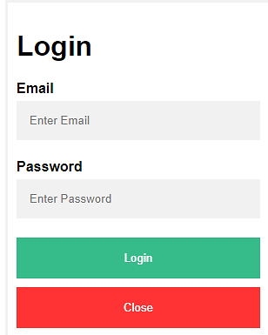

Popup Form
Notes:
<!DOCTYPE html>
<html>
<head>
<meta name="viewport" content="width=device-width, initial-scale=1">
<style>
body {font-family: Arial, Helvetica, sans-serif;}
* {box-sizing: border-box;}
/* Button used to open the contact form - fixed at the bottom of the page */
.open-button {
background-color: #555;
color: white;
padding: 16px 20px;
border: none;
cursor: pointer;
opacity: 0.8;
position: fixed;
bottom: 23px;
right: 28px;
width: 280px;
}
/* The popup form - hidden by default */
.form-popup {
display: none;
position: fixed;
bottom: 0;
right: 15px;
border: 3px solid #f1f1f1;
z-index: 9;
}
/* Add styles to the form container */
.form-container {
max-width: 300px;
padding: 10px;
background-color: white;
}
/* Full-width input fields */
.form-container input[type=text], .form-container input[type=password] {
width: 100%;
padding: 15px;
margin: 5px 0 22px 0;
border: none;
background: #f1f1f1;
}
/* When the inputs get focus, do something */
.form-container input[type=text]:focus, .form-container input[type=password]:focus {
background-color: #ddd;
outline: none;
}
/* Set a style for the submit/login button */
.form-container .btn {
background-color: #04AA6D;
color: white;
padding: 16px 20px;
border: none;
cursor: pointer;
width: 100%;
margin-bottom:10px;
opacity: 0.8;
}
/* Add a red background color to the cancel button */
.form-container .cancel {
background-color: red;
}
/* Add some hover effects to buttons */
.form-container .btn:hover, .open-button:hover {
opacity: 1;
}
</style>
</head>
<body>
<h2>Popup Form</h2>
<p>Click on the button at the bottom of this page to open the login form.</p>
<p>Note that the button and the form is fixed - they will always be positioned to the bottom of the browser window.</p>
<button class="open-button" onclick="openForm()">Open Form</button>
<div class="form-popup" id="myForm">
<form action="/action_page.php" class="form-container">
<h1>Login</h1>
<label for="email"><b>Email</b></label>
<input type="text" placeholder="Enter Email" name="email" required>
<label for="psw"><b>Password</b></label>
<input type="password" placeholder="Enter Password" name="psw" required>
<button type="submit" class="btn">Login</button>
<button type="button" class="btn cancel" onclick="closeForm()">Close</button>
</form>
</div>
<script>
function openForm() {
document.getElementById("myForm").style.display = "block";
}
function closeForm() {
document.getElementById("myForm").style.display = "none";
}
</script>
</body>
</html>

Slide 11
Thank You

