Slide 1
Web Design with HTML5 & CSS3
Chapter 8
Creating Tables

Slide 2
Chapter Objectives
Define table elements
Describe the steps used to plan, design, and code a table
Create a table with rows and data
Insert a table caption

Slide 3
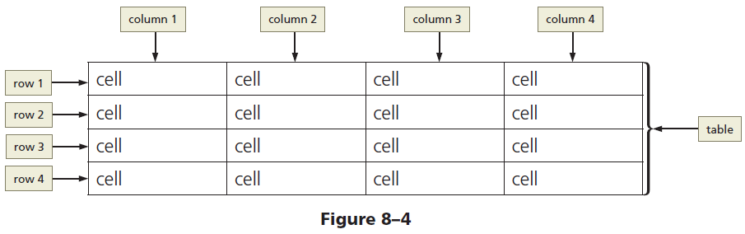
Tables
Consist of rows, columns, and cells
Cell - Intersection of a row and a column that usually contains data
Should not be used to design a layout for a webpage

Slide 4
Creating a Table with HTML Elements
Creating a table:
<table> and </table> tags indicate the starting/ending of a table
<th> and </th> tags
Starting/ending of table header
Displays text as bold and center-aligned
<tr> and </tr> tags indicate the starting/ending of each table row
<td> and </td> tags
Starting/ending tags for data elements within the table row elements
Displays normal, left-aligned text

Slide 5
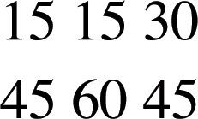
Basic Table Structure
<table> <tr> <td>15</td> <td>15</td> <td>30</td> </tr> <tr> <td>45</td> <td>60</td> <td>90</td> </tr> </table>
Notes:
Explain: Tables are drawn out one row at a time.

Slide 6
Table Structure - <table> tag
<table> <tr> <td>15</td> <td>15</td> <td>30</td> </tr> <tr> <td>45</td> <td>60</td> <td>90</td> </tr> </table>

Slide 7
Table Structure - <tr> tag
<table> <tr> <td>15</td> <td>15</td> <td>30</td> </tr> <tr> <td>45</td> <td>60</td> <td>90</td> </tr> </table>
Notes:
Explain: The "tr" in the <tr> tag stands for "table row".

Slide 8
Table Structure - <td> tag
<table> <tr> <td>15</td> <td>15</td> <td>30</td> </tr> <tr> <td>45</td> <td>60</td> <td>45</td> </tr> </table>
Notes:
Explain: The "td" in the <td> tag stands for "table data".

Slide 9

Table Headings - <th> tag
<table> <tr> <th></th> <th>Saturday</th> <th>Sunday</th> </tr> <tr> <th>Tickets sold</th> <td>120</td> <td>135</td> </tr> </table>
Notes:
Explain: You need to show tags for cells that have no data. For example, this table shows an empty cell on the first <th> element.

Slide 10
Table Borders - Default
Table Border – the line that defines the perimeter of the table
By default, a table is displayed without a border

Slide 11
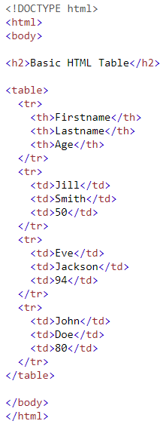
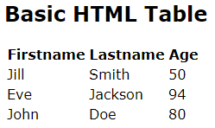
Notes:
Explain: Tables are drawn out one row at a time.

Slide 12

Table Borders
A border is set using the CSS border property:

Slide 13
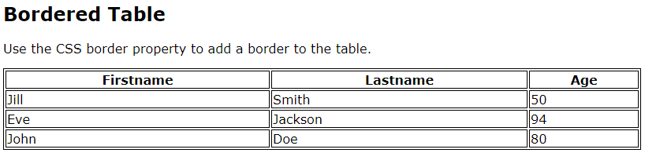
Table Borders – Default Borders
By default, each cell has its own border, making the table appear to have double lines between each table data cell

Slide 14
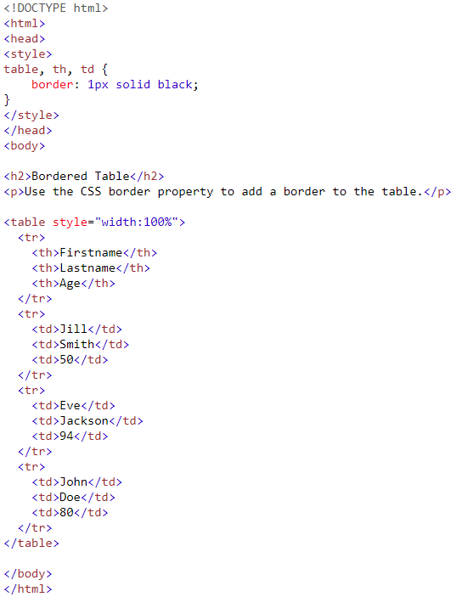

Slide 15
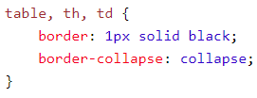
Table Borders – Collapsed Borders
To collapse the borders into one border, add the CSS border-collapse property:

Slide 16
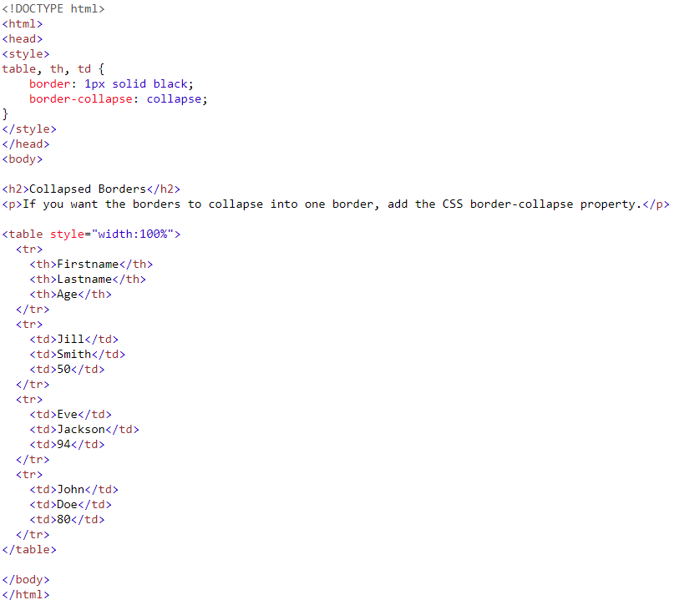
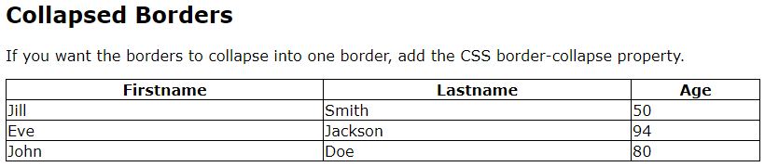

Slide 17

Table Borders – Cell Padding
Specifies the space between the cell content and its borders
Default is no cell padding
To set the CSS padding property:

Slide 18
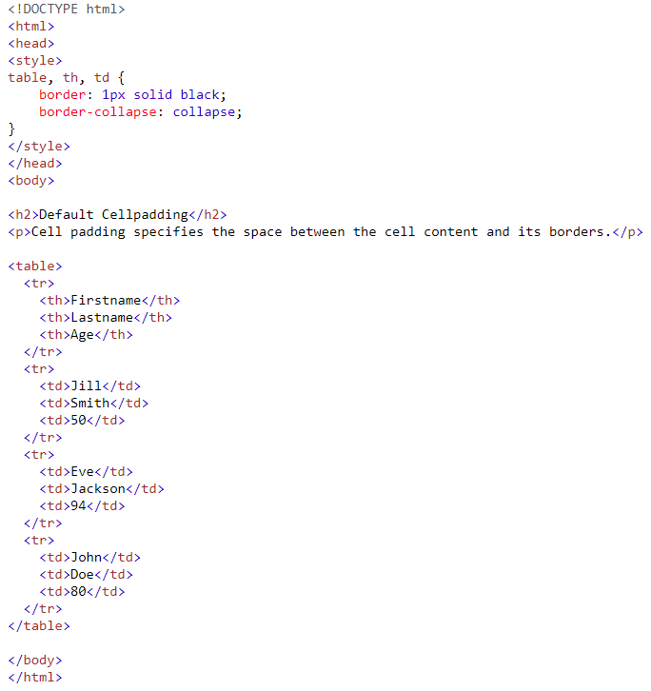
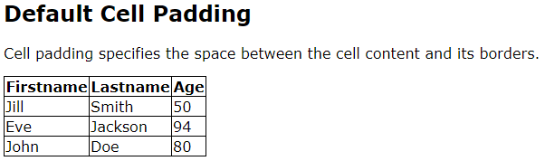

Slide 19
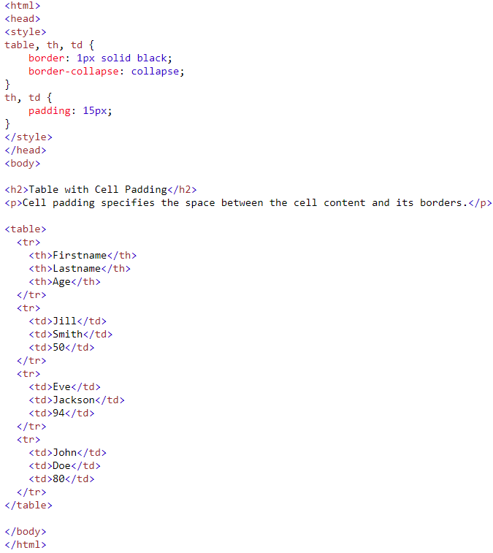
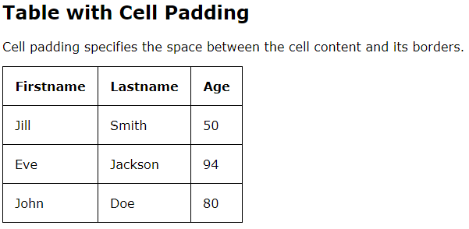

Slide 20
Table Headings - Default
By default, table headings are bold and centered

Slide 21

Table Headings – Left-align
Use the CSS text-align property:

Slide 22
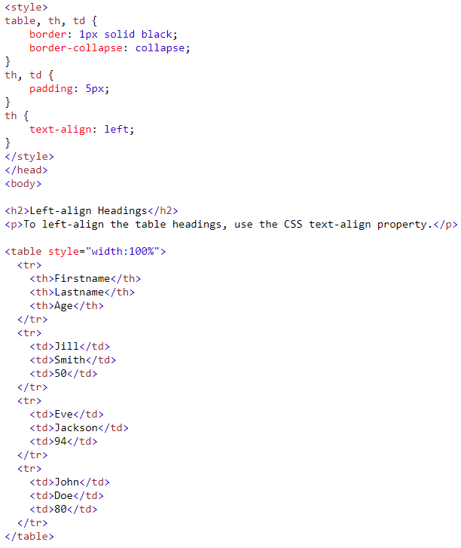
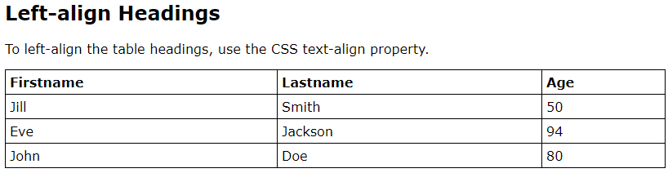

Slide 23

Table Border Spacing
Specifies the space between the cells
Use the CSS border-spacing property:

Slide 24
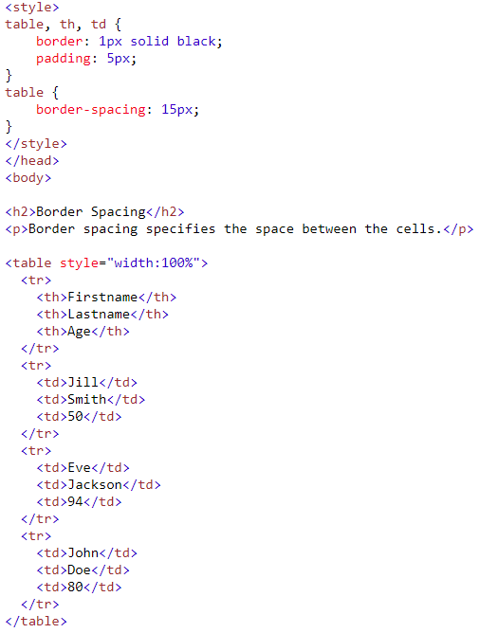
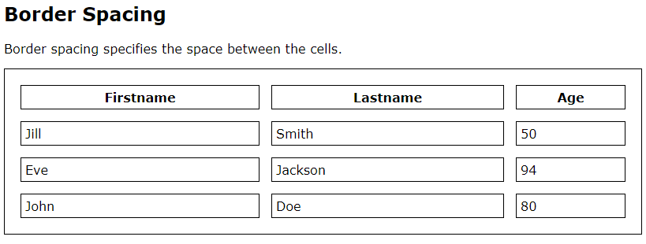

Slide 25
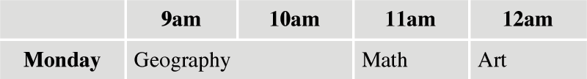
Spanning Columns – colspan attribute
… <tr> <th>Monday</th> <td colspan="2">Geography</td> <td>Math</td> <td>Art</td> </tr>
…

Slide 26
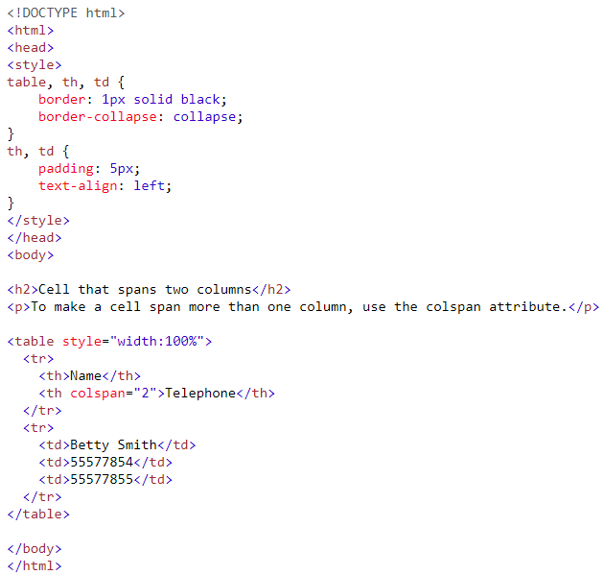
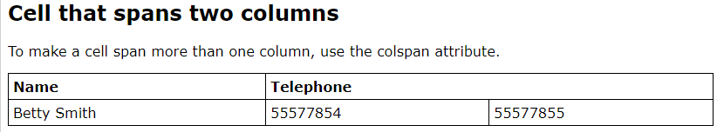

Slide 27
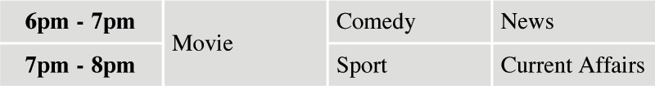
Spanning Rows - rowspan attribute
... <tr> <th>6pm - 7pm</th> <td rowspan="2">Movie</td> <td>Comedy</td> <td>News</td> </tr> <tr> <th>7pm - 8pm</th> <td>Sport</td> <td>Current Affairs</td> </tr>

Slide 28
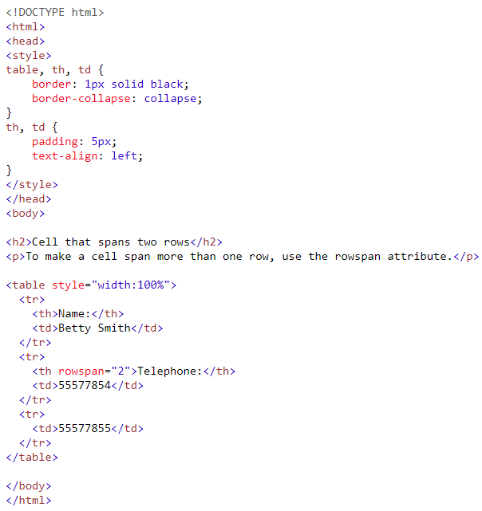
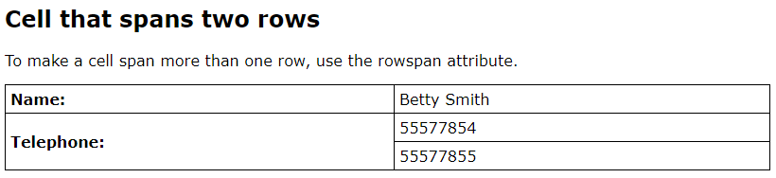

Slide 29
Table Caption
A descriptive text that serves as a title or identifies the table’s purpose
Defined with <caption> and </caption> tags
Inserted immediately after the <table> tag
A table can have only one caption
Tables can include headers and captions individually or in combination

Slide 30
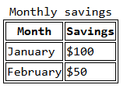
Table Caption
<table>
<caption>Monthly savings</caption>
<tr>
<th>Month</th>
<th>Savings</th>
</tr>
<tr>
<td>January</td>
<td>$100</td>
</tr>
<tr>
<td>February</td>
<td>$50</td>
</tr>
</table>
Notes:
Explain: The <thead>, <tbody>, and <tfoot> tags can be used to hold heading, body, and footer information in a long table. For example, it can be used to put a heading and footer on every page of a long table and also to style contents differently than other parts of the table.

Slide 31
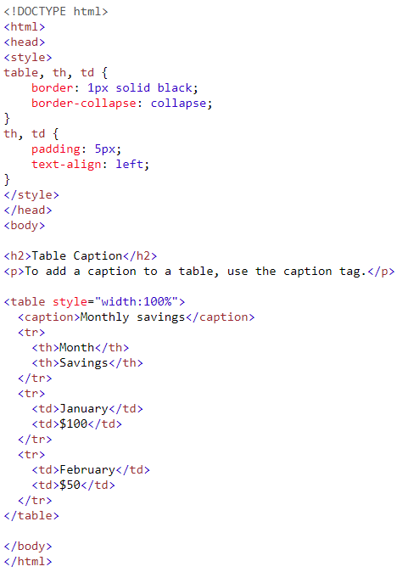
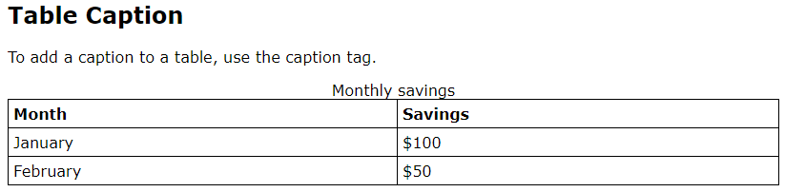

Slide 32
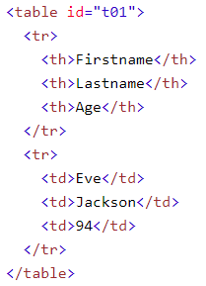
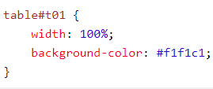
Styling a Table
Use the id attribute to style a table

Slide 33
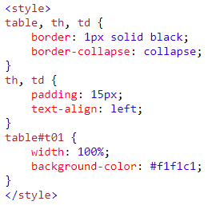
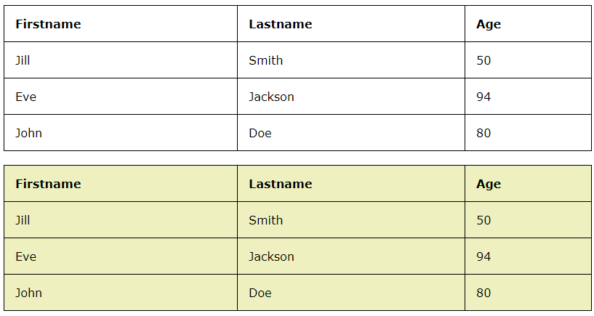
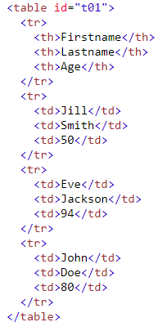

Slide 34
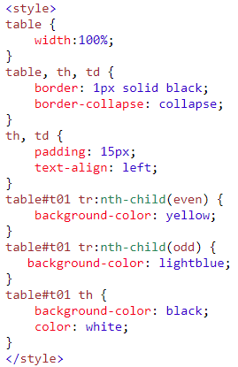
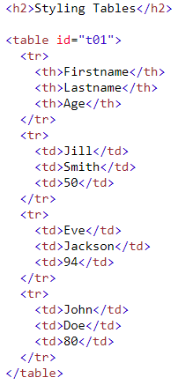
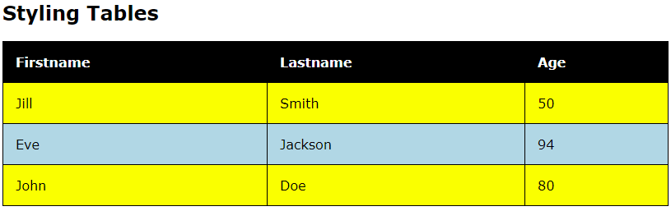

Slide 35


