Slide 1
Web Design with HTML5 & CSS3
Chapter 8
Creating Forms

Slide 2
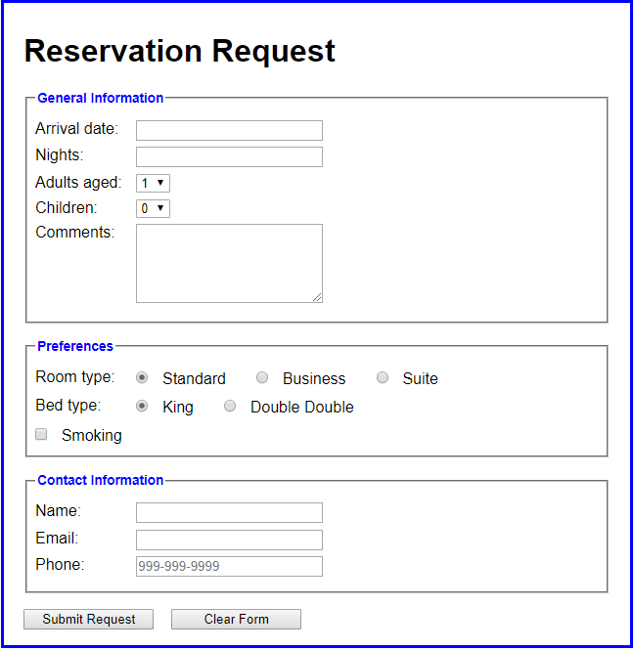
Form Controls
An example of a form with several input controls
date controls
labels
select controls
textarea control
radio controls
checkbox control
text control
email control
tel control
submit control
reset control

Slide 3
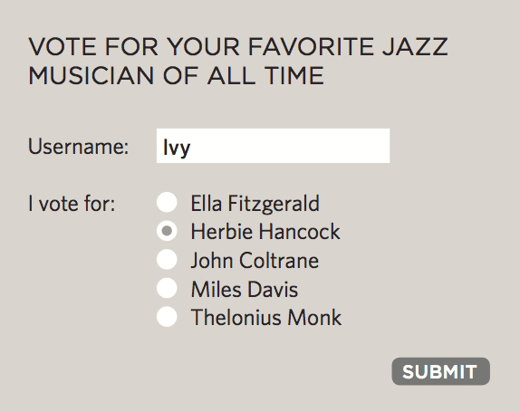
How Forms Work
1: User fills in form and presses button to submit info to server
Notes:
Explain: Each form control has a name and a value which is sent to the server.

Slide 4
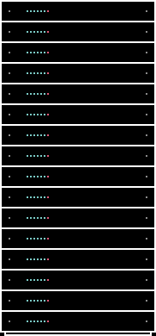
How Forms Work
2: Name of each form control sent with value user entered
Notes:
Explain: This is how server knows what info relates to each question.

Slide 5
How Forms Work
3: Server processes information using programming language
Notes:
Explain: How servers process information using programming language

Slide 6
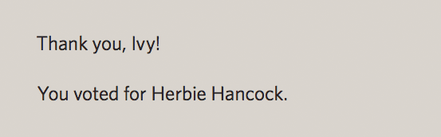
How Forms Work
4: Server send data (usually JSON) back to browser
Notes:
Explain: The server returns a page to the user based on the information supplied in the form. Note that this will largely contain HTML & CSS. (It's not just a hand-coded page, it is based on templates.)

Slide 7
Name & Value Pairs
Data from a form is send to server in name/value pairs
username=Ivy
Notes:
Explain: how the server needs to know what the user entered / chose for each different form element
To do this, each form element must have a name
The value is what the user enters / the value associated with the choice made

Slide 8
Name & Value Pairs
Data from a form is send to server in name/value pairs
NAME
username=Ivy
Notes:
Explain: how the server needs to know what the user entered / chose for each different form element
To do this, each form element must have a name
The value is what the user enters / the value associated with the choice made

Slide 9
Name & Value Pairs
Data from a form is send to server in name/value pairs
NAME
username=Ivy
VALUE
Notes:
Explain: how the server needs to know what the user entered / chose for each different form element
To do this, each form element must have a name
The value is what the user enters / the value associated with the choice made

Slide 10
Form Processing
<form method="POST“ action="newCustomer.aspx">
action - Specifies the browser’s action when submitting the form
method - Specifies how to send the data entered in the form to the server to be processed
GET
POST

Slide 11
Form Processing
GET method - appends the name-value pairs to the URL indicated in the action attribute
<form method="GET" action="newCustomer.aspx">
https://www.mycompany.com/newcustomer.aspx?fname=Peter&lname=Smith
POST method - sends a separate data file with the name-value pairs to the URL indicated in the action attribute
<form method="POST" action="newcustomer.aspx">

Slide 12
Form Structure
<form action="http://example.com/join.php" method="get"> This is where the form controls will appear. </form>

Slide 13
Form Structure
<form action="http://example.com/join.php" method="get"> This is where the form controls will appear. </form>
Notes:
Explain: The action attribute shows the page the form is sent to.

Slide 14
Form Structure
<form action="http://example.com/join.php" method="get"> This is where the form controls will appear. </form>
Notes:
Explain: Describe the difference between the get and post methods.

Slide 15
Form Controls
Each input control has attributes that are used more frequently than the others:
name – It identifies the specific information that is being sent when the form is submitted for processing. All controls have a name
id – It provides a unique ID for the element. Use the id attribute with input controls
value – It specifies the value of an input element and varies depending on input type

Slide 16
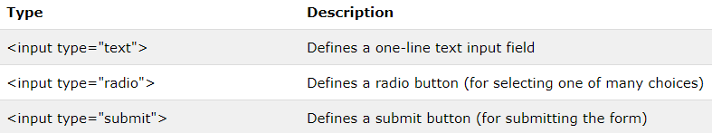
<input> Element
Most important form element
Can be displayed in several ways, depending on the type attribute:

Slide 17
<input type="text">
<input type="text"> defines a one-line input field for text input
If the type attribute is omitted, the input field gets the default type: "text"

Slide 18
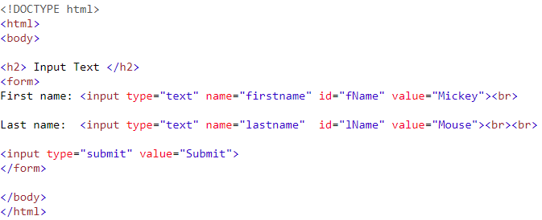
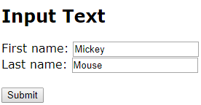
<input type="text">

Slide 19
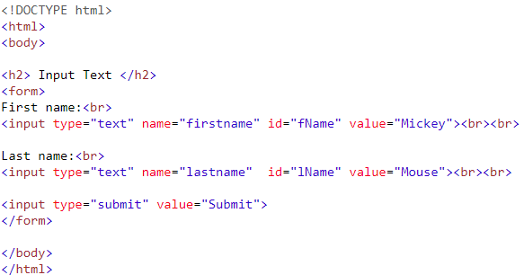
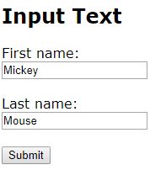
<input type="text">

Slide 20
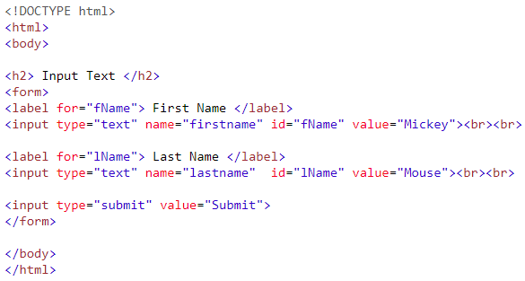
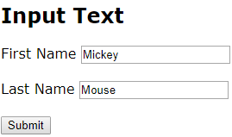
<input type="text"> - Label for

Slide 21
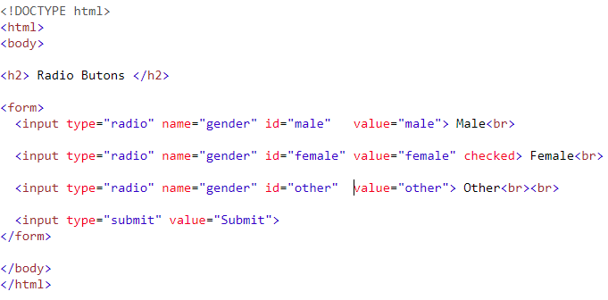
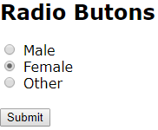
<input type="radio">
<input type="radio"> defines a radio button
Select ONLY ONE from several choices

Slide 22
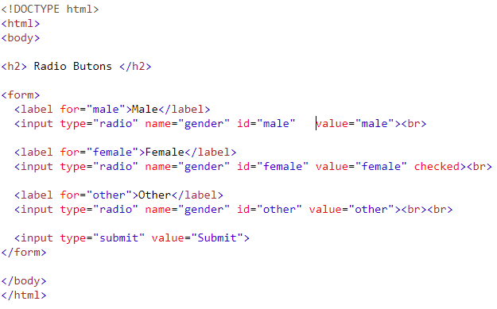
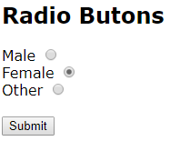
<input type="radio"> - Label for
Select ONE of a limited number of choices:

Slide 23

Input Type Checkbox
<input type="checkbox"> defines a checkbox
Select ZERO or MORE options from several choices

Slide 24
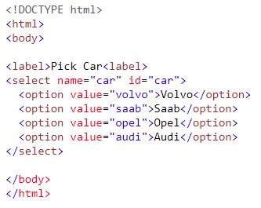
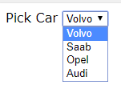
<select> Element
The <select> element defines a drop-down list
The <option> elements defines an option that can be selected

Slide 25
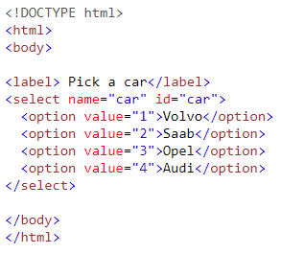
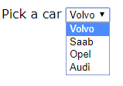
<select> Element
The <select> element defines a drop-down list
The <option> elements defines an option that can be selected

Slide 26
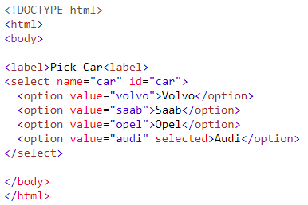

<select> Element
By default, the first item in the drop-down list is selected.
To define a pre-selected option, add the selected attribute to the option:

Slide 27
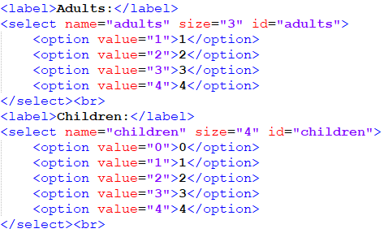
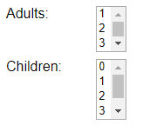
<select> Element – size attribute
Use the size attribute to specify the number of visible values:

Slide 28
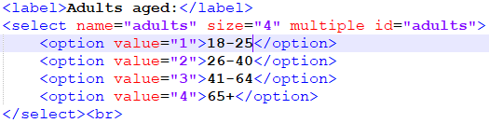

<select> Element – multiple attribute
Use the multiple attribute to allow the user to select more than one value
Hold down the Ctrl (windows) / Command (Mac) button to select multiple options.

Slide 29
<textarea> Element
The <textarea> element defines a multi-line input field (a text area)
The rows attribute specifies the visible number of lines in a text area.
The cols attribute specifies the visible width of a text area

Slide 30

<textarea> Element

Slide 31
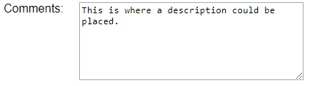
<textarea> Element
The size of the text area can be defined by using CSS:

Slide 32


Input Type Password
<input type="password"> defines a password field
The characters in a password are masked (shown as asterisks or circles)

Slide 33
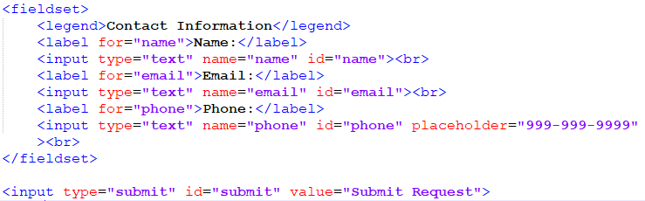
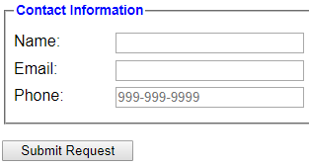
Input Type Submit
<input type="submit"> defines a button for submitting form data to a form-handler
The form-handler is specified in the form's action attribute
When "Submit Request" is clicked, the name of each control and it's data value are sent to the server (response.html) for processing

Slide 34
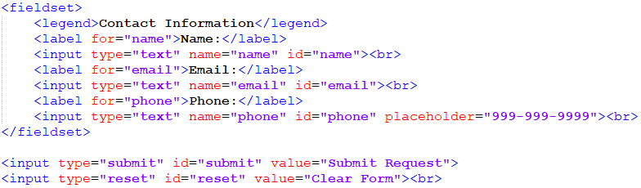
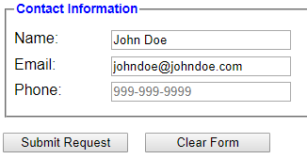
Input Type Reset
<input type="reset"> defines a reset button that resets all form values to their default values
If the "Clear Form" button is clicked, the form-data is reset to the default values

Slide 35
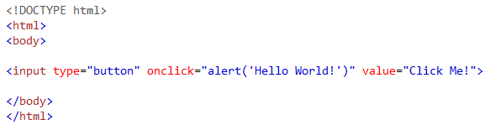

Input Type Button
The <button> element defines a clickable button:

Slide 36
Form Attribute - required
The required attribute specifies that an input field must be filled out before submitting the form

Slide 37
Form Validation
<label for="username">Username:</label> <input type="text" name="username" required="required" /> <label for="password">Password:</label> <input type="password" name="password" required="required" /> <input type="submit" value="Submit" />

Slide 38
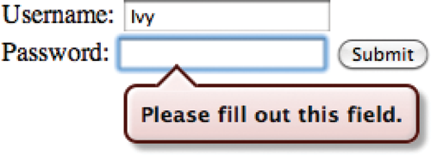

Slide 39
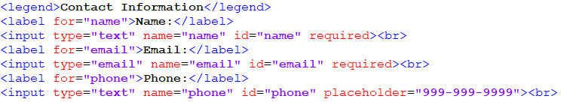
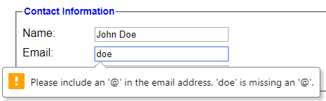
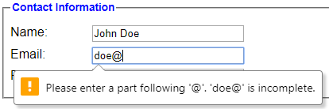
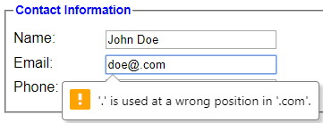
Required Form Attribute – Type Email
By changing the input type to "email" while using the required attribute, the browser can be used to validate (with some limitations) email addresses.

Slide 40
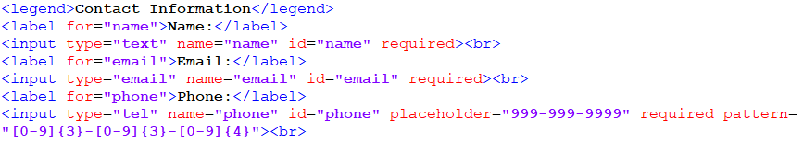
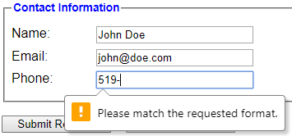
Required Form Attribute – Type Tel
By changing the input type to "tel" and using the "pattern" attribute while using the required attribute, the browser can be used to validate phone numbers.

Slide 41


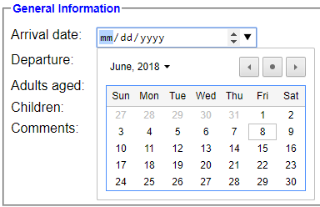
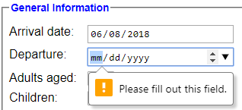
Required Form Attribute – Type Date
By changing the input type to “date” and using the required attribute, the browser can be used to input specific dates.

Slide 42
☺

