Slide 1

Final Term Project: Overlay networking between VMs using a Virtual Switch in a hypervisor based environment
Dated: 19th December, 2018
Name: Mehmood Asif
Masters Student, Network Convergence Lab - Computer Engineering Jeju National University, South Korea

Slide 2
Design

Slide 3
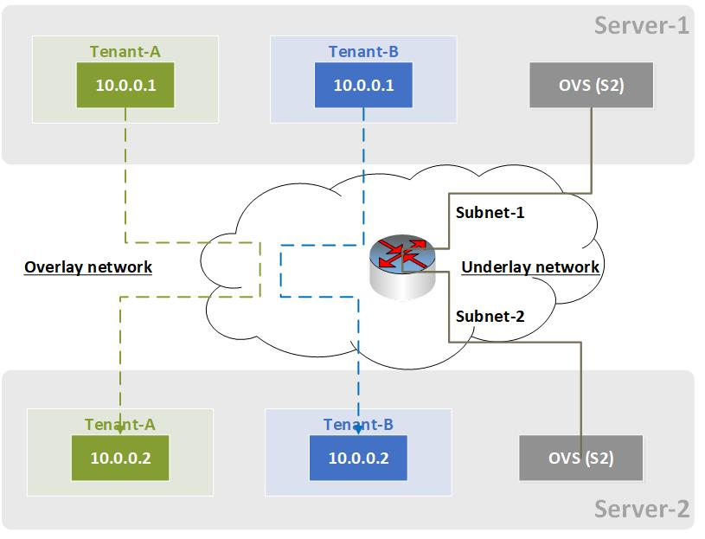
Proposed Statement

Slide 4
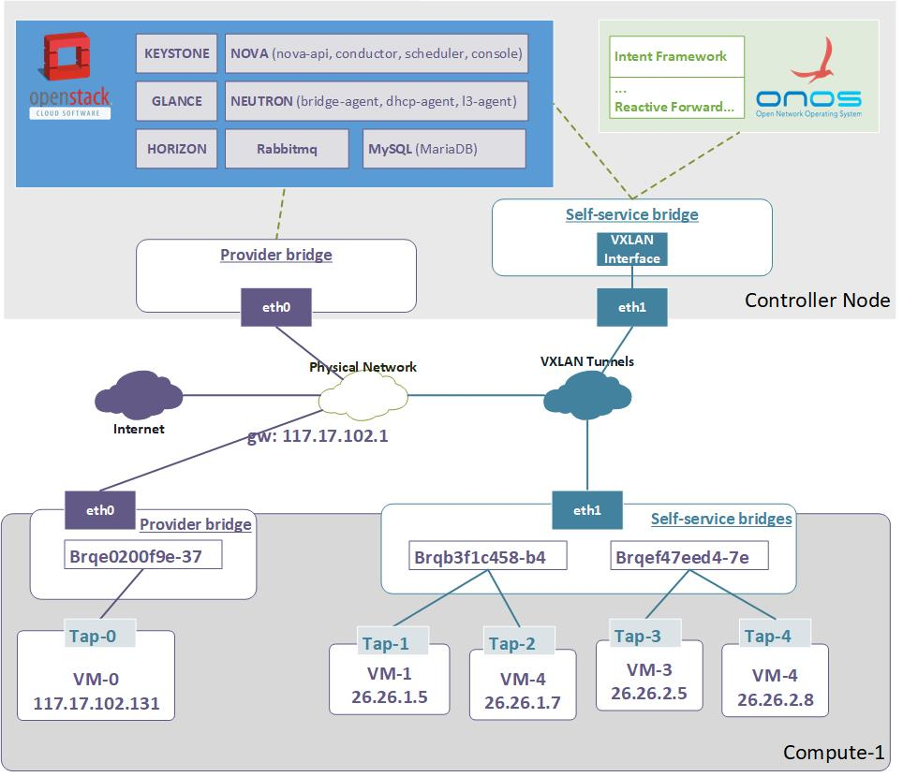
Architecture - Connectivity

Slide 5
Details

Slide 6
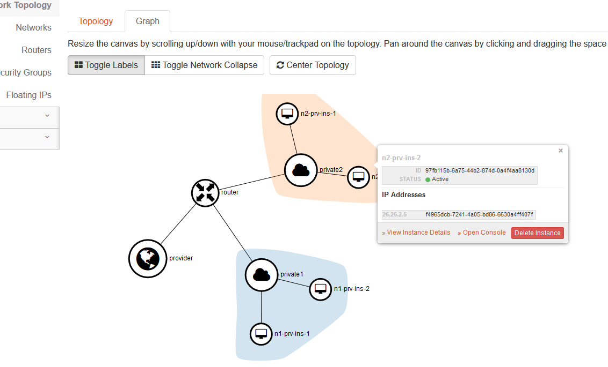
Network - Topology

Slide 7
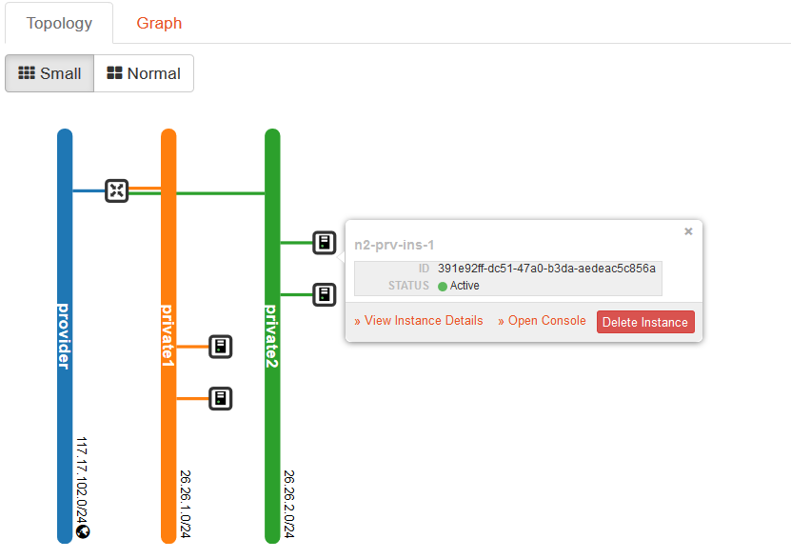
Network - instances

Slide 8
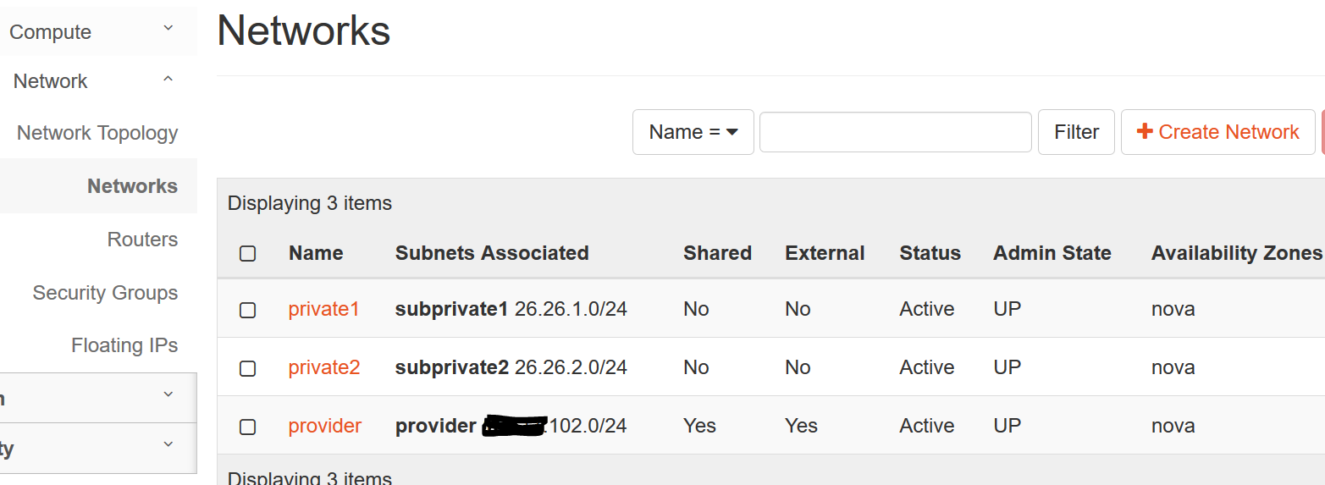
Networks

Slide 9
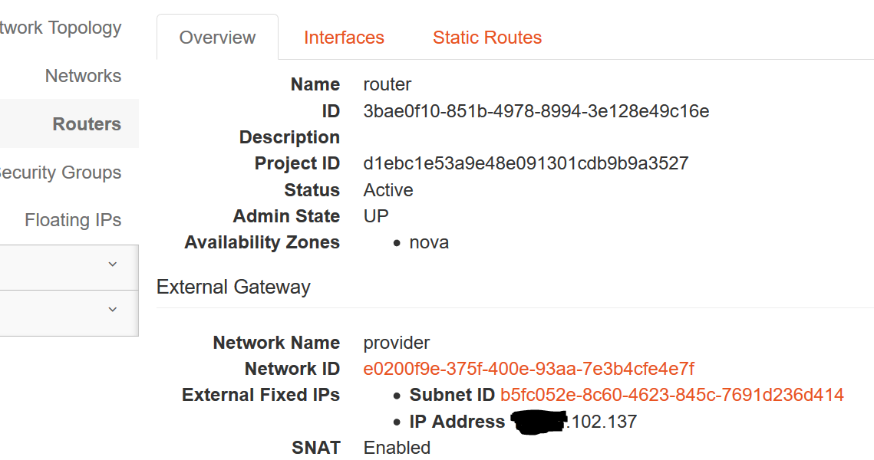
Router

Slide 10
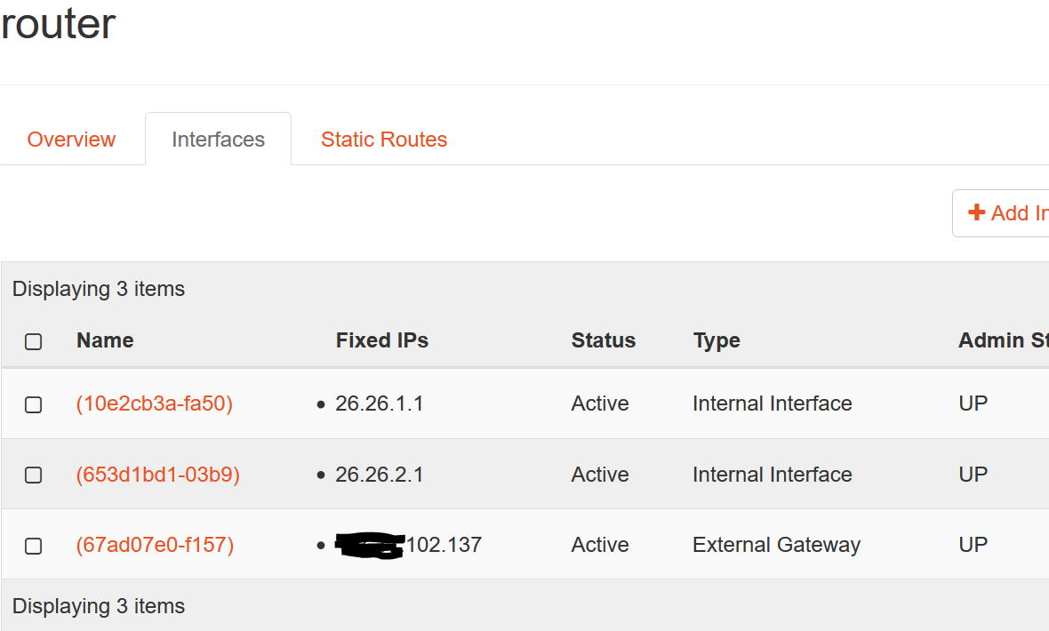
Router - Interfaces

Slide 11
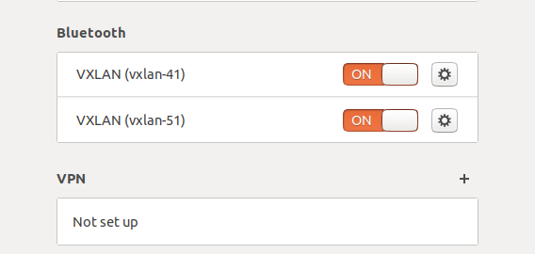
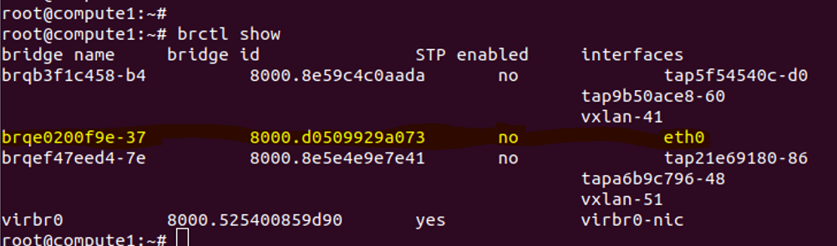
Architecture - Connectivity
Provider bridge
Self-service bridge

Slide 12
Thank you!

