Slide 1
Analyzing Soil and predict suitable crops Using Machine Learning
Supervisor: Presented by:
Nasif Ahmed Md Asif Ikbal
Assistant Professor Id :17cse051
BSMRSTU 4th year 1st semester

Slide 2
Outline
Introduction
Aim & Objectives
Related Works
Proposed Model
Dataset
Current Status
Expected Outcome
References

Slide 3
Introduction
The main challenge faced in agriculture sector is the lack of knowledge about the changing variations in climate. Each crop has its own suitable climatic features. This can be handled with the help of precise farming techniques.
The precision farming not only maintains the productivity of crops but also increases the yield rate of production
So,here comes our system which will measure the key elements of soil and predict the appropriate crops for that particular soil.

Slide 4
Aim & Objectives
Analysis of soil Properties and climatic data to predict Crop yields and cluster different agricultural regions of Bangladesh.
Crop selection method to maximize crop Yield rate using machine learning technique.
Making smarter decisions and getting better yield by ml algorithms.
Analysis of soil behaviour .
Classifying the soil according to the soil nutrients is much beneficial or the famers to predict which crop can be cultivated in a particular soil type.

Slide 5
Related Works
In a research carried out by Zaminur Rahman a comparative study of several machine learning techniques has been carried out. They have carried out the classification using the data of Bangladesh. They have used k Nearest Neighbour, Bagged tree and SVM finally compared the results of three algorithms and brought out a model for classifying the soil types and the suitable crop.
In an approach carried out by Jay Gholap carried out a modal to classify the soil based on fertility. The dataset was collected from the soil testing laboratories of Pune District. They have used WEKA tool for developing an automated system[5].

Slide 6
Related Works
Chiranjeevi M. N carried out a research for classifying the soil types so that it can be useful for the farmers for analyzing the type o soil and the crop that can be cultivated so that there will a good yield and profit.They have used algorithms such as J48 decision tree classifier and Naive bayes classifier among these two algorithms Naive bayes has obtained the maximum accuracy of 98%.
Suhas Athani et al proposed IoT enabled soil moisture monitoring for predicting the future harvest. This system detects soil moisture level for obtaining good plant growth. Initially, soil samples are given as an input to the sensors then the respective pH content, salinity content and moisture content is measured using Wi-Fi shield[6].

Slide 7
Methodology
Database
Data
Pre-processing
Train
data
Test
Data
Crop Suggestion
Interface
Predictioncrop
Suggestion
ML
MSE,Accuracy
Crop Suggestion Prediction Model

Slide 8
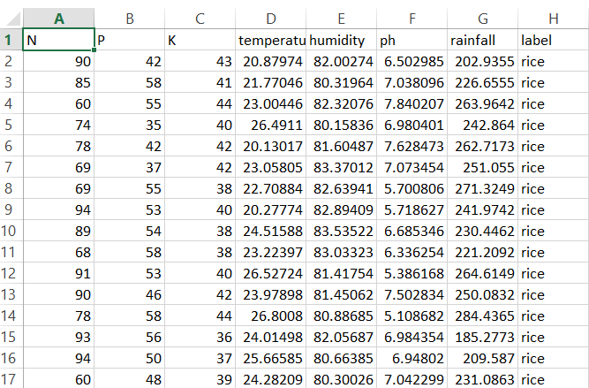
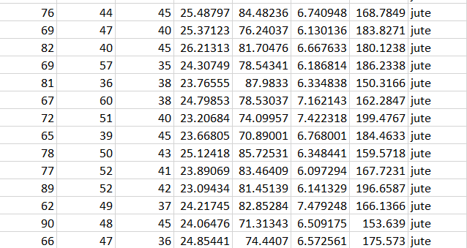
Dataset
The dataset was created by 2200 rows and 8 columns with a target column named “label”.
It was collected from “kaggle”.

Slide 9
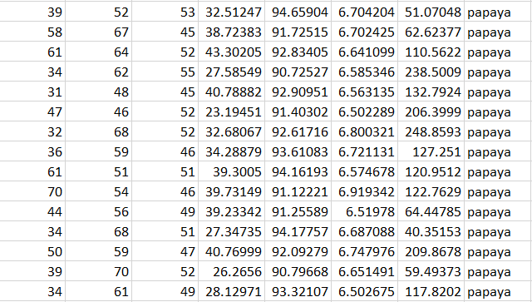
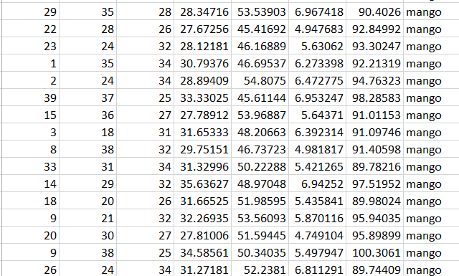
Dataset(cont..)

Slide 10
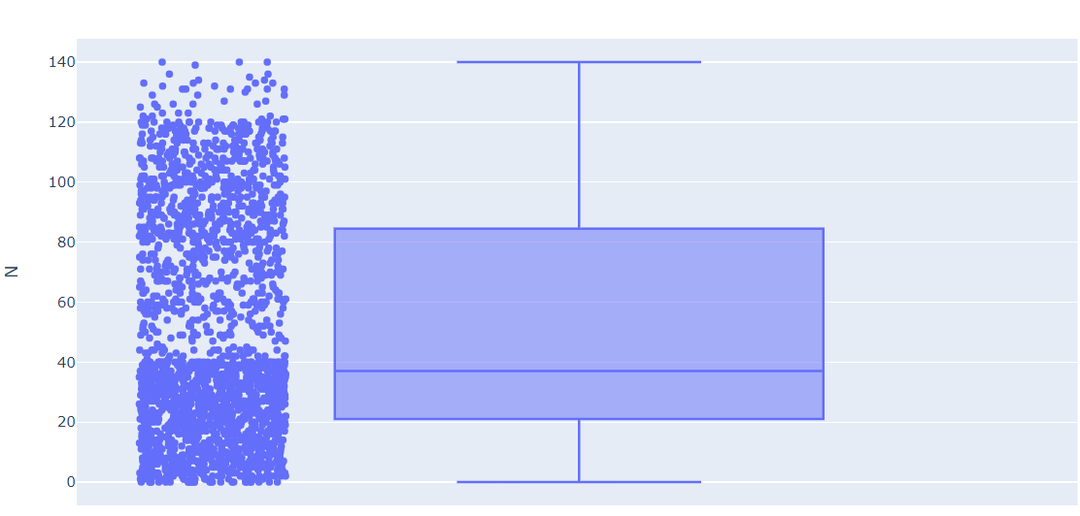
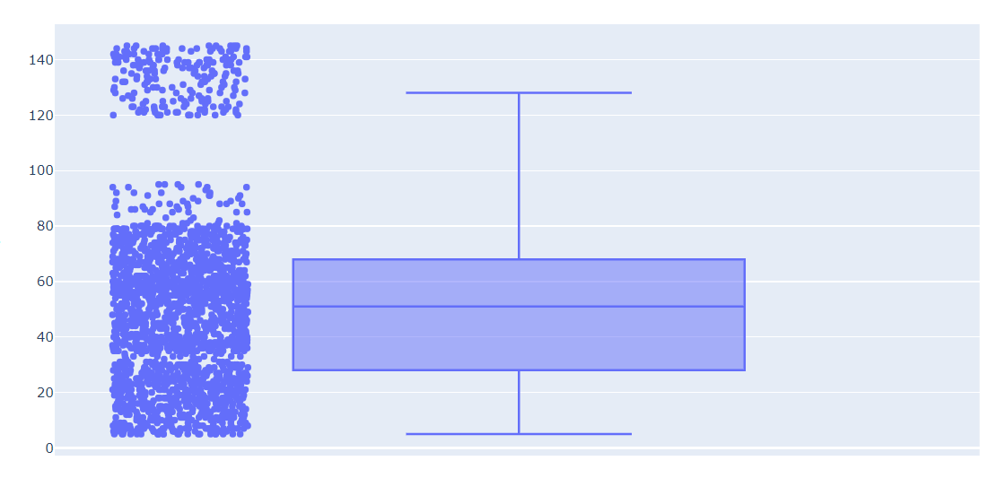
Implementation
At first I balanced my dataset with the help of balance function then preprocessed
the dataset.

Slide 11
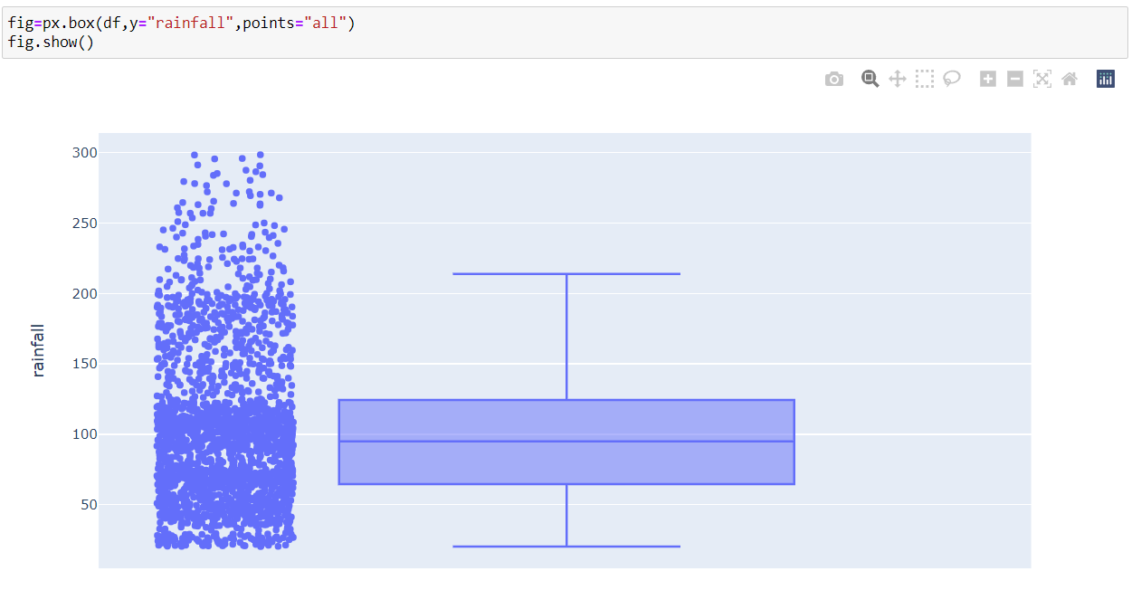
Current Status(cont..)

Slide 12
Current Status(cont..)
After pre processing this is the status of the dataset :

Slide 13
Result
Accuracy
Method | Train Accuracy(%) | Test Accuracy(%)
Lightgbm | 100 | 98.89
Decision Tree | 100 | 98.87

Slide 14
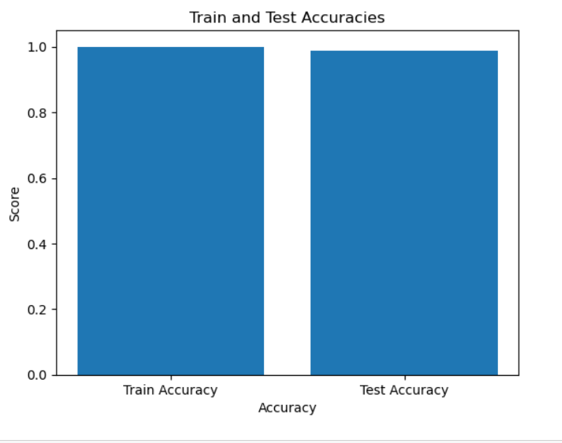
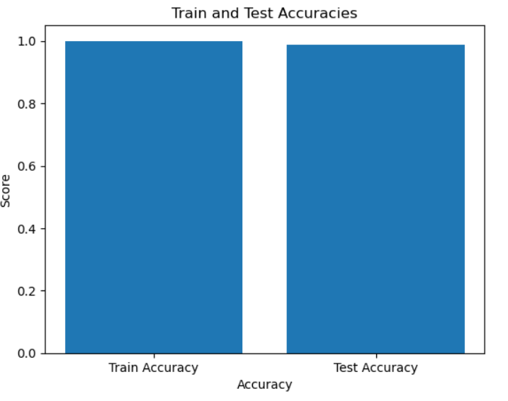
Accuracies(Cont.)

Slide 15
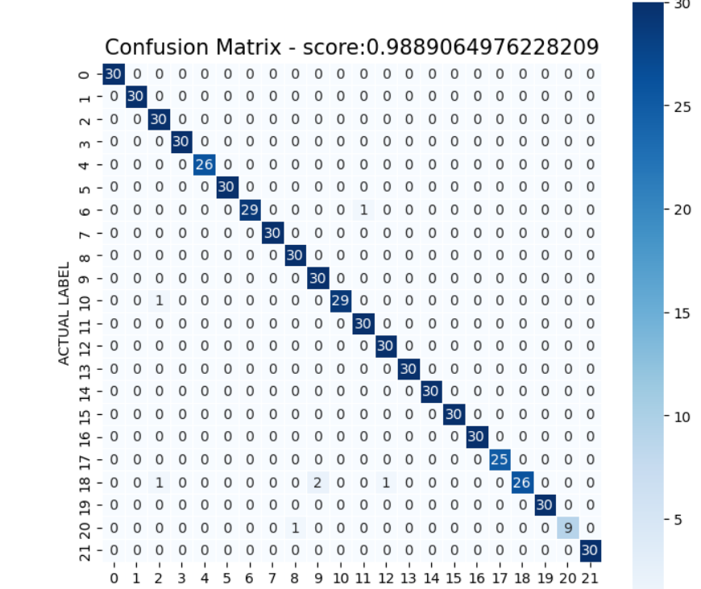
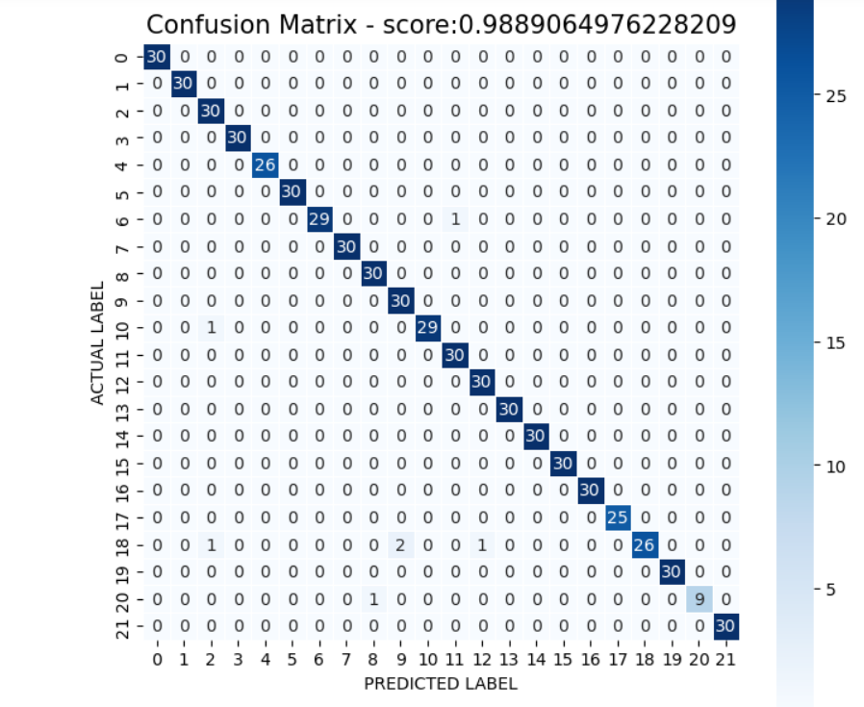
Confusion Matrix(DT,lightgbm)

Slide 16
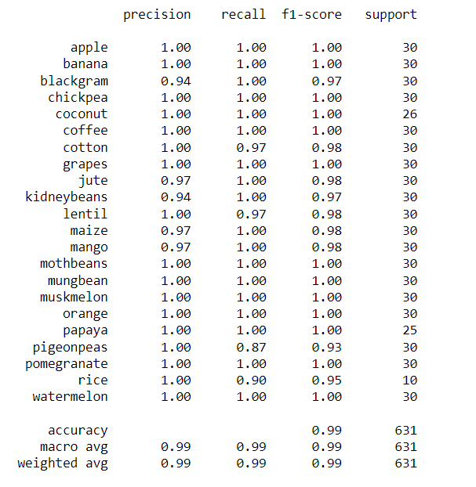
Result (cont.)

Slide 17
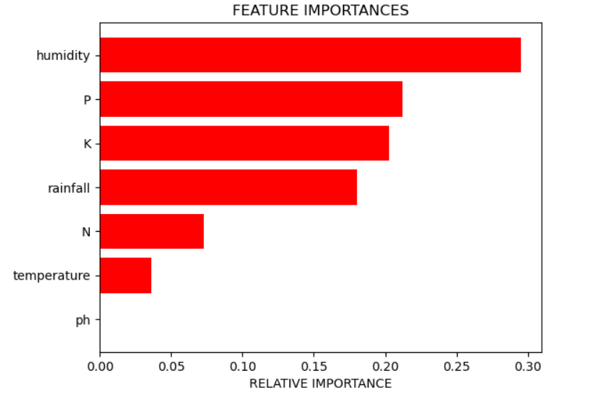
Feature Importances

Slide 18
References
Athani, S., Tejeshwar, C. H., Patil, M. M., Patil, P., & Kulkarni, R. (2017, February 1). Soil moisture monitoring using IoT enabled arduino sensors with neural networks for improving soil management for farmers and predict seasonal rainfall for planning future harvest in North Karnataka — India
Ahmad, S., Kalra, A., & Stephen, H. (2010). Estimating soil moisture using remote sensing data: A machine learning approach. Advances in Water Resources.

Slide 19
References(cont..)
Jayanthi, J., and J. Selvakumar. "A novel framework to facilitate personalized web search in a dual mode." Cluster Computing 20.4 (2017): 3527-3535.
. Radhika, Y., & Shashi, M. (2009). Atmospheric Temperature Prediction using Support Vector Machines. International Journal of Computer Theory and Engineering, 55–58.

Slide 20
ANY QUESTION ?

Slide 21
Thank you

