Slide 1
Analyzing Soil and predict suitable crops Using Machine Learning
Supervisor: Presented by:
Nasif Ahmed Md Asif Ikbal
Assistant Professor Id :17cse051
BSMRSTU 4th year 2nd semester

Slide 2
Outline
Introduction
Aim & Objectives
Related Works
Proposed Model
Dataset
Current Status
Outcome
References

Slide 3
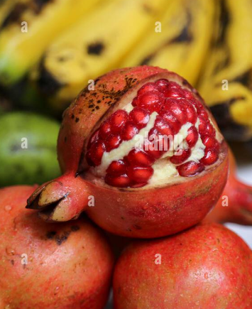
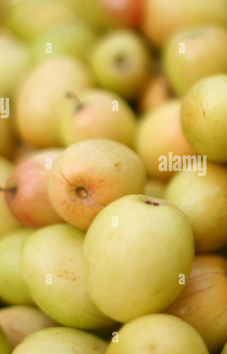
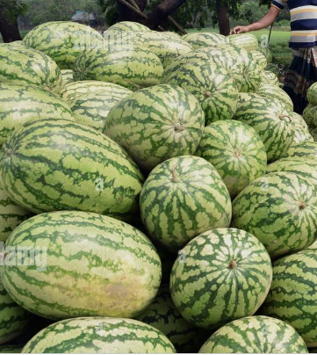
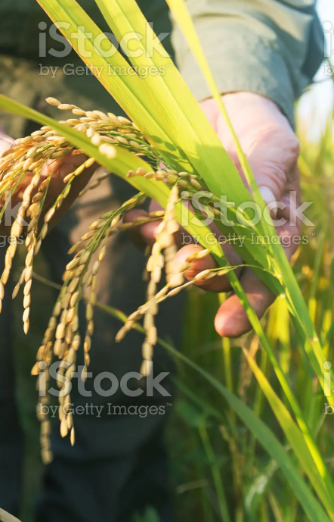
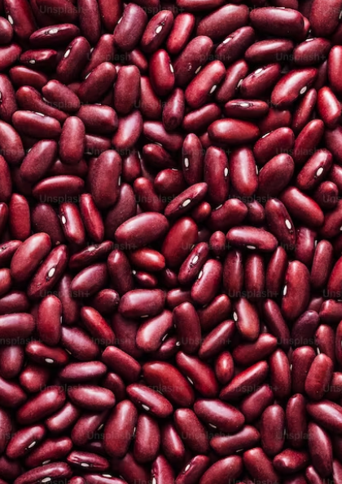
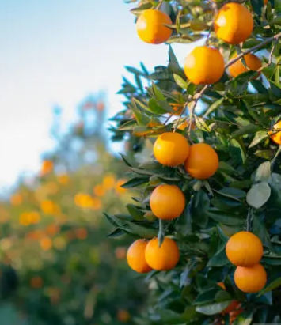
Introduction
The main challenge faced in agriculture sector is the lack of knowledge about the changing variations in climate. Each crop has its own suitable climatic features. This can be handled with the help of precise farming techniques.The precision farming not only maintains the productivity of crops but also increases the yield rate of production.

Slide 4
Aim & Objectives
Analysis of soil properties and climatic data to predict crop yields and cluster different agricultural regions of Bangladesh.
Crop selection method to maximize crop yield rate using machine learning technique.
Making smarter decisions and getting better yield by ml algorithms.
Analysis of soil behaviour .
Classifying the soil according to the soil nutrients is much beneficial or the famers to predict which crop can be cultivated in a particular soil type.

Slide 5
Related Works
In a research carried out by Zaminur Rahman a comparative study of several machine learning techniques has been carried out. They have carried out the classification using the data of Bangladesh. They have used k Nearest Neighbour, Bagged tree and SVM finally compared the results of three algorithms and brought out a model for classifying the soil types and the suitable crop.
In an approach carried out by Jay Gholap carried out a modal to classify the soil based on fertility. The dataset was collected from the soil testing laboratories of Pune District. They have used WEKA tool for developing an automated system[5].

Slide 6
Related Works
Chiranjeevi M. N carried out a research for classifying the soil types so that it can be useful for the farmers for analyzing the type o soil and the crop that can be cultivated so that there will a good yield and profit.They have used algorithms such as J48 decision tree classifier and Naive bayes classifier among these two algorithms Naive bayes has obtained the maximum accuracy of 98%.
Suhas Athani et al proposed IoT enabled soil moisture monitoring for predicting the future harvest. This system detects soil moisture level for obtaining good plant growth. Initially, soil samples are given as an input to the sensors then the respective PH content, salinity content and moisture content is measured using Wi-Fi shield[6].

Slide 7
Methodology
Database
Data
Pre-processing
Crop Suggestion
Interface
Test
Data
Train
data
Predictioncrop
Suggestion
MSE,Accuracy
ML
Crop Suggestion Prediction Model

Slide 8
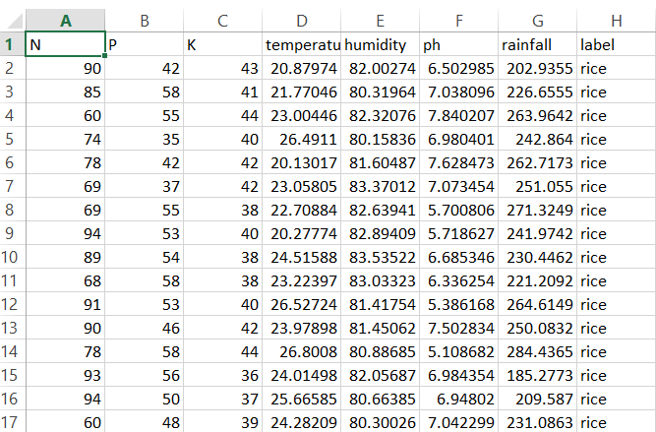
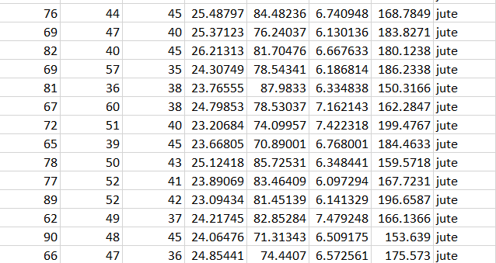
Dataset
The dataset was created by 2200 rows and 8 columns with a target column named “label”.
It was collected from “kaggle”.

Slide 9
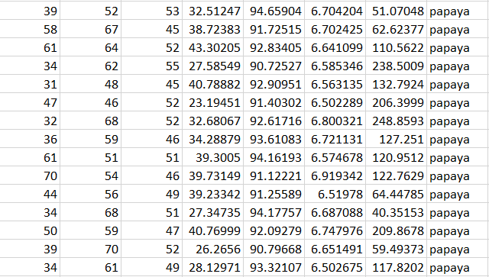
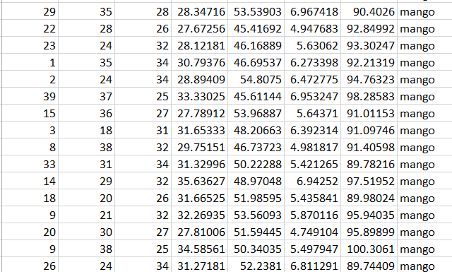
Dataset(cont..)

Slide 10
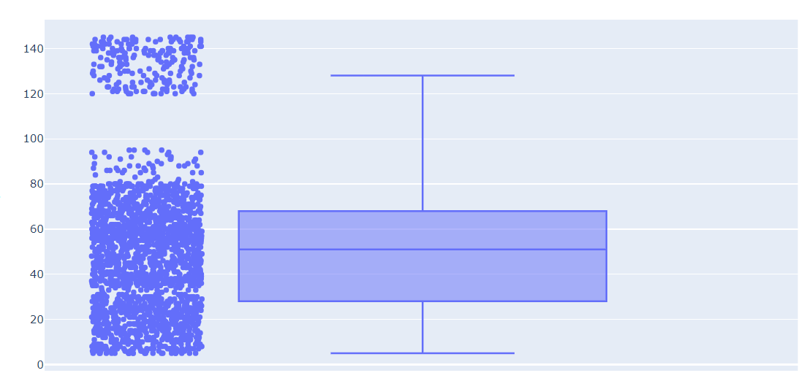
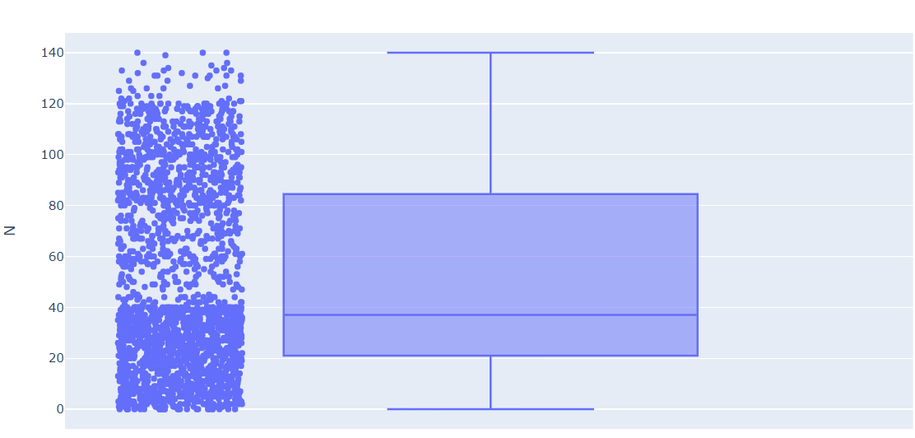
Implementation
At first I balanced my dataset with the help of balance function then preprocessed
the dataset.
Matplotlib was used for graph plotting purposes. For fair splitting of data, I have incorporated stratified splitting of data for training and testing purposes.
For further tackling the class imbalance, I have incorporated the concept of class weights in which the misclassification of a minority class is penalized heavily.

Slide 11
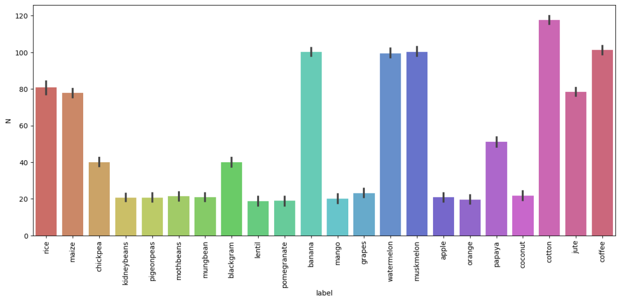
Implementation(cont.)
After preprocessing the dataset :

Slide 12
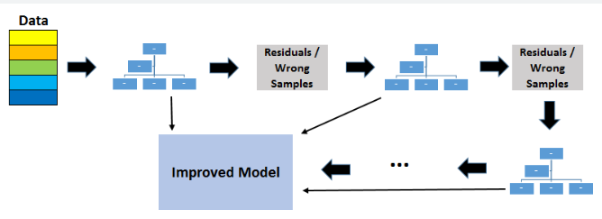
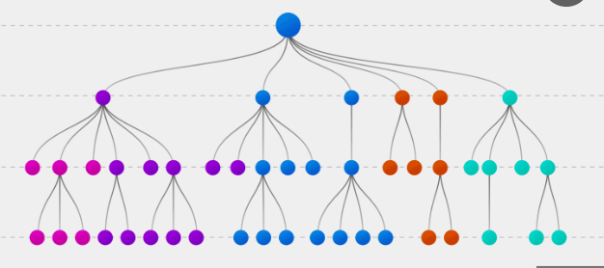
Models
I used Lightgbm classifier model and decision tree for better outcome.

Slide 13
Result
Accuracy
Method | Train Accuracy(%) | Test Accuracy(%)
Lightgbm | 100 | 98.89
Decision Tree | 100 | 98.87

Slide 14
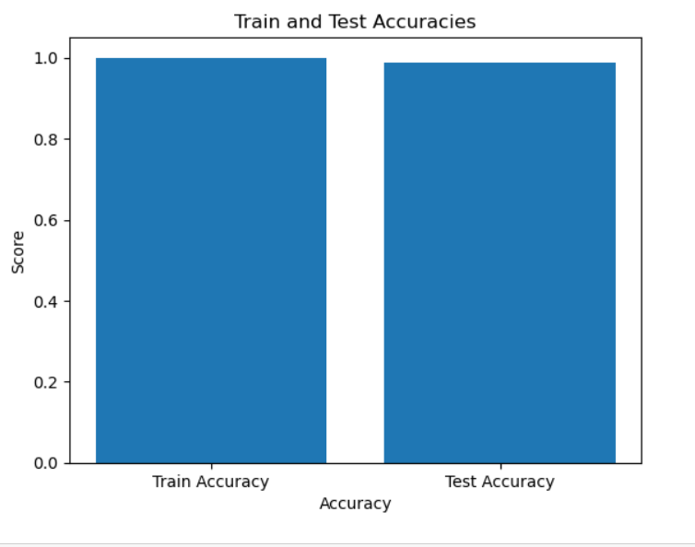
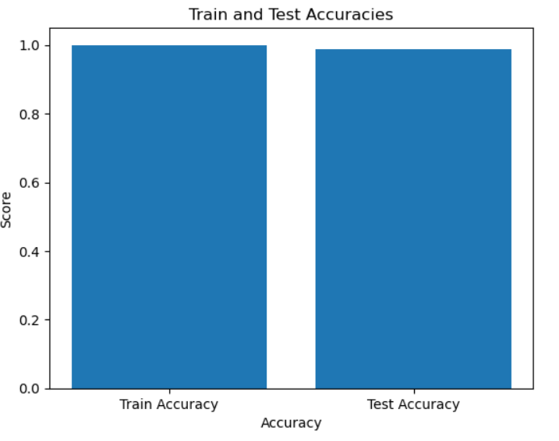
Accuracies(Cont.)

Slide 15
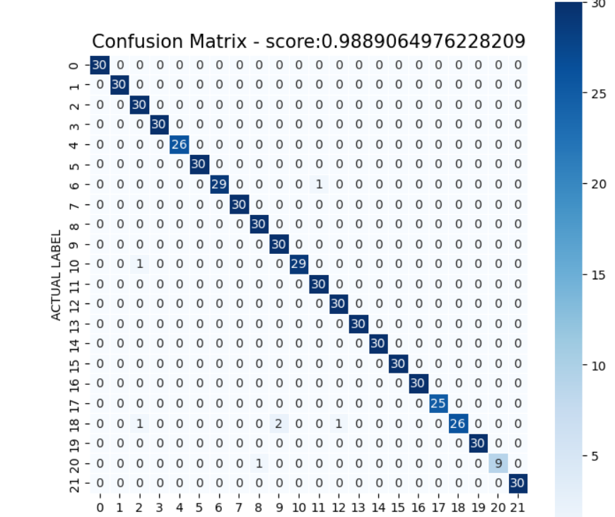
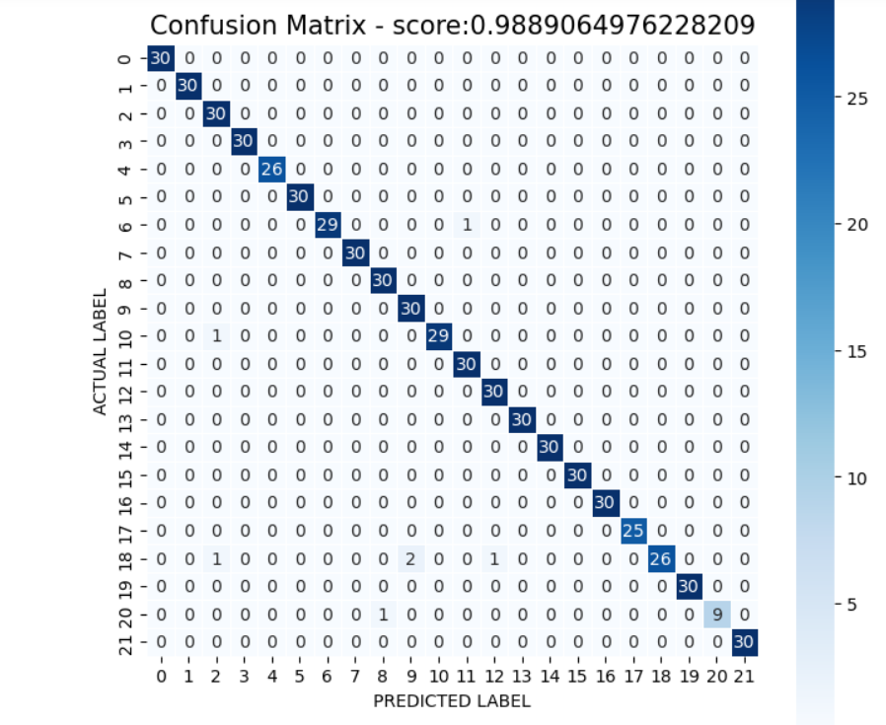
Confusion Matrix(DT,Lightgbm)

Slide 16
Result (cont.)
Crops | Precision | Recall | f1-score | support
apple | 1.00 | 1.00 | 1.00 | 30
rice | 1.00 | 0.90 | 0.95 | 10
banana | 1.00 | 1.00 | 1.00 | 30
blackgram | 0.94 | 1.00 | 0.97 | 30
chickpea | 1.00 | 1.00 | 1.00 | 30
coconut | 1.00 | 1.00 | 1.00 | 26
coffee | 1.00 | 1.00 | 1.00 | 30

Slide 17
Result (cont.)
Crops | Precision | Recall | f1-score | support
cotton | 1.00 | 0.97 | 0.98 | 30
grapes | 1.00 | 1.00 | 1.00 | 30
jute | 0.97 | 1.00 | 0.98 | 30
kidneybeans | 0.94 | 1.00 | 0.97 | 30
lentil | 1.00 | 0.97 | 0.98 | 30
maize | 0.97 | 1.00 | 0.98 | 30
mango | 0.97 | 1.00 | 0.98 | 30

Slide 18
Result (cont.)
Crops | Precision | Recall | f1-score | support
mothbeans | 1.00 | 1.00 | 1.00 | 30
muskmelon | 1.00 | 1.00 | 1.00 | 30
orange | 1.00 | 1.00 | 1.00 | 30
papaya | 1.00 | 1.00 | 1.00 | 25
pigeonpeas | 1.00 | 0.87 | 0.93 | 30
pomegranate | 1.00 | 1.00 | 1.00 | 30
watermelon | 1.00 | 1.00 | 1.00 | 30

Slide 19
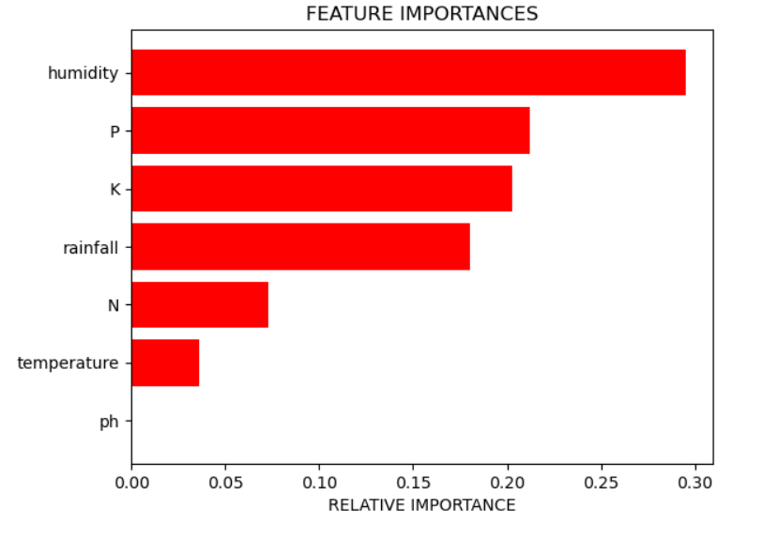
Feature Importances

Slide 20
conclusion
The results demonstrated the effectiveness of machine learning in predicting suitable crop types based on soil characteristics and environmental factors. The developed model showcased a high level of accuracy in suggesting appropriate crops for specific soil conditions. This has significant implications for agricultural practices, as it can assist farmers in making informed decisions regarding crop selection and optimizing yield.

Slide 21
Future Work
Expansion of Crop Selection: The current model focuses on suggesting suitable crops based on soil characteristics and environmental factors. Future work could involve expanding the scope to include additional parameters such as market demand, crop rotation strategies, and profitability analysis. This would provide farmers with a more comprehensive decision-making tool for crop selection.
Developing user-friendly interfaces and mobile applications can facilitate easy access to the soil and crop suggestion system. Future work can involve designing intuitive interfaces that provide personalized recommendations, real-time monitoring, and easy data input options, making the system more accessible and practical for farmers.

Slide 22
References
Athani, S., Tejeshwar, C. H., Patil, M. M., Patil, P., & Kulkarni, R. (2017, February 1). Soil moisture monitoring using IoT enabled arduino sensors with neural networks for improving soil management for farmers and predict seasonal rainfall for planning future harvest in North Karnataka — India
Ahmad, S., Kalra, A., & Stephen, H. (2010). Estimating soil moisture using remote sensing data: A machine learning approach. Advances in Water Resources.

Slide 23
References(cont..)
Jayanthi, J., and J. Selvakumar. "A novel framework to facilitate personalized web search in a dual mode." Cluster Computing 20.4 (2017): 3527-3535.
. Radhika, Y., & Shashi, M. (2009). Atmospheric Temperature Prediction using Support Vector Machines. International Journal of Computer Theory and Engineering, 55–58.

Slide 24
Thank you

