Slide 1
Context-Aware Testing System Using Generative AI

Slide 2
Overview
Objective: Implementing an AI-driven testing system that adapts dynamically to context.
Key Features:
Auto-generates test scenarios based on contextual inputs.
Simulates real-world usage and edge cases.
Uses Generative AI for functional mapping and validation.

Slide 3
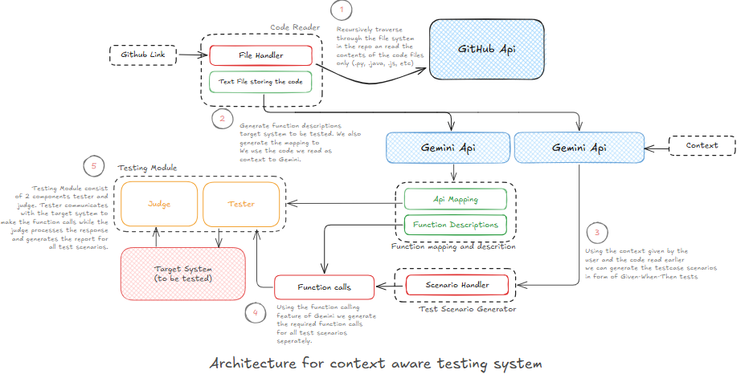
architecture

Slide 4
System Components
Web Form (Context Collector) – Gathers test context.
File Reader (GitHub Crawler) – Extracts code from repositories.
Function Description & API Mapping Engine – Creates function descriptions and API maps.
BDD Scenario Generator – Converts API behaviour into structured test cases.
Function Call Generator – Generates executable API function calls.
Test Execution Engine (Executioner) – Runs test cases automatically.
Test Evaluator (Judge) – Compares expected vs actual outcomes.

Slide 5
Why We Chose Gemini?
Advanced Context Understanding
Gemini efficiently processes and understands complex code structures and test contexts.
Multimodal Capabilities
Supports text, code, and structured data inputs, making it ideal for test generation.
Strong Reasoning & Comprehension
Generates high-quality BDD scenarios and function mappings with logical accuracy.
Efficient API Integration
Easily integrates into our workflow for real-time test generation and validation.
Enhanced Edge Case Detection
Provides adaptive test cases that cover various conditional flows.

Slide 6
Web Form (Context Collector)
Purpose: Captures key testing details.
Inputs:
GitHub Repository URL
Deployment API URL
User-defined test context (app domain, expected behavior, user personas)
Outcome: Initializes the test session with relevant data.

Slide 7
File Reader (GitHub Crawler)
Purpose: Fetches and processes code files.
Functionality:
Recursively scans GitHub repositories.
Extracts key code segments for analysis.
Outcome: Prepares the raw codebase for functional mapping.

Slide 8
Function Description & API Mapping Engine
Purpose: Uses Generative AI to understand the code structure.
Functionality:
Creates function descriptions in JSON format.
Identifies API endpoints and maps them to function implementations.
Outcome: Generates OpenAPI-style documentation.

Slide 9
BDD Scenario Generator
Purpose: Converts API behavior into structured test cases.
Functionality:
Uses "Given-When-Then" format for test cases.
Includes edge cases, conditional flows, and user roles.
Outcome: Creates comprehensive BDD test cases.

Slide 10
Function Call Generator
Purpose: Converts BDD scenarios into executable API requests.
Functionality:
Transforms "When" steps into API calls (GET, POST, etc.).
Embeds expected outcomes from "Then" clauses.
Outcome: Generates structured API test suites.

Slide 11
Test Execution Engine
Purpose: Automates test execution against live APIs.
Functionality:
Sends real API requests.
Captures system responses for validation.
Outcome: Collects actual behavior data for analysis.

Slide 12
Workflow Overview
Steps:
Context Acquisition (Gather test context from GitHub & API links).
Functional Description Generation (Extract function details).
BDD Scenario Generation (Auto-generate test cases).
API Mapping (Connect API endpoints to logic).
Execution & Evaluation (Run and validate tests).

Slide 13
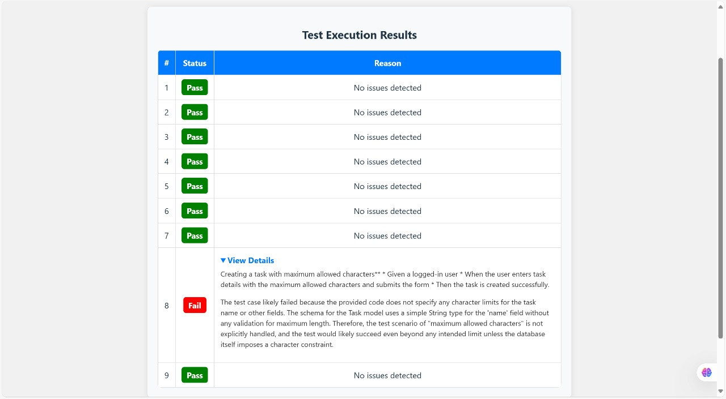
Screenshot

Slide 14
Benefits of the System
✅ Dynamic adaptability – Adjusts to new test contexts. ✅ Enhanced test coverage – Covers edge cases & real-world scenarios. ✅ AI-driven reasoning – Uses LLMs for test validation.

Slide 15
Limitations
⚠️ Strict prompt engineering required – To ensure consistency. ⚠️ Possible AI hallucinations – Results must be validated. ⚠️ Tuning needed for production use – To enhance reliability.

Slide 16
Tools & Technologies Used
Front-End: React.js
Back-End: Flask, Python
AI Model: Gemini API
Deployment: API-based automated testing

Slide 17
Conclusion & Next Steps
Key Takeaways:
AI-powered dynamic test generation.
Improved edge case handling & automation.
Enhanced API validation & reporting.
Future Enhancements:
Model fine-tuning for better accuracy.
Expanded test coverage with additional contexts.
Integration with CI/CD pipelines.

Slide 18
Thank you
WA_TESTCASE2
1. Kashish Agrawal
2. Md. Asif
3. Prashanth Chowdary
4. Sivam Das

