Slide 1

CSS
h1 {MD.HASAN MAHADI}

Slide 2
CSS
Cascading Style Sheet.
Hakon Wium Lie published his first
draft of Cascading HTML Style Sheets. In 1994
CSS is a language that describes the style of an HTML document.
CSS describes how HTML elements should be displayed.

Slide 3
Css Example
Body
{
margin: 0;
padding: 0;
background: red;
font: 12px sans-serif;
}

Slide 4
Three Ways to Insert CSS
Internal style sheet
External style sheet
Inline style

Slide 5
Internal style sheet
<head> <style> body
{ background-color: linen; } h1 { color: maroon; margin-left: 40px; } </style> </head>

Slide 6
External style sheet
<link rel="stylesheet" type="text/css" href="mystyle.css">

Slide 7
Inline style
<h1 style="color:blue; margin-left:30px;">This is a heading</h1>

Slide 8
Cascading Order
Generally speaking we can say that all the styles will "cascade" into a new "virtual" style sheet by the following rules, where number one has the highest priority:
Inline style (inside an HTML element)
External and internal style sheets (in the head section)
Browser default

Slide 9
CSS Rules
Style sheet Rule:
❑ Selector
❑ Declaration
❑ Property
❑ Value

Slide 10
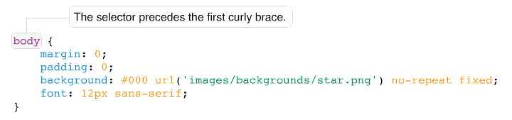
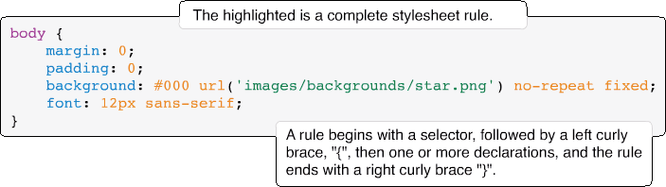

Slide 11
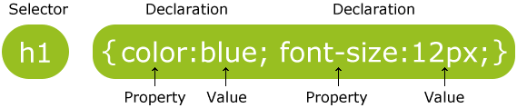

Slide 12
Selectors
In CSS, a selector is the HTML element or elements to which a CSS rule is applied. Put simply, the selector
tells the browser what to format. The simple selector that you saw in the last section is called a type
selector; it merely references an HTML element.

Slide 13
Declarations
Declarations are enclosed within curly braces to separate them from selectors. A declaration is the combination of a CSS property and value
A declaration is a complete instruction for styling a property of an HTML element.
A declaration always ends with a semi-colon.

Slide 14
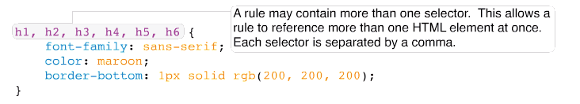
Grouping Selectors
You can group multiple selectors together in a single rule by
providing a comma after each selector

Slide 15
Example
<html >
<head>
<meta http-equiv=’Content-Type’ content=’text/html; charset=UTF-8’ />
<title>Selectors and Grouping</title>
<style type=’text/css’>
h1, h2, h3, h4, h5, h6 {
font-family: sans-serif;
color: maroon;
border-bottom: 1px solid rgb(200, 200, 200);
}
</style>
</head>
<body>
<h1>Style Sheet</h1>
<h2>Rule</h2>
<h3>Selector</h3>
<h4>Declaration</h4>
<h5>Property</h5>
<h6>Value</h6>
</body>
</html>

Slide 16
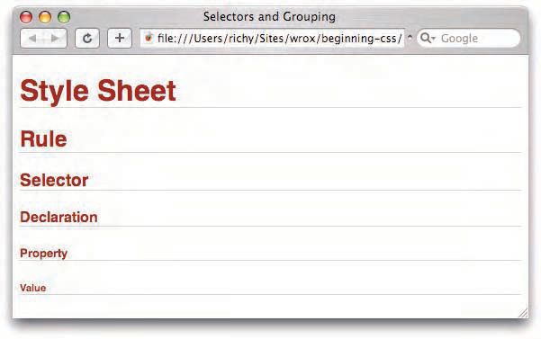

Slide 17
Generated content
<html >
<head>
<meta http-equiv=’Content-Type’ content=’text/html; charset=UTF-8’ />
<title>Generated content</title>
<style type=’text/css’>
div {
font-family: sans-serif;
}
div::before {
content: “I said, \”Hello, world!\””;
background: black;
color: white;
margin-right: 25px;
}
</style>
</head>
<body>
<div>The world said, “Hello, yourself!”</div>
</body>
</html>

Slide 18
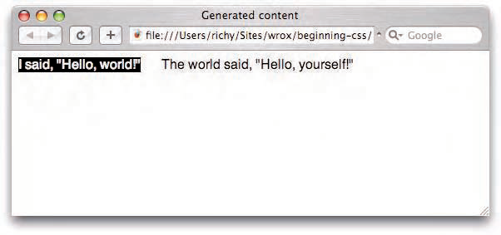
Out put

Slide 19
Length and Measurement
There are two kinds of lengths used in CSS: relative and absolute. Absolute lengths are not dependent on
any other measurement. An absolute measurement retains its length regardless of the environment
(operating system, browser, or screen resolution of a computer monitor) in which it is applied. Relative
lengths, on the other hand, depend on the environment in which they’re used, such as the computer
monitor’s screen resolution or the size of a font.

Slide 20
Inches = pixels
<html >
<head>
<meta http-equiv=’Content-Type’ content=’text/html; charset=UTF-8’ />
<title>Pixels to Inches</title>
<style type=’text/css’>
div {
background: #000;
border: 1px solid rgb(128, 128, 128);
color: white;
font: 9px monospace;
margin: 15px;
text-align: center;
}
div#inches {
width: 1in;
height: 1in;
}
div#pixels {
width: 96px;
height: 96px;
}
</style>
</head>
<body>
<div id=’inches’>&lt;-- 1 Inch --&gt;</div>
<div id=’pixels’>&lt;-- 96 Pixels --&gt;</div>
</body>
</html>

Slide 21
Em=px
<html xmlns=’http://www.w3.org/1999/xhtml’ xml:lang=’en’>
<head>
<meta http-equiv=’Content-Type’ content=’text/html; charset=UTF-8’ />
<title>Em Measurement Comparison to Pixels</title>
<style type=’text/css’>
body {
font: 1em sans-serif;
}
p {
background: rgb(234, 234, 234);
border: 1px solid rgb(200, 200, 200);
}
p#em-measurement {
width: 12em;
padding: 1em;
}
p#px-measurement {
width: 192px;
padding: 16px;
} </style>
</head>
<body>
<p id=’em-measurement’>
This paragraph is 12em wide, with a 1em padding.
</p>
<p id=’px-measurement’>
This paragraph is 192 pixels wide, with 16 pixels of
padding.
</p>
</body>
</html>

Slide 22
100% width
<html>
<head>
<title>Experimenting with Percentage Measurement</title>
<style>
div {
width: 100%;
background: black;
color: white;
}
</style>
</head>
<body>
<div>What happens when I apply a 100% width?</div>
</body>
</html>

Slide 23
Setting a Negative Margin
<!DOCTYPE html>
<html>
<head>
<title>Setting a Negative Margin</title>
<style type=’text/css’>
div {
background: black;
color: white;
margin: -10px 0 0 -15px;
font: 12px sans-serif;
}
</style>
</head>
<body>
<h1>margin: 10px(top) 0(right) 0(bottom) 0px(left);</h1>
<div>What happens when I apply a negative margin?</div>
</body>
</html>

Slide 24
Colors
Color keywords
RGB values
RGB Percentage
Hexadecimal

Slide 25
CSS Backgrounds
The CSS background properties are used to define the background effects for elements.
CSS background properties:
background-color
background-image
background-repeat
background-attachment
background-position

