Slide 1
Practical:3
Measures of Central Tendency

Slide 2
Data Entry in MATLAB
Example 1:
Find the arithmetic mean and median of the number 6, 7, 10, 11 and 8
Arithmetic Mean:
Command: Mean (x)

Slide 3
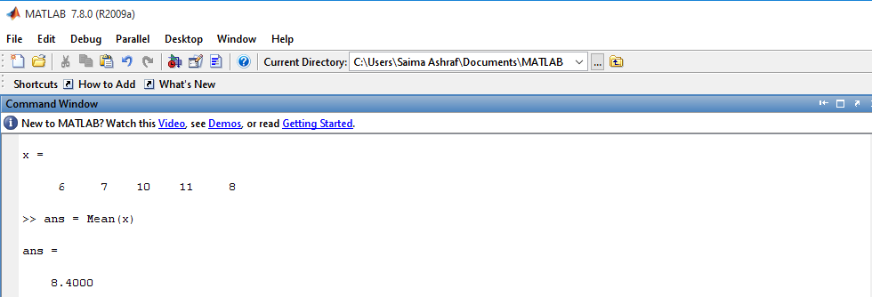
Arithmetic Mean for Ungrouped Data

Slide 4
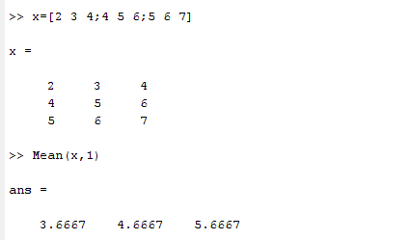
Arithmetic Mean
Mean each column:
Command: Mean (x, 1)

Slide 5
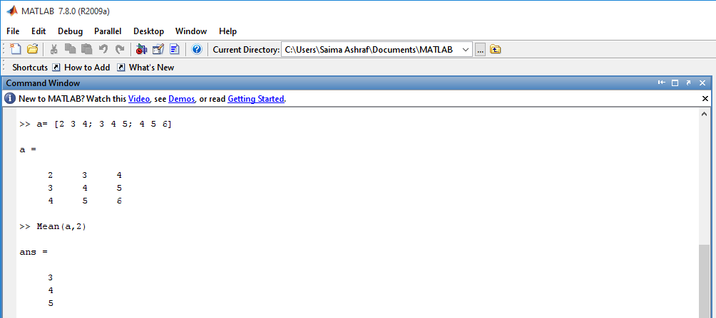
Arithmetic Mean
Mean each row:
Command: Mean (a, 2)

Slide 6

Exercise Question
Find the arithmetic mean and median of the following numbers using MATLAB built-in function.
2, 4, 13, 12, 3, 4, 5 ,2 and 8

Slide 7
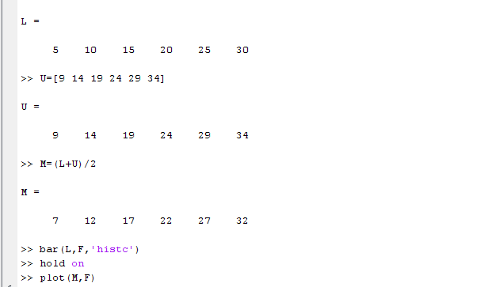
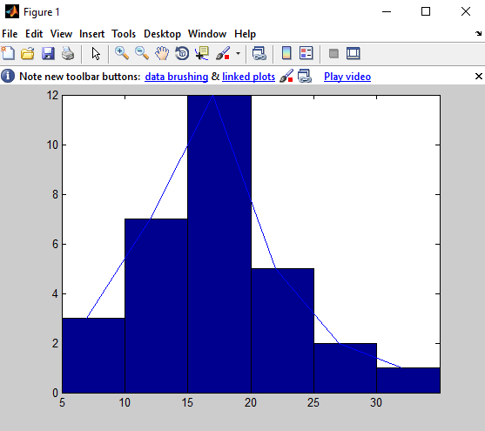
Draw a histogram and frequency polygon on same graph

Slide 8
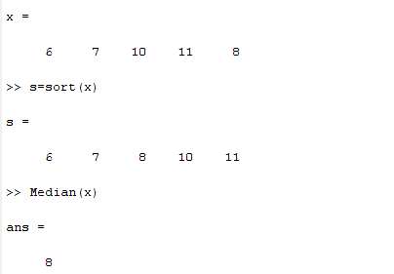
Median
Median:
Command: Median (x)

Slide 9
Median
Example: 2 (even number of score)
Suppose we have the data below(10 scores)
65 ,55,89, 56, 35 ,14 ,56, 55, 87, 45
we ﬁrst need to rearrange that data into order of magnitude (smallest ﬁrst)
Only now we have to take the 5th and 6th score in our data set and average them to get a
Median of 55.5

Slide 10
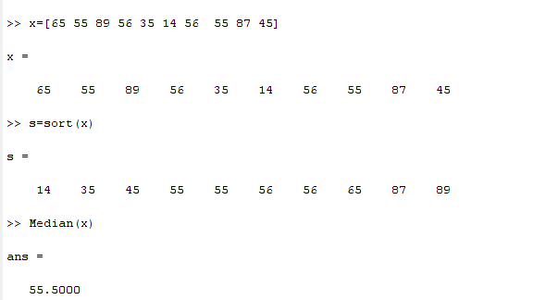
Median

Slide 11
Mode
Example 3:
For the data given below, find Mode
12, 13 14,11,15,16,11,9,56,44,11

Slide 12
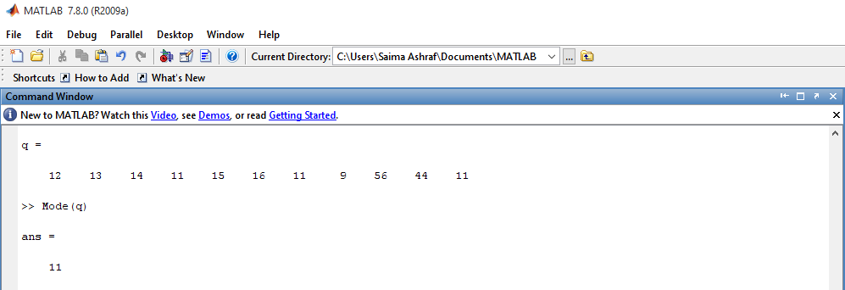
Mode
Command: Mode (q)

Slide 13
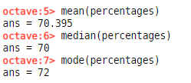

Slide 14
Exercise Question
Find the Mode of the following numbers using MATLAB built-in function.
2, 4, 13, 12,12,13, 4,12, 5 ,2 and 8

Slide 15
Weighted Mean
Example 4:
Compute the weighted mean of the price of wheat for the following data assuming the quantities consumed as weight.
Price | 5.50 | 6.00 | 7.00 | 8.00
Qty.Consumed(kg) | 4 | 6 | 18 | 10

Slide 16
Step’s
>> x=[5.50 6.00 7.00 8.00]
>> w=[4 6 18 10]
>> sum_w=sum(w)
>> wx= w.*x
>> sum_wx=sum(wx)
>> mean=sum_wx/sum_w

Slide 17
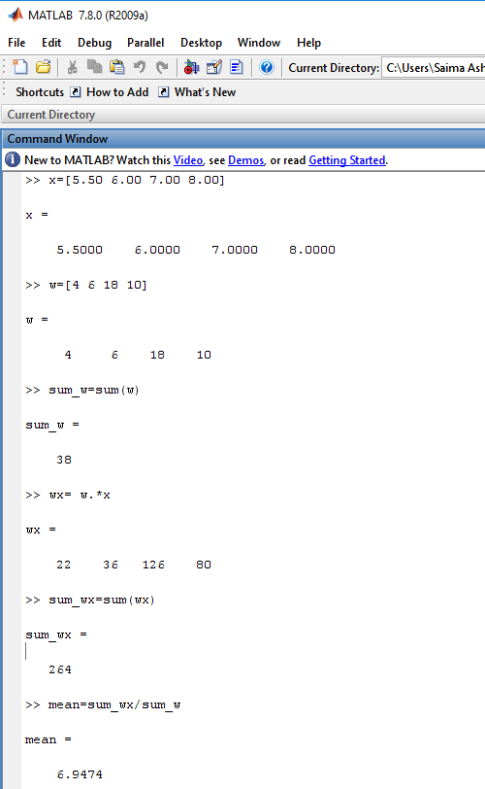
Weighted Mean

Slide 18
Assignment Question: NOTE: Work in MATLAB
Question: 1
Find the Arithmetic mean of the numbers 3, 56 ,12,32,34,23,1,2,5,7,34,56,23,13,45,56,34,67,56,78.

Slide 19
Assignment Question(J)
Question: 3
A person walks 9 hours at a speed of 3 km.p.h,again walks 8 hours at a speed of 4 km.p.h.Find the average speed.
Formula:
Average speed= Total speed/Total Time.

Slide 20
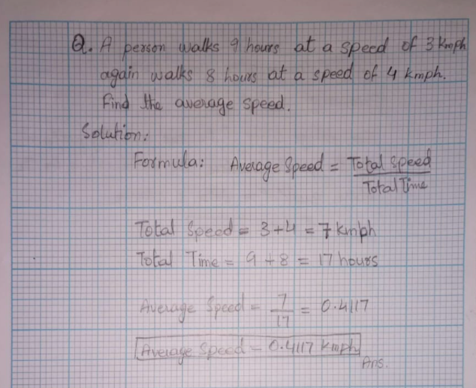

Slide 21
Assignment Question(J):
Question: 4
The following data shows the results of a survey which was conducted to find out the colour preference of people regarding the cars.
Orange Orange White Grey Black Orange White Orange White Grey Black Orange Orange Grey Orange Black Orange White Black Black
Find the Modal colour for the above qualitative data.

Slide 22
