Slide 1
INTRODUCTION TO NOSQL DATABASES

Slide 2
Outline
Background
What is NOSQL?
Who is using it?
3 major papers for NOSQL
CAP theorem
NOSQL categories
Conclusion
References

Slide 3
Background
Relational databases → mainstay of business
Web-based applications caused spikes
  explosion of social media sites (Facebook, Twitter) with large data needs
  rise of cloud-based solutions such as Amazon S3 (simple storage solution)
Hooking RDBMS to web-based application becomes trouble

Slide 4
Issues with scaling up
Best way to provide ACID and rich query model is to have the dataset on a single machine
Limits to scaling up (or vertical scaling: make a “single” machine more powerful) → dataset is just too big!
Scaling out (or horizontal scaling: adding more smaller/cheaper servers) is a better choice
Different approaches for horizontal scaling (multi-node database):
  Master/Slave
  Sharding (partitioning)

Slide 5
Scaling out RDBMS: Master/Slave
Master/Slave
  All writes are written to the master
  All reads performed against the replicated slave databases
  Critical reads may be incorrect as writes may not have been propagated down
  Large datasets can pose problems as master needs to duplicate data to slaves

Slide 6
Scaling out RDBMS: Sharding
Sharding (Partitioning)
  Scales well for both reads and writes
  Not transparent, application needs to be partition-aware
  Can no longer have relationships/joins across partitions
  Loss of referential integrity across shards

Slide 7
Other ways to scale out RDBMS
Multi-Master replication
INSERT only, not UPDATES/DELETES
No JOINs, thereby reducing query time
  This involves de-normalizing data
In-memory databases

Slide 8
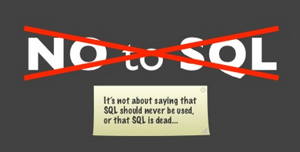
What is NOSQL?
The Name:
  Stands for Not Only SQL
  The term NOSQL was introduced by Carl Strozzi in 1998 to name his file-based database
  It was again re-introduced by Eric Evans when an event was organized to discuss open source distributed databases
  Eric states that “… but the whole point of seeking alternatives is that you need to solve a problem that relational databases are a bad fit for. …”

Slide 9
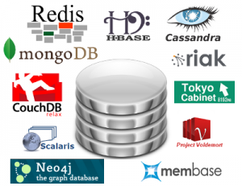
What is NOSQL?
Key features (advantages):
  non-relational
  don’t require schema
  data are replicated to multiple
  nodes (so, identical & fault-tolerant)
  and can be partitioned:
    down nodes easily replaced
    no single point of failure
  horizontal scalable
  cheap, easy to implement
  (open-source)
  massive write performance
  fast key-value access

Slide 10
What is NOSQL?
Disadvantages:
  Don’t fully support relational features
    no join, group by, order by operations (except within partitions)
    no referential integrity constraints across partitions
  No declarative query language (e.g., SQL) → more programming
  Relaxed ACID (see CAP theorem) → fewer guarantees
  No easy integration with other applications that support SQL

Slide 11
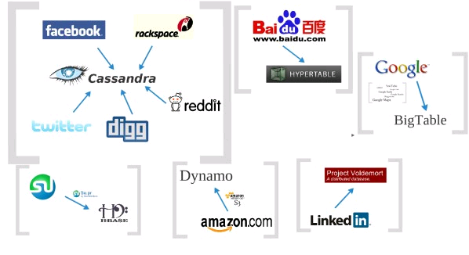
Who is using them?

Slide 12
3 major papers for NOSQL
Three major papers were the “seeds” of the NOSQL movement:
  BigTable (Google)
  DynamoDB (Amazon)
    Ring partition and replication
    Gossip protocol (discovery and error detection)
    Distributed key-value data stores
    Eventual consistency
  CAP Theorem
Notes:
-> BigTable: http://labs.google.com/papers/bigtable.html
-> Dynamo: http://www.allthingsdistributed.com/2007/10/amazons_dynamo.html and http://www.allthingsdistributed.com/files/amazon-dynamo-sosp2007.pdf
-> Amazon and consistency
* http://www.allthingsdistributed.com/2010/02
* http://www.allthingsdistributed.com/2008/12

Slide 13
The Perfect Storm
Large datasets, acceptance of alternatives, and dynamically-typed data has come together in a “perfect storm”
Not a backlash against RDBMS
SQL is a rich query language that cannot be rivaled by the current list of NOSQL offerings

Slide 14
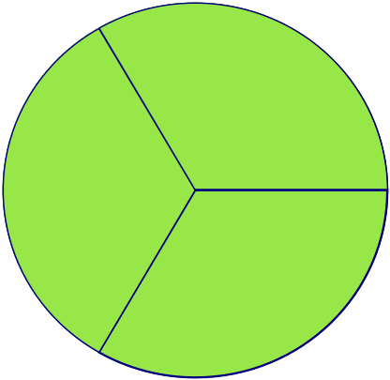
CAP Theorem
Suppose three properties
of a distributed system (sharing data)
  Consistency:
    all copies have same value
  Availability:
    reads and writes always succeed
  Partition-tolerance:
    system properties (consistency and/or availability) hold even when network failures prevent some machines from communicating with others
A
C
P

Slide 15
CAP Theorem
Brewer’s CAP Theorem:
  For any system sharing data, it is “impossible” to guarantee simultaneously all of these three properties
  You can have at most two of these three properties for any shared-data system
Very large systems will “partition” at some point:
  That leaves either C or A to choose from (traditional DBMS prefers C over A and P )
  In almost all cases, you would choose A over C (except in specific applications such as order processing)

Slide 16
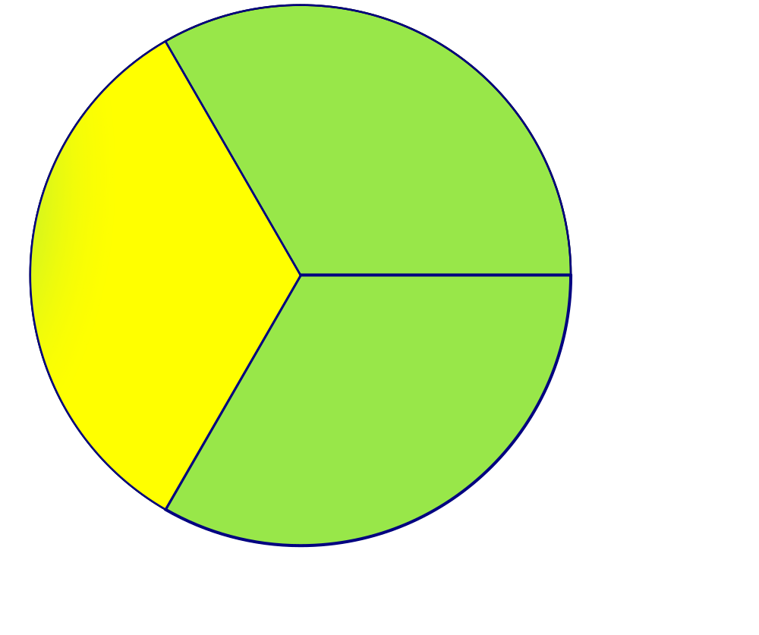
CAP Theorem
All client always have the same view of the data
Availability
Consistency
Partition tolerance

Slide 17
CAP Theorem
Consistency
  2 types of consistency:
    Strong consistency – ACID (Atomicity, Consistency, Isolation, Durability)
    Weak consistency – BASE (Basically Available Soft-state Eventual consistency)

Slide 18
CAP Theorem
ACID
  A DBMS is expected to support “ACID transactions,” processes that are:
  Atomicity: either the whole process is done or none is
  Consistency: only valid data are written
  Isolation: one operation at a time
  Durability: once committed, it stays that way
CAP
  Consistency: all data on cluster has the same copies
  Availability: cluster always accepts reads and writes
  Partition tolerance: guaranteed properties are maintained even when network failures prevent some machines from communicating with others

Slide 19
CAP Theorem
A consistency model determines rules for visibility and apparent order of updates
Example:
  Row X is replicated on nodes M and N
  Client A writes row X to node N
  Some period of time t elapses
  Client B reads row X from node M
  Does client B see the write from client A?
  Consistency is a continuum with tradeoffs
  For NOSQL, the answer would be: “maybe”
  CAP theorem states: “strong consistency can't be achieved at the same time as availability and partition-tolerance”

Slide 20
CAP Theorem
Eventual consistency
  When no updates occur for a long period of time, eventually all updates will propagate through the system and all the nodes will be consistent
Cloud computing
  ACID is hard to achieve, moreover, it is not always required, e.g. for blogs, status updates, product listings, etc.

Slide 21
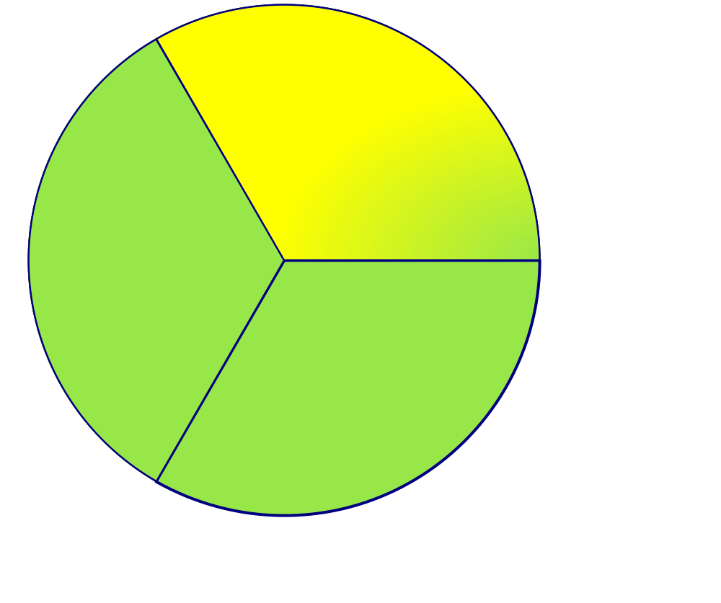
CAP Theorem
Each client always can read and write.
Availability
Consistency
Partition tolerance

Slide 22
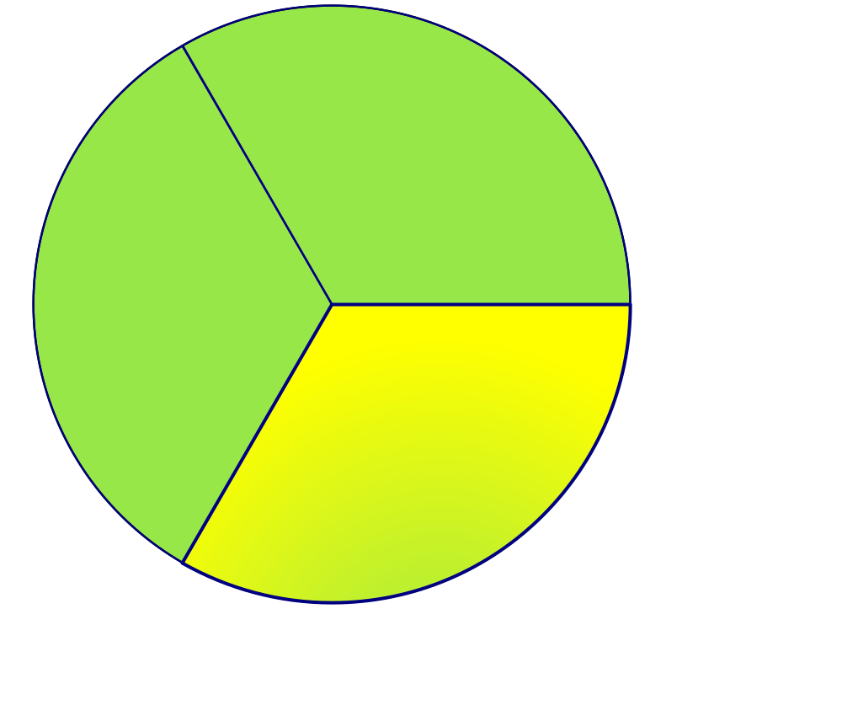
CAP Theorem
A system can continue to operate in the presence of
a network partitions
Availability
Consistency
Partition tolerance

Slide 23
NOSQL categories
Key-value
    Example: DynamoDB, Voldermort, Scalaris
Document-based
    Example: MongoDB, CouchDB
Column-based
    Example: BigTable, Cassandra, Hbased
Graph-based
    Example: Neo4J, InfoGrid
“No-schema” is a common characteristics of most NOSQL storage systems
Provide “flexible” data types

Slide 24
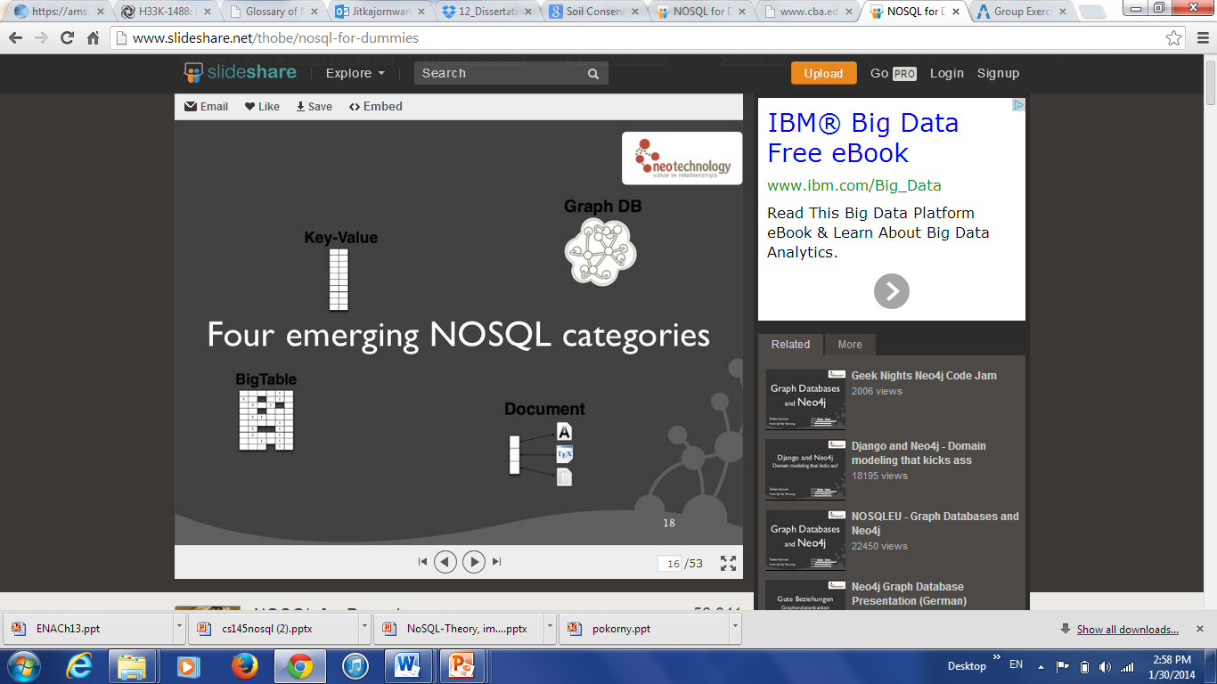
Key-value
Focus on scaling to huge amounts of data
Designed to handle massive load
Based on Amazon’s dynamo paper
Data model: (global) collection of Key-value pairs
Dynamo ring partitioning and replication
Example: (DynamoDB)
  items having one or more attributes (name, value)
  An attribute can be single-valued or multi-valued like set.
  items are combined into a table

Slide 25
Key-value
Basic API access:
  get(key): extract the value given a key
  put(key, value): create or update the value given its key
  delete(key): remove the key and its associated value
  execute(key, operation, parameters): invoke an operation to the value (given its key) which is a special data structure (e.g. List, Set, Map .... etc)
Notes:
-> http://chariotsolutions.blogspot.com/2010/01/why-you-need-nosql-in-your-toolbox.html

Slide 26
Key-value
Pros:
  very fast
  very scalable (horizontally distributed to nodes based on key)
  simple data model
  eventual consistency
  fault-tolerance
Cons:
  - Can’t model more complex data structure such as objects
Notes:
-> http://chariotsolutions.blogspot.com/2010/01/why-you-need-nosql-in-your-toolbox.html

Slide 27
Key-value
Name | Producer | Data model | Querying
SimpleDB | Amazon | set of couples (key, {attribute}), where attribute is a couple (name, value) | restricted SQL; select, delete, GetAttributes, and PutAttributes operations
Redis | Salvatore Sanfilippo | set of couples (key, value), where value is simple typed value, list, ordered (according to ranking) or unordered set, hash value | primitive operations for each value type
Dynamo | Amazon | like SimpleDB | simple get operation and put in a context
Voldemort | LinkeId | like SimpleDB | similar to Dynamo
Notes:
-> http://chariotsolutions.blogspot.com/2010/01/why-you-need-nosql-in-your-toolbox.html

Slide 28
Document-based
Can model more complex objects
Inspired by Lotus Notes
Data model: collection of documents
Document: JSON (JavaScript Object Notation is a data model, key-value pairs, which supports objects, records, structs, lists, array, maps, dates, Boolean with nesting), XML, other semi-structured formats.

Slide 29
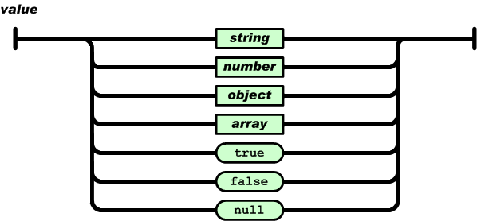
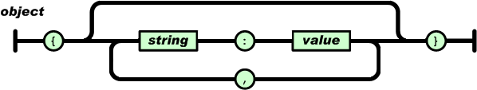
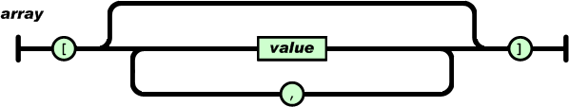
Document-based
Example: (MongoDB) document
  {Name:"Jaroslav",
    Address:"Malostranske nám. 25, 118 00 Praha 1”,
    Grandchildren: {Claire: "7", Barbara: "6", "Magda: "3", "Kirsten: "1", "Otis: "3", Richard: "1“}
    Phones: [ “123-456-7890”, “234-567-8963” ]
    }

Slide 30
Document-based
Name | Producer |  | Data model |  | Querying
MongoDB |  | 10gen |  | object-structured documents stored in collections; each object has a primary key called ObjectId |  | manipulations with objects in collections (find object or objects via simple selections and logical expressions, delete, update,)
Couchbase |  | Couchbase¹ |  | document as a list of named (structured) items (JSON document) |  | by key and key range, views via Javascript and MapReduce

Slide 31
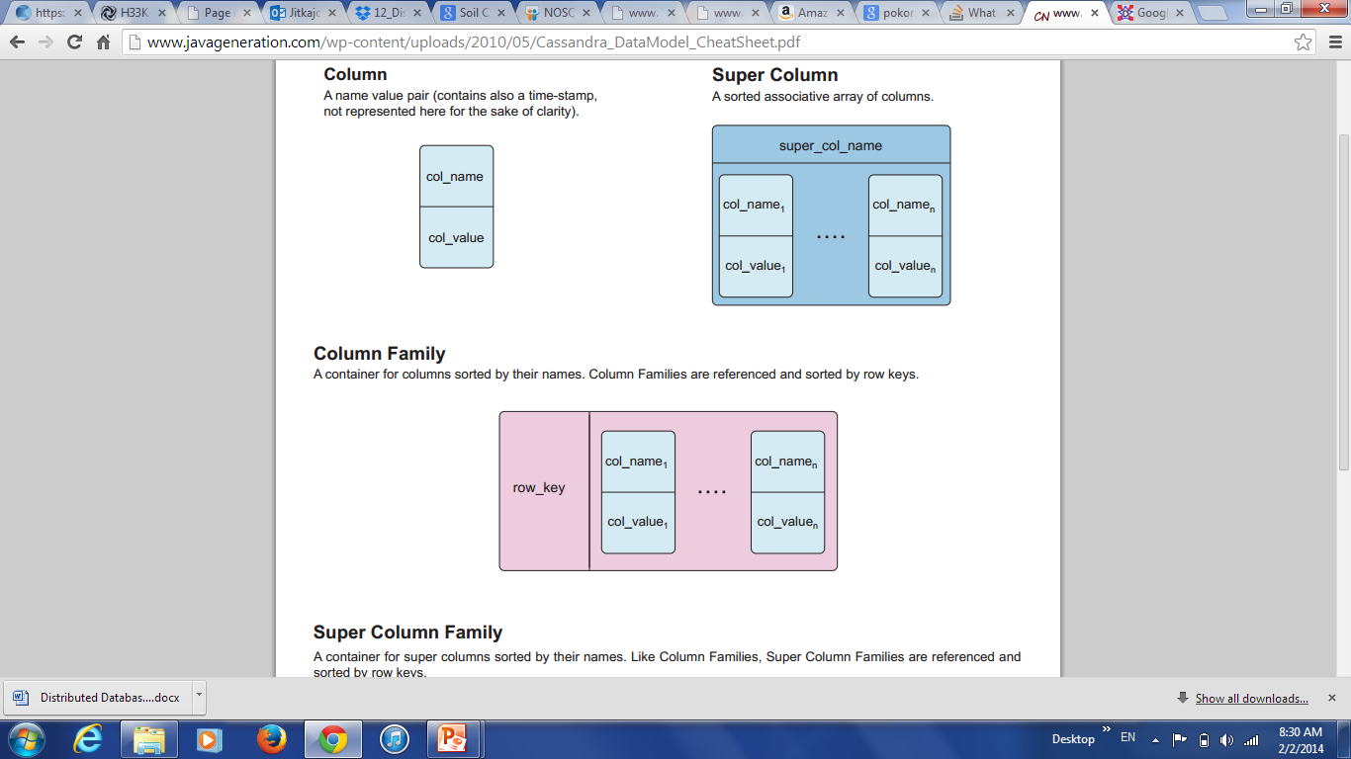
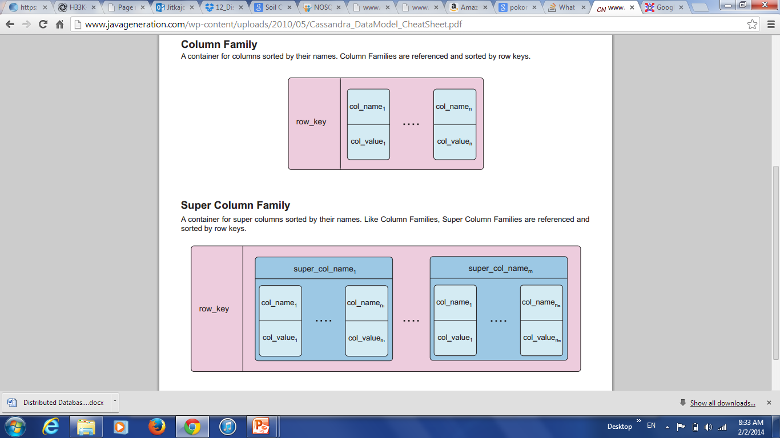
Column-based
Based on Google’s BigTable paper
Like column oriented relational databases (store data in column order) but with a twist
Tables similarly to RDBMS, but handle semi-structured
Data model:
  Collection of Column Families
  Column family = (key, value) where value = set of related columns (standard, super)
  indexed by row key, column key and timestamp
allow key-value pairs to be stored (and retrieved on key) in a massively parallel system
storing principle: big hashed distributed tables
properties: partitioning (horizontally and/or vertically), high availability etc. completely transparent to application
* Better: extendible records

Slide 32
Column-based
One column family can have variable
numbers of columns
Cells within a column family are sorted “physically”
Very sparse, most cells have null values
Comparison: RDBMS vs column-based NOSQL
  Query on multiple tables
    RDBMS: must fetch data from several places on disk and glue together
    Column-based NOSQL: only fetch column families of those columns that are required by a query (all columns in a column family are stored together on the disk, so multiple rows can be retrieved in one read operation → data locality)

Slide 33
Column-based
Example: (Cassandra column family--timestamps removed for simplicity)
UserProfile = {
Cassandra = { emailAddress:”casandra@apache.org” , age:”20”}
TerryCho = { emailAddress:”terry.cho@apache.org” , gender:”male”}
Cath = { emailAddress:”cath@apache.org” , age:”20”,gender:”female”,address:”Seoul”}
}

Slide 34
Column-based
Name | Producer |  | Data model | Querying
BigTable |  | Google | set of couples (key, {value}) | selection (by combination of row, column, and time stamp ranges)
HBase |  | Apache | groups of columns (a BigTable clone) | JRUBY IRB-based shell (similar to SQL)
Hypertable |  | Hypertable | like BigTable | HQL (Hypertext Query Language)
CASSANDRA |  | Apache (originally Facebook) | columns, groups of columns corresponding to a key (supercolumns) | simple selections on key, range queries, column or columns ranges
PNUTS |  | Yahoo | (hashed or ordered) tables, typed arrays, flexible schema | selection and projection from a single table (retrieve an arbitrary single record by primary key, range queries, complex predicates, ordering, top-k)

Slide 35
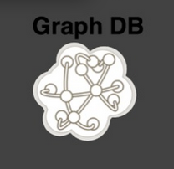
Graph-based
Focus on modeling the structure of data (interconnectivity)
Scales to the complexity of data
Inspired by mathematical Graph Theory (G=(E,V))
Data model:
  (Property Graph) nodes and edges
    Nodes may have properties (including ID)
    Edges may have labels or roles
  Key-value pairs on both
Interfaces and query languages vary
Single-step vs path expressions vs full recursion
Example:
  Neo4j, FlockDB, Pregel, InfoGrid …

Slide 36
Conclusion
NOSQL database cover only a part of data-intensive cloud applications (mainly Web applications)
Problems with cloud computing:
  SaaS (Software as a Service or on-demand software) applications require enterprise-level functionality, including ACID transactions, security, and other features associated with commercial RDBMS technology, i.e. NOSQL should not be the only option in the cloud
  Hybrid solutions:
    Voldemort with MySQL as one of storage backend
    deal with NOSQL data as semi-structured data
    → integrating RDBMS and NOSQL via SQL/XML

Slide 37
Conclusion
next generation of highly scalable and elastic RDBMS: NewSQL databases (from April 2011)
  they are designed to scale out horizontally on shared nothing machines,
  still provide ACID guarantees,
  applications interact with the database primarily using SQL,
  the system employs a lock-free concurrency control scheme to avoid user shut down,
  the system provides higher performance than available from the traditional systems.
Examples: MySQL Cluster (most mature solution), VoltDB, Clustrix, ScalArc, etc.

Slide 38
References
Rajshekhar Sunderraman
  http://tinman.cs.gsu.edu/~raj/8711/sp13/berkeleydb/finalpres.ppt
Tobias Ivarsson
  http://www.slideshare.net/thobe/nosql-for-dummies
Jennifer Widom
  http://www.stanford.edu/class/cs145/ppt/cs145nosql.pptx
Ruoming Jin
  http://www.cs.kent.edu/~jin/Cloud12Spring/HbaseHivePig.pptx
Seth Gilbert
  http://lpd.epfl.ch/sgilbert/pubs/BrewersConjecture-SigAct.pdf
Patrick McFadin
  http://www.slideshare.net/patrickmcfadin/the-data-model-is-dead-long-live-the-data-model
Chaker Nakhli
  http://www.javageneration.com/wp-content/uploads/2010/05/Cassandra_DataModel_CheatSheet.pdf
Ricky Ho
  http://horicky.blogspot.com/2010/10/bigtable-model-with-cassandra-and-hbase.html

