Slide 1
Leaf Disease Detection Using Machine Learning
Mia Mahmudul Houque Shaon
ID: 2014314042
Asif Rahman
ID: 2012691042
Md Nazmul Islam Srabon
ID: 2021227042
CSE 299
Section 02
Group 05
Week 01

Slide 2
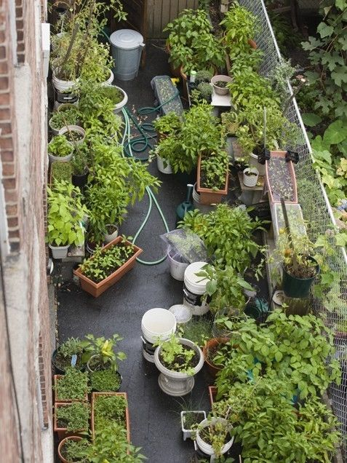
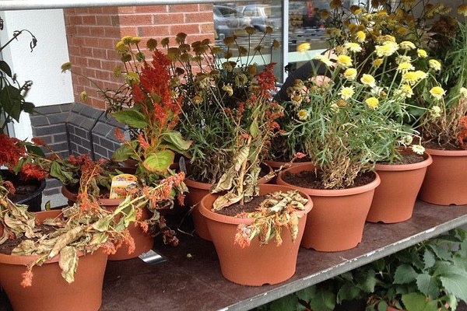
Gardening has become one of the top hobbies of urban people.
But the enthusiasm about it does not last for long among most of them.
Why?

Slide 3
Background
Most of the urban people have no prior experience in farming.
Most features of agricultural technologies only focus on field agricultural crops rather than residential gardening.
Urban people are often unable to detect the plant diseases in time.

Slide 4
What is the solution?
A Mobile Application
Can Recognise
the leaf
Detect healthy or diseased leaf
Identify the disease
Suggest suitable remedies.

Slide 5
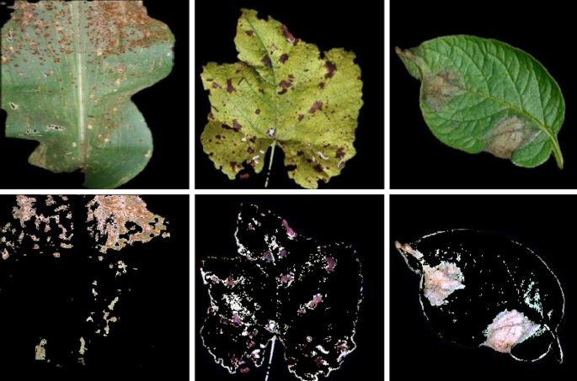
Continued…
Leaf disease detection is a field of study under the image recognition field of computer vision.
Machine learning(ML) is a part of artificial intelligence.
ML is used here to understand the training data and fit that training data into models to detect the disease.

Slide 6








System Diagram
Registered User
Save Result
(For Registered Users)
Registration
Image Collection
Image Processing
Capture Image
Features Extraction
Show Result
Search Again
Exit
User
Leaf Condition
Guest User

Slide 7
Aims and Objective
Aims
Developing a mobile application that can detect leaf disease and also suggest suitable remedies
Objective
Research ML and leaf diseases
Identify and collect proper datasets and design the ML model
Train the model and improve accuracy
Train the model with unbiased data
Implement the model in mobile application

Slide 8
Work Plan
Week Number | Work Plan
Week 1 | Background Study
Week 2 – 3 | Learning about leaf disease and collecting dataset
Week 4 – 5 | Learning about ML and ML models
Week 6 – 7 | Designing ML model and implementing datasets
Week 8 – 9 | Testing ML model and improve accuracy
Week 10 – 11 | Mobile application implementation
Week 12 – 13 | Testing the mobile application

Slide 9
Thank You

