Slide 1
Leaf Disease Detection Using Machine Learning
Mia Mahmudul Houque Shaon
ID: 2014314042
Asif Rahman
ID: 2012691042
Md Nazmul Islam Srabon
ID: 2021227042
CSE 299
Section 02
Group 05
Week 02

Slide 2
Overview
A Mobile Application
Can Recognise
the leaf
Detect healthy or diseased leaf
Identify the disease
Suggest suitable remedies.

Slide 3








System Diagram
Registered User
Save Result
(For Registered Users)
Registration
Image Collection
Image Processing
Capture Image
Show Result
Search Again
Exit
User
Features Extraction
Guest User

Slide 4
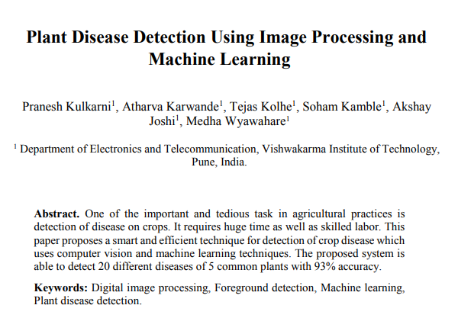
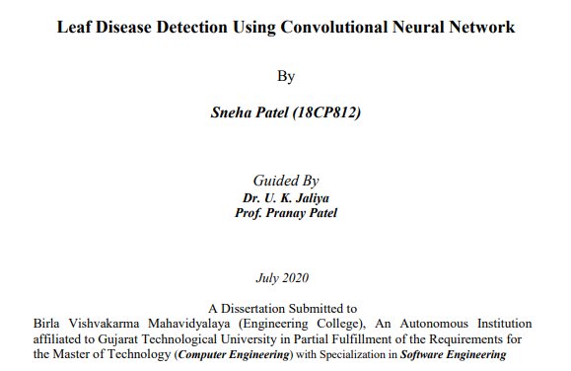
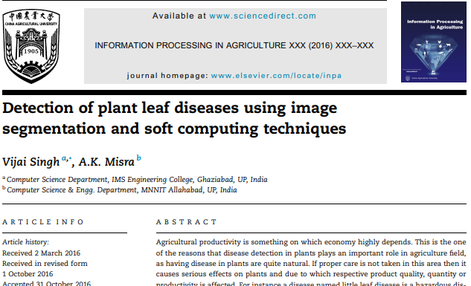
Background Study
Plant Disease Detection Using Image Processing and Machine Learning
A Research Paper
Leaf Disease Detection Using Convolutional Neural Network
A Research Paper
Detection of plant leaf diseases using image segmentation and soft computing techniques
Article in Press

Slide 5
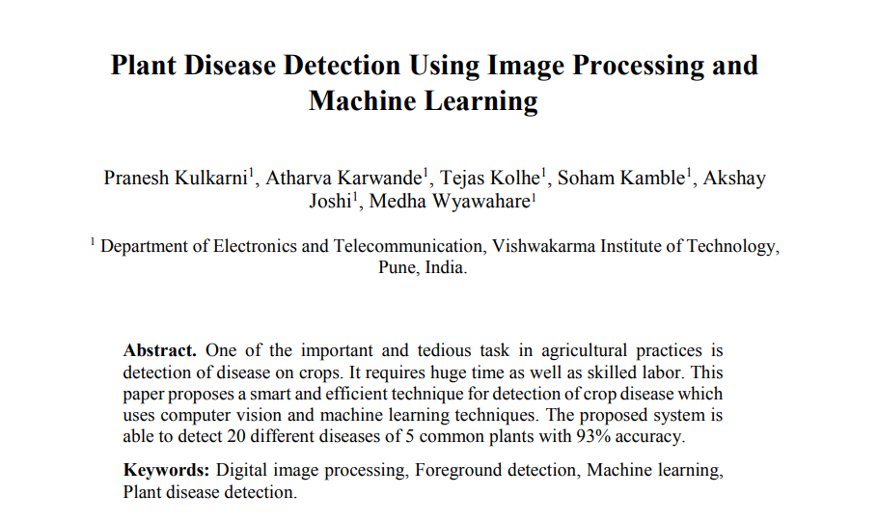
Background Study on Plant Disease Detection Using Image Processing and Machine Learning

Slide 6
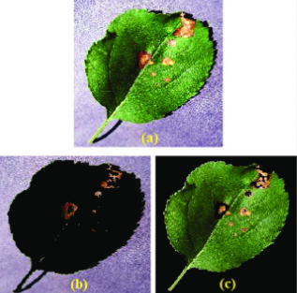
Continued…
Concept:
A technique for detection of crop disease which uses computer vision and machine learning techniques. This system is able to detect 20 different diseases of 5 common plants. The model is trained with 87000 RGB image samples.

Slide 7
Continued…
Methods Followed:
Image Preprocessing
  Extracting textures using GLCM
Feature Selection
  Correlation of variables with target variable
Image Classification
  Random Forest Classifier
Results Achieved:
Average Accuracy of 93%
K-fold cross validation technique is implemented to find the accuracy score.
This method can find the accuracy on whole dataset without any bias

Slide 8
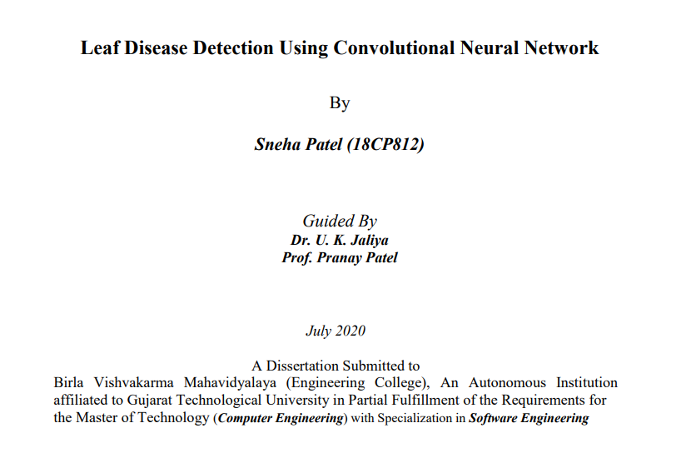
Background Study on Leaf Disease Detection Using Convolutional Neural Network

Slide 9
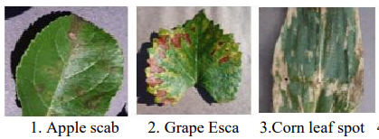
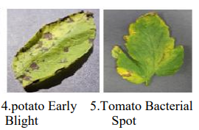
Continued…
Concept:
The aim is to detect apple, grape, corn, potato, and tomato plant leaves diseases. That contains twenty-four types of leaf diseases and twenty-four thousand leaves images are used.

Slide 10
Continued…
Methods Followed:
Image Preprocessing
  Less preprocessing is required
  compared to traditional approaches
Features Extraction
  Automatic feature extraction is performed for better performance
Classification
  CNN( Convolution Neural Network)
Results Achieved:
CNN
  Accuracy of 90.23%
VGG16
  Accuracy of 51.17%

Slide 11

Background Study on Detection of plant leaf diseases using image segmentation and soft computing techniques

Slide 12
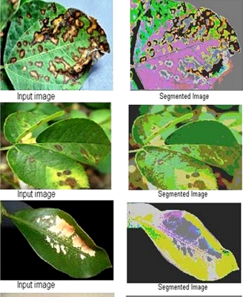
Continued…
Concept:
An article about detecting plant leaf disease using image segmentation where the author proposed some techniques which can be used to detect leaf disease.

Slide 13
Continued…
Methods Followed:
Image Preprocessing
  Remove undesired distortion
Features Extraction
  Color Co-occurrence method
Classification
  K-Mean clustering
  Support Vector Matrix (SVM)
Results Achieved:
K-Mean Clustering
  Accuracy of 86.54%
SVM
  Accuracy of 95.71%

Slide 14
Work Plan
Week Number | Work Plan
Week 1 | Background Study
Week 2 – 3 | Learning about leaf disease and collecting dataset
Week 4 – 5 | Learning about ML and ML models
Week 6 – 7 | Designing ML model and implementing datasets
Week 8 – 9 | Testing ML model and improve accuracy
Week 10 – 11 | Mobile application implementation
Week 12 – 13 | Testing the mobile application

Slide 15
Thank You

