Slide 1
Leaf Disease Detection Using Machine Learning
Mia Mahmudul Houque Shaon
ID: 2014314042
Asif Rahman
ID: 2012691042
Md Nazmul Islam Srabon
ID: 2021227042
CSE 299
Section 02
Group 05
Week 05

Slide 2
Overview
A Mobile Application
Can Recognise
the leaf
Detect healthy or diseased leaf
Identify the disease
Suggest suitable remedies.

Slide 3








System Diagram
Registered User
Save Result
(For Registered Users)
Registration
Image Collection
Image Processing
Capture Image
Show Result
Search Again
Exit
User
Features Extraction
Guest User

Slide 4

Work Progress
TensorFlow
An AI framework for machine learning and high performance numerical computation.
A Python library that invokes C++ to construct and execute dataflow graphs.
Supports many classification and regression algorithms, and more generally, deep learning and neural networks.

Slide 5
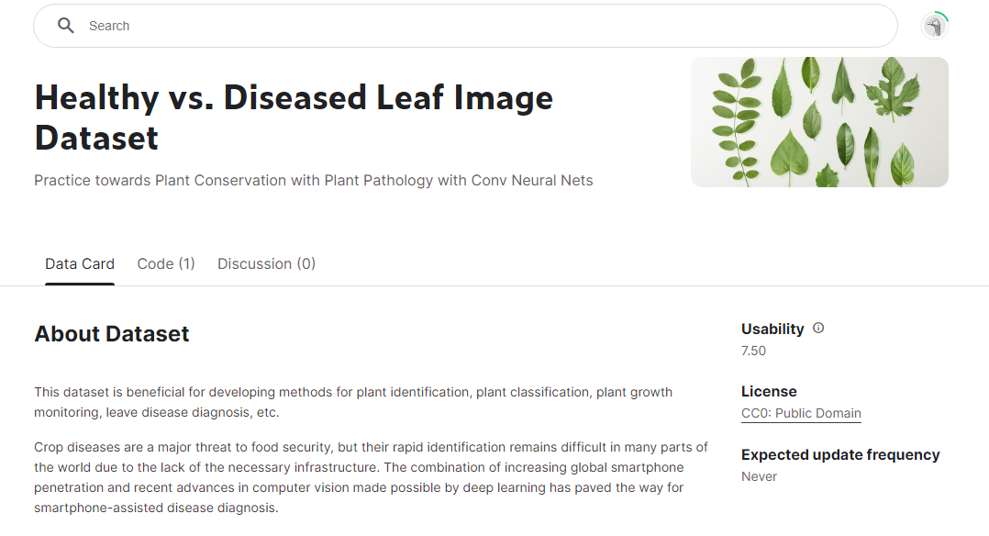
Work Progress
https://www.kaggle.com/datasets/amandam1/healthy-vs-diseased-leaf-image-dataset

Slide 6
Work Progress
Import TensorFlow
Collect and Prepare Dataset
Verify The Data
Create the convolutional base
Add dense layer on top
Compile and train the model
Evaluate the model

Slide 7
Work Plan
Week Number | Work Plan
Week 1 | Background Study
Week 2 – 3 | Learning about leaf disease and collecting dataset
Week 4 – 5 | Learning about ML and ML models
Week 6 – 7 | Designing ML model and implementing datasets
Week 8 – 9 | Testing ML model and improve accuracy
Week 10 – 11 | Mobile application implementation
Week 12 – 13 | Testing the mobile application

Slide 8
Thank You

