Slide 1
Leaf Disease Detection Using Machine Learning
Mia Mahmudul Houque Shaon
ID: 2014314042
Asif Rahman
ID: 2012691042
Md Nazmul Islam Srabon
ID: 2021227042
CSE 299
Section 02
Group 05
Week 06

Slide 2
Overview
A Mobile Application
Can Recognise
the leaf
Detect healthy or diseased leaf
Identify the disease
Suggest suitable remedies.

Slide 3








System Diagram
Registered User
Save Result
(For Registered Users)
Registration
Image Collection
Image Processing
Capture Image
Show Result
Search Again
Exit
User
Features Extraction
Guest User

Slide 4
Work Progress
Planning
Background Study
Dataset Collection
Implementation
Testing
Building a Model

Slide 5
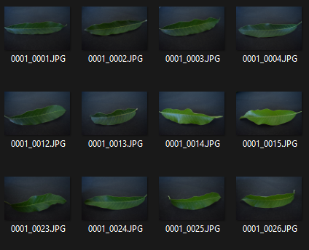
Work Progress
https://www.kaggle.com/datasets/amandam1/healthy-vs-diseased-leaf-image-dataset

Slide 6
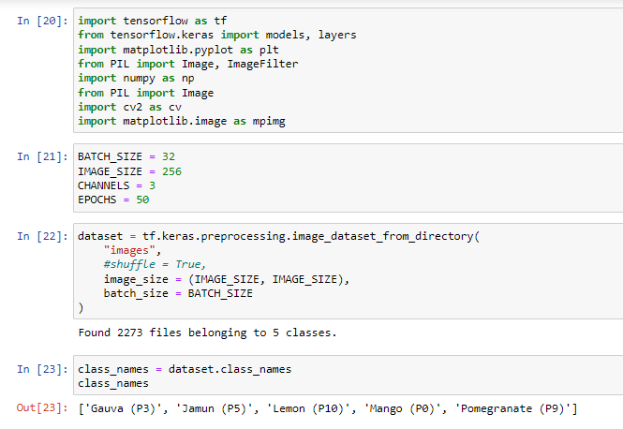
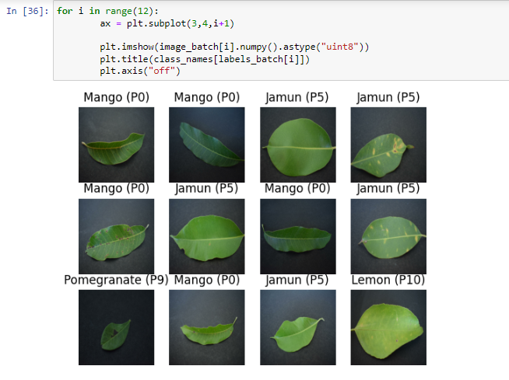
Work Progress

Slide 7
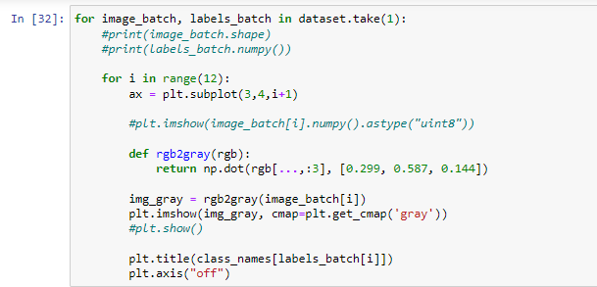
Work Progress

Slide 8
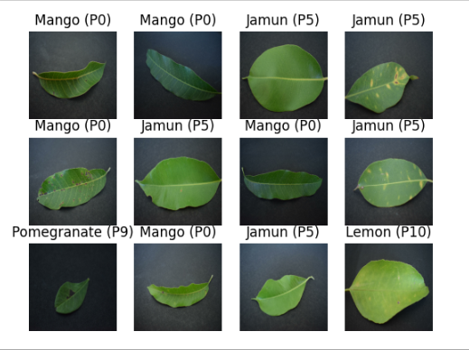
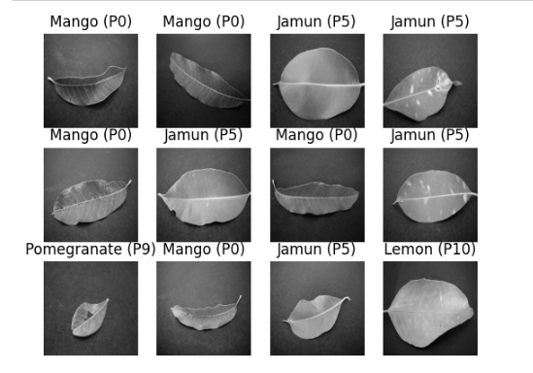
Work Progress
Figure: Original Image
Figure: Grayscale Image

Slide 9
Work Plan
Week Number | Work Plan
Week 1 | Background Study
Week 2 – 3 | Learning about leaf disease and collecting dataset
Week 4 – 5 | Learning about ML and ML models
Week 6 – 7 | Designing ML model and implementing datasets
Week 8 – 9 | Testing ML model and improve accuracy
Week 10 – 11 | Mobile application implementation
Week 12 – 13 | Testing the mobile application

Slide 10
Thank You

