Slide 1
Leaf Disease Detection Using Machine Learning
Mia Mahmudul Houque Shaon
ID: 2014314042
Asif Rahman
ID: 2012691042
Md Nazmul Islam Srabon
ID: 2021227042
CSE 299
Section 02
Group 05
Week 10

Slide 2
Overview
A Mobile Application
Can Recognise
the leaf
Detect healthy or diseased leaf
Identify the disease
Suggest suitable remedies.

Slide 3



Recap
Image Resize
Image Pre-processing
GLCM
  Image resize
  Image smoothening
  Gray-scale conversion
Smoothing
Using
Gaussian
Filter
Grayscale
Conversion

Slide 4
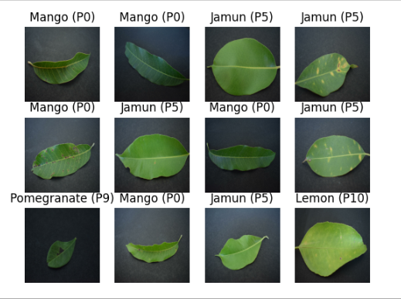
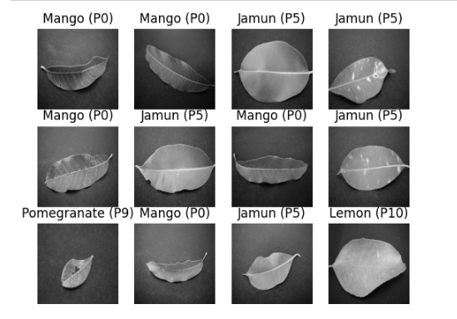
Recap
Figure: Original Image
Figure: Grayscale Image

Slide 5








System Diagram
Registered User
Save Result
(For Registered Users)
Registration
Image Collection
Image Processing
Capture Image
Show Result
Search Again
Exit
User
Features Extraction
Guest User

Slide 6
Work Progress
Planning
Background Study
Dataset Collection
Implementation
Testing
Building a Model

Slide 7
Work Progress
To make the best use of our dataset we partitioned the dataset into 3 subsets. That are namely:
Training: Dataset to be used while training
Validation: Dataset to be tested against while training
Test: Dataset to be tested against after we trained a model
Prepare the dataset
  80% training
  20% testing
    10% validation
    10% test

Slide 8
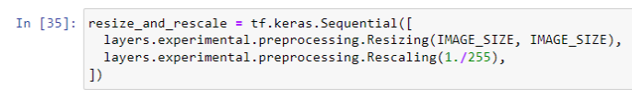

Work Progress
Building the Model:
  Creating a layer for resizing and normalization
  Data Augmentation
  Apply data augmentation to train the dataset
  Model Architecture

Slide 9
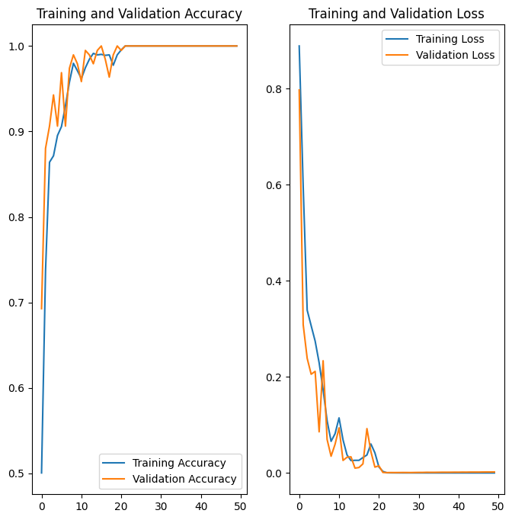
Work Progress
After compiling the model we move on to plot the accuracy and loss curve.
Figure: Training and Validation Accuracy
Figure: Training and Validation Accuracy

Slide 10
Work Plan
Week Number | Work Plan
Week 1 | Background Study
Week 2 – 3 | Learning about leaf disease and collecting dataset
Week 4 – 5 | Learning about ML and ML models
Week 6 – 7 | Designing ML model and implementing datasets
Week 8 – 9 | Building ML model and testing accuracy
Week 10 – 11 | Mobile application implementation
Week 12 – 13 | Testing the mobile application

Slide 11
Thank You!

