Slide 1
Leaf Disease Detection Using Machine Learning
Mia Mahmudul Houque Shaon
ID: 2014314042
Asif Rahman
ID: 2012691042
Md Nazmul Islam Srabon
ID: 2021227042
CSE 299
Section 02
Group 05
Week 12

Slide 2
Overview
A Mobile Application
Can Recognise
the leaf
Detect healthy or diseased leaf
Identify the disease
Suggest suitable remedies.

Slide 3



Recap
Image Resize
Image Pre-processing
GLCM
  Image resize
  Image smoothening
  Gray-scale conversion
Smoothing
Using
Gaussian
Filter
Grayscale
Conversion

Slide 4
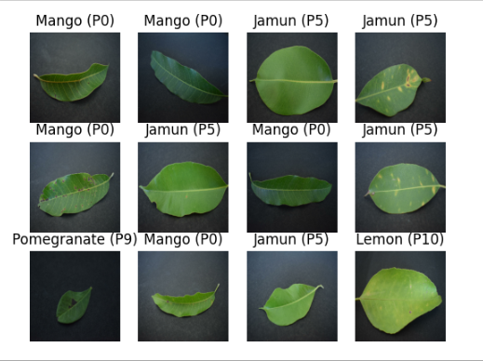
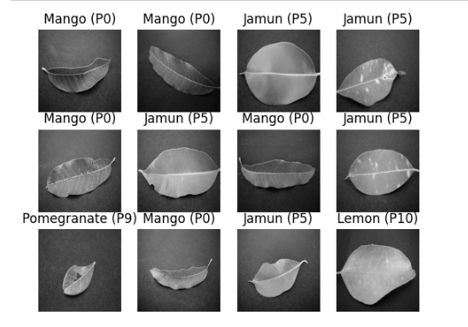
Recap
Figure: Original Image
Figure: Grayscale Image

Slide 5








System Diagram
Registered User
Save Result
(For Registered Users)
Registration
Image Collection
Image Processing
Capture Image
Show Result
Search Again
Exit
User
Features Extraction
Guest User

Slide 6
Work Progress
Planning
Background Study
Dataset Collection
Implementation
Testing
Building a Model

Slide 7
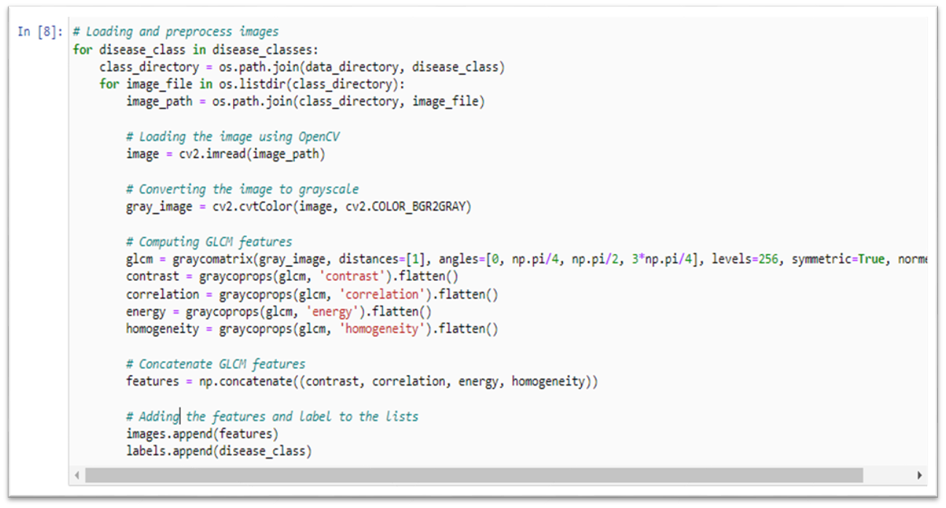
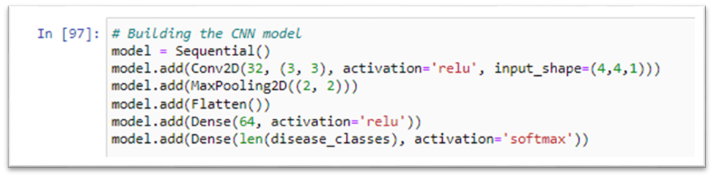
Work Progress
Image Pre-processing
  Converting RGB image to grayscale image
  Computing GLCM features
    Contrast
    Co-relation
    Energy
    Homogeneity
  Concatenating all GLCM features
Building the Model

Slide 8
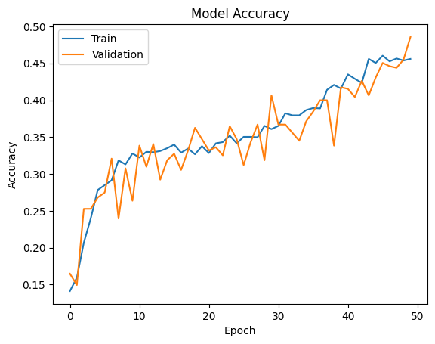
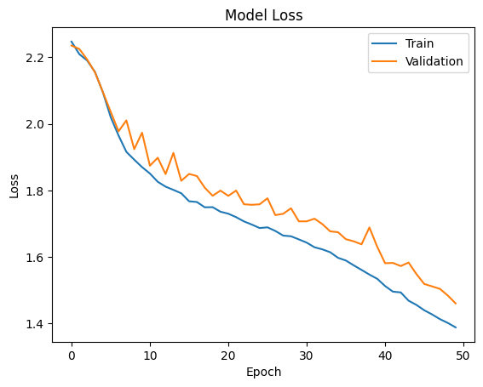
Accuracy & Loss Graph

Slide 9
Work Progress
To make the best use of our dataset we partitioned the dataset into 3 subsets. That are namely:
Training: Dataset to be used while training
Validation: Dataset to be tested against while training
Test: Dataset to be tested against after we trained a model
Prepare the dataset
  80% training
  20% testing
    10% validation
    10% test

Slide 10
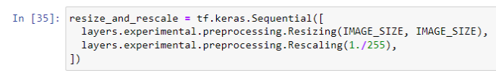


Work Progress
Building the Model:
  Creating a layer for resizing and normalization
  Data Augmentation
  Apply data augmentation to train the dataset

Slide 11
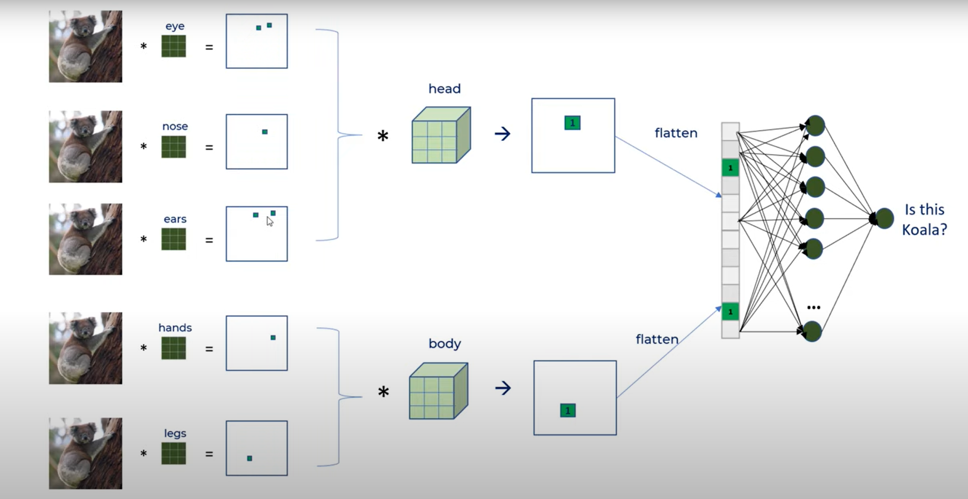
Model Architecture

Slide 12
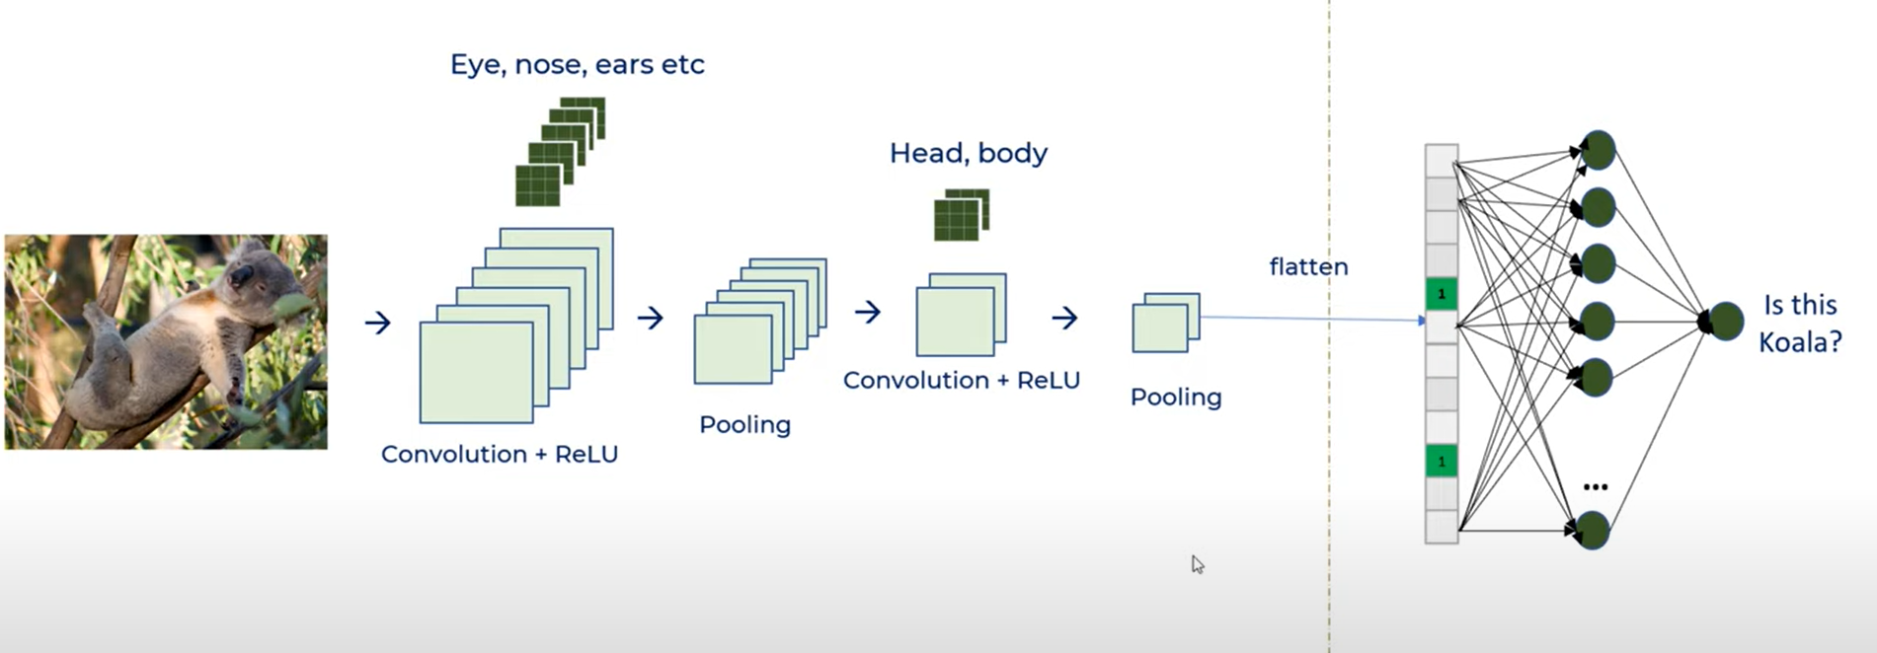

Slide 13
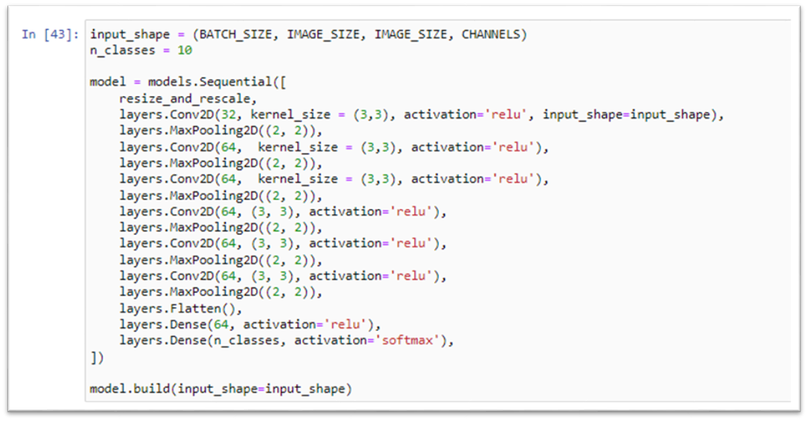
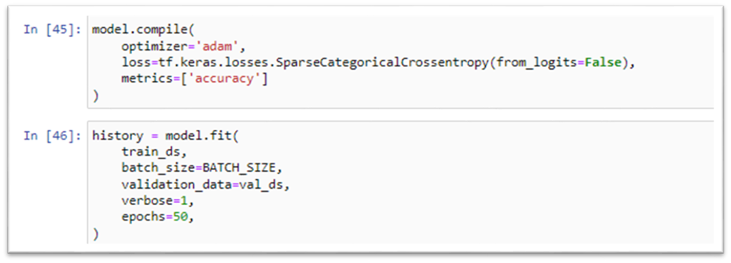
Model Architecture
Two Layers
  Convolutional Layer
  Pooling Layer
Model Architecture
  Resize and Rescale
  Data Augmentation
  Convolutional Layer
  Pooling Layer
  Flatten Layer
  Dense Layer

Slide 14
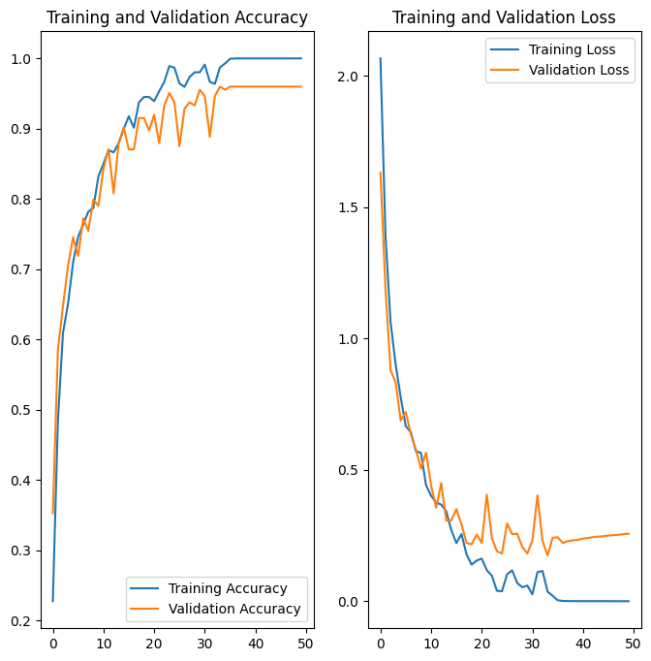
Accuracy & Loss Graph

Slide 15
Work Plan
Week Number | Work Plan
Week 1 | Background Study
Week 2 – 3 | Learning about leaf disease and collecting dataset
Week 4 – 5 | Learning about ML and ML models
Week 6 – 7 | Designing ML model and implementing datasets
Week 8 – 9 | Building ML model and testing accuracy
Week 10 – 11 | Mobile application implementation
Week 12 – 13 | Testing the mobile application

Slide 16
Thank You!

